Slide 1





Beginner Course on Microbial Genomics: Applications & Research (2026)
Module 2.1
Post Assembly Profiling Quality Assessment & Gene Content Analysis
Lecturer
PhD Student: Quynh Nguyen
Teaching assistant
Mr: Ton Ngoc Minh Quan

Slide 2
Our journeys
Annotated genomes
Hybrid Assembly
QC & Post-Assembly Profiling
Raw sequences
Assembled
genome
QC
Variant calling and filtering
Phylogeny
Mapping

Slide 3
Our journeys
Annotated genomes
Hybrid Assembly
QC & Post-Assembly Profiling
Raw sequences
Assembled
genome
QC
Variant calling and filtering
Phylogeny
Mapping

Slide 4
Agenda
Theory
Quality/Contamination Assessment
Contiguity
Completeness
Contamination
Downstream Analysis Steps
Multilocus Sequence Typing (MLST)
AMR / Virulence genes identification
Practical Command-line (CLI)
checkm2
Kleborate
Data Visualization and Manipulation with Bandage
Module 2.1: Post Assembly Profiling

Slide 5
Theory
Module 2.1: Post Assembly Profiling

Slide 6
Theory
Quality/Contamination Assessment
Contiguity : N50, Number of Contigs
Completeness: Estimated Genome Size
Contamination: SH index
Module 2.1: Post Assembly Profiling

Slide 7
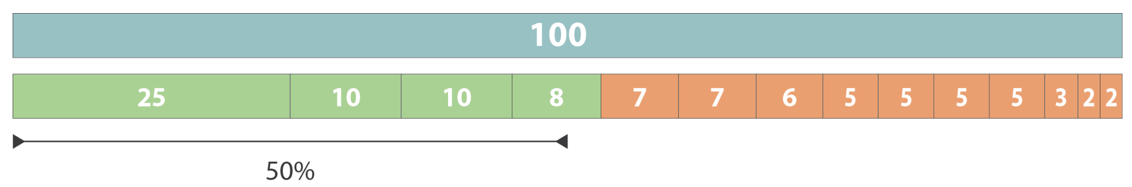
Quality/Contamination Assessment
Contiguity: N50 value
Definition: 50% of the total assembly size is contained in contigs of that length or longer
N50 value (10.1371/journal.pcbi.1010752)
N50 = 8
Module 2.1: Post Assembly Profiling

Slide 8
Quality/Contamination Assessment
Contiguity: N50 value
Definition: 50% of the total assembly size is contained in contigs of that length or longer
Length = 200 → N50 = 70
Strain A
120
10
20
20
30
50
70
Strain B
150
10
20
20
30
30
30
30
Length = 170 → N50 = 30
Total length: 10 + 20 + 20 + 30 + 50 + 70 + 120 = 320
50% = 160
What is the N50 value of Strain A?
Which strain has better assembly quality?
Module 2.1: Post Assembly Profiling

Slide 9
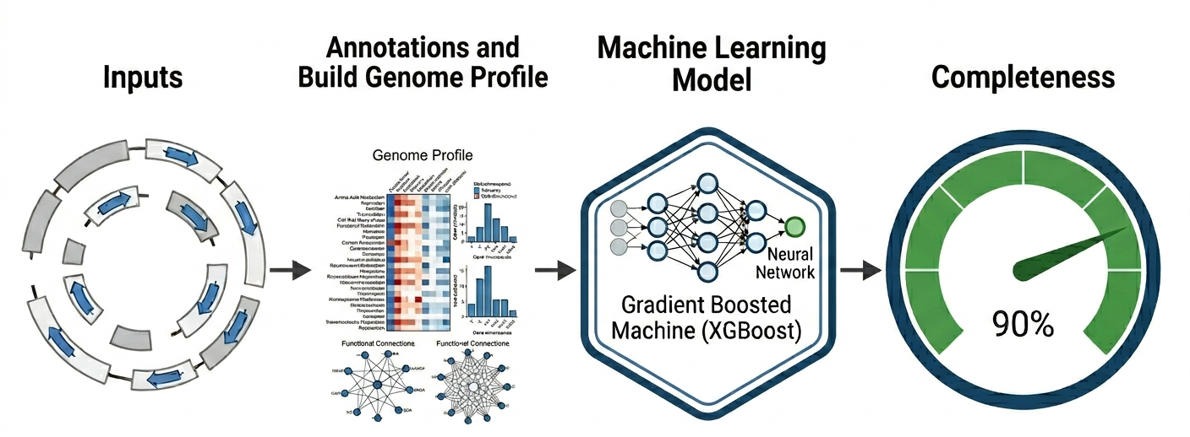
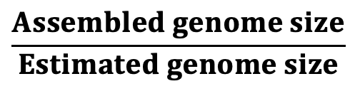
Quality/Contamination Assessment
Completeness: Estimated Genome Size (%)
Definition: percentage of the organism’s total genome that is present in the assembly
$$\frac{Assembled genome size}{Estimated genome size}$$
Recommend Quality Threshold - Completeness: > 90%
Module 2.1: Post Assembly Profiling

Slide 10
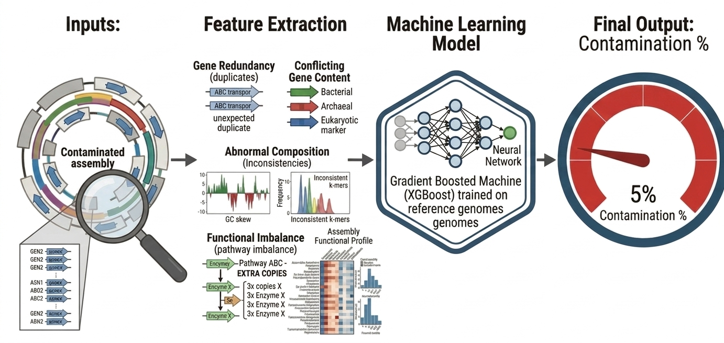
Quality/Contamination Assessment
Contamination
Definition: percentage of sequences that originate from organisms other than the target genome
Recommend Quality Threshold - Contamination: < 5%
Module 2.1: Post Assembly Profiling

Slide 11
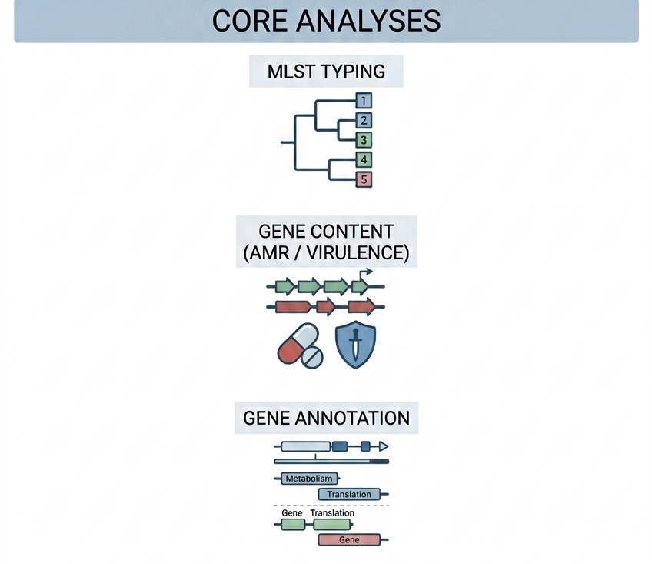
Theory
Downstream Analysis Steps
MLST Typing
Gene Content Identification (AMR/Virulence genes,…)
Genome Annotation
Module 2.1: Post Assembly Profiling

Slide 12
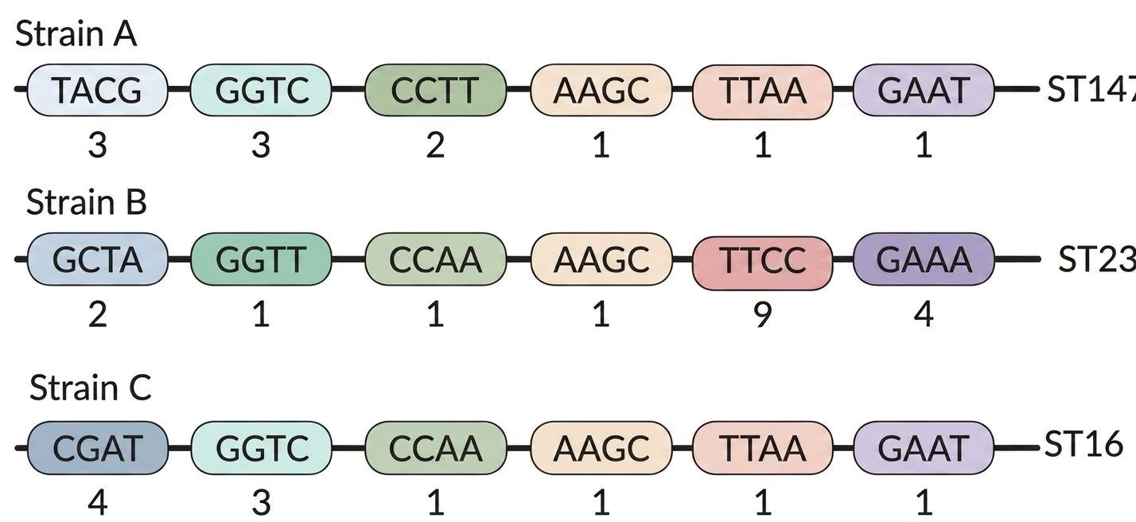


Theory
MLST typing
Definition: A housekeeping gene is a gene that is always expressed on in bacterial cell, provides essential functions. MLST identifies a bacterial sequence type (ST) by analyzing the allelic profiles of several housekeeping genes.
MLST Schemes
N50 value (10.1371/journal.pcbi.1010752)
Module 2.1: Post Assembly Profiling

Slide 13
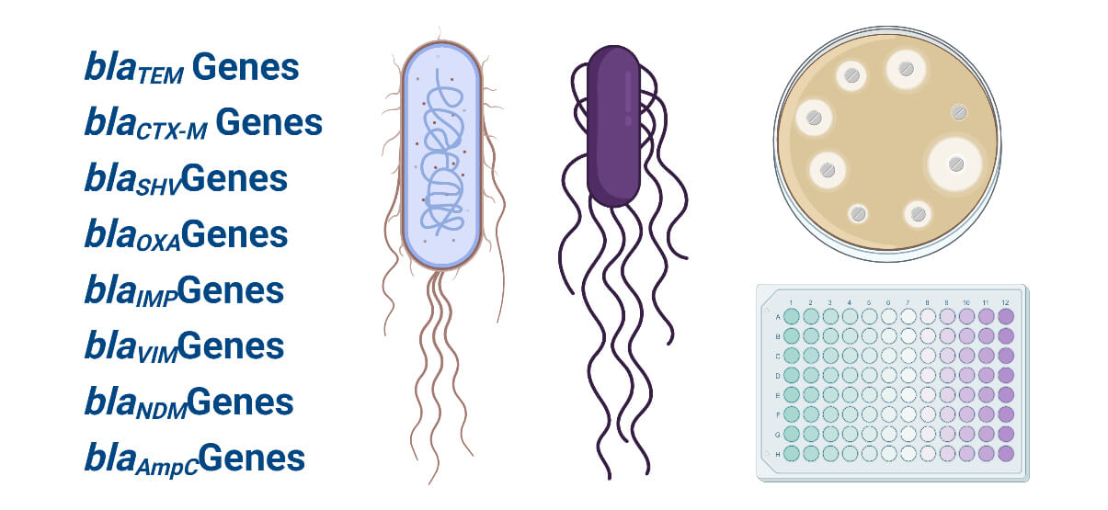
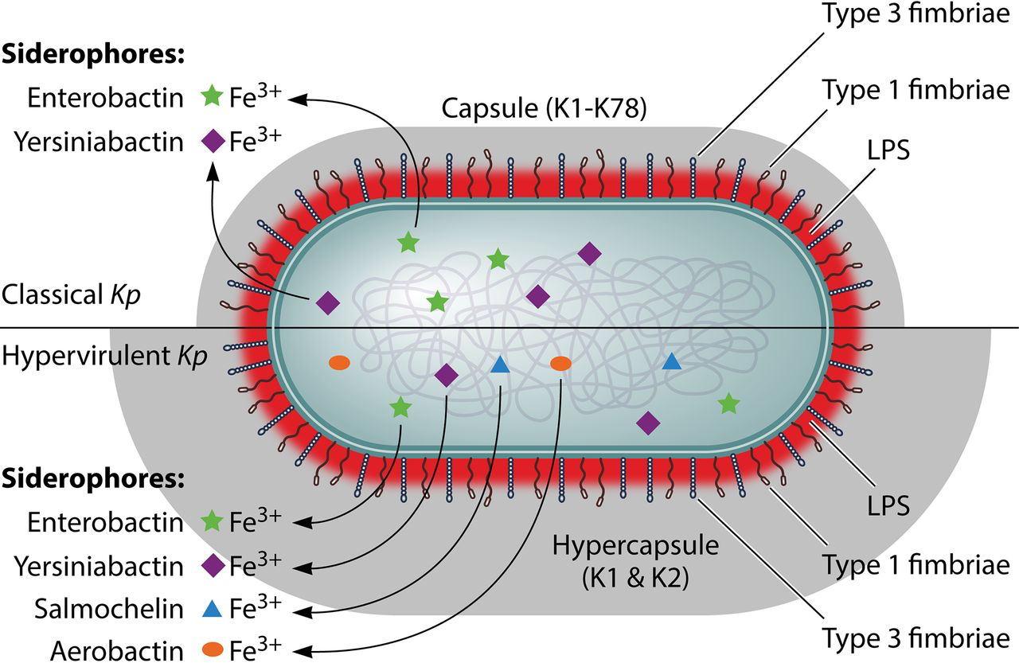


Theory
Gene Content Identification
AMR
Virulence
AMR genes in Enterobacteriaceae (https://microbenotes.com/)
Virulence factors in classical and hypervirulent Kp (10.1128/MMBR.00078-15)
Module 2.1: Post Assembly Profiling

Slide 14
Practical Command-line (CLI)
Module 2.1: Post Assembly Profiling

Slide 15
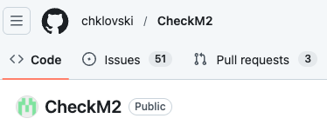
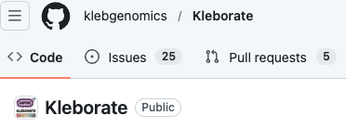
Practical Command-line (CLI)
Quality/Contamination Assessment – checkm2
https://github.com/chklovski/CheckM2
Gene Content Indentification– kleborate
https://github.com/klebgenomics/Kleborate
Module 2.1: Post Assembly Profiling

Slide 16
Data Visualization and Manipulation
Bandage / BandageNG
Module 2.1: Post Assembly Profiling

Slide 17


THE END.
Thank you for your attention
Module 2.1: Post Assembly Profiling

