Slide 1

Simple Network
Management Protocol

Slide 2
Content
1
Simple Network Management Protocol
2
Management Information Base
3
SNMP Operations

Slide 3

Simple Network Management Protocol
Simple Network Management Protocol (SNMP)
The standard network management protocol of the Internet community.
SNMP is an application layer protocol and uses UDP
SNMP is based on an asynchronous request-response protocol enhanced with trap-directed polling.
Notes:
- Simple network management protocol is the standard network management protocol of the Internet community.
- SNMP is an application layer protocol and uses User Datagram Protocol (UDP) to exchange management information between management entities, which offers network management services for monitoring and control of network devices.
SNMP is based on an asynchronous request-response protocol enhanced with trap-directed polling.
Giao thuc quan ly mang de truyen thong giua cac thuc
(SNMP sử dụng mô hình quản lý manager – agent làm việc theo 2 hướng: polling và traps
- Polling: Tham rò ở đây chính việc chủ động or theo yêu cầu gửi các yêu cầu từ manager -> agents. Không đồng bộ định tính: giao thức không cần đợi phản hồi trước khi gửi các thông báo khác.
- Trap-directed polling: Khi có một sự kiện bất thường hay 1 giá nào đó vượt ngưỡng agent sẽ chủ động gửi thông báo đến manager mà ko phải chờ đến khi manager polling)
SNMP sử dụng giao thức UDP bởi 2 đặc điểm hướng không kết nối(ko cần thiết lập kết nối giữa ng nhận và ng gửi), best-effort (đây là giao thức không tin cậy nó liên tục gửi dữ liệu đến người nhận mà ko cần chờ phản hồi xác nhận). Chế độ không kết nối được chọn một phần để đơn giản hóa việc triển khai SNMP và vì không kết nối thường là chế độ ưu tiên cho các ứng dụng quản lý mà cần phải nói chuyện với nhiều đại lý.

Slide 4
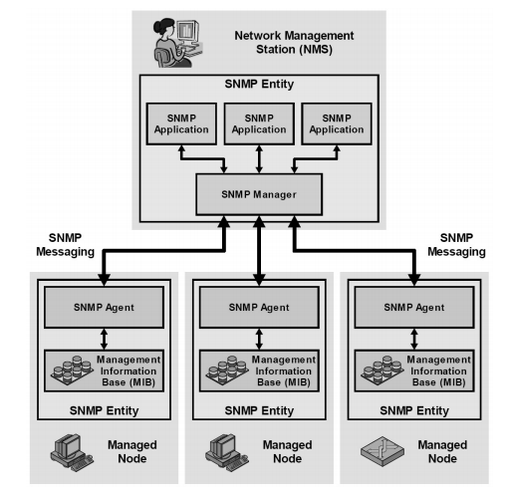
Simple Network Management Protocol
SNMP
SNMP Architecture
Notes:
SNMP consists of a small number of network management stations (NMSs) that interact with regular TCP/IP devices that are called managed nodes. The SNMP manager on the NMS and the SNMP agents on the managed nodes implement the SNMP protocol and allows network management information to be exchanged. SNMP applications run on the NMS and provide the interface to the human administrator, and allow information to be collected from the MIBs at each SNMP agent.

Slide 5
Network management
Simple Network Management Protocol
Interactions between NMSs and managed devices can be any of four different types of commands:
Read: Monitor managed devices
Write: Control managed devices
Trap: Notify certain events to NMSs
Notes:
Lệnh Read: Được SNMP dùng để đọc thông tin từ thiết bị. Các thông tin này được cung cấp qua các biến SNMP lưu trữ trên thiết bị và được thiết bị cập nhật. ▪ Lệnh Write: Được SNMP dùng để ghi các thông tin điều khiển lên thiết bị bằng cách thay đổi giá trị các biến SNMP. ▪ Lệnh Trap: Dùng để nhận các sự kiện gửi từ thiết bị đến SNMP. Mỗi khi có một sự kiện xảy ra trên thiết bị một lệnh Trap sẽ được gửi tới NMS • Traverse: NMS sử dụng các hoạt động này để xác định các biến mà thiết bị được quản lý hỗ trợ và để thu thập tuần tự thông tin từ các bảng biến (chẳng hạn như bảng định tuyến IP) trong các thiết bị được quản lý.

Slide 6
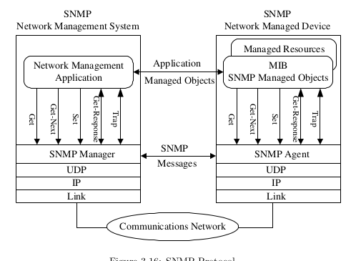
Simple Network Management Protocol
SNMP
SNMP protocol model

Slide 7
Simple Network Management Protocol
SNMP
SNMP version
 | SNMPv1 | SNMPv2 | SNMPv3
PDU | GET SET TRAP RESPONE | GET GETNEXT GETBULK SET INFORM TRAP RESPONE | GET GETNEXT GETBULK SET INFORM TRAP RESPONE
Authentication | Community string | Community string | Username MD5 SHA
Encryption | No | No | DES
Notes:
SNMPv1 is the initial version of SNMP and provides the minimum network management functions. SNMPv1 provides authentication based on community names, causing low security. In addition, a limited number of error codes are returned in packets. 1991
SNMPv2 also provides authentication based on community names. Compared with SNMPv1, SNMPv2 has enhancements to standard error codes, data types (Counter64 and Counter32), and operations including GetBulk and Inform. 1993
SNMPv3 enhances security, and provides authentication(MD5 or SHA) and encryption (DES-56) SNMPv3 supports the same operations as SNMPv2c. 1997/1999/2002

Slide 8
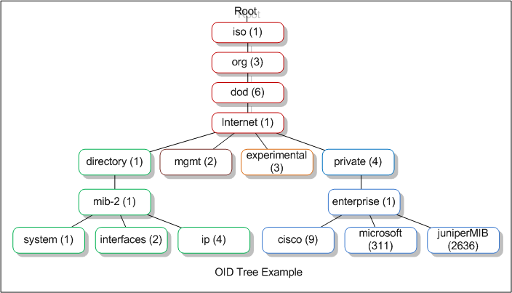
Management Information Base
Network managerment
OBJECT IDENTIFIER
An ordered list of non-negative numbers for defining a particular object, each number in the list is referred to as a sub-identifier.
Notes:
RFC 2578
-> The managed objects in a SNMP environment are arranged in a hierarchical tree structure. The leaf of the tree is the real management object, each element in this object represents the managed resource, activity, or related information.
Mỗi dạng đối tượng liên kết trong một MIB là một nhận diện của kiểu ASN.1 OBJECT IDENTIFIER.
Các đối tượng quản lý trong môi trường SNMP được sắp xếp theo cấu trúc hình cây có thứ bậc. Lá của cây là đối tượng quản lý thực, mỗi thành phần trong đối tượng này biểu thị cho tài nguyên, sự hoạt động hoặc các thông tin liên quan được quản lý.
there are at most 128 sub-identifiers in a value, and each sub-identifier has a maximum value of 2^32-1 (4294967295)

Slide 9
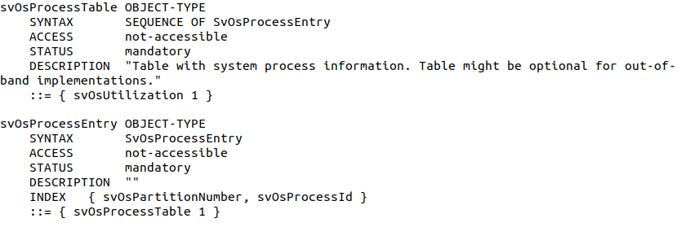
Management Information Base
Network managerment
MIB contains managed objects described by a syntax template (ASN.1) OBJECT-TYPE. Each object type is an identifier of (ASN.1) OBJECT IDENTIFIER.
Notes:
-> The managed objects in a SNMP environment are arranged in a hierarchical tree structure. The leaf of the tree is the real management object, each element in this object represents the managed resource, activity, or related information.
Module definitions are used when describing information modules. An ASN.1 macro, MODULE-IDENTITY, is used to concisely convey the semantics of an information module.
Object definitions are used when describing managed objects. An ASN.1 macro, OBJECT-TYPE, is used to concisely convey the syntax and semantics of a managed object.
Notification definitions are used when describing unsolicited transmissions of management information. An ASN.1 macro, NOTIFICATION-TYPE, is used to concisely convey the syntax and semantics of a notification.

Slide 10
Management Information Base
Name | Description | Required | Option
SYNTAX | Defines data structure corresponding to that object. | x | INTEGER, OCTET STRING,OBJECT IDENTIFIER, BITS, IpAddress, Counter(32/64), Gauge32, Unsigned32, TimeTicks.
UNITS | Contains a textual definition of the units associated with that object.
ACCESS | Defines level of access for the object | x | not-accessible,accessible-for-notify,read-only,read-write,read-create
STATUS | Indicates whether this definition is current or historic. | x | current, obsolete, deprecated
DESCRIPTION | Contains a textual definition of object | x
REFERENCE | Contains a textual cross-reference to some other document, either another information
INDEX | Defines index objects in table mibs
DEFVAL | Defines an acceptable default value
Value | OBJECT IDENTIFIER | x

Slide 11
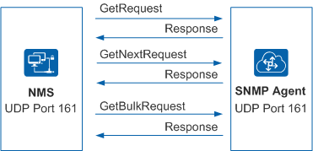
SNMP Operations
SNMP get operations
Get
GetNext
GetBulk
Notes:
Get: get one or more variables from the SNMP agent.
GetNext: one or more subsequent variables from the SNMP agent.
GetBulk: This operation is equal to consecutive GetNext operations. You can set the number of GetNext operations to be included in one GetBulk.
The NMS can send get requests to an SNMP agent to obtain data. After receiving a get request, the SNMP agent executes the corresponding instruction in the MIB and sends the result to the NMS.

Slide 12
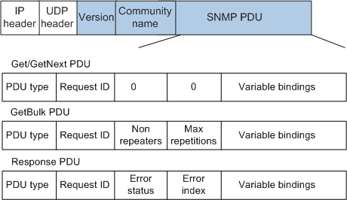
SNMP Operations
SNMP get packets
Notes:
SNMP get packets consist of the version, community name, and SNMP protocol data unit (PDU). Packets of various SNMP operations are encapsulated in SNMP PDUs.
Version: specifies the SNMP version. The value is 0 for SNMPv1 or 1 for SNMPv2c.
Community name: is used for authentication between the SNMP agent and NMS. The value is a user-defined string of characters.
Request ID: specifies the unique ID of each request. It is used to match a request and the corresponding response.
Non repeaters: bao nhieu object gui nhu get tinh tu dau tien
Max repetitions: nhung cai con lai can getnext bao ve sau
Error status: chi ra kieu loi
Error index: chi ra object nao loi
Variable bindings: specifies the list of variable names and corresponding values.
. The community name can be read or write. When SNMP get operations are performed, the read community name is used for authentication. When SNMP set operations are performed, the write community name is used for authentication.

Slide 13
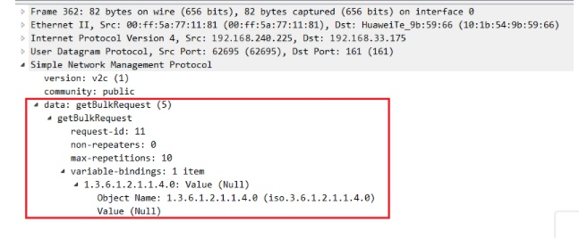
SNMP Operations
GetBulk packet

Slide 14
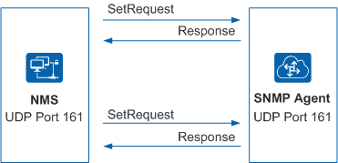
SNMP Operations
SNMP Set
Notes:
The NMS can send set requests to an SNMP agent to complete configurations on the managed device.
Using the SNMP set operation, the NMS can configure one or more parameters for an SNMP agent.

Slide 15
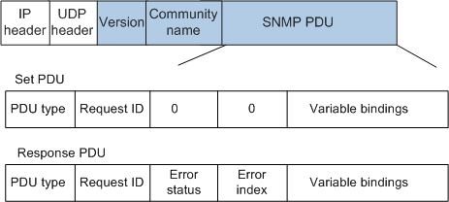
SNMP Operations
SNMP Set Packets
Notes:
Generally, information about the SNMPv3 set operation is encrypted and encapsulated in an SNMP PDU. The format of the SNMP PDU in an SNMPv3 set packet is the same as that in an SNMPv2c set packet.
Request ID: specifies the unique ID of each request. It is used to match a request and the corresponding response.
Error status: specifies the status of an error occurring when a request is processed.
Error index: specifies the index of an error. If an exception occurs, information about the variable (in variable bindings) that causes the exception is provided.
Variable bindings: specifies the list of variable names and corresponding values.

Slide 16
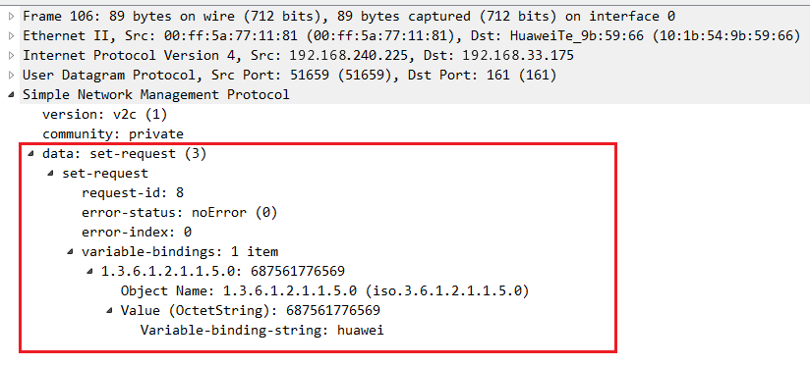
SNMP Operations
Set packet

Slide 17
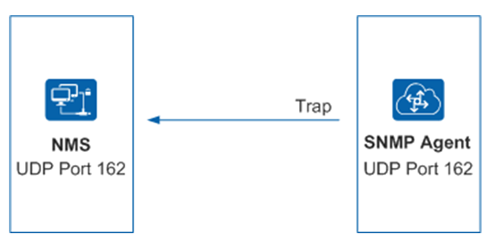
SNMP Operations
SNMP Traps
SNMP traps are notification messages sent by an SNMP agent to inform the NMS of alarms or events generated by the device.

Slide 18
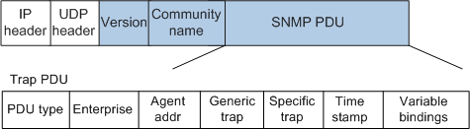
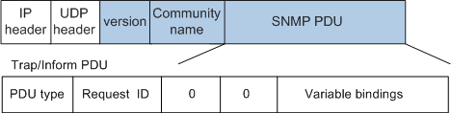
SNMP Operations
SNMPv1 trap
SNMPv2(v3) trap
Notes:
Enterprise: specifies the type of a trap source (device that generates the trap).
Agent addr: specifies the IP address of a trap source.
Generic trap: specifies a common trap type: coldStart, warmStart, linkDown, linkUp, authenticationFailure, egpNeighborLoss, and enterpriseSpecific.
Specific trap: specifies the private trap information of an enterprise.
Time stamp: specifies the time elapsed between the time when the network entity is reinitialized and the time when the trap is generated.
Variable bindings: specifies the list of variable names and corresponding values.
Request ID: specifies the unique ID of each request. It is used to match a request and the corresponding response.
Variable bindings: specifies the list of variable names and corresponding values.

Slide 19
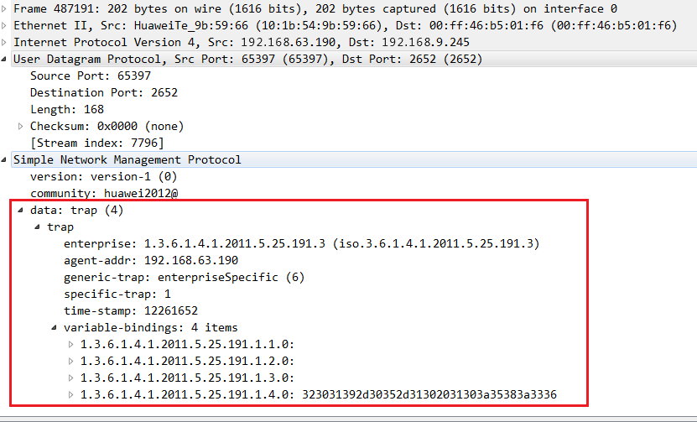
SNMP Operations

Slide 20
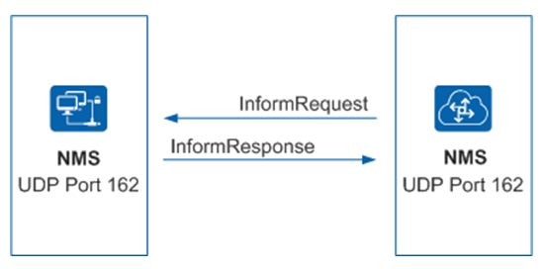
SNMP Operations
SNMP Inform
Inform operation allows one NMS to send trap information to another NMS and to then receive a response.

Slide 21
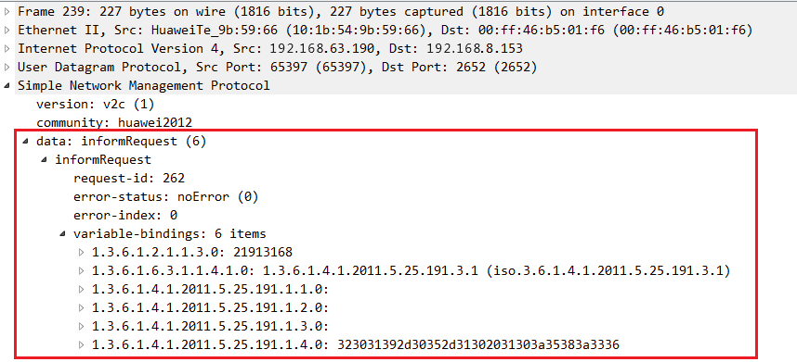
SNMP Operations
SNMPv2(v3) inform
Format of SNMP inform packet is same trap packet.

Slide 22
Thank For Watching

