Slide 1


Krita
Open Source Digital Painting
Further Confusion 2025
with Quykfox

Slide 2
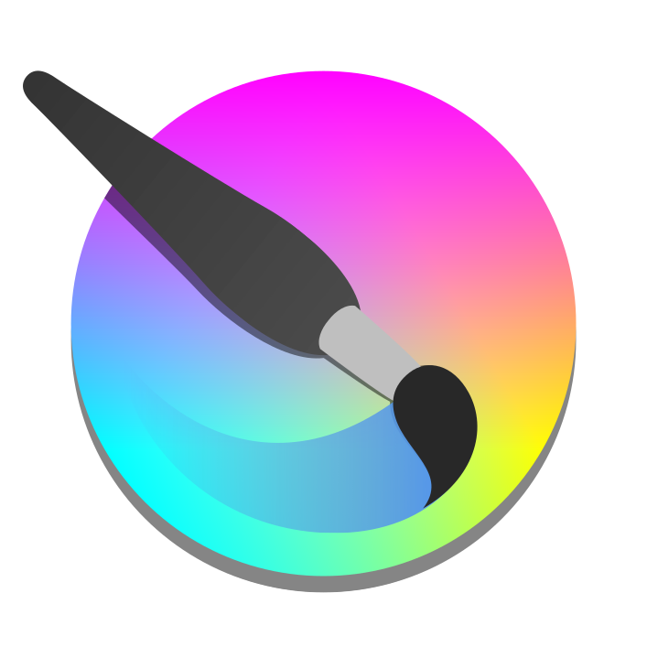
What is Krita?
Krita is an open source digital painting program.
Krita is completely free to download and use.
Runs on Windows, macOS, Linux, Android, and more.
Developed by the Krita Foundation and KDE.
Website: https://krita.org
Krita Logo

Slide 3
Some Features
Primarily designed for digital painting (as opposed to general image editing).
Several advanced brush engines
Painting assistant tools
Animation features
Support for Python plugins
Integration with G’MIC and SeExpr
Makes an effort to be compatible with other formats

Slide 4
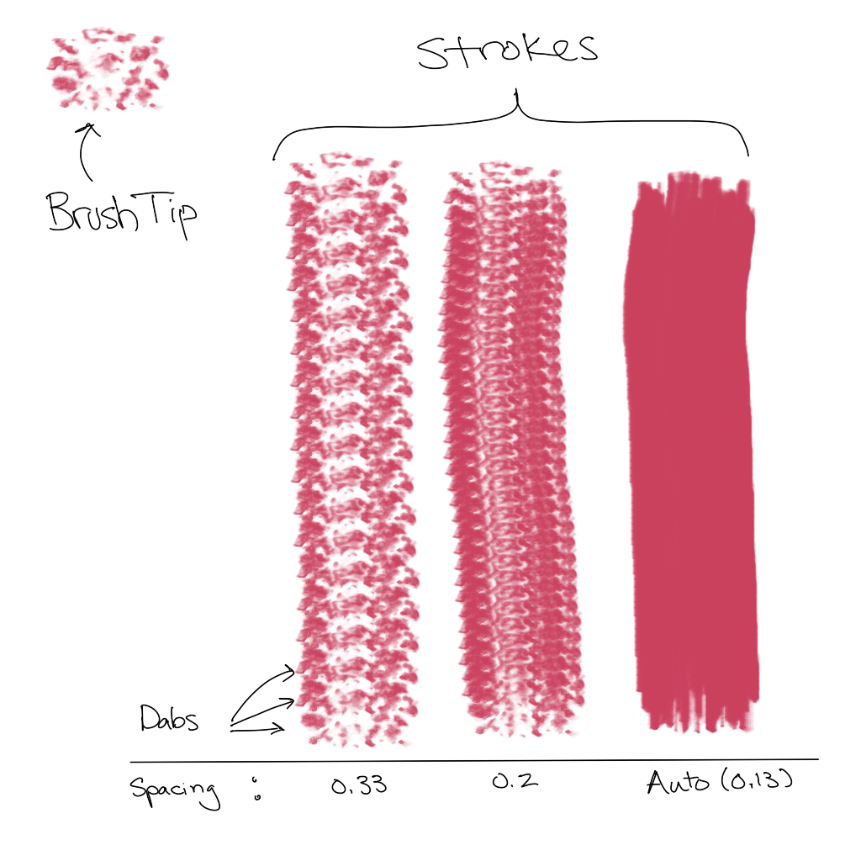
How Digital Brushes Work
Repeatedly draws a small image under the pen.
As the spacing between dabs decreases, it starts to look like a brush stroke.
Similiar in most painting software.

Slide 5
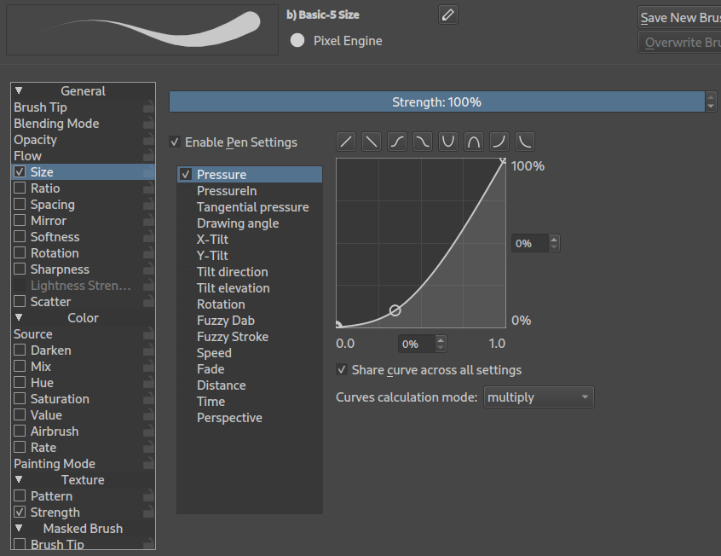
Brush Settings
We want to control brush properties like size, opacity, or rotation using sensor inputs like pressure, tilt, or speed.
The brush settings let us choose what sensors control which properties.
The curve allows us to precisely control the relationship.

Slide 6
Documentation & Resources
Offical Docs: https://docs.krita.org
Krita Artists Forum: https://krita-artists.org
IRC: #krita at libera.chat
Matrix: #krita:kde.org
Krita-Users Matrix Channel:
#krita-users-general:kde.org
Krita YouTube channel:
https://www.youtube.com/@KritaOrgPainting
Source Code Repository:
https://invent.kde.org/graphics/krita

Slide 7
Bundles, Brushes & More
David Revoy's website has excellent free bundles:
https://www.davidrevoy.com
Ramón Miranda has created numerous great bundles at https://files.kde.org/krita/extras.
  Impressionism brushes are from the Impressionism bundle.
https://opengameart.org has some good tiling textures with open licenses.
https://docs.krita.org/en/resources_page.html

Slide 8
Thank You!
Thanks for coming to this panel!
Have fun at the convention :3
Thank you to the users on the Krita Artists forum who gave suggestions and thoughts on the panel.
Special thanks to my partner who sat through my entire 2½ hour practice talk.

