Slide 1
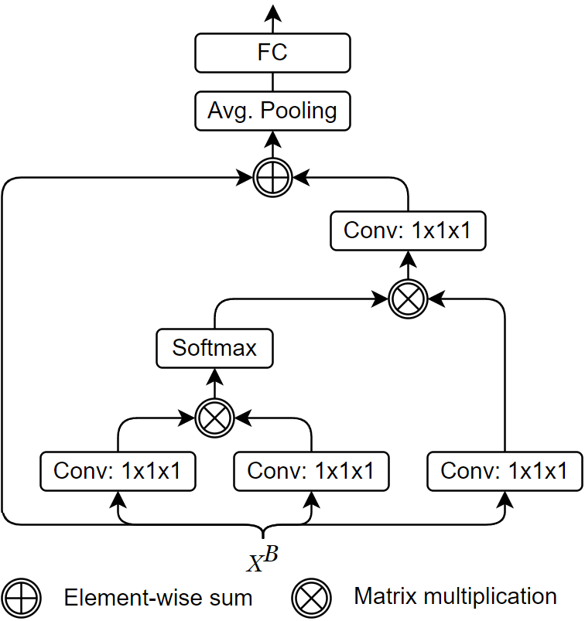


$$f$$
$$g$$

