Slide 1

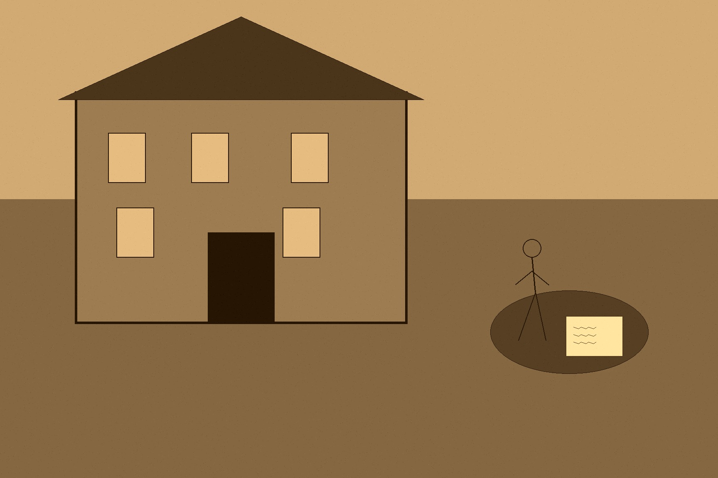






MJF
TREVELYAN TO MONTEAGLE, 9 OCTOBER 1846
Whitehall, London
No occupier of more than a quarter acre of land could receive any relief whatsoever, whether inside the workhouse or out of it. That was the entire operative text of the clause a Member of Parliament named William Gregory would attach to the Poor Law Extension Act the following June, and it left any family holding even a small plot exactly one legal path to survival: surrender the land, in writing, to the landlord, before a workhouse bed or an ounce of relief meal could be had. The law did not spring from nowhere. Eight months before Gregory drafted it, on October 9, 1846, Charles Trevelyan — Assistant Secretary to the Treasury, and the man Lord John Russell's government had put in charge of Irish relief — wrote a letter that said, in essence, exactly what a clause like Gregory's would later say in the cold language of statute. Trevelyan wrote to Thomas Spring-Rice, Lord Monteagle, at his estate of Mount Trenchard in County Limerick, after Monteagle asked what more the government intended to do. Trevelyan's answer laid out, in full and with no apparent sense that he was saying anything extreme, the doctrine that would govern the crisis for the rest of its course: "It forms no part of the functions of government to provide supplies of food or to increase the productive powers of the land." The condition of a community, he continued, depended on the efforts each member of it made in his own private and individual capacity, and government's proper role was only to protect merchant and agriculturist alike in the free exercise of their trades, never to enter those trades itself. Then, of the blight specifically, in the sentence that would outlive every other line he ever wrote: he hoped he was not guilty of irreverence in thinking that, the overpopulation of Ireland being altogether beyond the power of man to correct, "the cure has been applied by the direct stroke of an all-wise Providence, in a manner as unexpected and as unthought of as it is likely to be effectual."
Trevelyan meant this. Cecil Woodham-Smith, whose history of the famine remains the standard account, described him as a man of powerful mind, scrupulous and upright character, and remarkable insensitivity — not a cynic dressing cruelty in theology, but a sincere evangelical who read the blight as a genuine act of divine correction, and who therefore understood restraint, not intervention, as the morally serious response. The letter to Monteagle was not a private indulgence. It was policy, stated plainly to a landlord who had asked a direct question and received a direct theological answer.
Two months and six days later, on December 15, 1846, a Cork magistrate named Nicholas Cummins went to see for himself what the doctrine looked like on the ground. He traveled to South Reen, a townland on the eastern side of Castlehaven Harbour in the parish of Myross, near Skibbereen, bringing as much bread as five men could carry because he already expected to find people hungry. What he found instead was a hamlet that appeared deserted. He went into the cottages to find out why, and in the first one, he later wrote to the Duke of Wellington in a letter he also sent to the Times, he found six people — "famished and ghastly skeletons, to all appearances dead" — huddled together on filthy straw under what looked like a single ragged horse-cloth, legs bare above the knee. He approached in horror, and it was only a low moaning that told him they were alive: four children, a woman, and what had once been a man, all in fever. Within minutes he was surrounded by some two hundred more people in the same condition, most of them delirious from hunger or disease. His letter, published in the Times on December 24, 1846, put a specific, witnessed, undeniable human scene under the doctrine Trevelyan had committed to paper in October — not as rebuttal, since Cummins never claimed to be arguing with Treasury policy, only reporting what a magistrate had actually seen when he went to look.
The doctrine did not soften after Cummins's letter reached London. If anything, the machinery built on it tightened. By June 1847 the government had shifted the entire remaining relief effort onto the amended Poor Law, and Gregory's clause put Trevelyan's private theology into public statute, word for word in effect if not in phrasing. For a family holding even a small plot, it meant exactly one legal path to survival — give up the land entirely, in writing, to the landlord — before a workhouse bed or an ounce of relief meal could be had. Landlords facing their own poor-rate liability on every holding under four pounds' rental value had every financial incentive to accept the surrender and see that the vacated cottage could never be reoccupied. Hired men known across the country as the crowbar brigade went from townland to townland the same day a family walked out, pulling down the roof first and then the walls, working fast enough that a family who changed its mind by nightfall would find nothing left standing to walk back into.

