Slide 1


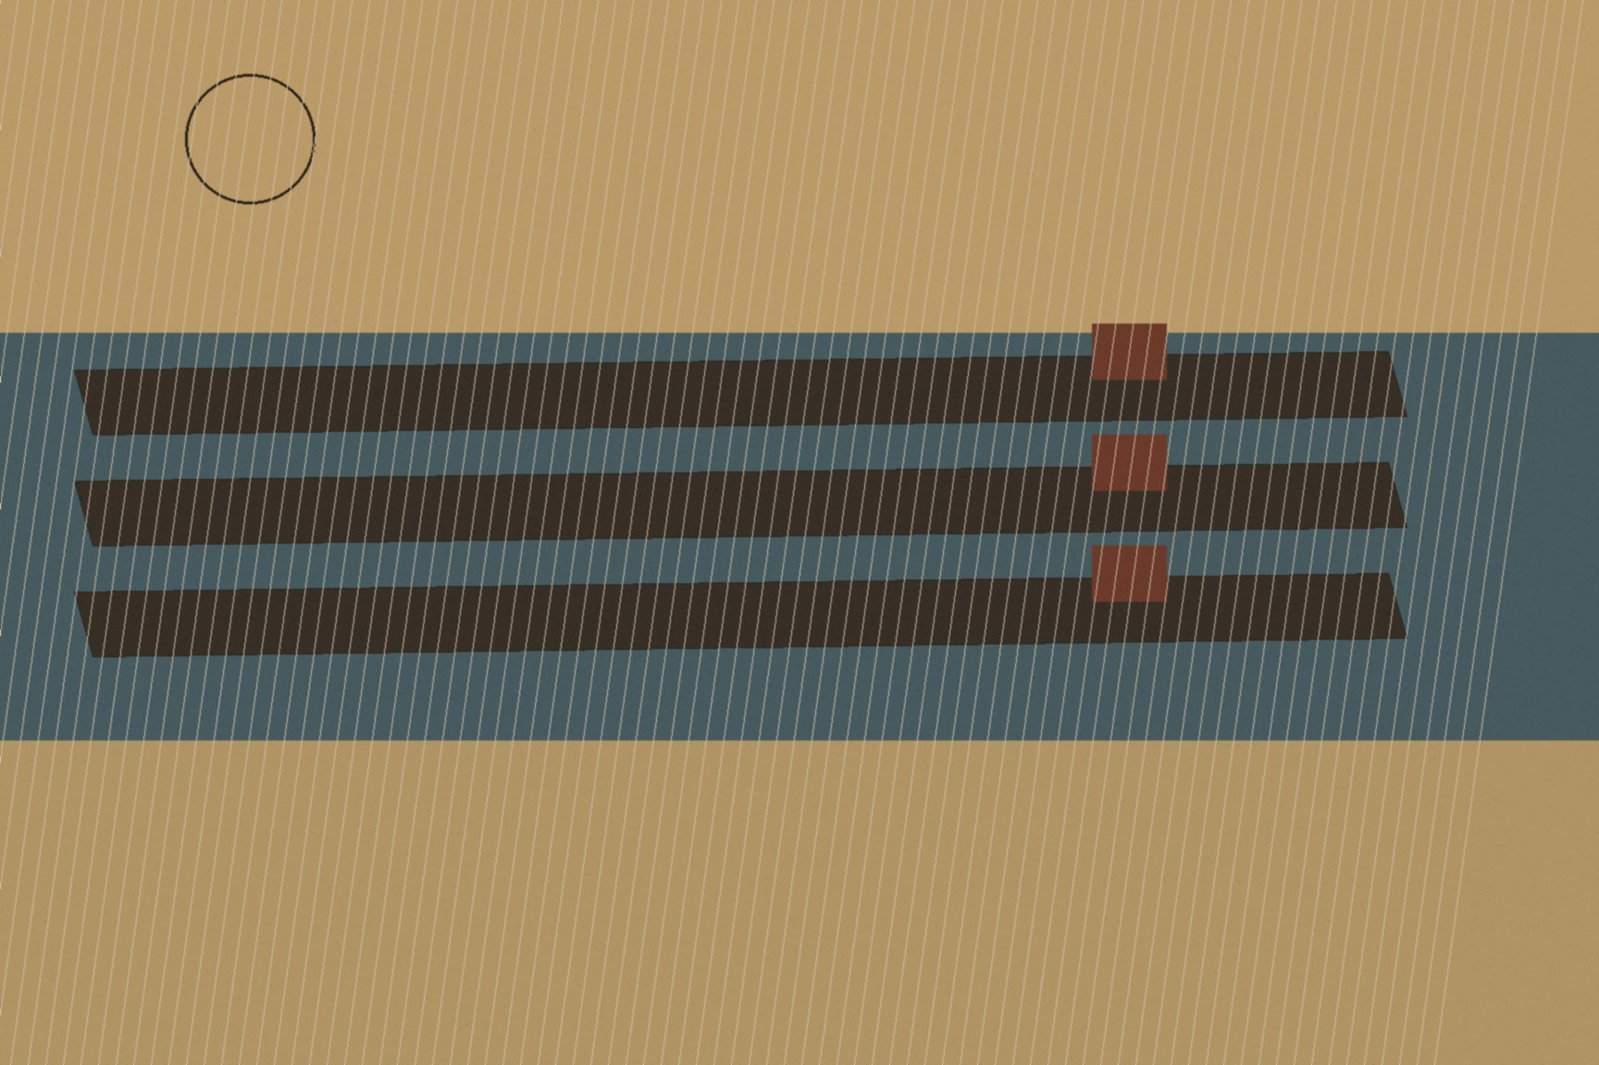
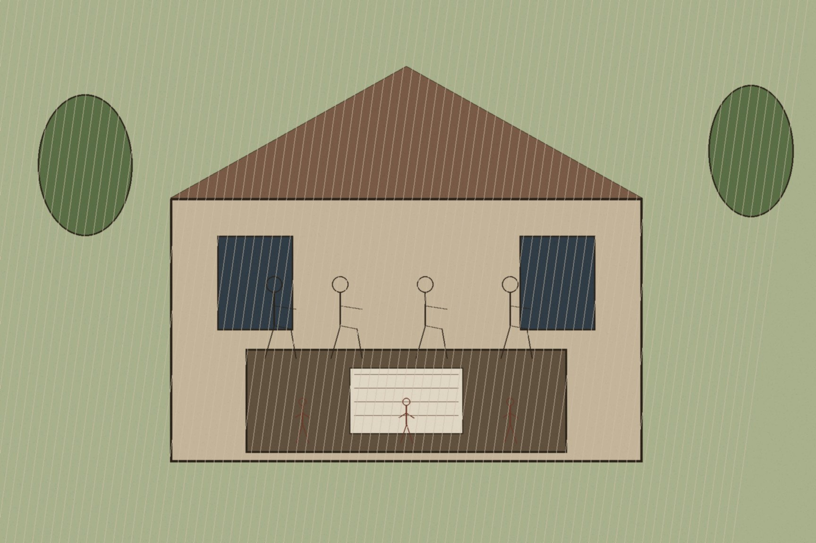
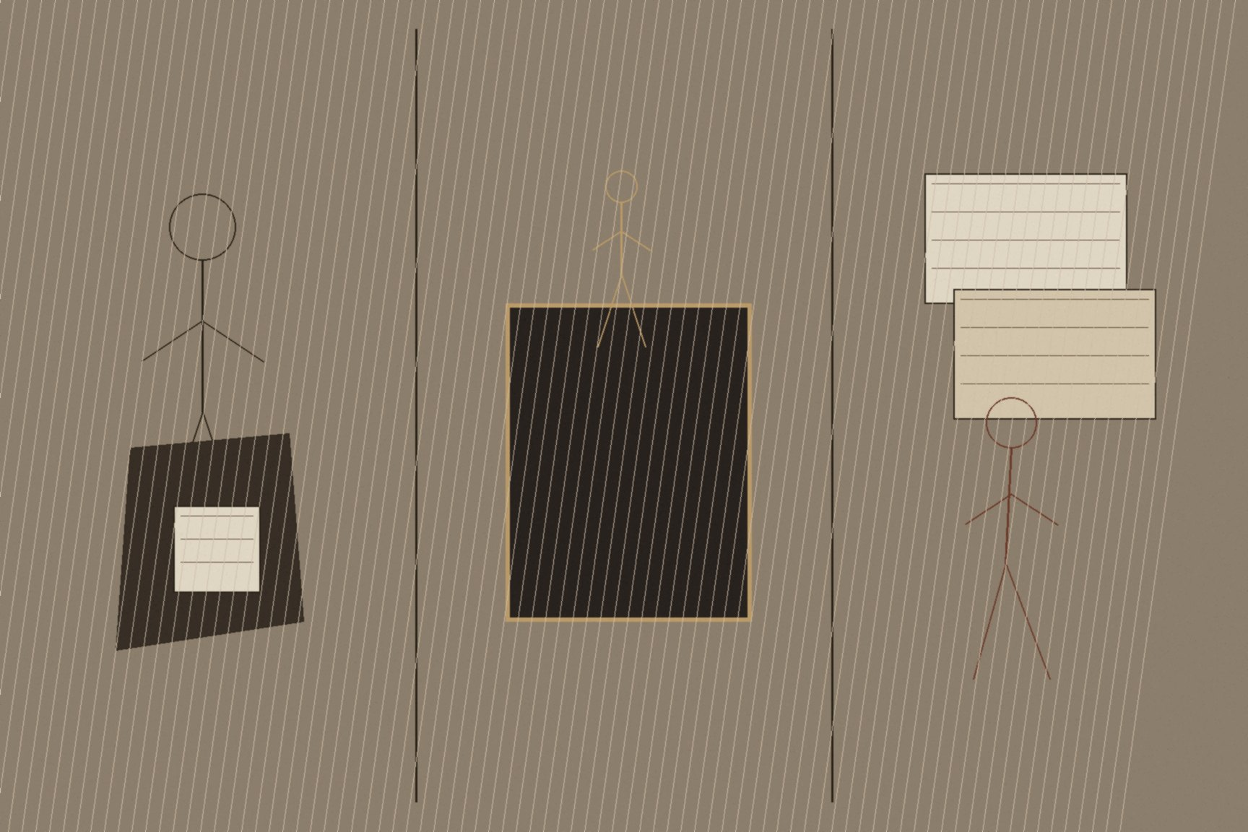
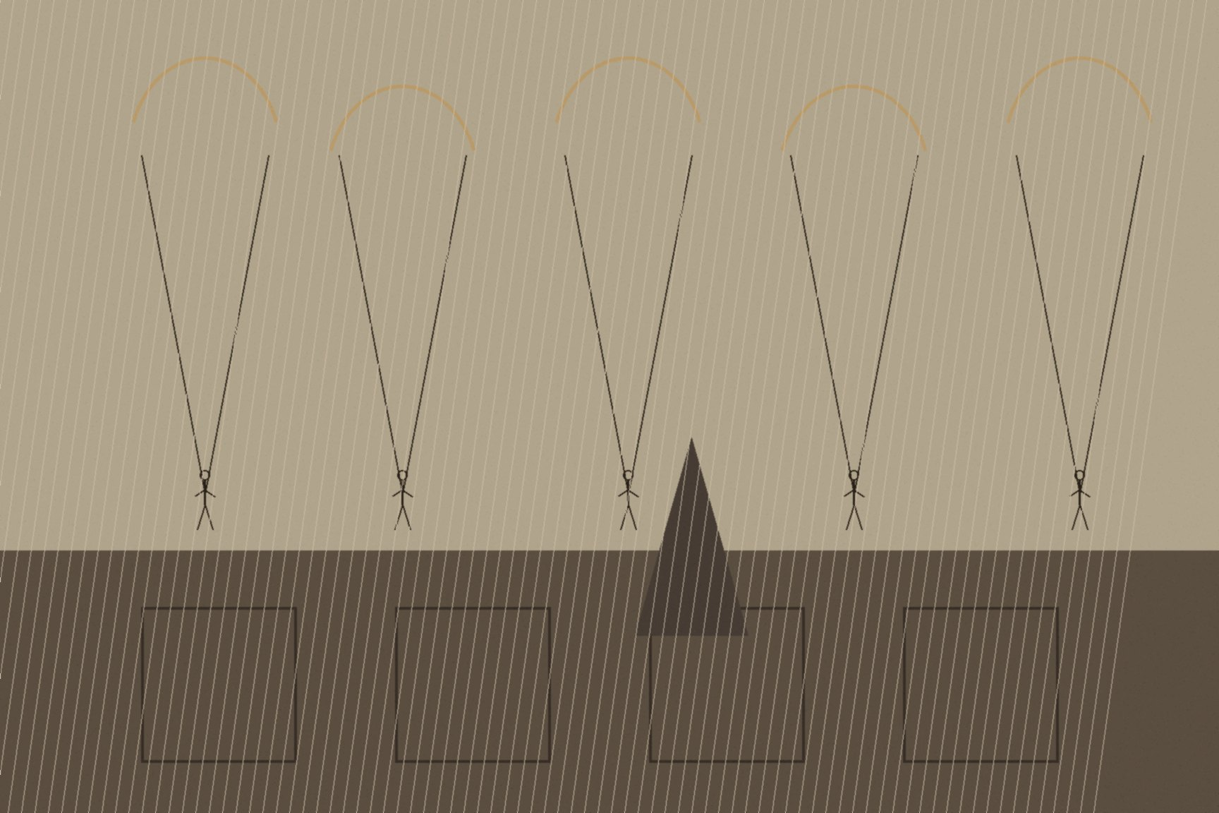
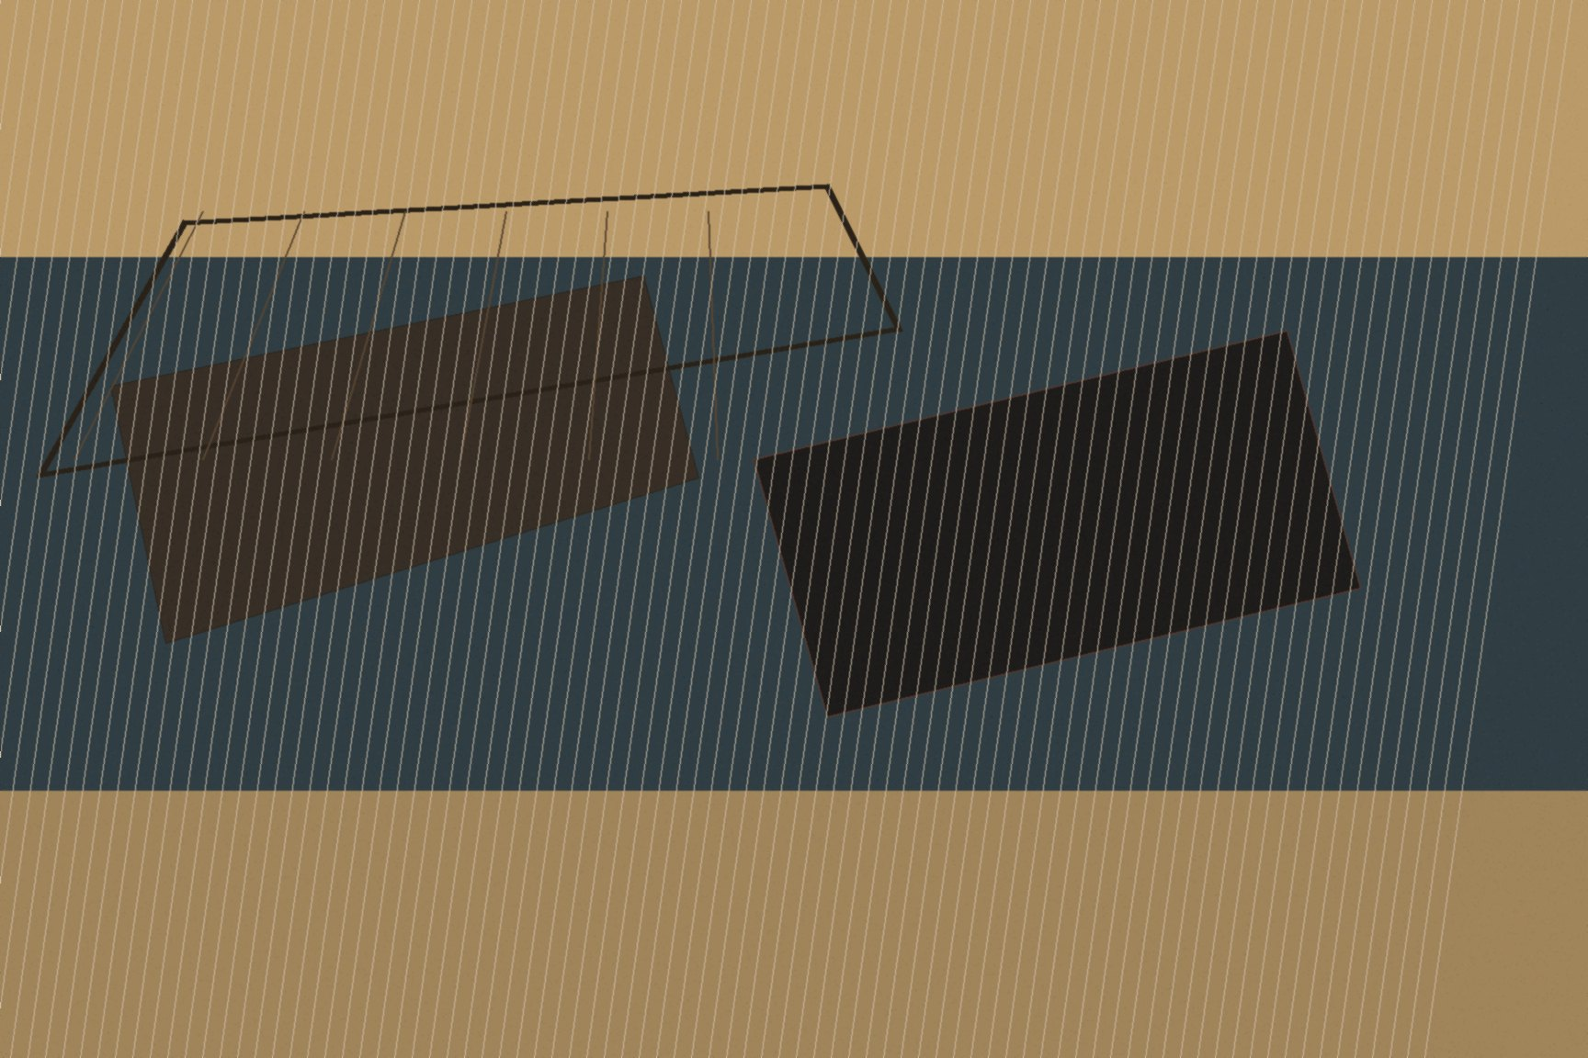
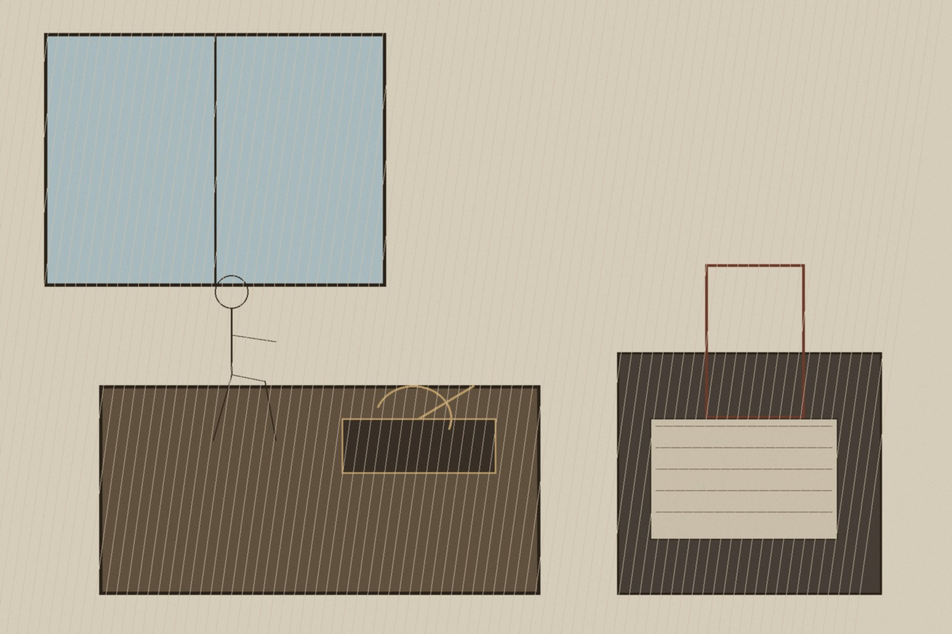
MJF
THE DITCH AND THE DESK, 1956
Sèvres, Port Said, and Washington
26 July 1956. Alexandria. Gamal Abdel Nasser stood on the balcony overlooking Manshiyya Square—the same square Royal Navy bluejackets had occupied after the bombardment seventy-four years earlier. He spoke for two and a half hours, laughing into the microphone, recounting the history of the canal's construction and the foreign debt that had eaten Egypt. The broadcast carried a prearranged code. Whenever Nasser pronounced the name of Ferdinand de Lesseps, Egyptian military units and engineers moved through the dark to occupy the company offices in Port Said, Ismailia, and Suez. By midnight the Compagnie Universelle du Canal Maritime de Suez belonged to Cairo. The tolls, the pilots, the cut through the sand.
The panic in London and Paris had little to do with abstract international law. It was the arithmetic of 1875 facing a closed book. Half of Western Europe's oil supply moved north through that hundred-mile slit; the sterling area's foreign exchange reserves rested on the crude pumped out of the Persian Gulf. If a nationalist government in Cairo could price the transit, inspect the manifests, or swing the gate shut, the imperial circuit that had run on tea, opium, and silver broke on oil. Anthony Eden called Nasser a plunderer with his thumb on Britain's windpipe.
The response was not improvised; it reached for the oldest move in the file.
Between 22 and 24 October 1956, seven men met in total secrecy at a secluded private villa in Sèvres, southwest of Paris. Guy Mollet and Christian Pineau for France; Selwyn Lloyd and Patrick Dean for Britain; David Ben-Gurion, Shimon Peres, and Moshe Dayan for Israel. They spent three days negotiating a conspiracy and typing it onto paper: the Protocol of Sèvres. The mechanism was pure theater. Israel would launch an armored thrust across the Sinai toward the canal. Britain and France would feign shock at the outbreak of hostilities, issue a joint ultimatum ordering both Egyptian and Israeli armies to withdraw ten miles from either bank, and then land an Anglo-French expeditionary force—Operation Musketeer—to "separate the combatants" and occupy the waterway to protect international shipping.
It was the classic posture: invite other men's sons to fight, step between them under the flag of order, and secure the asset with paperwork. Dean signed for the British government. When Anthony Eden saw London's copy, the traditional imperial reliance on the paper trail inverted into panic: terrified of the international exposure of collusion, he ordered Dean back to Paris to collect and destroy every sheet. The French refused. Ben-Gurion folded his copy and put it in his pocket. The paperwork survived because someone always keeps the receipt.
On 5 November, British and French paratroopers dropped over Port Said and Port Fuad. French commandos took the waterworks; British infantry fought through the streets behind naval bombardment, killing several hundred Egyptian soldiers and civilians. But the 1882 script did not run to its conclusion. Before the landing force could advance down the canal, Nasser ordered forty-seven merchant hulls, tugs, and dredges filled with concrete and iron scrap and scuttled in the main navigation channel. The El Ferdan railway bridge was dropped into the water. The ditch was dead before the troops had finished securing the quays.
The decisive counter-stroke did not come from the canal bank. It came from a desk in Washington.
On 6 November, a catastrophic run on the British pound began on the New York exchange. Within days, Britain lost fifteen percent of its gold and dollar reserves. Harold Macmillan, Chancellor of the Exchequer, called Washington to plead for an immediate loan from the International Monetary Fund and access to the US Federal Reserve's credit lines. President Dwight D. Eisenhower and Treasury Secretary George Humphrey delivered the answer without euphemism: not one dollar of financial assistance, and not a single tanker of American emergency oil to replace the blocked Gulf supplies, until British and French forces agreed to an immediate, unconditional ceasefire and a total evacuation of Egyptian territory.
The machinery that had operated across the Mediterranean since 1801 stopped in that telephone call.
The story had never been an ancient, insoluble clash of creeds. It began in the modern ledger: in 1831, when Ibrahim Pasha marched an army out of Cairo with French encouragement, dismantling the Ottoman contract of local repose. Ibrahim took the Muslim sons for lifetime conscription in a modern standing army and left Jews and Christians to pay the jizya directly to his treasury, breaking the customary local equilibrium that had governed the Galilean towns. Britain and Austria answered in 1840 not by marching an infantry war through the interior, but by shattering Acre from the decks of warships to check French ambitions and keep the overland routes open, balancing Cairo against Istanbul while spending other men's blood.
The violence of paperwork followed the guns. The 1858 Ottoman Land Code, drafted under British pressure to turn collective peasant tenure into individual taxable deeds, ran straight into the living memory of that levy. Villagers who had watched their fathers blind an eye, extract their front teeth, or chop off a trigger finger to escape Ibrahim's musket drill refused to put their names in the sultan's registry. To avoid the draft and the tax clerk, they handed their titles to literate urban notables in Beirut and Jerusalem. Customary holders became tenants by sunset. When the Sursocks sold the Jezreel Plain to European buyers half a century later, British police arrived with the deeds to enforce the signatures of men who had never touched the dirt.
The corridor demanded the canal; the canal in 1875 demanded Egypt; Egypt in 1882 demanded a garrison; and the garrison demanded a buffer in Palestine. When the British entered Jerusalem, they brought the one policing instrument the empire kept on the shelf for populations that did not consent: the Royal Irish Constabulary. Seven hundred former Black and Tans and Auxiliaries, dismissed after the Irish Treaty, landed at Haifa in 1922 and unpacked the habits of Munster—curfews, warrantless raids, collective village fines, and the demolition of family homes.
For three decades, British policy managed the territory by balancing communal friction, issuing contradictory promises in Whitehall letters, and then stepping back as the two populations collided inside the rising dust cloud. In 1947, facing armed revolt from both sides and broke from a world war, Britain dropped the file on the desk of the United Nations, tiptoed out the back door, and left the inhabitants to fight out the habits of violence the administration had cultivated and policed.
Nine years later, at Port Said, Britain and France tried the ditch one last time. They landed the troops, staged the ultimatum, and found that the century of managing the world from a European drawing room had run out. They retreated in humiliation. Anthony Eden resigned his office, broken in health and reputation. The imperial baton and the curse of its management passed west across the Atlantic.
The British marched out. The United States took the desk. The people inside the corridor were left to live with the deeds, the borders, and the wreckage. The ditch remained.

