Slide 1

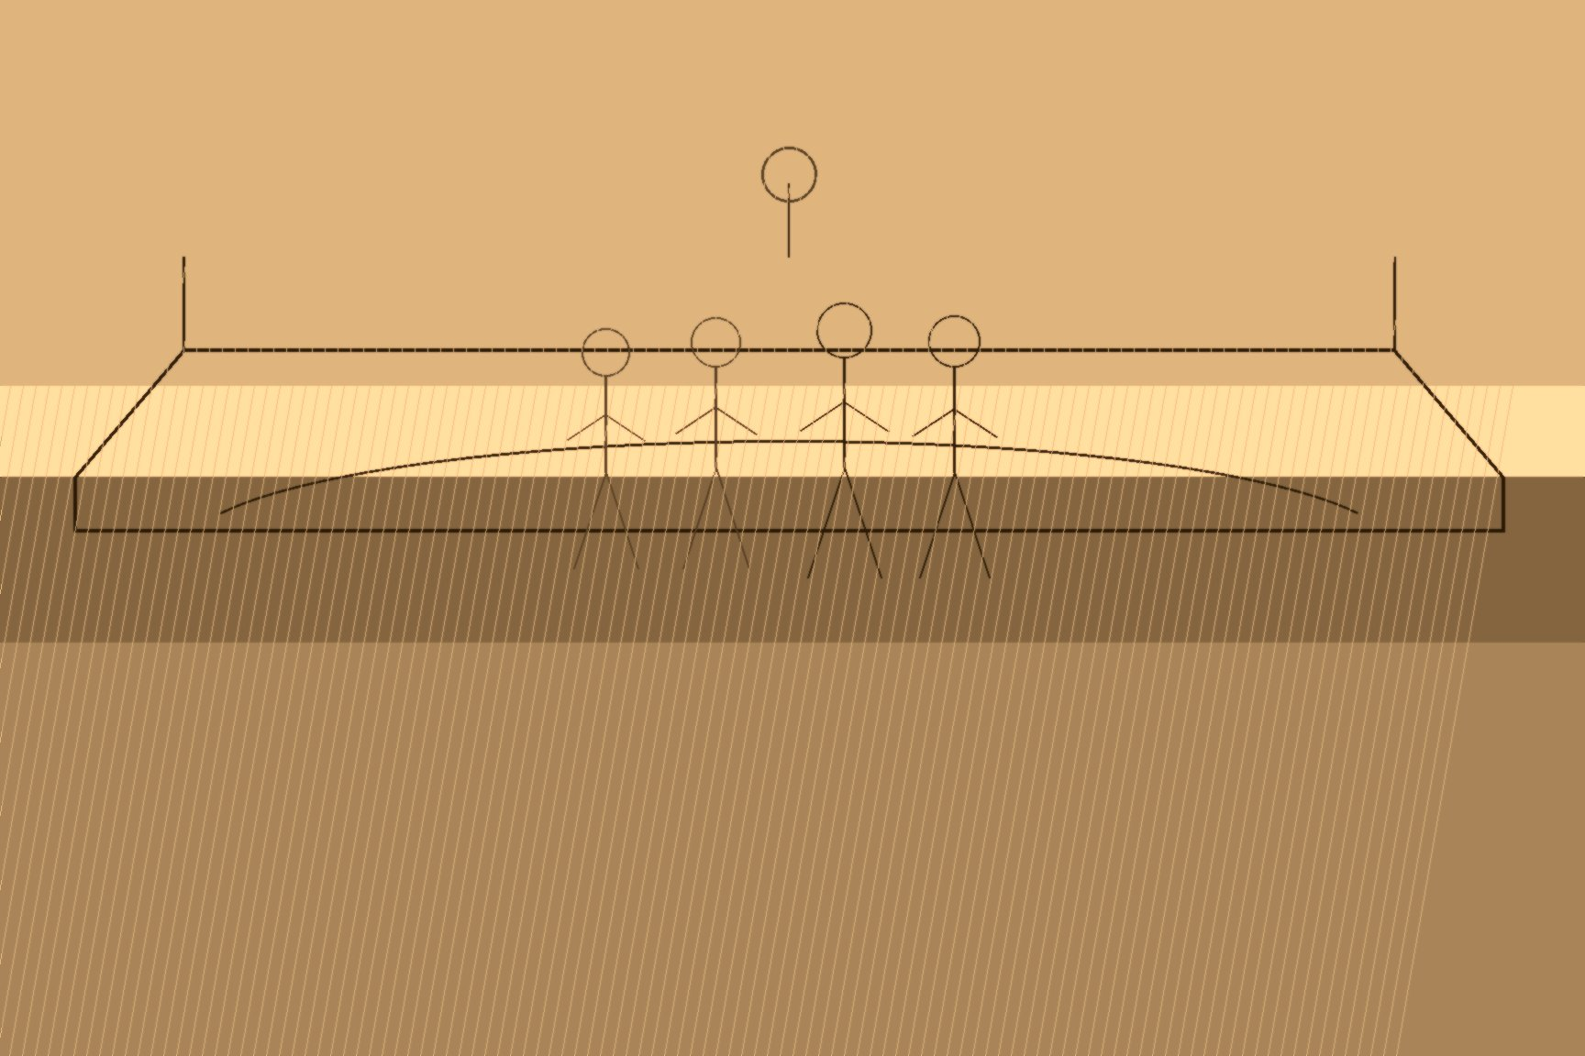

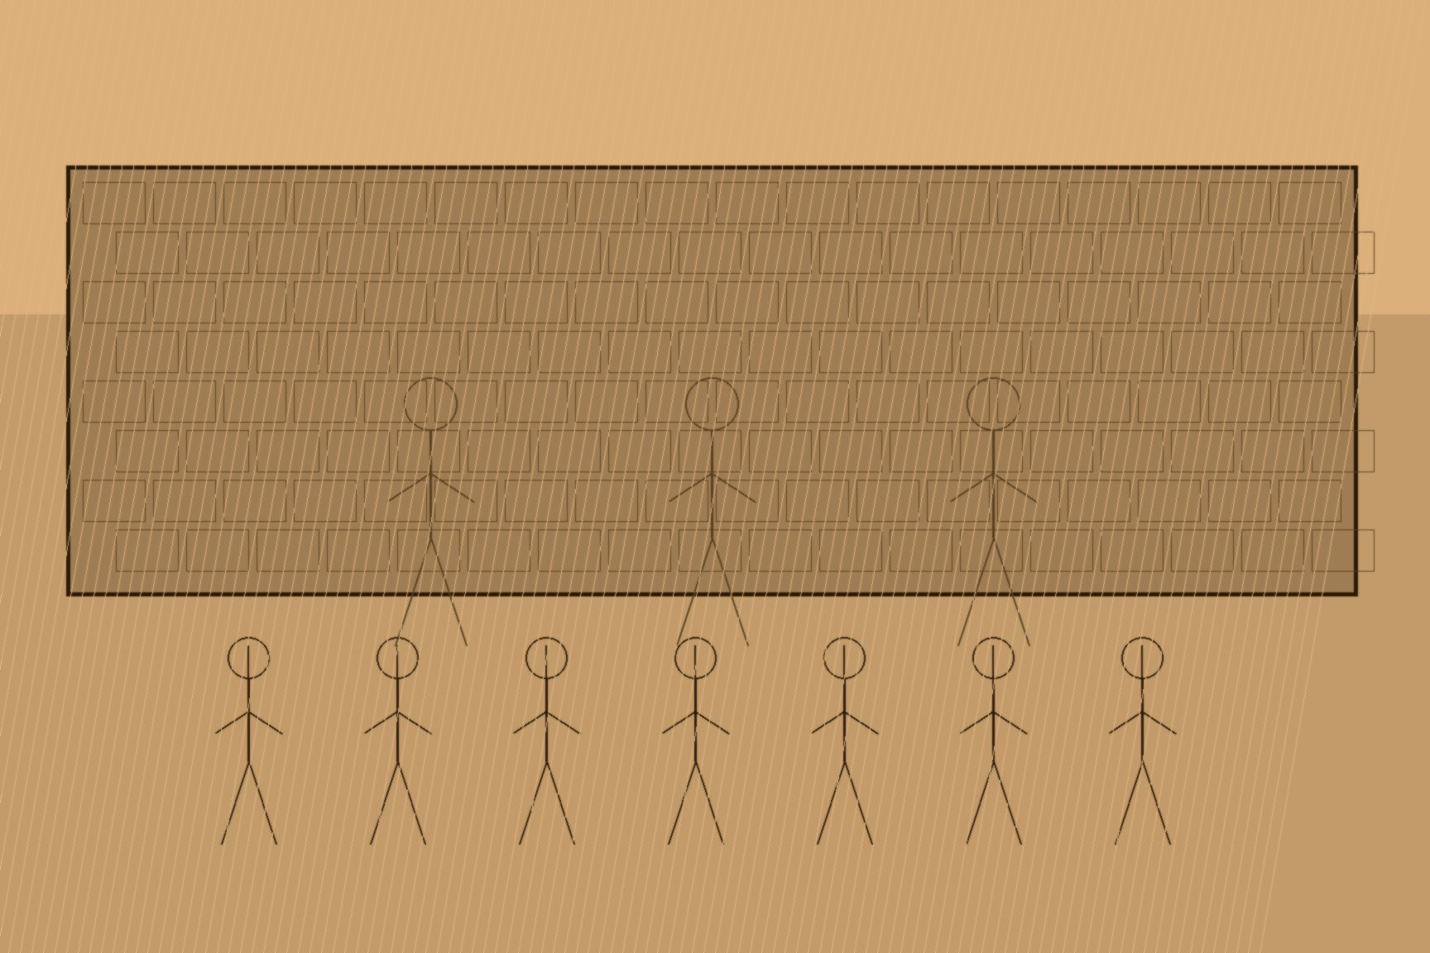
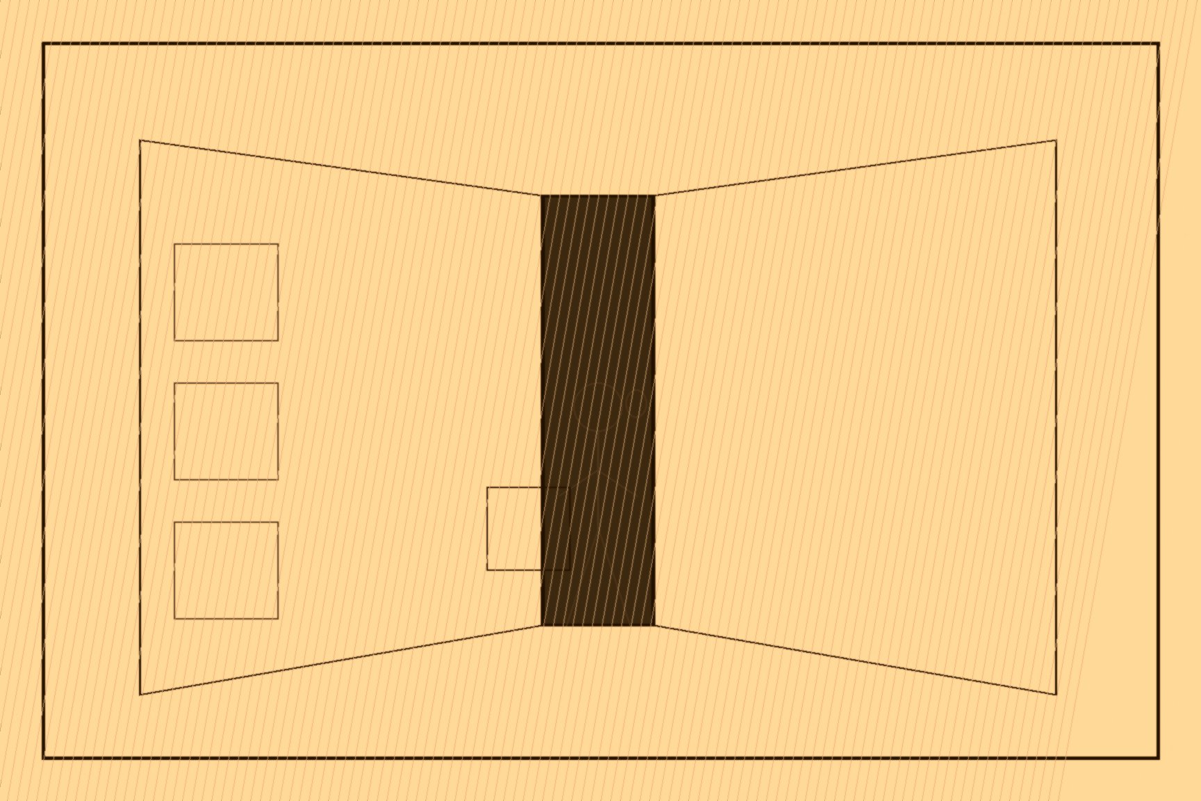
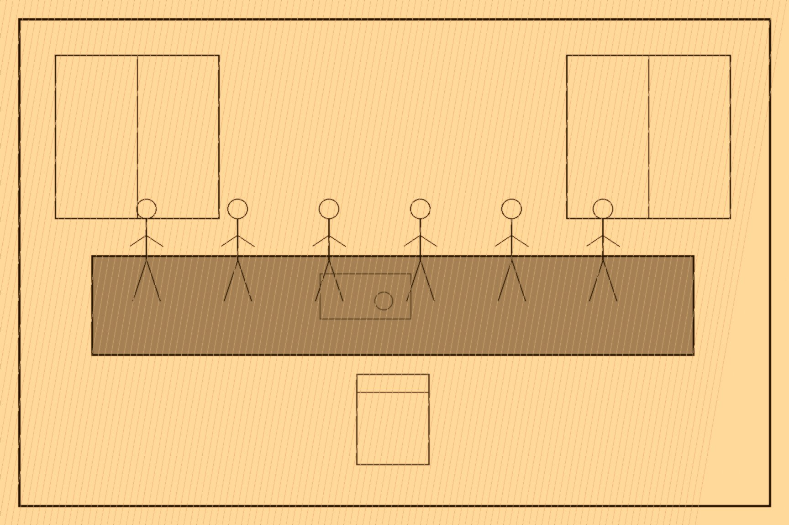
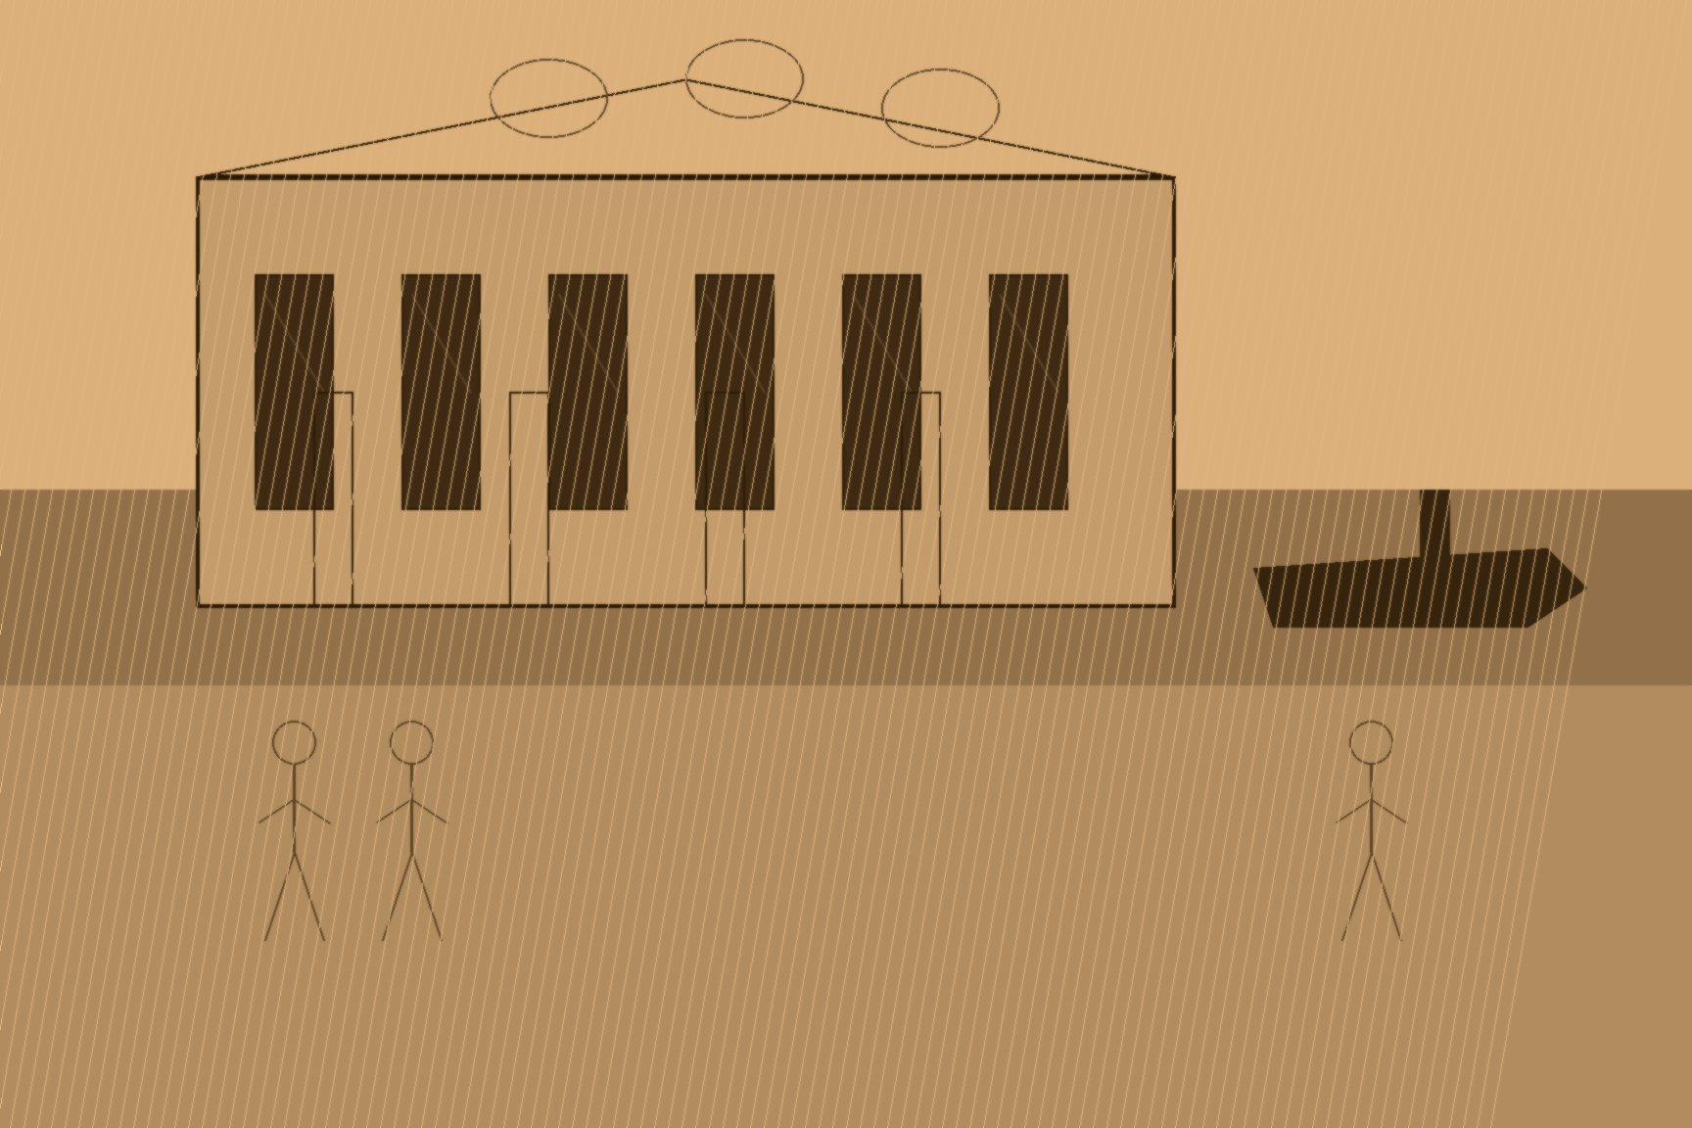
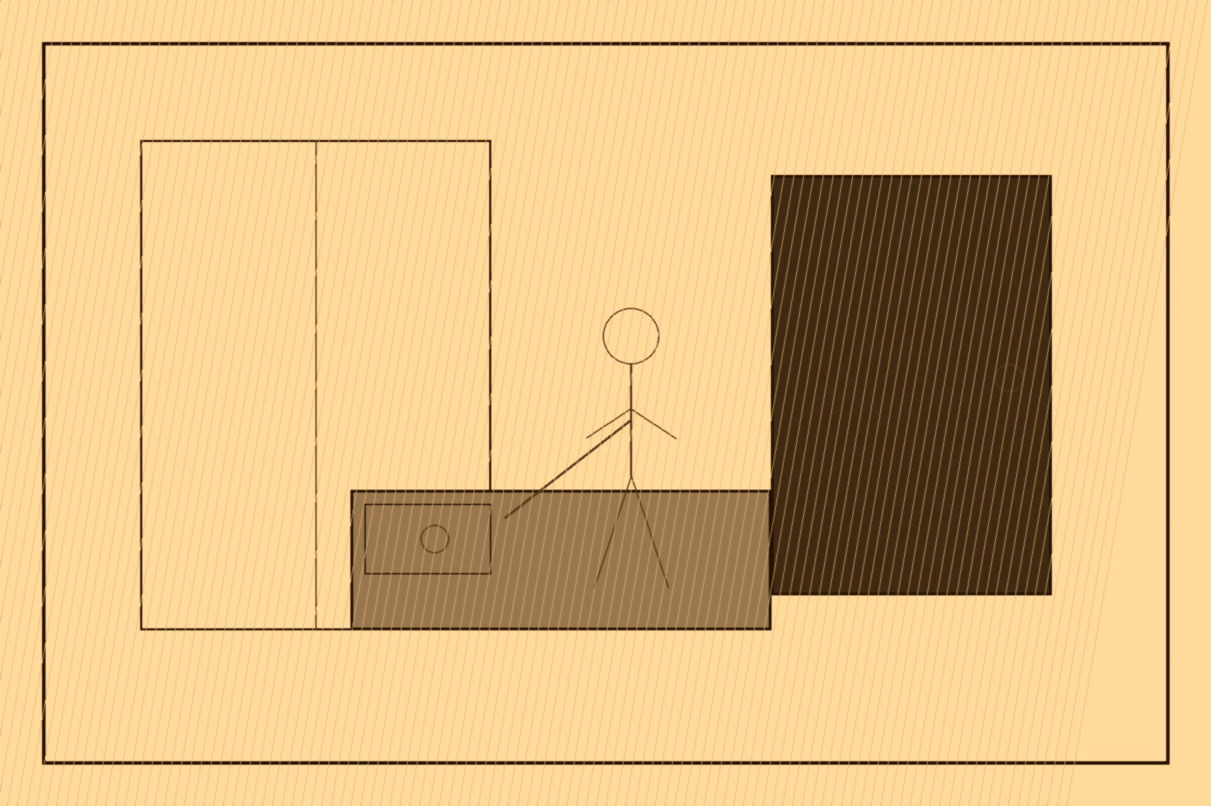
MJF
PORTOBELLO BARRACKS, 26 APRIL 1916
Dublin
Francis Sheehy-Skeffington never fired a shot in Easter Week and never intended to. A pacifist, feminist, and socialist journalist who had campaigned against British Army recruitment since 1914 and against the militarization of nationalist organizations before that, he went into Dublin's city center on the Rising's first day to try to talk looters into standing down, and the following evening, walking home across Portobello Bridge, was arrested for no offense anyone at the barracks could later name. He was still in custody the next morning, April 26, when Captain John Bowen-Colthurst — the senior officer present at Portobello Barracks while his own commander was on sick leave — marched him out as a human shield ahead of a raiding party, shot dead an uninvolved nineteen-year-old named J.J. Coade on the way, and had Sheehy-Skeffington and two journalists, Thomas Dickson and Patrick McIntyre, stood against a wall in the barracks yard and executed by firing squad without charge, trial, or any authority Bowen-Colthurst held to order it.
What happened next reveals more about how the state treated its own excesses than the killing itself does. A fellow officer, Major Sir Francis Vane, investigated on his own initiative, confirmed what had happened, and traveled to London to force the matter in front of the Prime Minister's office and the War Office directly — over the objections of his own superiors, who preferred the matter stay inside the barracks. Bowen-Colthurst was eventually court-martialed, in a proceeding held privately specifically to limit the political damage, and found guilty of the killings but legally insane. He served roughly a year in Broadmoor before being quietly released to emigrate to Canada. Vane, the officer who had forced the investigation, was the one whose career ended over the affair — dismissed from the army, his own service record later noting only that he had been "relegated to unemployment owing to his action in the Skeffington murder case."
Sheehy-Skeffington's death happened inside a much larger military failure that had already been decided by the time Bowen-Colthurst gave his order. Roughly 1,200 IRB-directed Irish Volunteers, James Connolly's Citizen Army, and members of Cumann na mBan had seized the General Post Office and a handful of other buildings across central Dublin on April 24, proclaiming a Republic that both its own leaders and the British garrison understood was not going to survive contact with artillery. Six days of urban combat followed, a gunboat shelled the city center from the River Liffey, and the rebels surrendered unconditionally on April 29, having cost 485 lives, most of them Dublin civilians who had never picked up a rifle on either side.
General Sir John Maxwell, who took command under martial law once the surrender was signed, did not execute the surviving leadership all at once. Between May 3 and May 12, fifteen men were shot in Kilmainham Gaol's stonebreakers' yard in a slow sequence spread across nine days — Patrick Pearse, Thomas Clarke, and Thomas MacDonagh first, the rest following in staggered groups, James Connolly last of all, so badly wounded from the fighting that he had to be carried to the yard on a stretcher and shot while strapped upright to a chair because he could no longer stand. Dublin's own reaction to the surrender had initially run somewhere between hostile and indifferent — the rebels had wrecked the city center and inconvenienced a population that had sons serving in the British Army in France. The staggered executions reversed that reaction inside two weeks, converting a militarily hopeless rising that had already failed into the martyrdom that made failure politically irrelevant.
A royal commission of inquiry, convened afterward to examine what had happened to Sheehy-Skeffington, found in his widow Hanna's favor and awarded her monetary damages for her husband's killing. She refused to accept the money. It was not, for her, a case that closed with a check.

