Slide 1
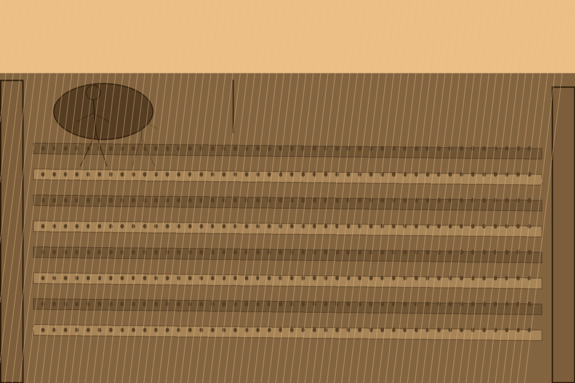
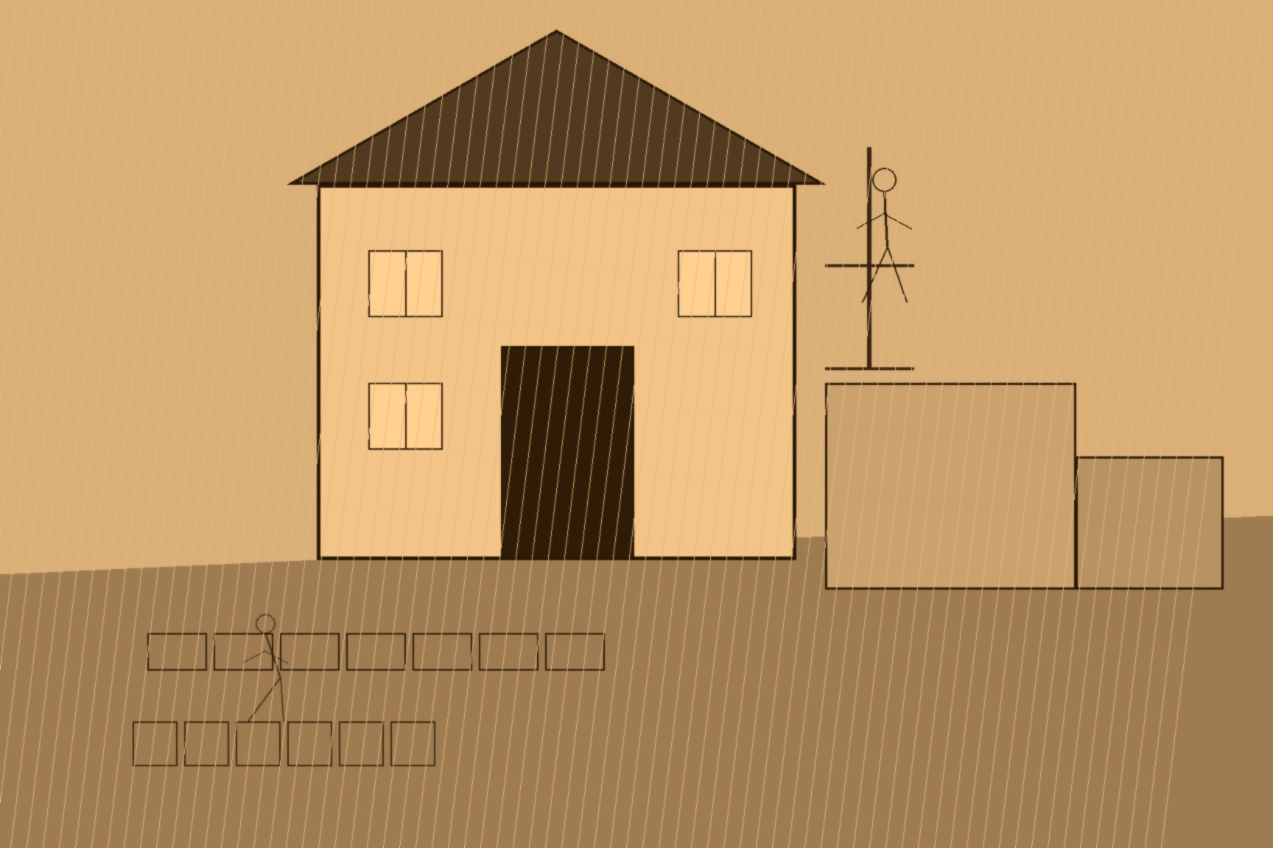
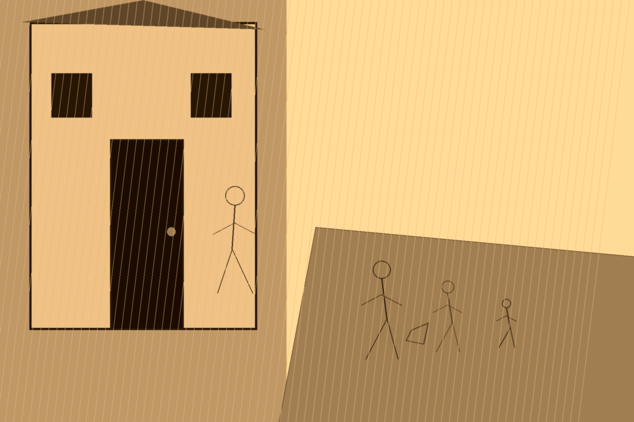
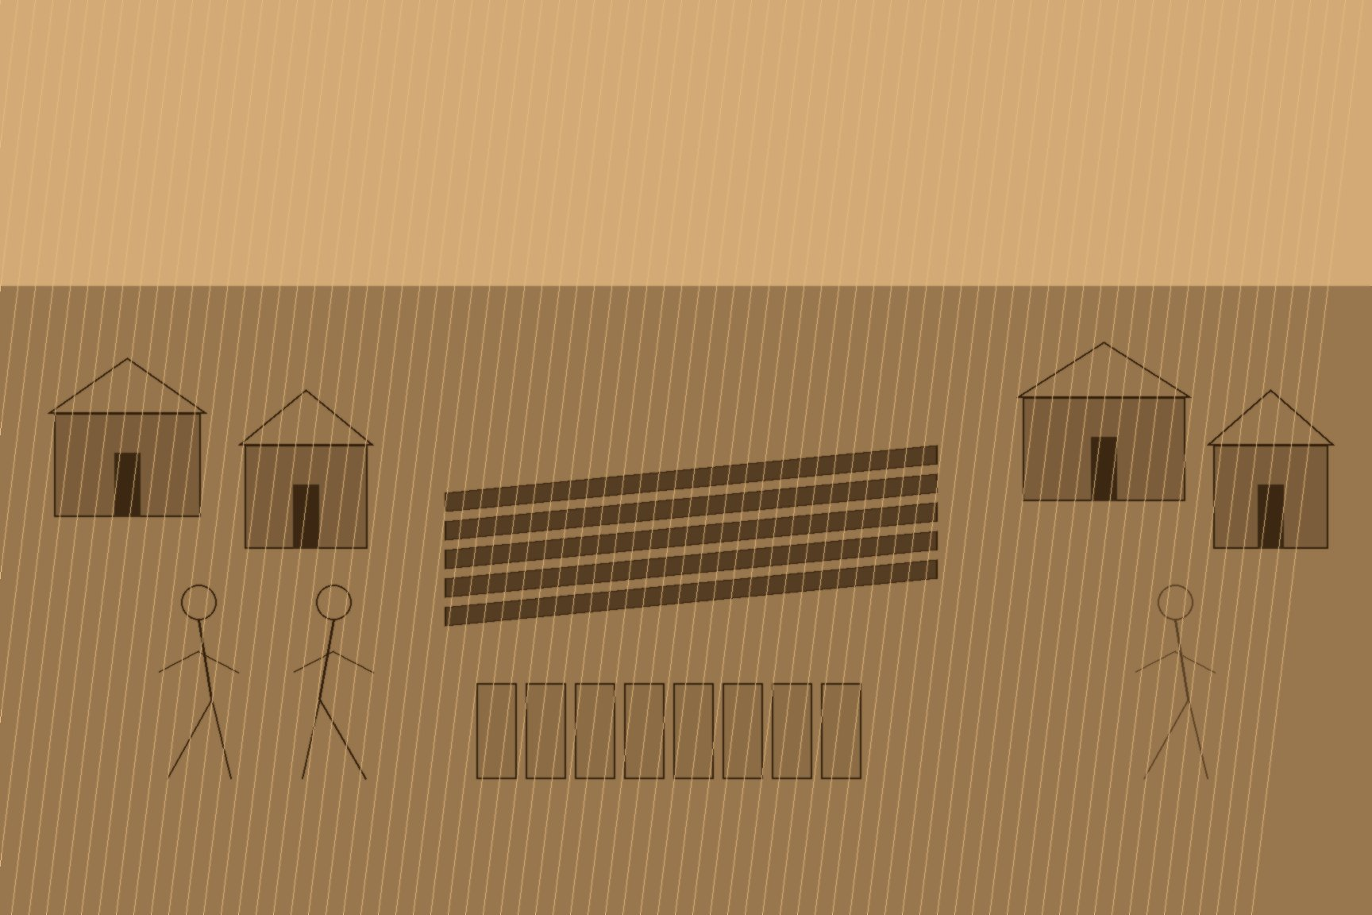
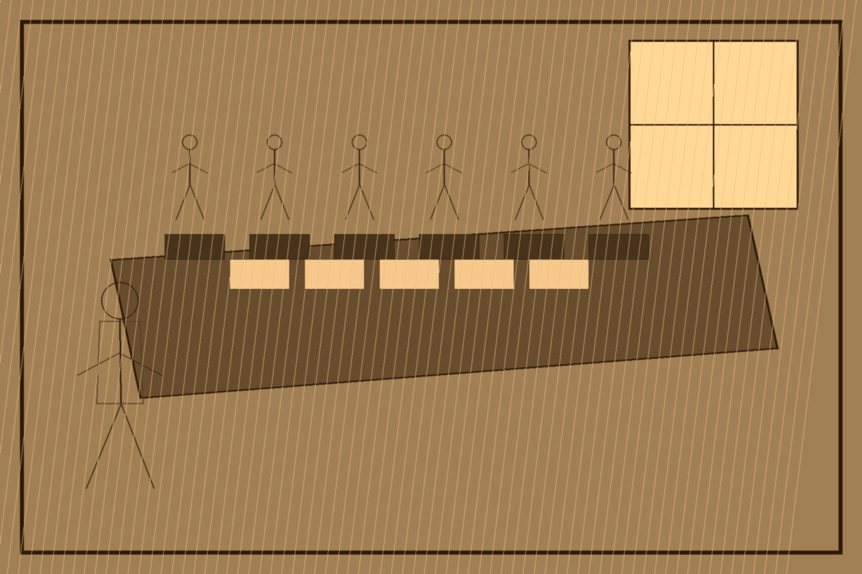
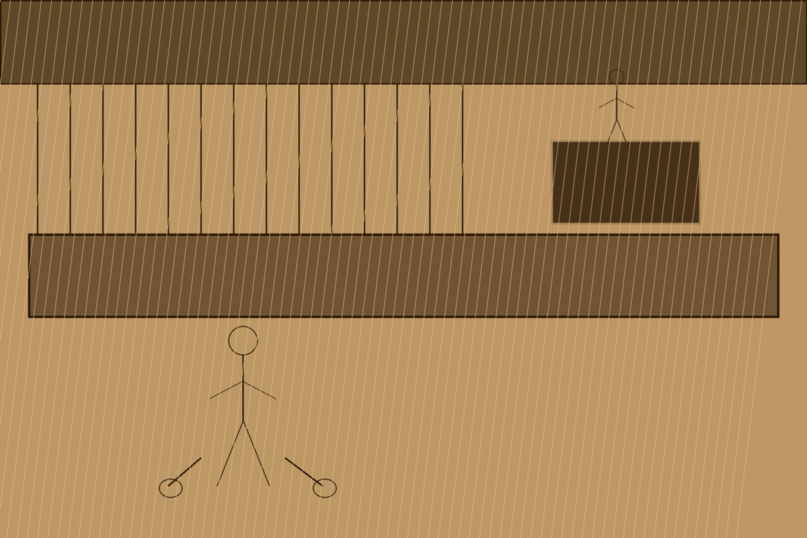

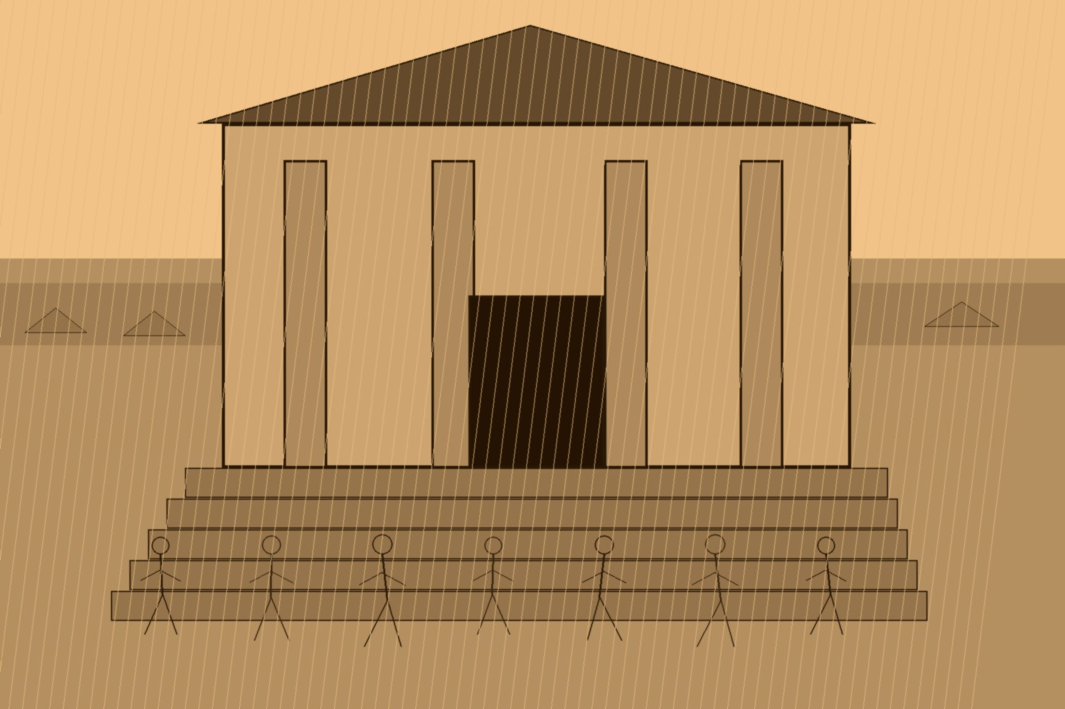
MJF
CROTTY'S HOUSE, 1832
Kilrush, County Clare
Why did nobody in Rev. Malachi Duggan's parish build a better house for nine straight years running? The priest gave the Devon Commission a one-word answer, under oath, in August 1844: Crotty. The system that made one man's name sufficient explanation had a name of its own that outsiders found almost comic: mock ground. Land proprietors in County Clare called it conacre, and it worked the same way across most of Munster and Connacht — a landholder let out a strip of ground, usually already manured, for eleven months and no longer, just long enough to sow and harvest a single crop. No lease was signed, because the eleven-month term existed specifically to avoid creating one. The tenant held no legal claim to the ground he worked, no right of renewal, no protection if the same field was promised to someone else the following season. Rent ran anywhere from three pounds ten shillings to eight pounds an Irish acre, paid in cash, in labor on the landholder's own farm, or some combination of the two, and if a man fell behind, the ground's owner could recover what was owed by distraining and selling his standing potato crop, or through a civil bill process that cost him more than the debt itself. County landowner James Molony, testifying to the Devon Commission's inquiry in 1844, told the commissioners plainly that he believed the scarcity of conacre land was itself the origin of most agrarian unrest in the county — the poor, in his words, conceived that farmers and proprietors ought to make sacrifices to give them the means of subsistence they could not otherwise obtain.
The Commission had been sitting since November 1843, chaired by the Earl of Devon, taking sworn testimony from landowners, land agents, and tenant farmers across every county in Ireland on the state of the law respecting the occupation of land. On Friday, August 23, 1844, its sitting at Kilrush took evidence from a Roman Catholic parish priest named the Rev. Malachi Duggan, witness number 608 on that day's list. Duggan was asked a fairly abstract question — what effect did tenancy-at-will, as opposed to a formal lease, have on a tenant's willingness to improve his own holding. He answered with a story instead of an opinion.
He had known, he told the commissioners, many men turned out over the preceding thirty-two years, but one case in particular had done lasting damage to the whole parish. A poor man had built himself a nice dwelling-house on his holding, without a lease, because no lease was on offer. The farm was subsequently given over to a middleman, who took a fancy to the house the poor man had built with his own labor, picked a quarrel with him, and threw him out onto the highway. Asked directly for the man's name, Duggan gave it without hesitation: Crotty. Asked how long ago it had happened — he said about twelve years — so the eviction sits around 1832. The Commission put its report before Parliament the following February. The blight reached the country the August after that, twelve months after Duggan left the room.
What followed in Duggan's testimony was the detail that gives the story its actual weight. He did not say the parish forgot Crotty. He said the opposite: no improvement was made in his parish for eight or nine years afterward, because everybody liked the house — a pretty thing, he called it, paved all around, with back offices built onto it. The dwelling itself had been the argument against building one. For the better part of a decade, men in Duggan's parish who might otherwise have put labor and whatever small capital they had into a better roof or a paved yard chose not to, having watched exactly what happened to the one neighbor who had.
Nothing about this required a villain acting in bad faith by his own lights. The middleman who took Crotty's house was operating inside a system that made his conduct not merely legal but, from where landlords like David J. Wilson sat, actively encouraged. Wilson — a Clare landowner who submitted his own model for a "cheap cottage for a cottier" to the same Commission, complete with a separate sleeping room, a warm pig-sty so the sow needn't be brought indoors to farrow, and a small room specifically built for a loom — argued elsewhere in his testimony that leases were themselves a positive bar to improvement, since a tenant secured by one had, in his telling, no reason to submit to a steward's instruction. Wilson believed he had solved the cottier's condition with drawings and a subsoil-loosening technique that cost ten to fifteen shillings an acre. He was not being cynical. He had simply never had to weigh what he'd learned to build against the reasonable certainty that it might be taken from him without cause, the way Crotty's had.
The arithmetic ran the same way at every level below the landlord. William Daxon, a farmer and land agent who testified the day before Duggan at Ennis, was asked whether small tenants preferred a lease at a high rent or land without one at a lower rent, and answered that they would rather have the lease every time — because a lease meant credit, meant a bank in Limerick or Ennis would advance a man fifteen or twenty pounds at six percent, where a tenant-at-will had no standing to borrow from anyone but a country usurer charging fifty percent interest a year. A man with no lease could not improve his land without risking exactly what Crotty lost, and could not borrow to improve it in any case, because no lender would extend credit against a holding he might not still occupy by spring.
Daniel Cullen, another Clare farmer who testified that same week, told the commissioners a different but related story: that in his own recent experience, getting land at all from an agent named White in the townland of Quinpool had cost him twenty pounds paid quietly to the agent, entered in no receipt and no deed — a sum he understood other tenants taking farms at the same time had also been made to pay. When the landlord himself, Benjamin Finch White, was given the chance to answer the accusation in an appendix to the same report, he stated flatly that he had never been aware any such payment had changed hands, and that he strongly disapproved of the practice. Both statements can be true. That was the ordinary condition of tenure in Clare in 1844 — a system opaque enough that a landlord could plausibly not know what was being extracted from his own tenants in his name, and a tenant had no forum to raise it in except a royal commission that had traveled specifically to Ennis, Scarriff, Kilrush, and Limerick to ask.
Duggan gave his answer that August afternoon in Kilrush and the Commission moved on to its next question, one witness among several hundred it would hear before the sitting ended. Nothing in the surviving record suggests anyone in that room treated Crotty's story as remarkable. It was simply one more piece of sworn testimony confirming what tenure without a lease did to a man who built something worth wanting, entered into the official minutes and set beside all the others like it — while, outside the courthouse, the parish Duggan had just described was still doing exactly what it had done for nine years running: nothing worth taking, to no one who could take it.

