Slide 1
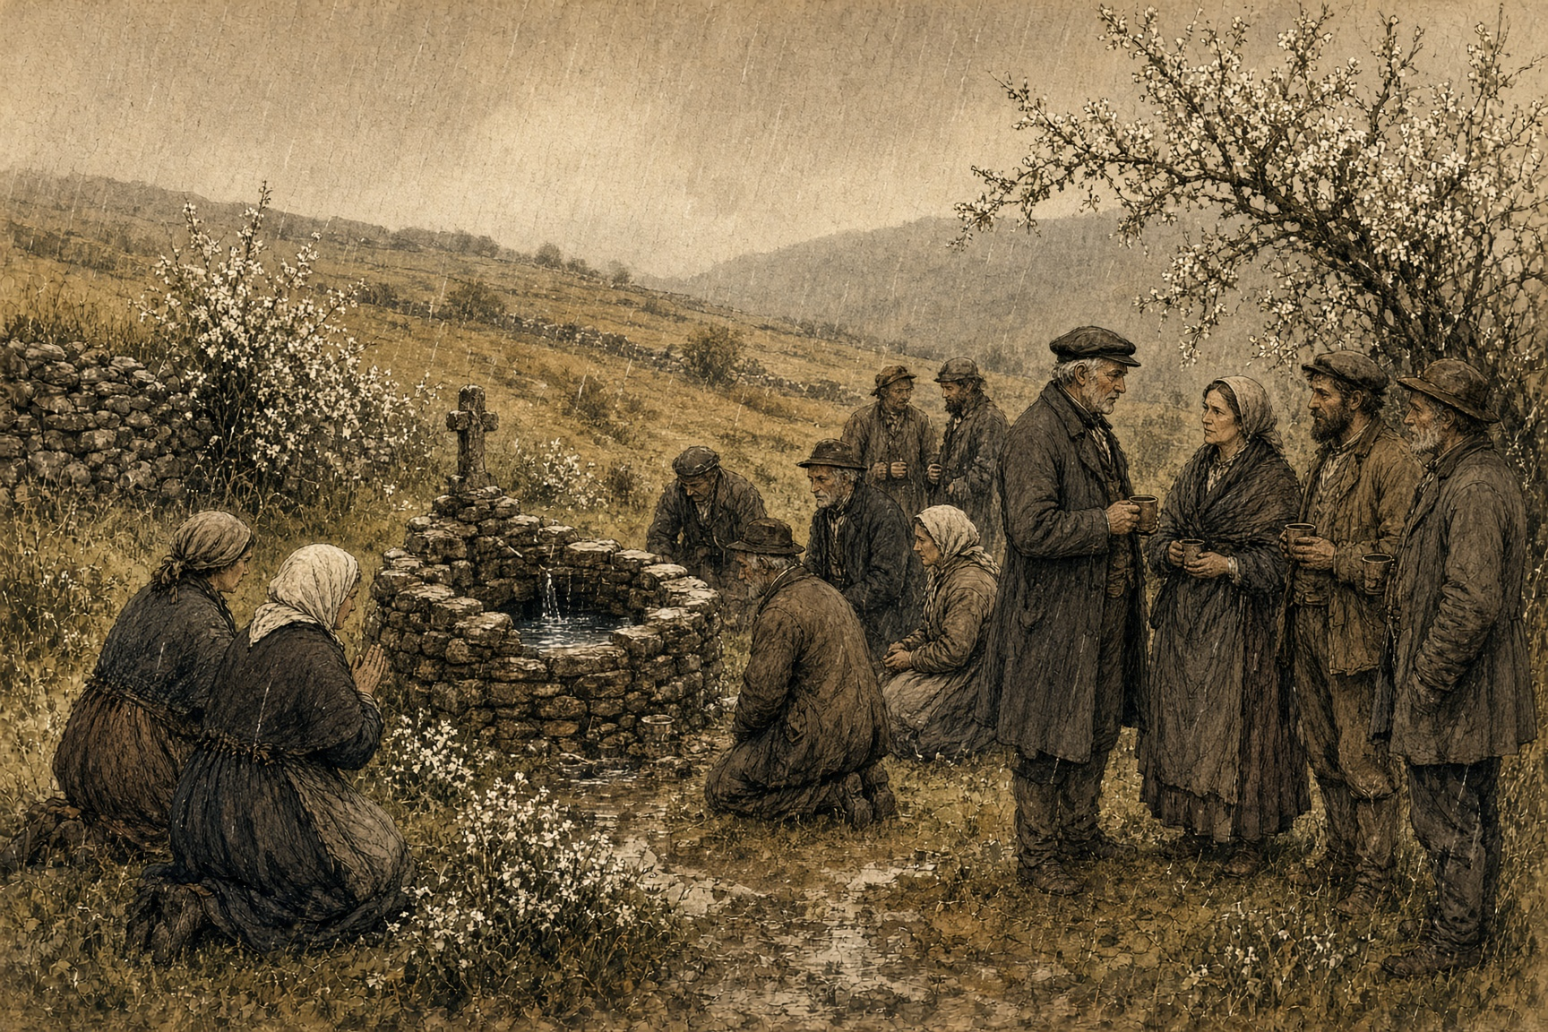
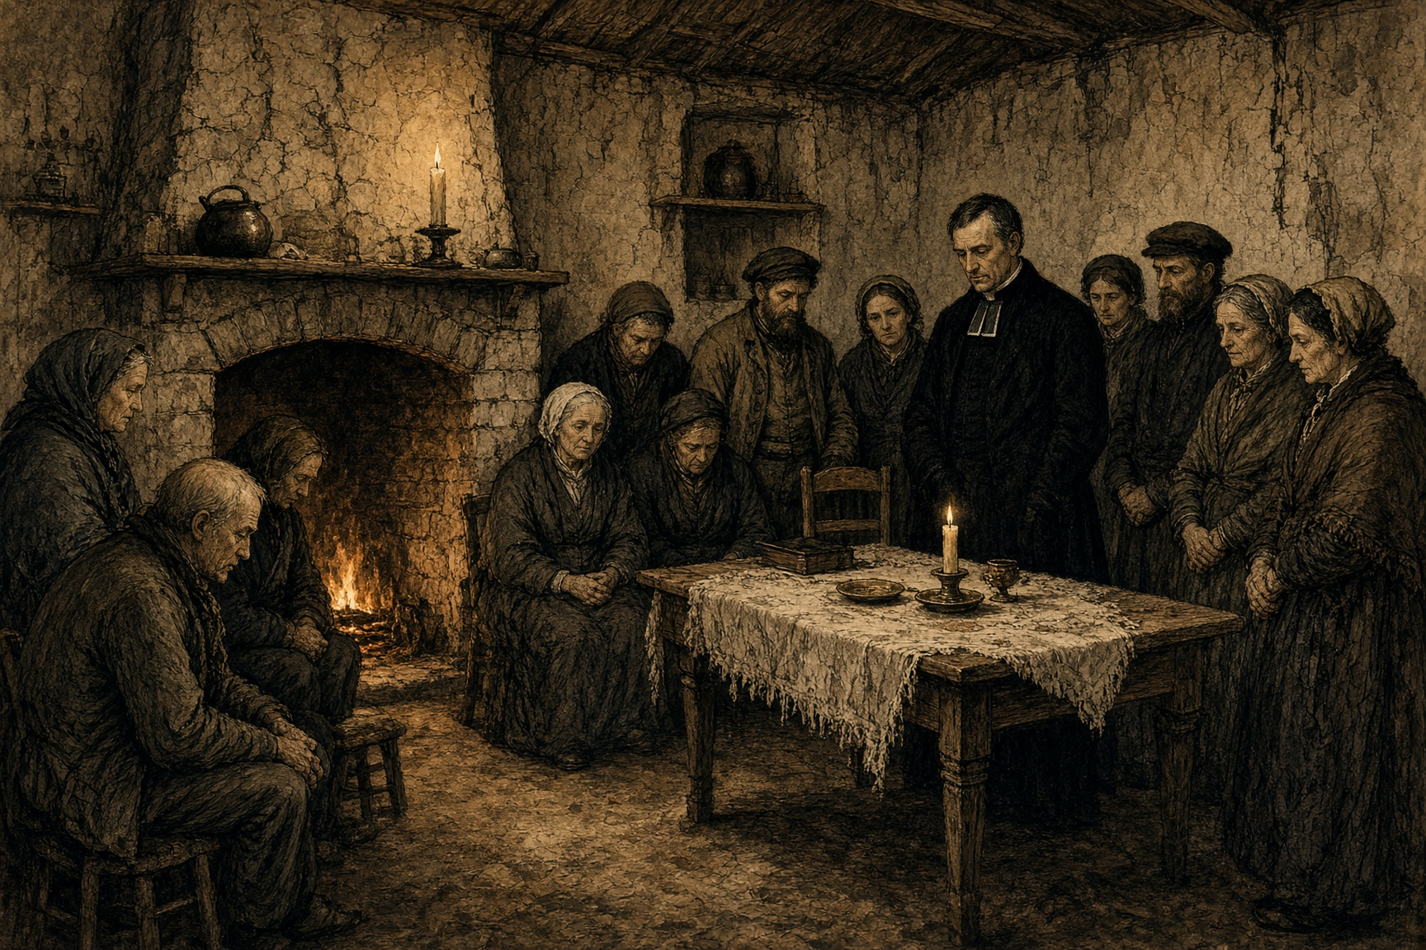
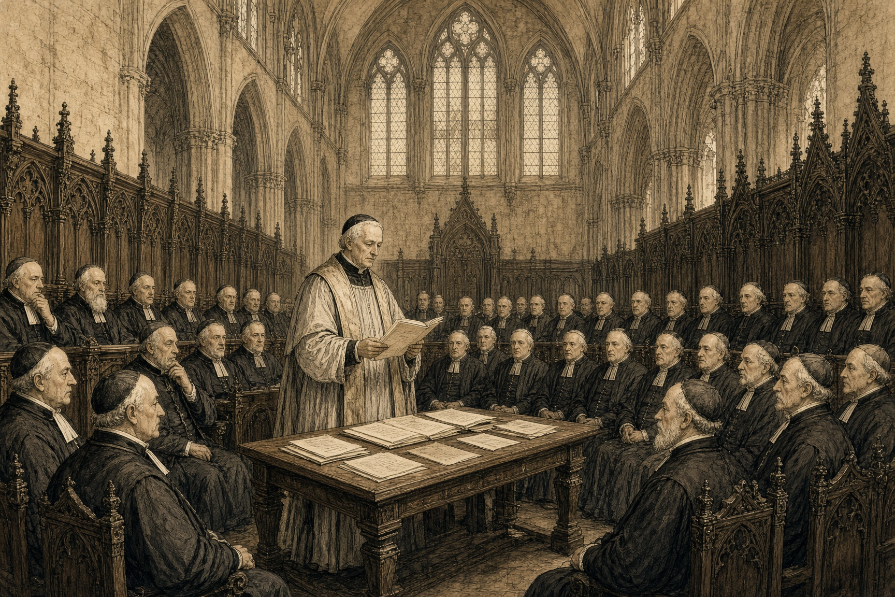
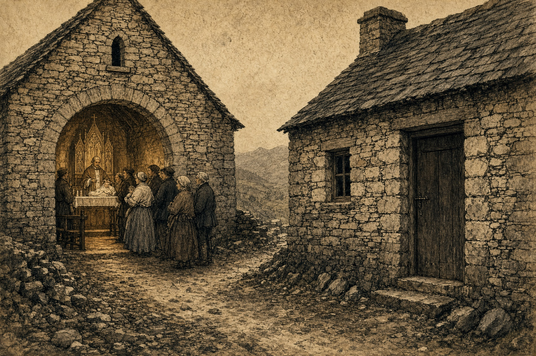
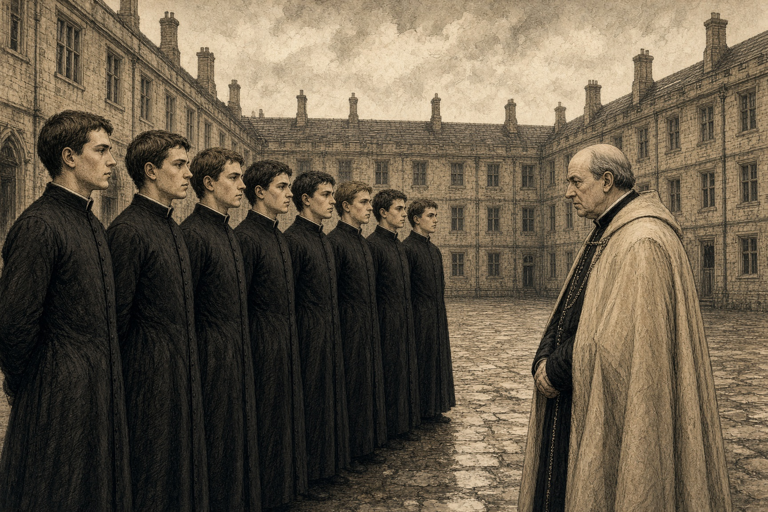
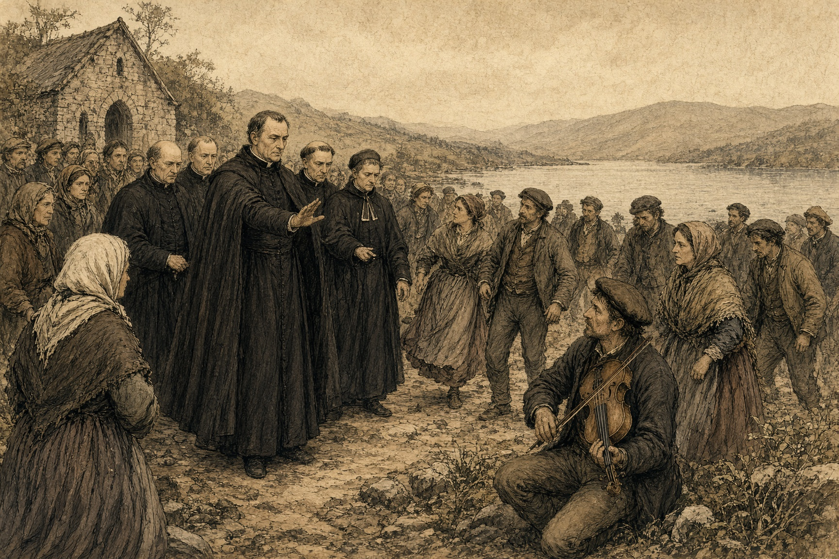
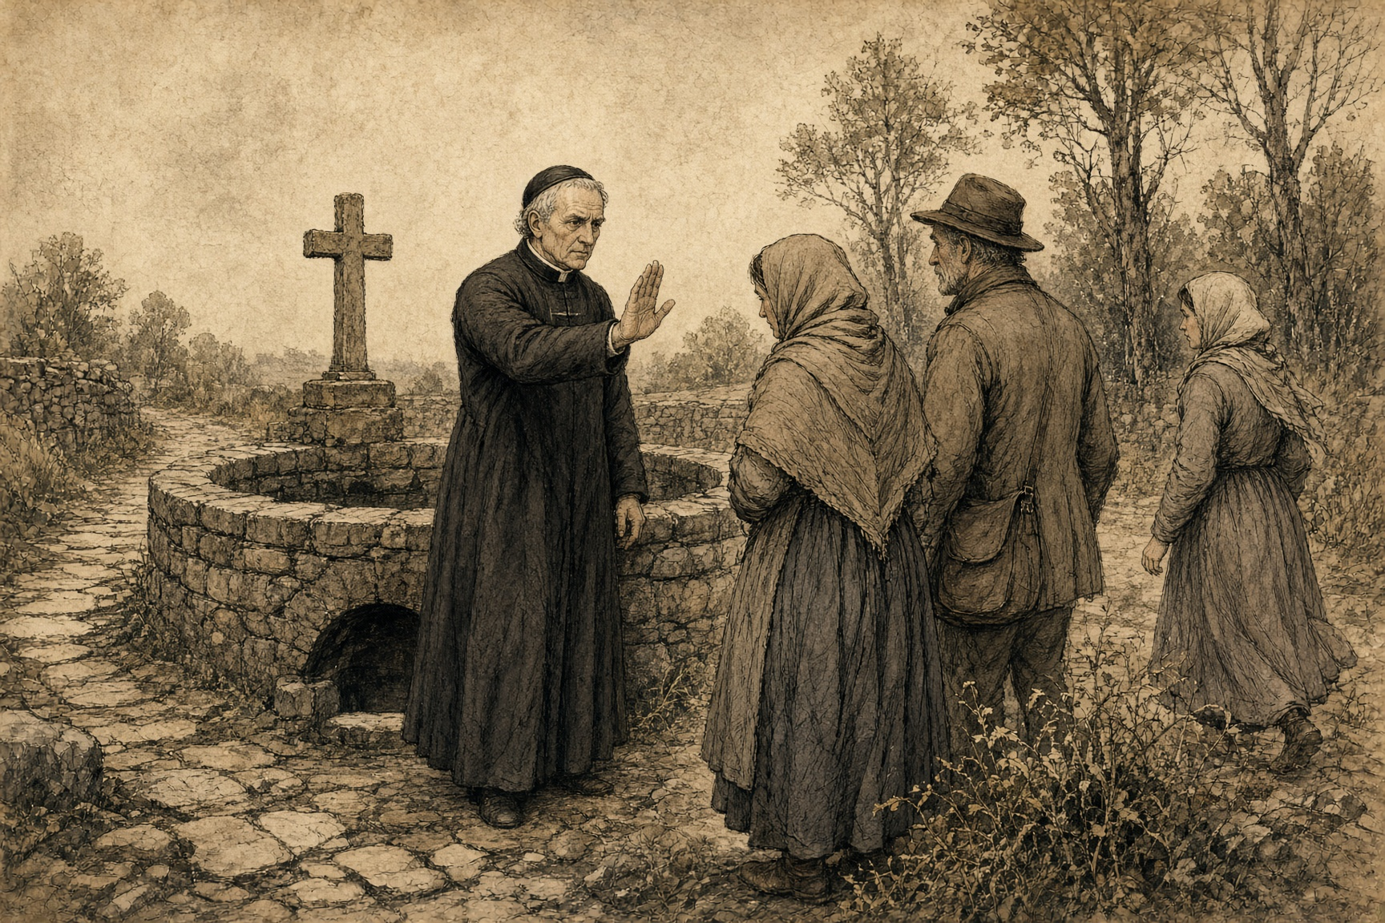
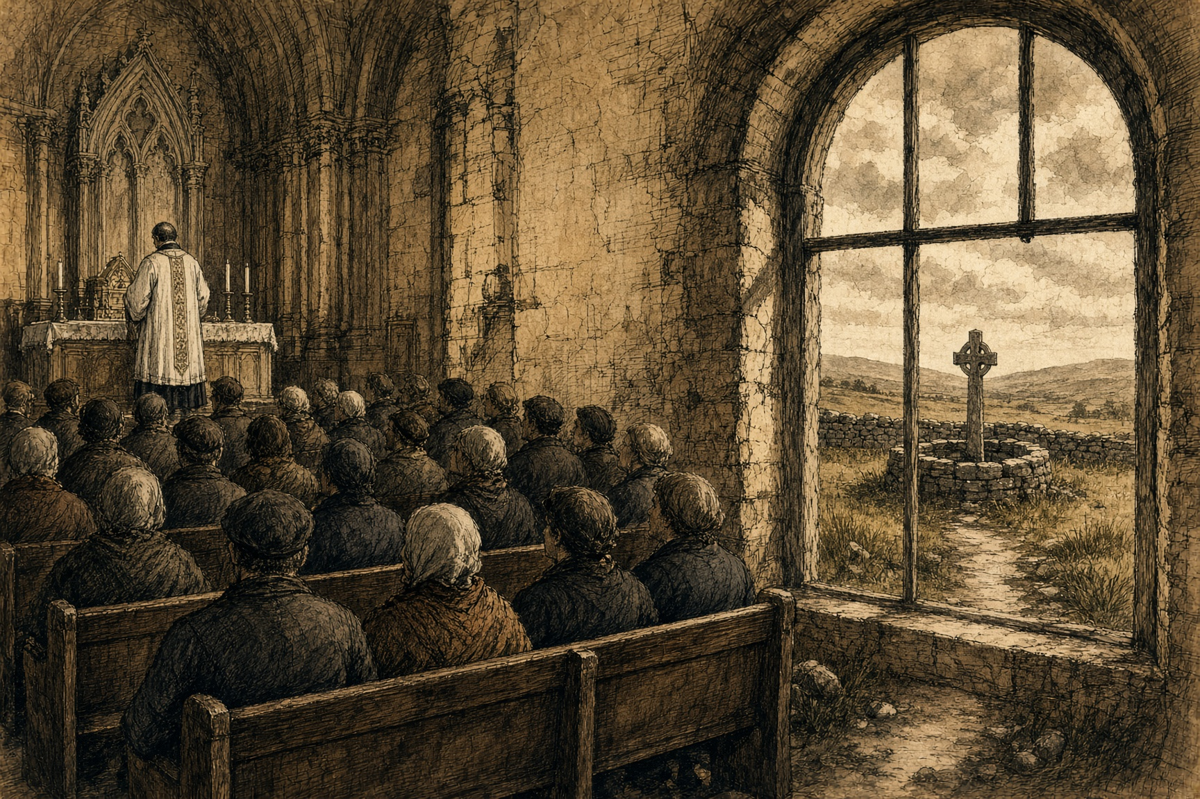
SMOKE ON THE MEDITERRANEAN · CHAPTER 3 · MJF
FROM THE WELL TO THE CHURCH
1850–1878 · Thurles, County Tipperary
In 1834, a government survey known as the Commissioners of Public Instruction attempted to measure religious practice across Ireland. What it found, later reconstructed in detail by the historian David Miller, was deeply uneven: something close to universal weekly Mass attendance in the relatively prosperous southeast of the country, and sharply lower compliance almost everywhere else, with national attendance among Catholics estimated at roughly a third. Around and beneath that formal practice ran a second religious life historians now call folk Catholicism — patterns held at holy wells on a saint's local feast day, blending prayer with drinking, dancing, and storytelling; wakes conducted at home with customs the institutional Church had never sanctioned and did not control; sacraments administered in private houses when a priest was reachable and a church was not. This was not an irreligious country. It was, in large part, an outdoor one — its devotion practiced at wells and crossroads and firesides that no bishop supervised, on a calendar of local saints' days rather than a universal one, in a landscape Rome would not have recognized as a church at all, because most of it had no walls.
Paul Cullen returned to Ireland from Rome in 1850 to take up the archbishopric of Armagh, arriving as apostolic delegate with direct papal authority to reorganize the Irish church, and immediately convened the Synod of Thurles — the first national synod held in Ireland since 1642. It opened on August 22, 1850, and issued 187 decrees that reached into nearly every corner of ordinary religious practice: sacraments were barred from private houses and required to take place in churches; priests were forbidden from attending dances, horse races, and other secular festivities; and the patterns held at holy wells, already regarded with suspicion by reform-minded clergy as occasions for drink and disorder as much as devotion, were actively discouraged in favor of pilgrimage to a small number of centrally sanctioned sites such as Lough Derg and Croagh Patrick, where the Church itself could supervise what happened. Knock was not available to them. The apparition there is 21 August 1879, ten months after Cullen was dead.
Cullen's reform belonged to the same current as the Encumbered Estates Court that was, in the same years, clearing customary tenures off Munster's insolvent estates in favor of clear commercial title. Both operated on the same premise: that an unregistered, locally variable practice — land held by unwritten arrangement, devotion held at a well nobody had deeded to the Church — was a liability to be centralized and put on a uniform ledger answerable to a single authority. The 187 decrees were, in that sense, a land code for the soul. They took a landscape of scattered, unsupervised holy ground and folded it into a small number of centrally sanctioned, priest-administered sites — the same operation the tapu clerks would run on Palestinian musha' land a few years later, and for the same underlying reason: an unregistered commons cannot be governed from the center, and a registered one can.
Cullen moved to the archbishopric of Dublin in 1852 and spent the following quarter-century making the Thurles reforms permanent rather than personal. He used his standing in Rome to shape the appointment of like-minded bishops across the country, so that his program would not depend on his own presence in any one diocese to hold. By the end of the 1850s he had imposed strict loyalty oaths on the staff of Maynooth, the national seminary, and in 1859 founded a second seminary at Clonliffe specifically for his own diocese, built to produce priests formed from the outset in his own ultramontane understanding of clerical discipline rather than converted to it later. In 1866 he became Ireland's first cardinal. By any measure available to a historian working from parish records and mass-attendance data, it worked: within a generation of Thurles, the near-universal weekly Mass attendance that would define Irish Catholic identity for the next century had replaced the patchy, regionally uneven practice the 1834 census had recorded.
The suppression did leave a few named scenes. At Gougane Barra in County Cork, local clergy moved for years against the pattern held on the saint's feast day, denouncing the dancing and faction-fighting from the altar and, by the 1830s and 40s, moving to break up the gathering itself rather than merely preaching against it. At Saint John's Well near Kilkenny a parish priest is recorded threatening to withhold the sacraments from parishioners who kept attending the well pattern after he had proscribed it. These are the exceptions. For most parishes no comparably detailed record survives, at least none this account has been able to locate, of what a specific pattern day looked like before it stopped, or of a named family that quietly let a custom go because a priest newly answerable to Thurles told them to. The loss, unlike the loss in a house on the Coombe or a farm in Clare, left no eviction notice and no sworn testimony for most of the country — only the aggregate shape of it, visible in the attendance numbers before and after, and in a scatter of local histories that note, usually in passing, that a given well's pattern "declined" or "ceased" sometime in the second half of the nineteenth century without naming the year or the reason in any way a historian could cite with confidence.
---

