Slide 1




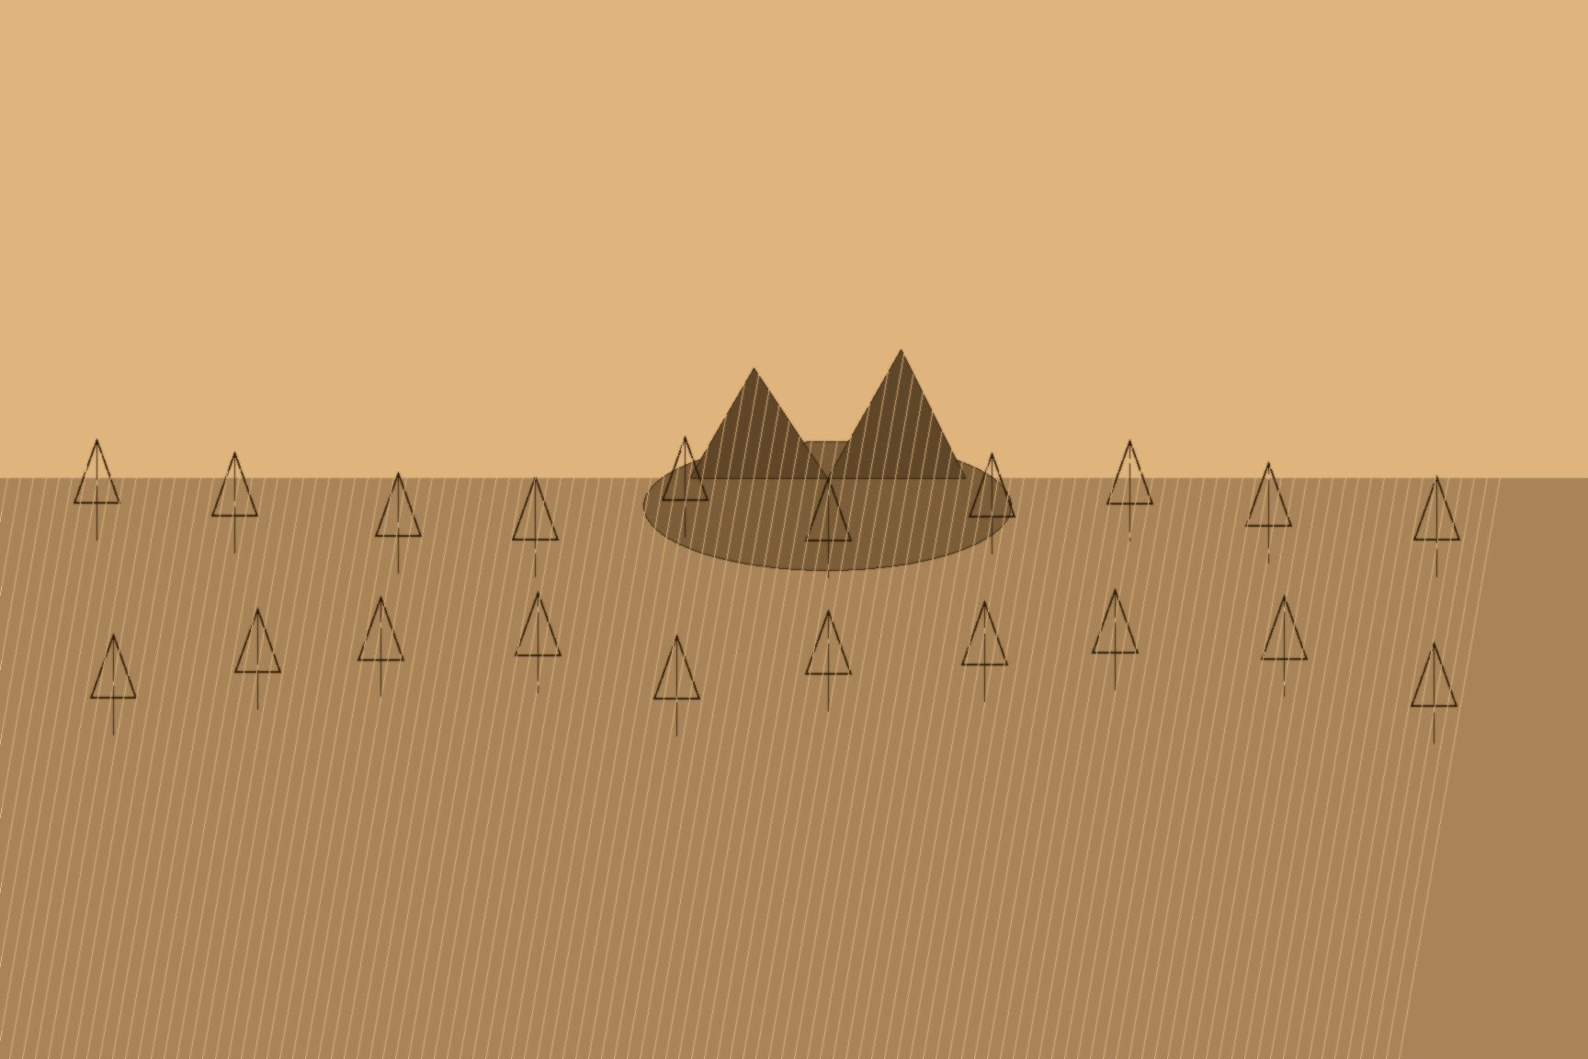



MJF
DE VERE'S LETTER, 1847
County Limerick
Stephen de Vere could afford a cabin. He was the son of a baronet, a Trinity-educated barrister, a landlord at Curragh Chase in County Limerick whose own income from the estate had collapsed along with everyone else's under the famine — but he had the means, in the spring of 1847, to cross the Atlantic in reasonable comfort. Instead, when he decided to accompany a number of his own former tenants to Canada, he booked steerage passage and ran what amounted to a controlled experiment on himself: if a credentialed witness, a landlord and a barrister whose word Parliament could not simply dismiss as an emigrant's exaggeration or a journalist's invention, personally endured the six-week crossing and wrote down exactly what happened, he believed the government would have no choice left but to act on it.
What he found matched the reports and then went past them. In the letter he later wrote from Toronto, addressed to the Colonial Office official Thomas Frederick Elliot, he described "hundreds of poor people, men, women, and children, of all ages, from the robust youth to the decrepit old man, huddled together without light, without air, wallowing in filth, and breathing a mephitic atmosphere, sick in body, dispirited in heart." He recorded fever spreading unchecked through the packed steerage decks, the sick and the merely exhausted forced to share the same berths and the same barrels of drinking water, and passengers being transferred between vessels in open barges where people too weak to stand were, by his account, at times trampled in the crush. This was not secondhand outrage. De Vere had eaten the same food, breathed the same air, and slept in the same berths for six weeks to be able to write it.
The ships like the one de Vere sailed on were only the first stage. Their destination, for most of the roughly one hundred thousand Irish who crossed to Canada in 1847 alone, was Grosse Île, a quarantine station in the Gulf of Saint Lawrence that had been built in 1832 for a cholera outbreak and was never built for what arrived on its shores fifteen years later. On May 31, 1847, forty ships lay at anchor off the island at once, carrying some 12,500 passengers between them, waiting for inspectors and medical staff who did not exist in anything like sufficient numbers. Parks Canada's own historical accounting of that single year records 398 ships inspected at the station, over five thousand people who died at sea before ever reaching it, and 5,424 burials on the island itself — the overwhelming majority Irish, the overwhelming majority claimed by typhus rather than by anything that happened during the ocean crossing proper. Reaching Grosse Île alive was not the same thing as surviving it.
De Vere's own party illustrates the same point from the other direction. The tenants he had personally escorted did make it through Grosse Île and on to Ontario, where he arranged for them to be housed together in a large, reportedly healthy building near London, Ontario. It made no difference. Over a period of about eight months, nearly all of them fell ill in succession — the dormant fever, in the words of his biographer, "becoming rapidly developed by the stimulus of better air and food, and by infection" once they had stopped moving. De Vere stayed and nursed them himself, providing what his own account described as the ministrations of a hospital nurse, for people he had crossed an ocean in steerage specifically to protect.
His letter reached London that November, and it worked exactly as intended in the narrow, mechanical sense his experiment had been designed to test: Earl Grey, the Colonial Secretary, read it aloud in the House of Lords, and the reading led directly to the formation of a parliamentary committee to inquire into the Passenger Acts governing conditions on emigrant vessels. The hypothesis had been correct. A credentialed eyewitness, suffering the crossing himself and reporting it in his own voice, really could move the machinery of government at least that far. What de Vere's experiment could not control for was what happened after the machinery moved. The committee, according to the Dictionary of Irish Biography's own account of his life, proved slow to report, and was, by 1851, conscientiously indisposed to recommend any significant amendment to the law it had been formed to examine. The proof he had staked his own body on producing was received, read aloud in the highest chamber in the land, formally investigated for four years, and then set down, unamended, exactly where it had started.

