Slide 1
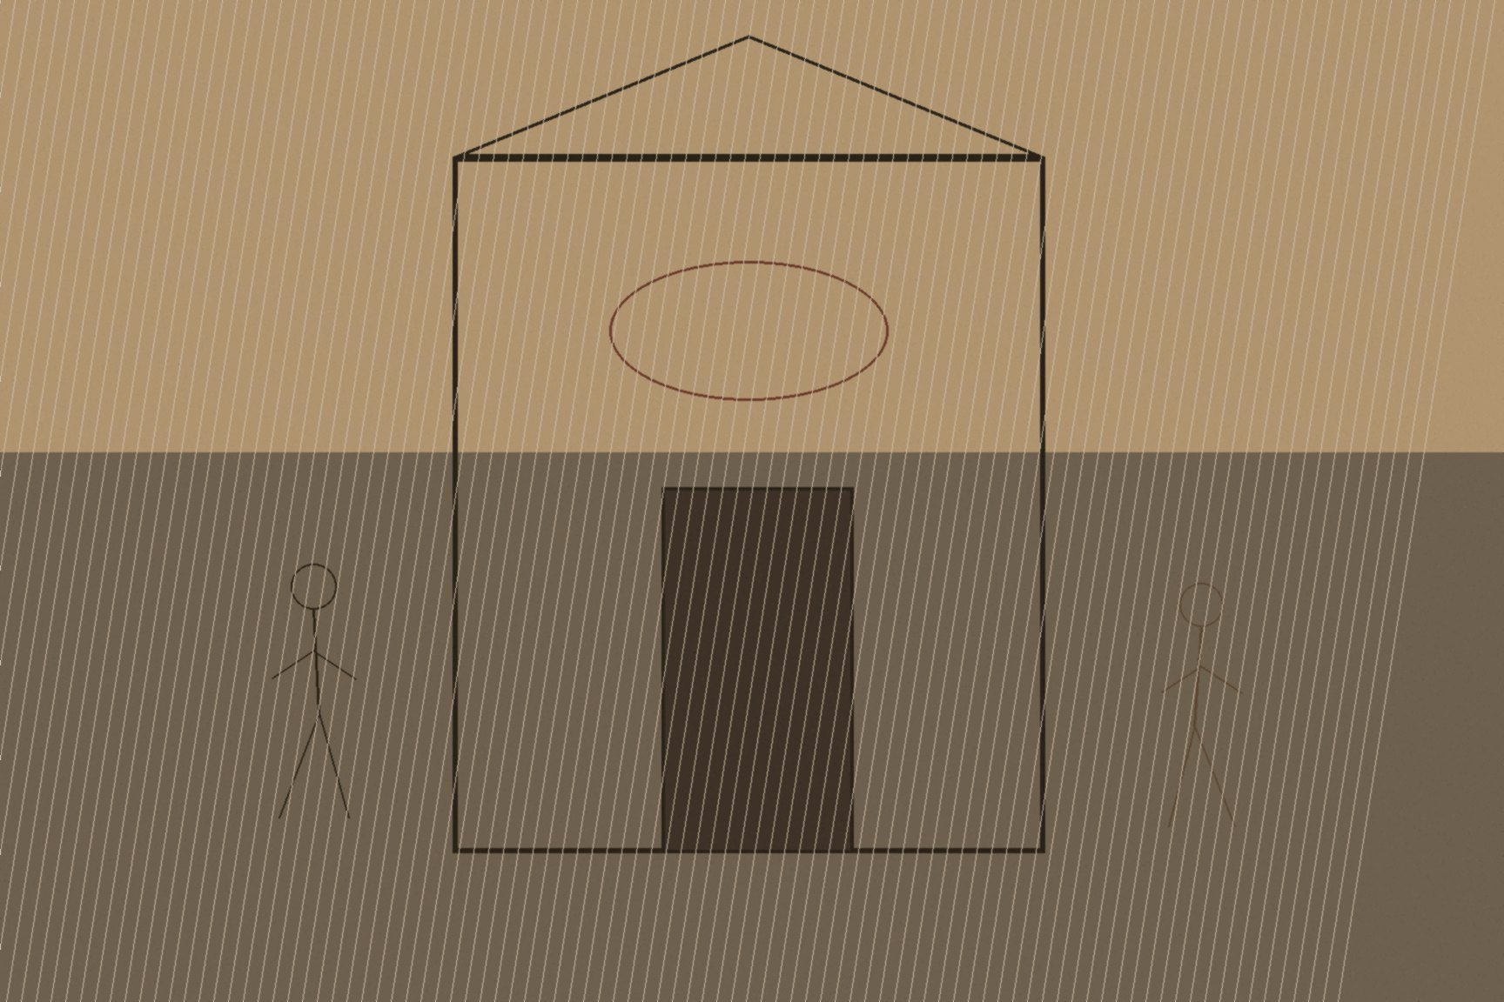

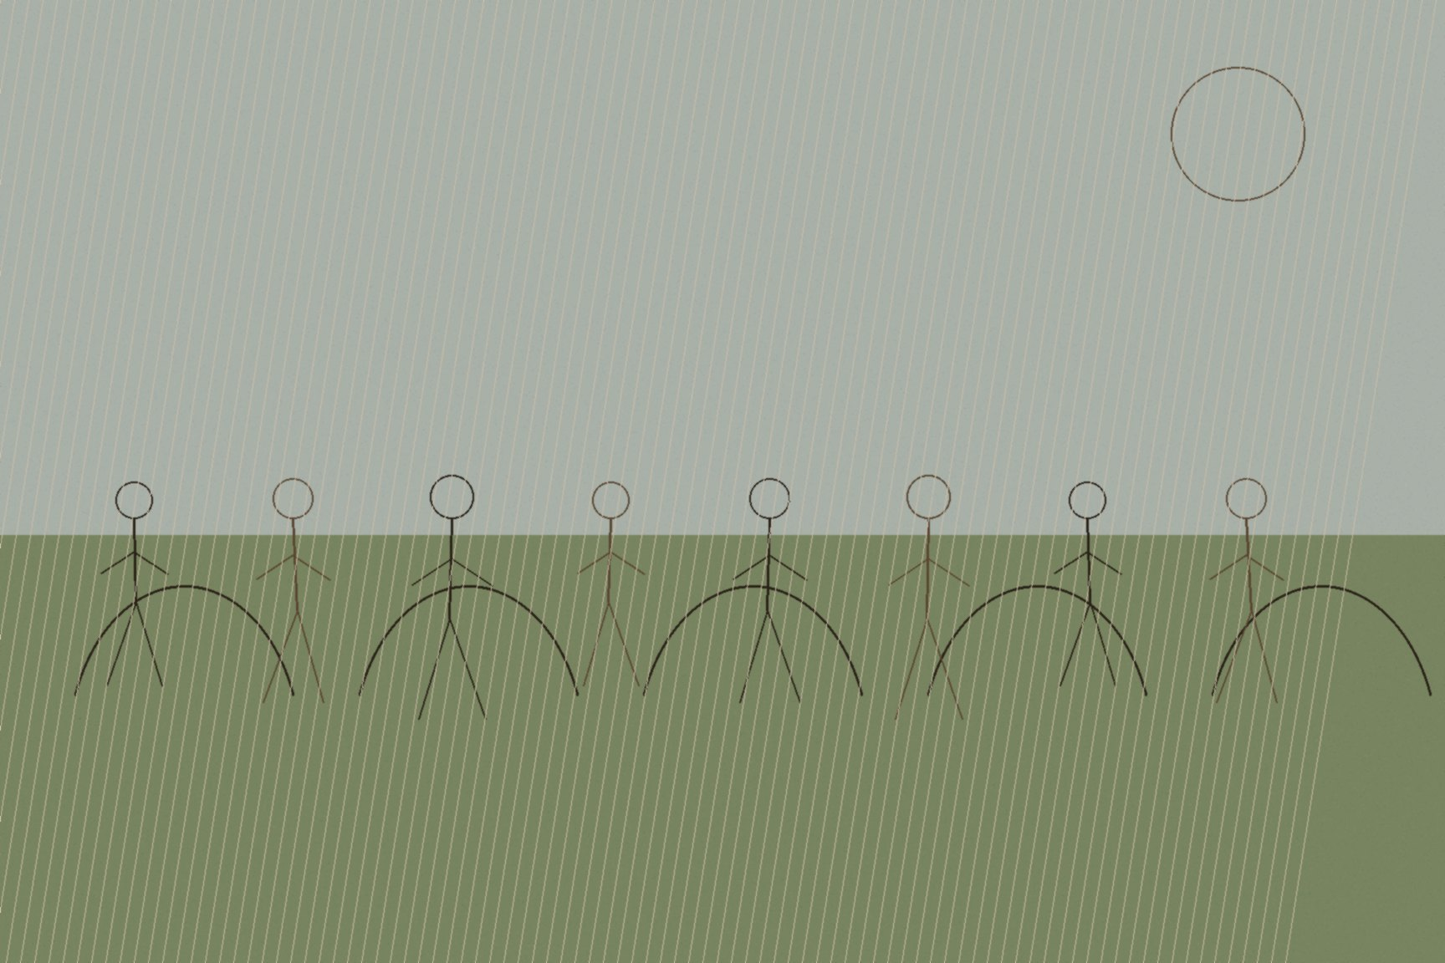
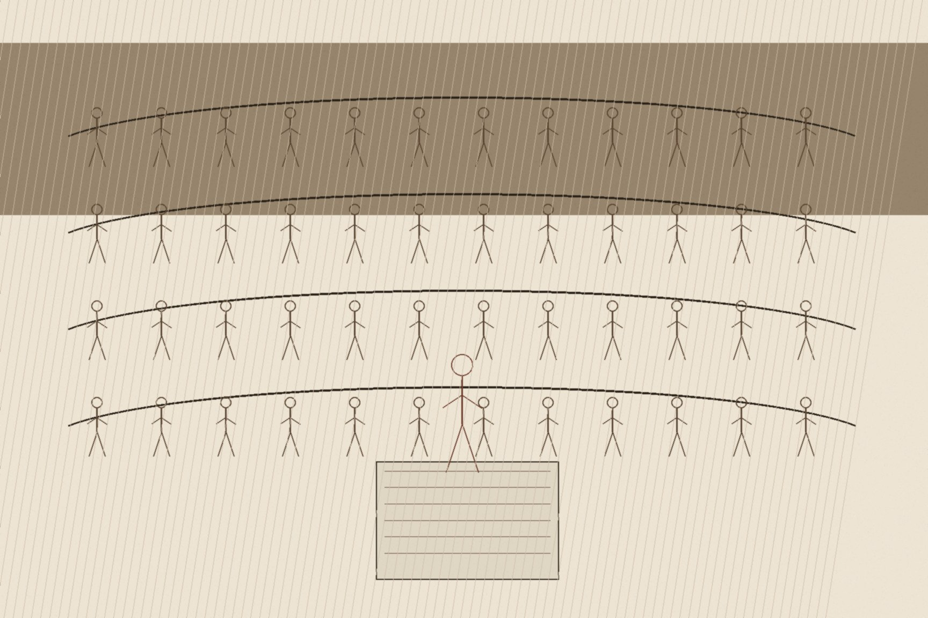
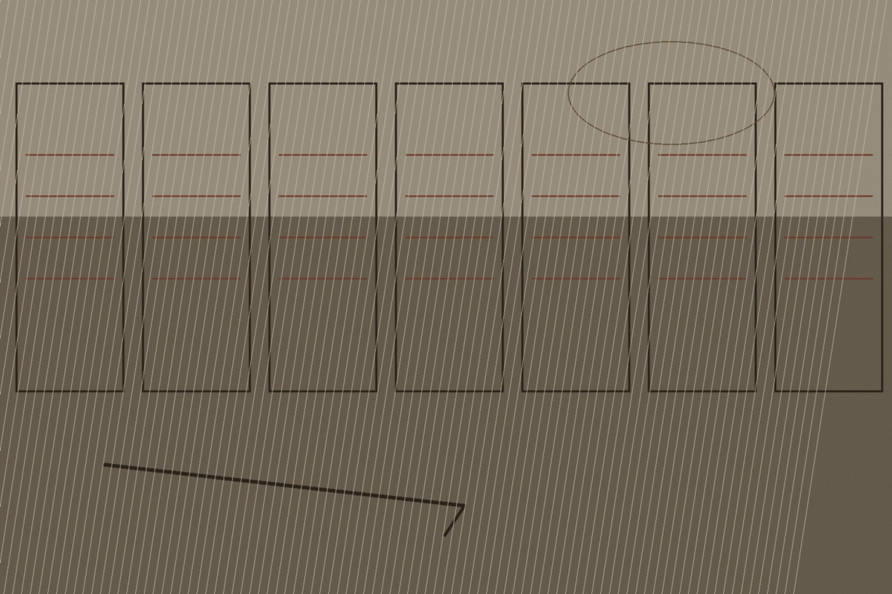
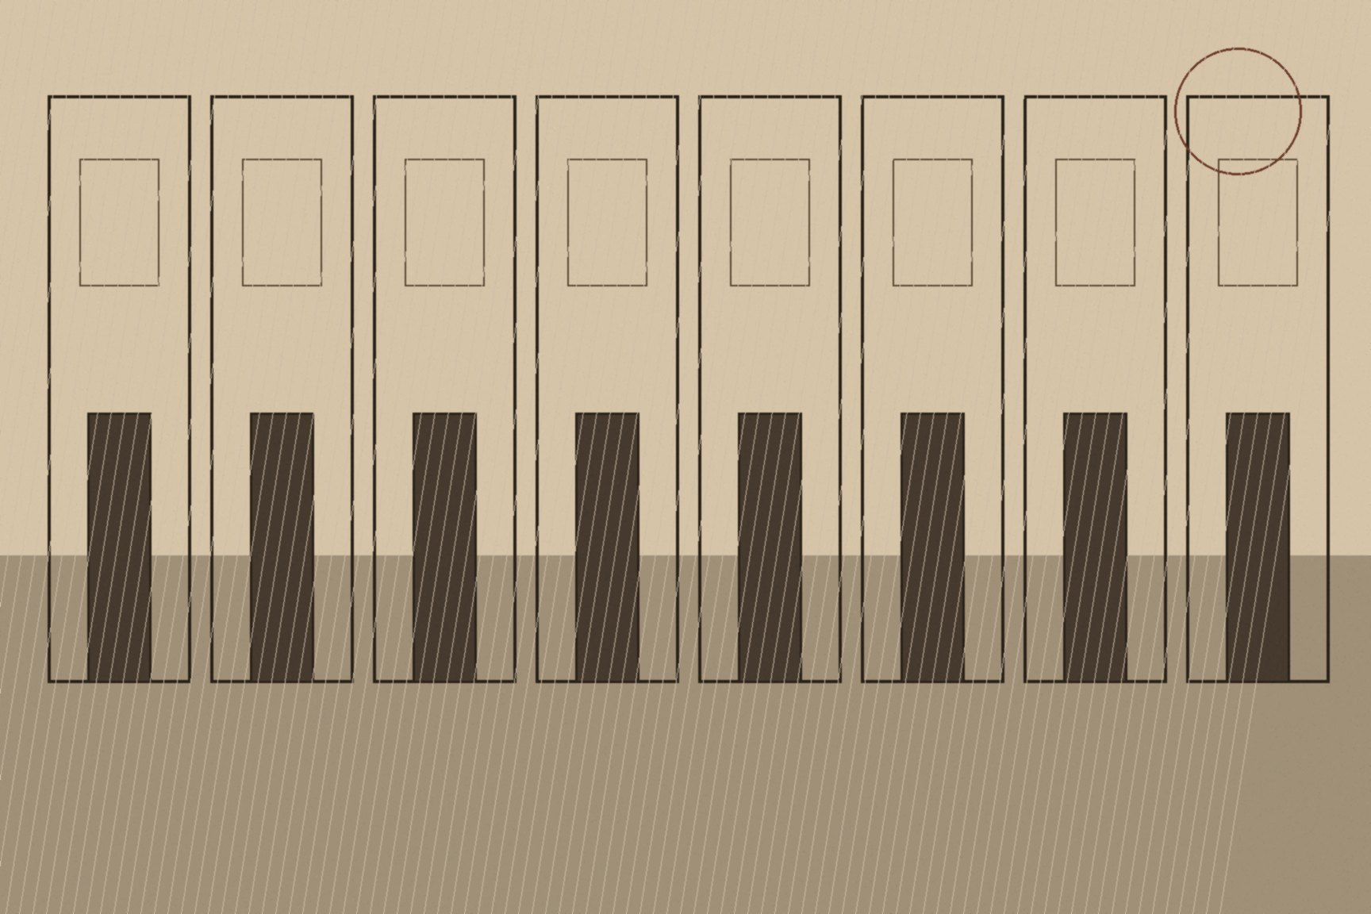
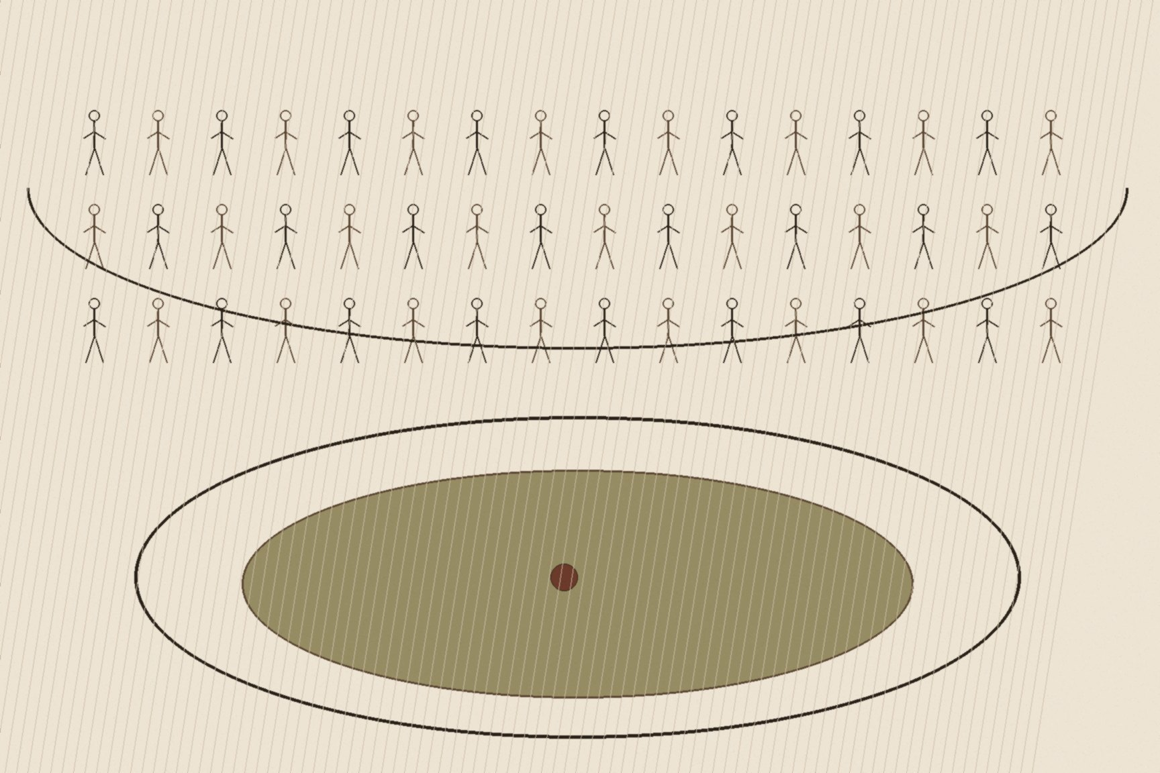
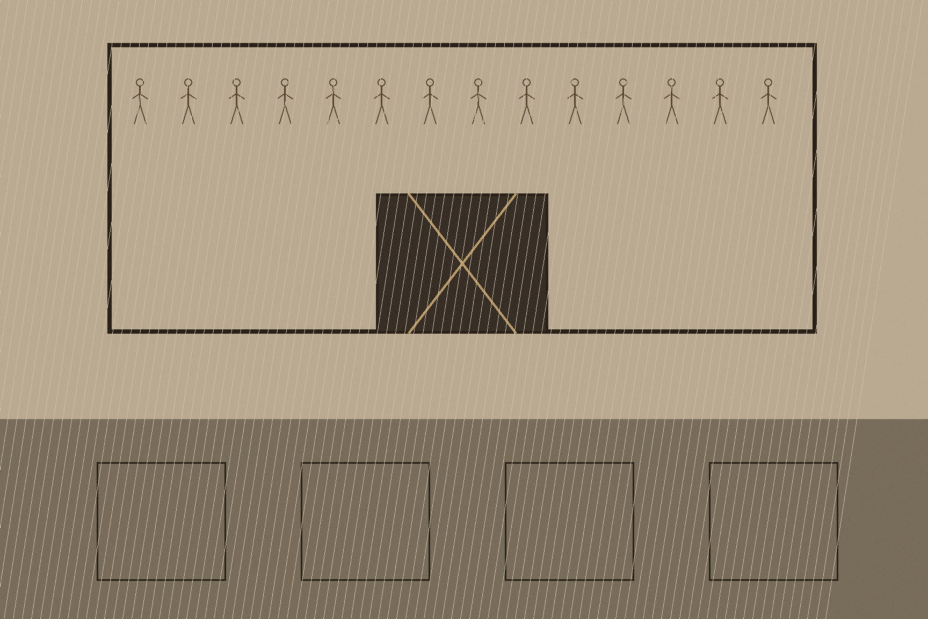
MJF
CROKE PARK, 21 NOVEMBER 1920
County Dublin
On the evening of September 20, 1920, RIC Head Constable Peter Burke and his brother, Sergeant Michael Burke, stopped into Smyth's public house in Balbriggan, a small town on the North Dublin coast, on their way back to the Black and Tan depot at Gormanston Camp. An argument broke out, local police were called, and in the confusion an IRA unit that happened to be nearby opened fire — an unplanned, spur-of-the-moment shooting, by most accounts, rather than a sanctioned operation. Peter Burke died of his wounds. Within the hour, 100 to 150 Black and Tans arrived from Gormanston in a convoy of lorries and spent the night burning the town.
They set fire to Deeds, Templar & Co's hosiery factory and burned or wrecked somewhere between twenty-five and fifty-four houses, concentrated on Clonard Street, along with four public houses. Families fled into the surrounding fields in their nightclothes and stayed there through the cold; a later Labour Party commission of inquiry recorded that two women died of exposure, two more suffered miscarriages, and four babies already sick with measles died as a result of being driven out of their homes. Two local men, Séamus Lawless and Seán Gibbons, were pulled from their houses, beaten with rifle butts, bayoneted, and shot dead in the street, their bodies left where they fell. Lawless was forty-seven, a barber, married with eight children ranging from eighteen months to nineteen years old. Gibbons was twenty-six and helped his mother run the family's small dairy business. Neither had any confirmed connection to the shooting that triggered the reprisal. When the British Chief Secretary for Ireland, Hamar Greenwood, was asked about Balbriggan in the House of Commons a month later, he told the chamber he had yet to find "one authenticated case of a member of this Auxiliary Division being accused of anything but the highest conduct characteristic of them."
Balbriggan was not an isolated escalation. Reprisal burnings of this kind became a recurring feature of the autumn of 1920, and the pattern reached Cork on the night of December 11, culminating in a fire that gutted much of the city center along Patrick Street, destroyed City Hall and the Carnegie Library, and left, by later estimates, some forty businesses in ashes. Firemen who arrived to fight the blaze had their hoses cut. Auxiliary cadets were seen looting shops even as the flames spread, and some were later photographed wearing pieces of burnt cork pinned to their caps, a black joke about the city they had just set on fire.
Eleven days later, on the morning of November 21, Michael Collins's Squad carried out coordinated assassinations across Dublin, killing a group of British intelligence officers in their beds. That afternoon, a Gaelic football challenge match between Dublin and Tipperary went ahead at Croke Park as scheduled, drawing a crowd of roughly ten thousand despite the morning's violence. About ten minutes into the game, an aircraft circled the ground twice and fired a signal flare, and a mixed force of RIC, Auxiliaries, and soldiers stormed the entrances and opened fire into the crowd. Fourteen people were killed, including Michael Hogan, the Tipperary team's captain and an IRA volunteer, shot in the back as he tried to get clear. Among the other thirteen were three children — ten-year-old Jerome O'Leary, shot through the head as he sat watching from a wall behind the goal, and eleven-year-old William Robinson, shot from the tree he had climbed to see over the crowd. Jane Boyle, twenty-six, had come to the match with her fiancé, Daniel Byron; the two of them were due to be married that Friday. She was shot dead outside the ground and, six days before her wedding day, was buried in the dress she had meant to wear to it.

