Slide 1

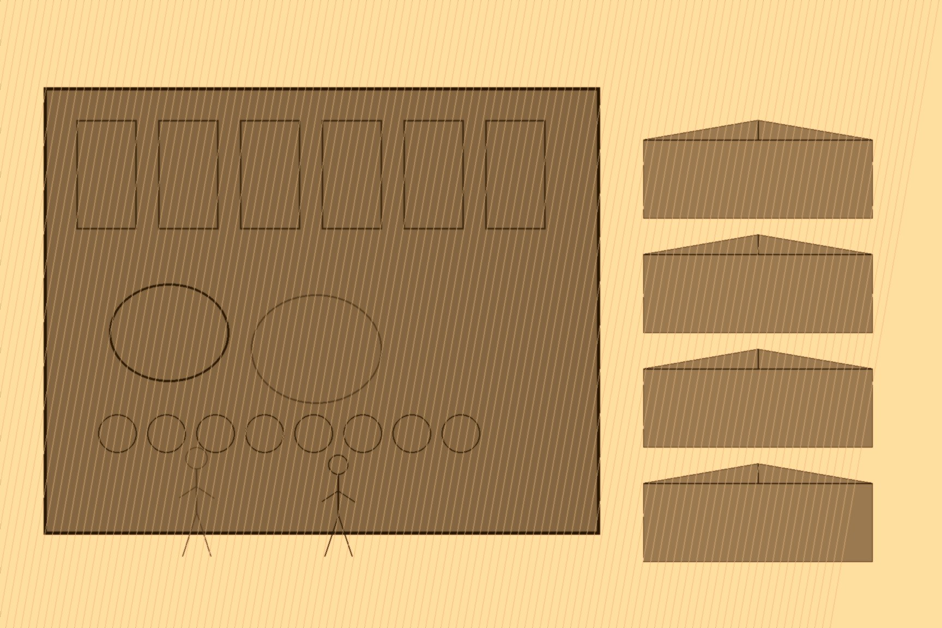
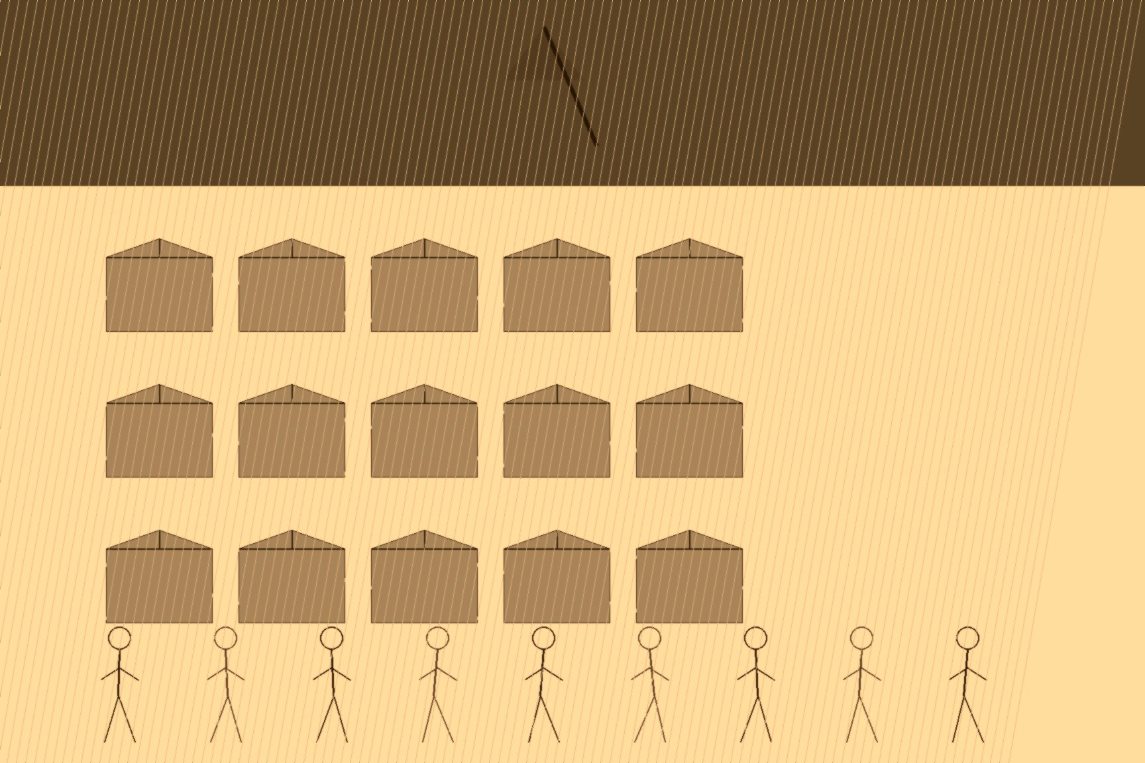


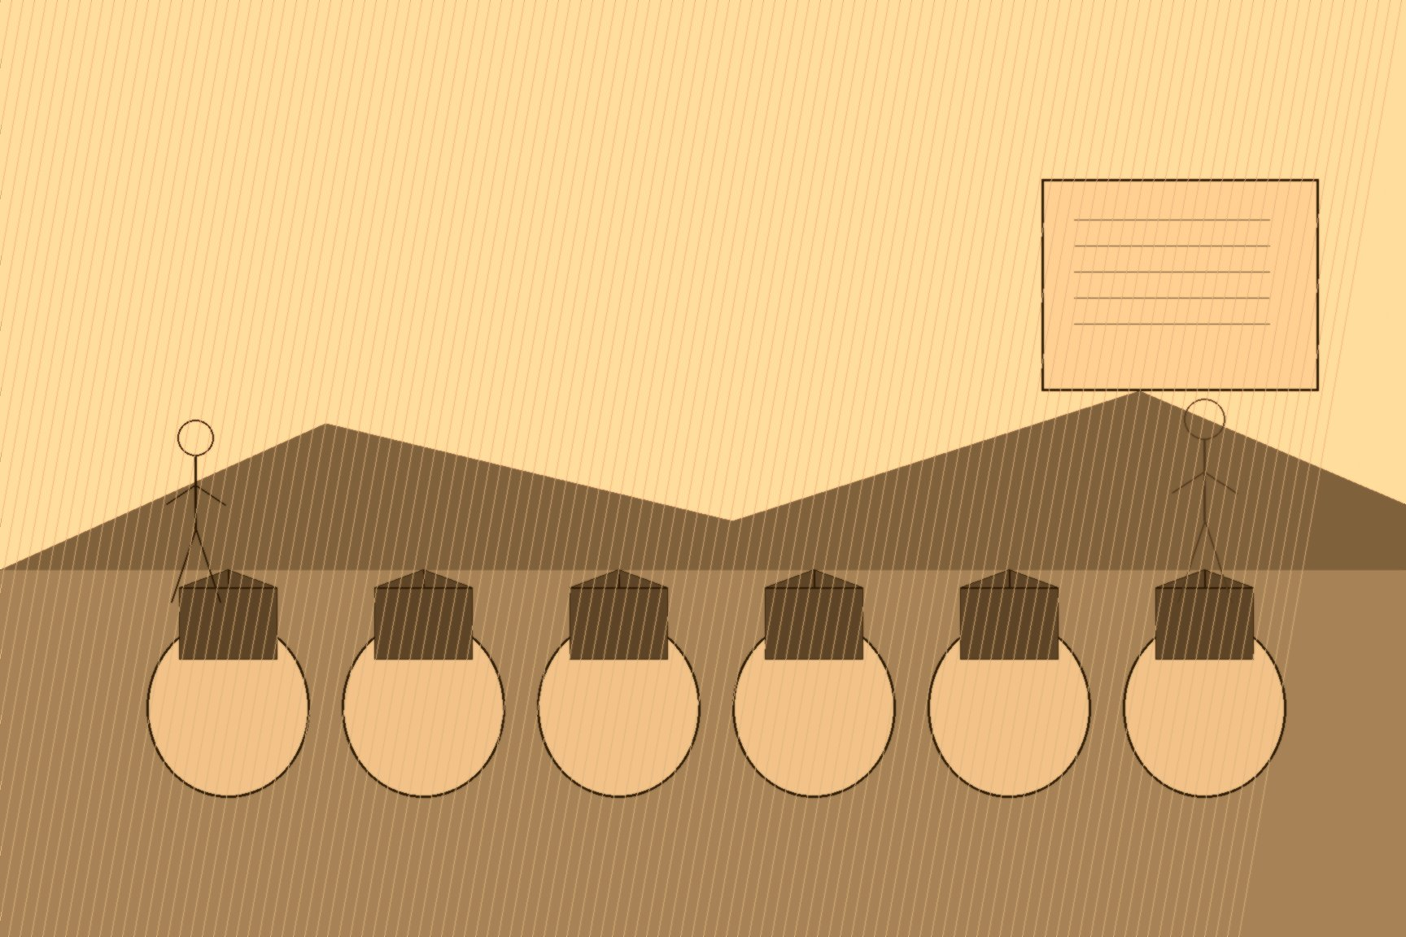
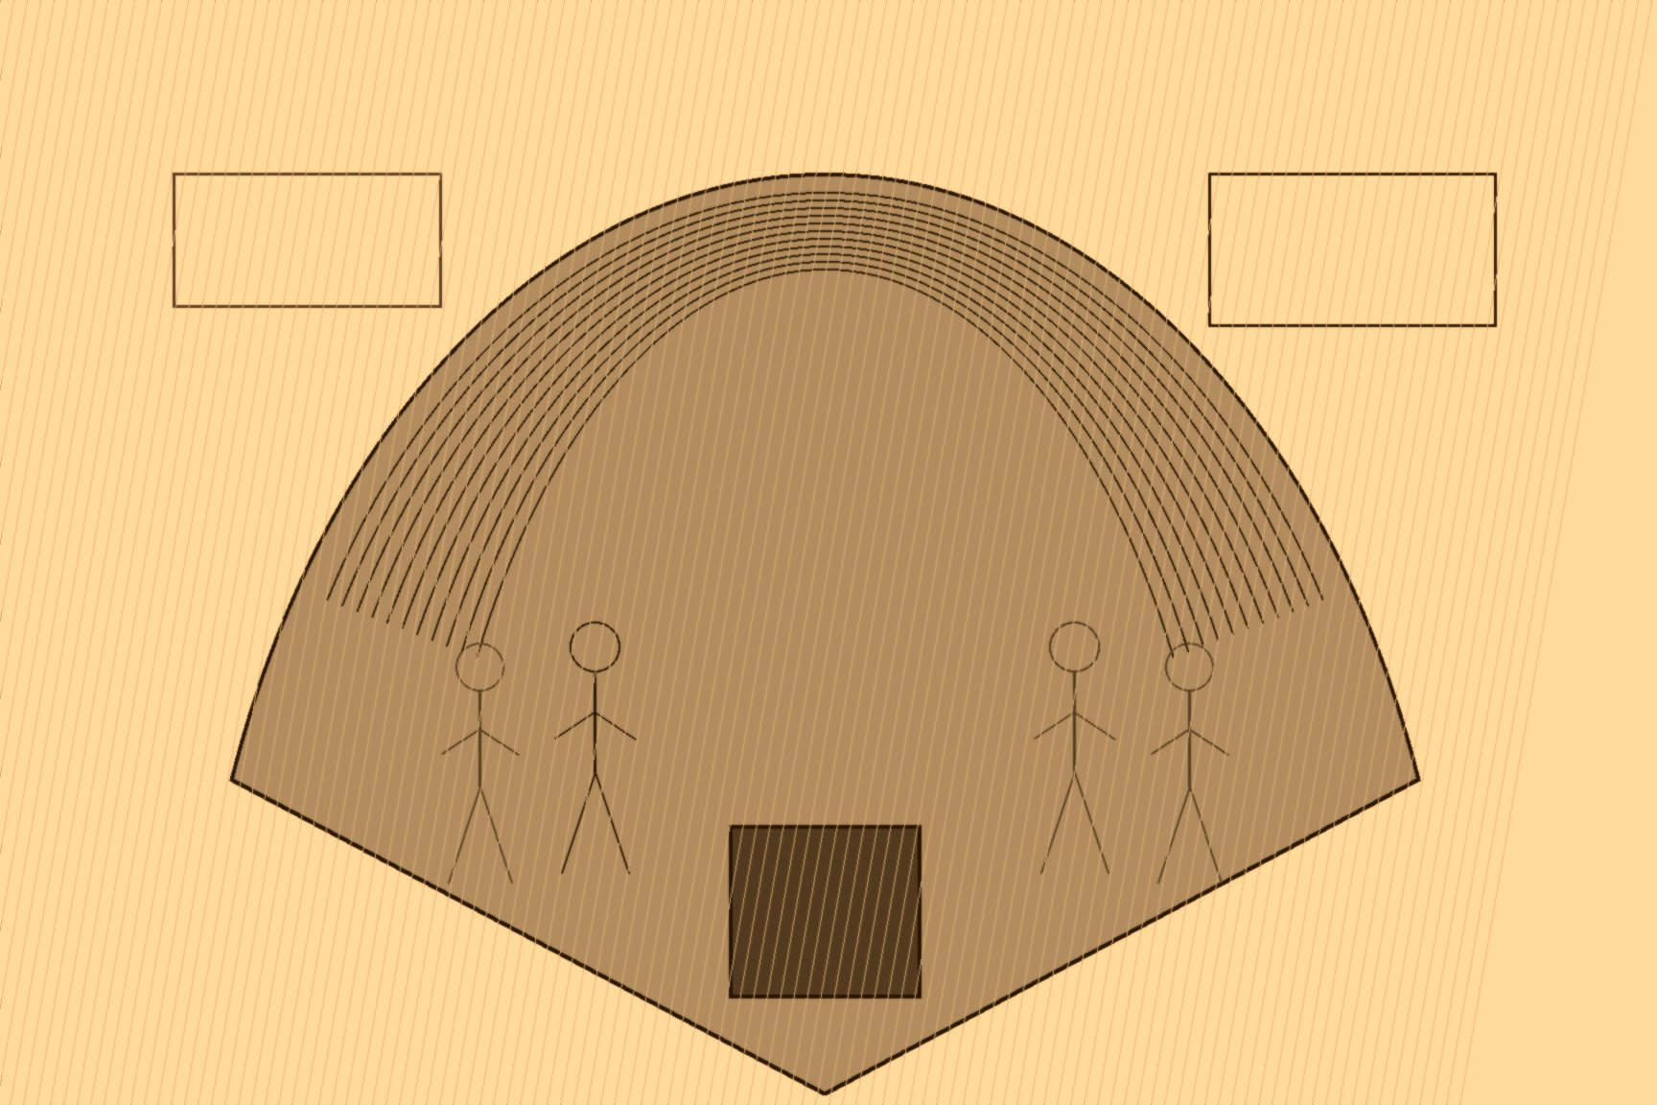

MJF
THE OPIUM AUCTION
Patna and Canton
A peasant in Bihar did not plant poppy because the harvest would make him rich. He planted it because the money had already arrived. The dadni came before the seed. Cash in the hand, seed in the ground, tax paid on a crop that was not yet a plant. After that the field was not his in any sense that mattered. The same shape turns up later on a different ledger: a peasant in عين الزيتون ʿAyn al-Zaytūn bound to a merchant's book in Beirut before the olives are on the tree. Advance against a harvest that has not happened. Different empire. Same hinge.
London had a tea problem. Canton — 广州 Guǎngzhōu — sold leaf, silk, porcelain. Canton took silver. The silver left Britain faster than the Treasury could put it back. In 1773 Warren Hastings made opium a Company monopoly in Bengal. By 1797 two salaried Opium Agents sat at Patna and Ghazipur and watched the fields themselves. Agents and tax farmers issued the advances. Seed, tools, land tax. At harvest the raw juice went to the government factories at a price the Company set. Fail the crop, try grain again, and the advance became a debt that ate the next season. The household stayed.
The factories were brick and large. Workers kneaded gum, rolled it into balls, rack-dried it, packed it into mango-wood chests of about a hundred and forty pounds. What it cost to make a chest had nothing to do with what the chest would fetch once it left the river. That gap was the point.
The Company could not ship the chests into China. The Qing ban was on the books, and the legal tea trade with the court was the charter the Company could not risk. So the chests went to Calcutta and went under the hammer. Private merchants bought them. Country traders. Jardine, Matheson & Co. and the rest. The Company took clean money in Bengal. The agency houses took the chests and the law. Four thousand chests a year around 1800. Near fifteen thousand in the 1820s. Past forty thousand by 1839.
Canton received them at the 公行 Gōngháng, the Cohong. 十三行 Shísān Háng — Thirteen Factories. Licensed 行商 hángshāng. Under the 保商 bǎoshāng rule a Hong merchant stood personal surety for a foreign ship: duties, conduct, whatever the crew did that the yamen decided to notice. Squeeze from above — 报效 bàoxiào, the donations that were not donations, birthday levies, military levies, sums that did not wait for a good year. Squeeze from below — 商欠 shāngqiàn, the foreign debts he had guaranteed because the system required a Chinese name on the paper.
蔡世文 Cài Shìwén, 伍浩官 style Munqua, of the 万和行 Wànhé Háng, ate other men's bankruptcies until there was nothing left to eat. In 1796, facing prosecution and abandoned by the English houses he had covered, he killed himself. 卢观恒 Lú Guānhéng, Mowqua, of the 广利行 Guǎnglì Háng, underwrote cotton and tea until the family's money froze into land and then dissolved after the war. 伍秉鉴 Wǔ Bǐngjiàn, Howqua, of the 怡和行 Yíhé Háng, was called the richest man alive. American railroads. European paper. It did not matter. In 1817 an American ship under his guarantee was caught with opium. The fine was 160,000 taels. Fifty times the seized cargo. Between 1773 and 1835 the Canton merchants handed more than five million taels to the treasury in forced levies.
怡和行 Yíhé Háng is Howqua's house. 怡和洋行 Yíhé Yángháng is Jardine, Matheson. Same two characters in English mouths. Different books.
林则徐 Lín Zéxú, December 1839, memorial to 道光 Dàoguāng, after the 琪华馆 Qíhuá Guǎn bust in Macao: 夷六土四 yí liù tǔ sì. Foreigners six parts. Locals four. The hulks sat at 伶仃 Língdīng. Armed. Offshore. Sixty percent of the gross in silver without a foot on the mud. The boatmen, the clerks, the inland men split forty and carried the statute. Risk down. Profit up.
The silver did not go home in the hold. It went into the Company's Canton treasury. Bills of exchange, payable in London, came out. The same silver, still in the vault, bought the tea and the silk. Indian labor into Chinese habit. Chinese silver into London paper. London paper into British tea. No ingot had to cross twice.
Lin arrived in Canton in 1839, took twenty thousand British chests, and put them in lime at 虎门 Hǔmén. The circuit broke. Jardine went to London with maps and a plan for the river. April 1840, Commons. Palmerston called it free trade and the defense of property. Gladstone, thirty, Tory backbencher:
"A war more unjust in its origin, a war more calculated to cover this country with permanent disgrace, I do not know, and have not read of."
Three days. 271 to 262. Nine votes. The gunboats left for the Pearl.

