Slide 1


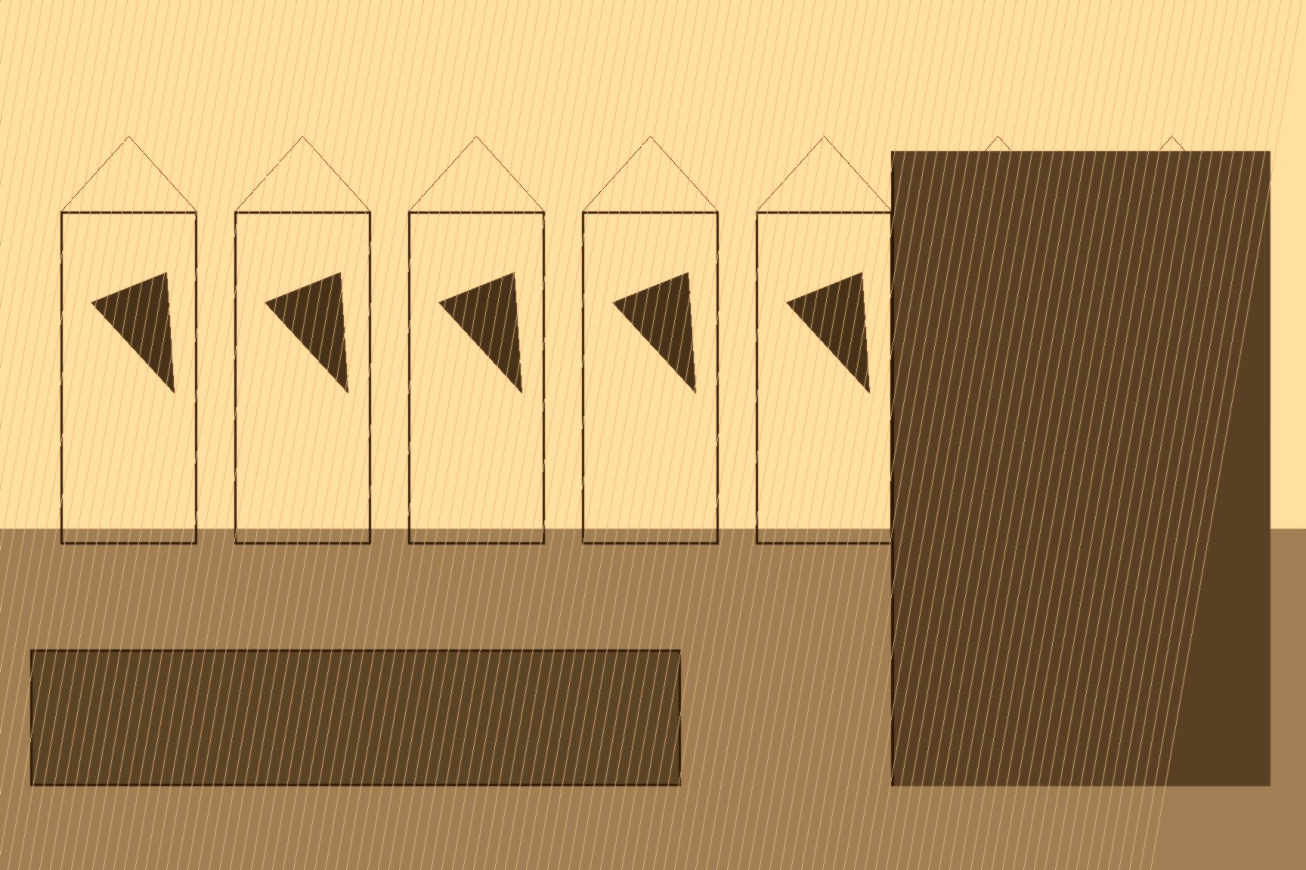



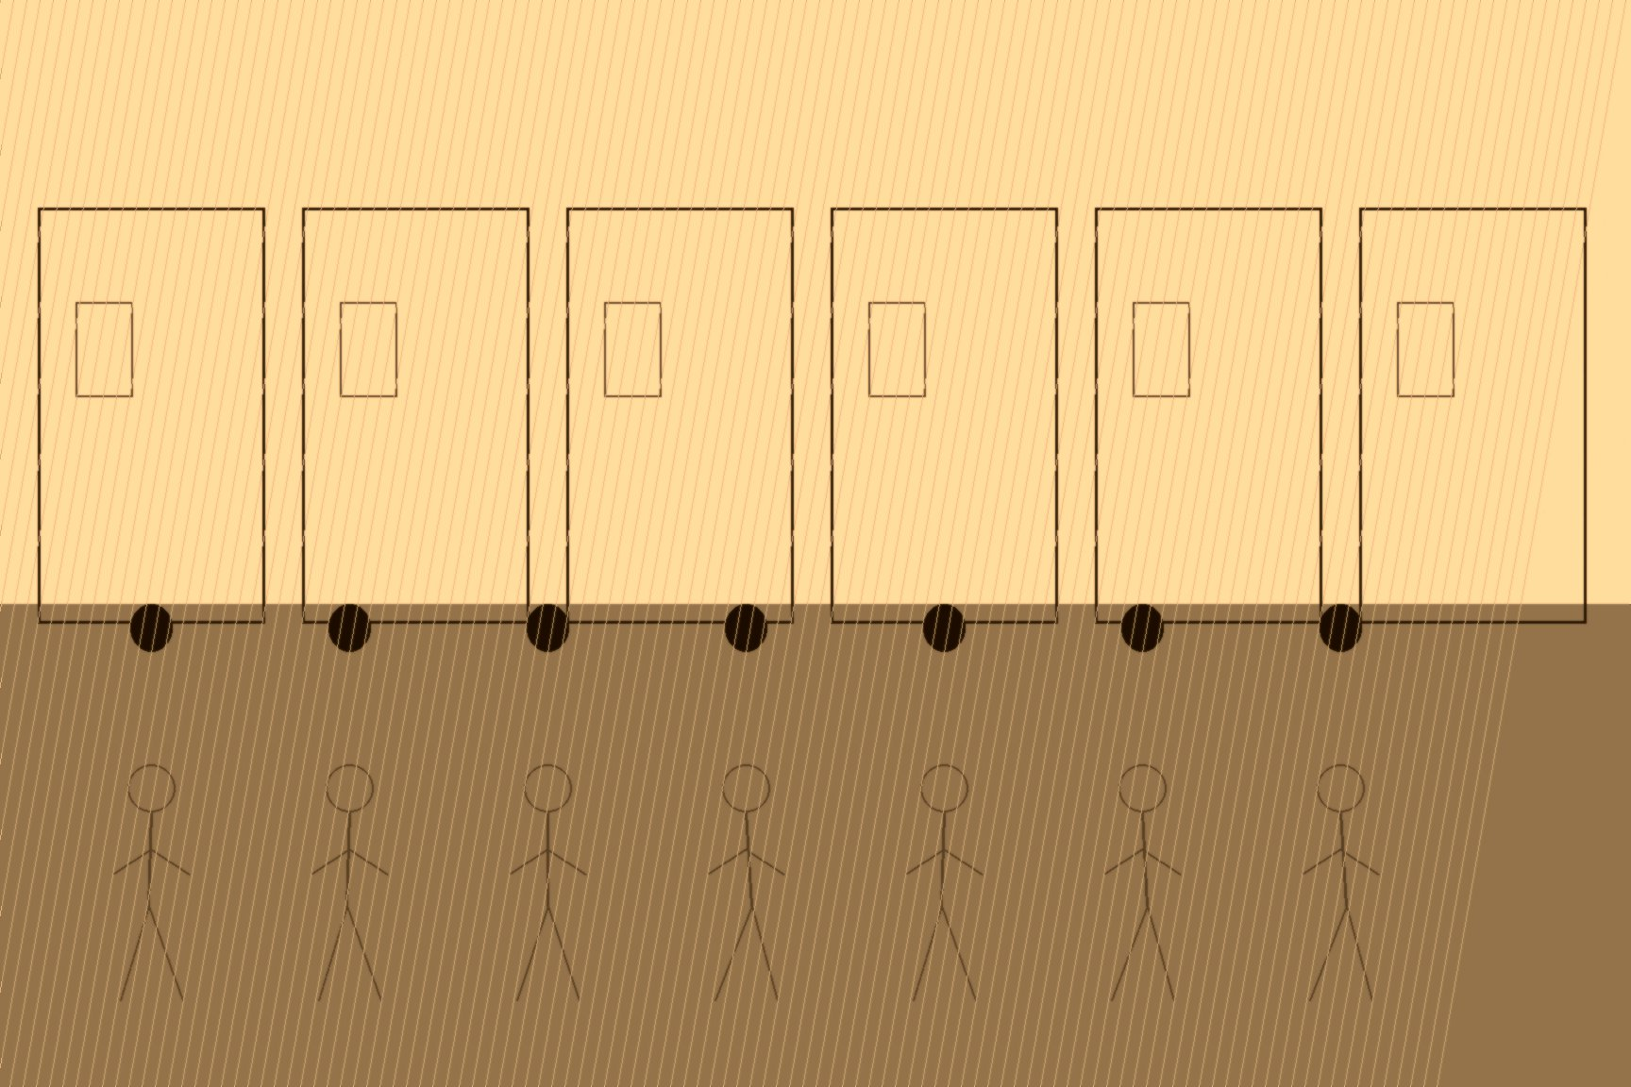
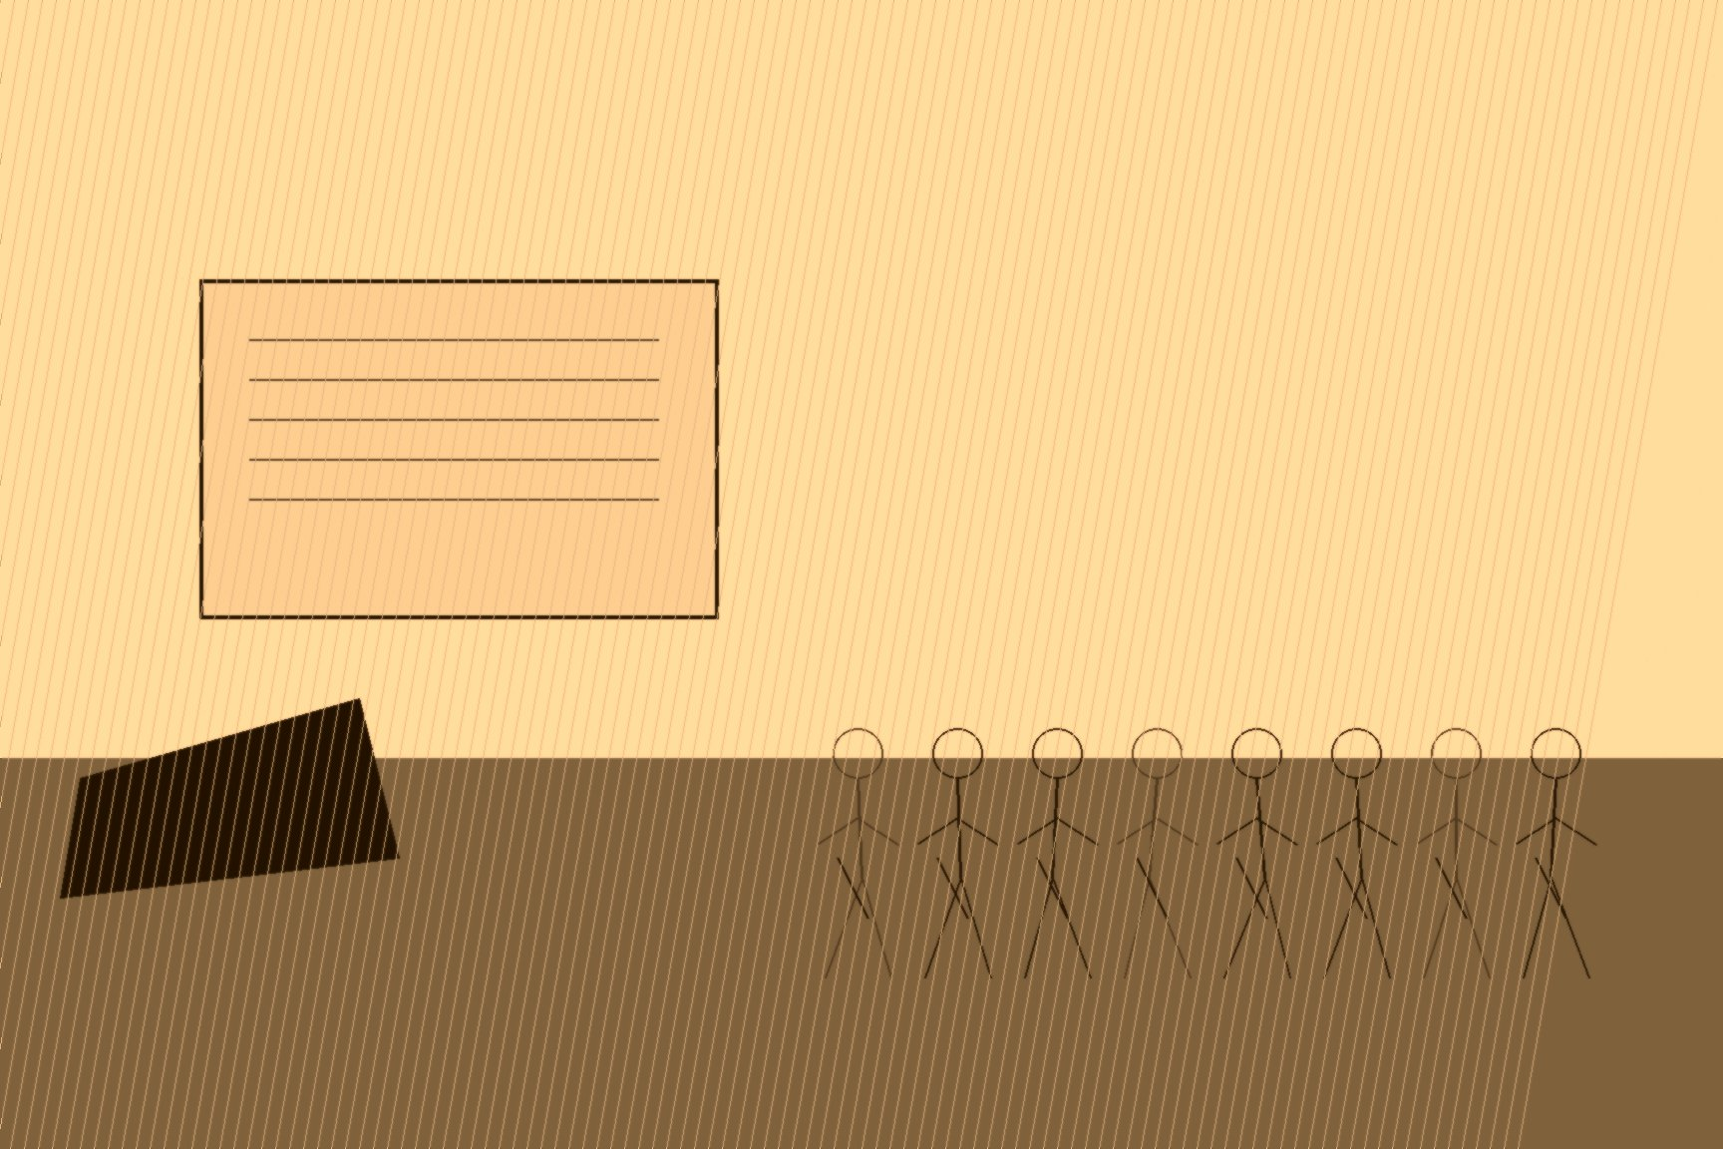
MJF
SECURING THE ARTERY, 1882
Alexandria and Jerusalem
Ismail Pasha's Egypt owed foreign bondholders by 1876 more than the fellahin could raise in a generation. The Caisse de la Dette Publique — Commission of the Public Debt, four European commissioners with a lien on the customs receipts and the railway before any Egyptian minister touched a piaster — began running the books out of Cairo that year. Britain and France split the supervision between them as the Anglo-French Dual Control: an English Controller-General over revenue, a French Controller-General over expenditure, both answerable to the bondholders in London and Paris, neither to the Khedive. The Baring house — the same firm that had financed the Irish famine corn purchases in 1846 — held Egyptian paper alongside Rothschild and the rest of the London market. When Ismail tried in 1879 to shake off the Control by dismissing his European-appointed ministers outright, the Powers had the Sultan depose him within four months. His son Tewfik inherited a treasury already mortgaged to men in London and Paris he had never met.
11 July 1882. Admiral Sir Beauchamp Seymour's fleet opened on the forts at Alexandria and kept the guns going for ten hours. The stated reason was European lives during the Urabi rising — Ahmed Urabi, مصر للمصريين, Egypt for the Egyptians, against the debt and the khedive who served it. By evening the Grand Square that Muhammad Ali had built to advertise a modernizing Egypt was burning — looters and stray shellfire between them gutting the consulates and the customs house — before Royal Navy bluejackets came ashore to hold what was left of the waterfront. The canal sat seventy miles east.
13 September. Sir Garnet Wolseley at Tel el-Kebir. Night attack. Urabi's army gone in under an hour. Garrison in Cairo. Gladstone called it temporary. It lasted sixty years. Evelyn Baring — Lord Cromer — ran the veiled protectorate. Same Baring house that had financed the Irish famine corn purchases in 1846.
Cromer governed without a governor's title. He held no ministry, signed no law, sat in no cabinet meeting under Egyptian letterhead. What he held were British "Financial Advisers" seated inside every Egyptian ministry, each empowered to withhold funds from any decision he had not cleared first. An Egyptian minister could issue an order; an adviser who had not initialed the budget line could make it unfundable. Cromer called this consultative government in his own Modern Egypt. It was administration by veto without portfolio — the same trick the land registrars would later run in the Palestinian villages under a different name: paperwork doing the work a garrison would otherwise have to do by force.
Gibraltar, Malta, Cyprus, Alexandria, Suez, Aden, Ceylon, Singapore, Hong Kong. One fortified lane from the Channel to the South China Sea. Holding the water now meant holding the land that could close it. When the Ottoman state came apart in the 1914 war, Palestine was read in that light: the eastern shield of the cut. Not a hymn.
The force for a corridor full of people who had not asked for the corridor was already on the shelf. The Royal Irish Constabulary. Armed. Centralized. Barracks. Built in the nineteenth century to keep tenure, rent, and agrarian revolt in an island that did not consent. Metropolitan Britain had unarmed constables. Ireland had the other thing.
The choice was not improvised fresh each time a colony asked for men. The Colonial Office had it in writing. Charles Jeffries later set the doctrine down plainly in The Colonial Police: the London Metropolitan force — unarmed, locally recruited — was never the model exported; the Royal Irish Constabulary, armed and centrally directed from Dublin Castle, was the standing blueprint circulated to governors from Africa to the Straits Settlements whenever a population could not be trusted to police itself. Ireland was not an exception the empire later happened to imitate elsewhere. It was the prototype held in reserve for exactly this purpose.
Where the local population could not be trusted to hit its own, the model imported the men. Hong Kong and the Canton concessions took Sikh and Punjabi Muslim constables — 黑头巾 hēitóujīn, black-turban police in the local mouth. Language, stature, no kin on the street. Useful in a strike.
1920, Mandate. Suez and the Irish template met in the same office. 1922, the Treaty broke up the RIC. Churchill at the Colonial Office, Major-General Henry Hugh Tudor recruiting. Seven hundred-odd former Black and Tans and Auxiliaries into the Palestine Gendarmerie.
Munster methods traveled with the men. Night raids without warrant. Village curfew. Custody that left marks. Houses dropped. In the 1936–39 revolt the administration put it on paper: Collective Punishment Ordinances. Fines on the whole village. Livestock seized. Walls blown. The same mechanics the crowbar parties had used in Clare.
The silver that left Chinese households through Bengal chests paid for tea and, in time, for a canal share. The canal wanted Egypt. Egypt wanted a land buffer. The buffer was staffed by the men Ireland had already used and then dismissed.

