Slide 1
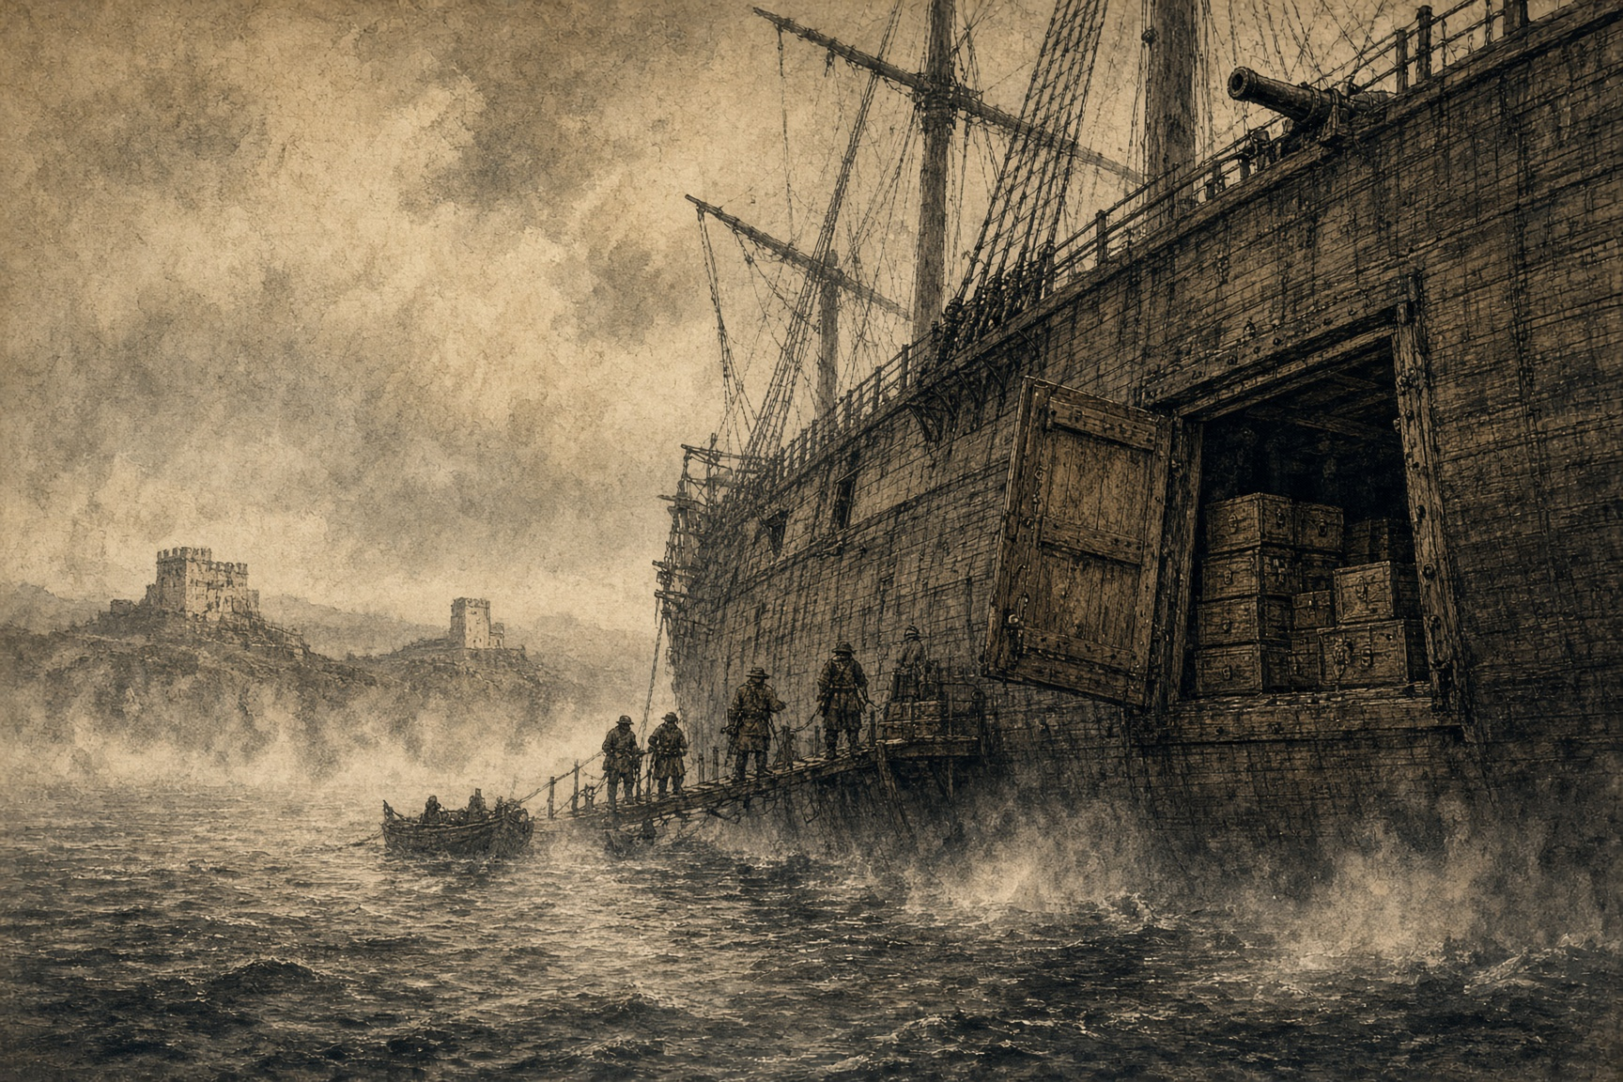

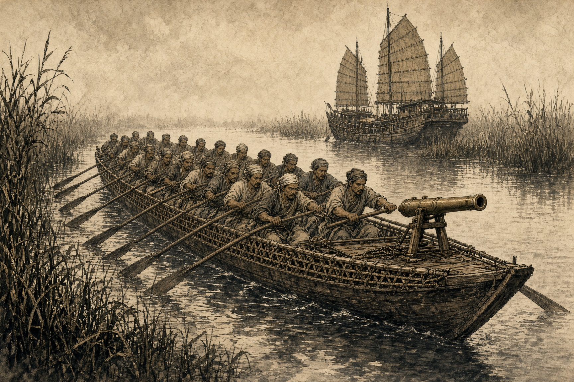
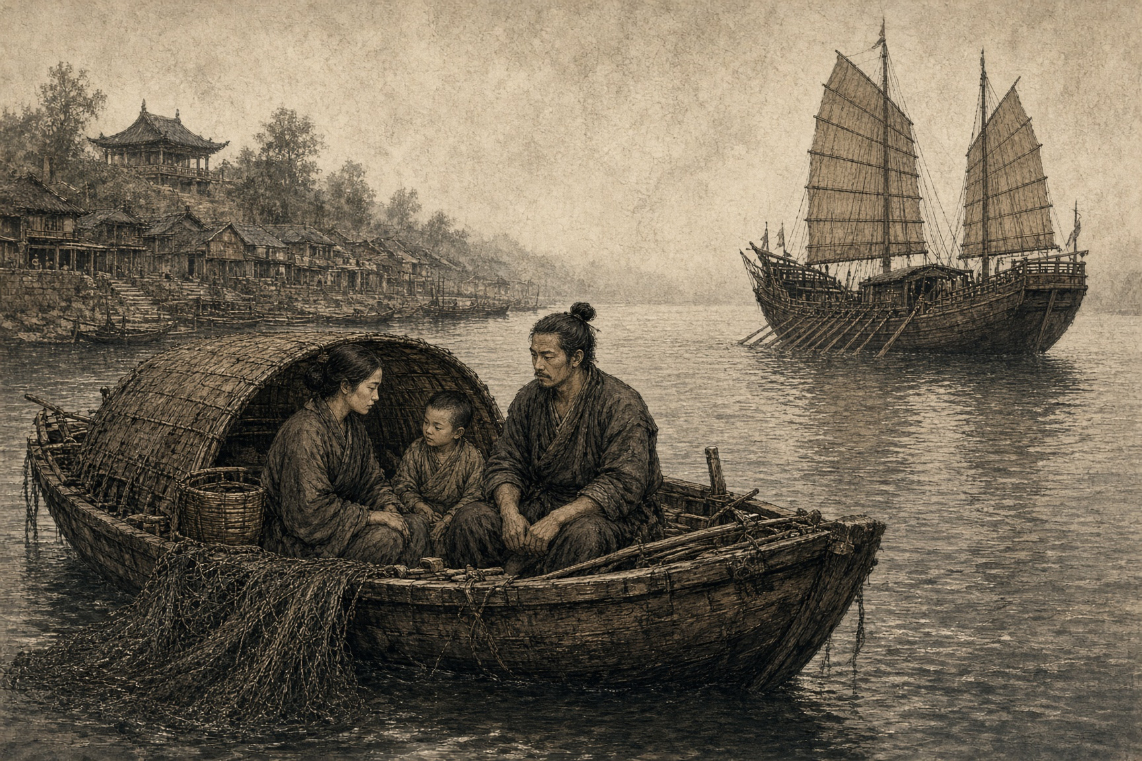
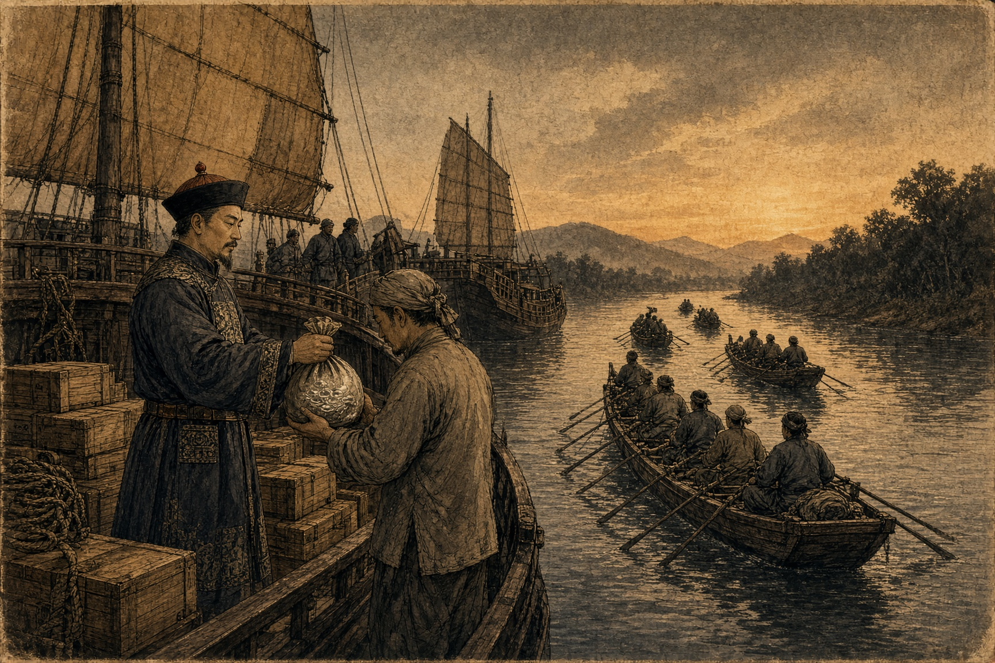
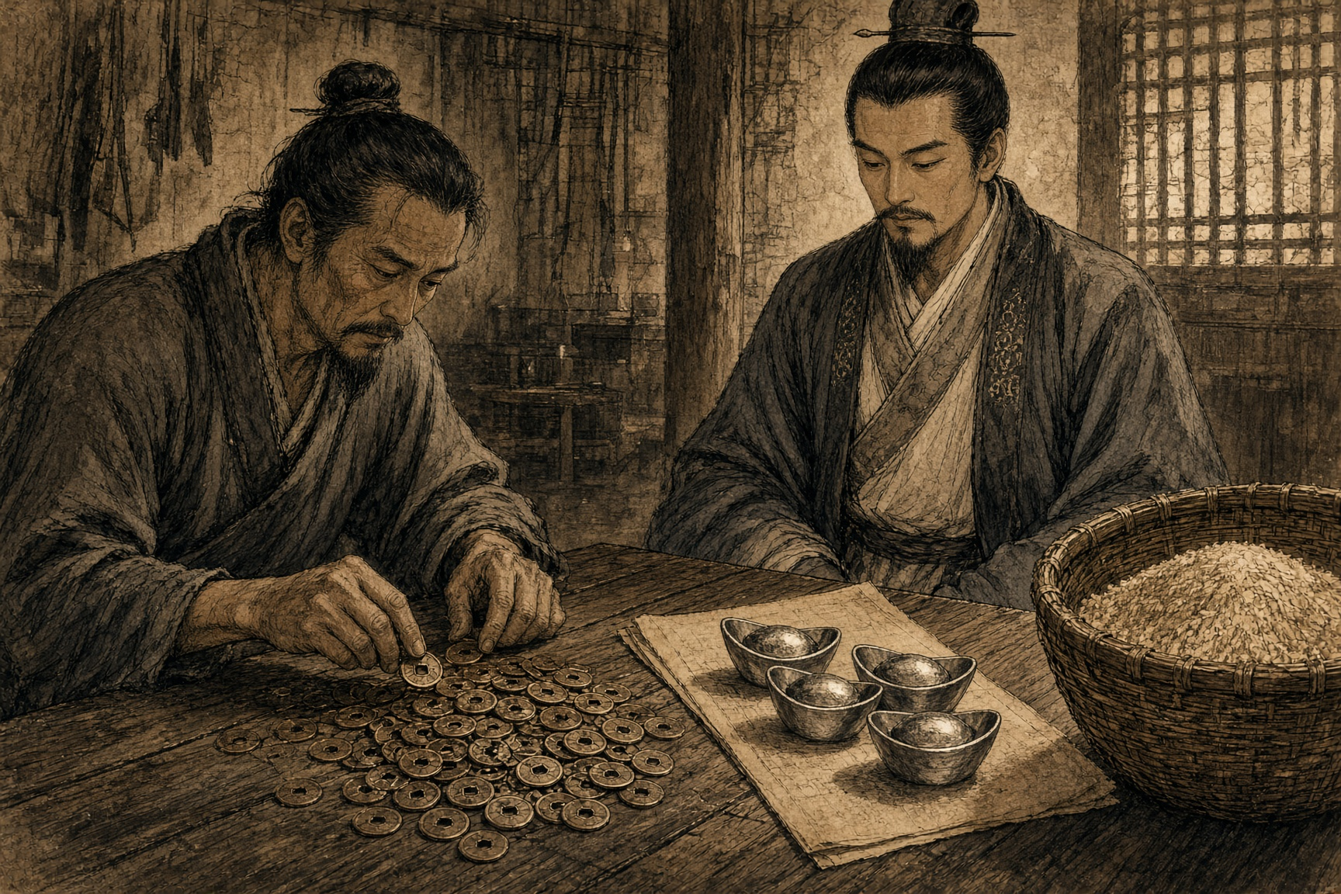
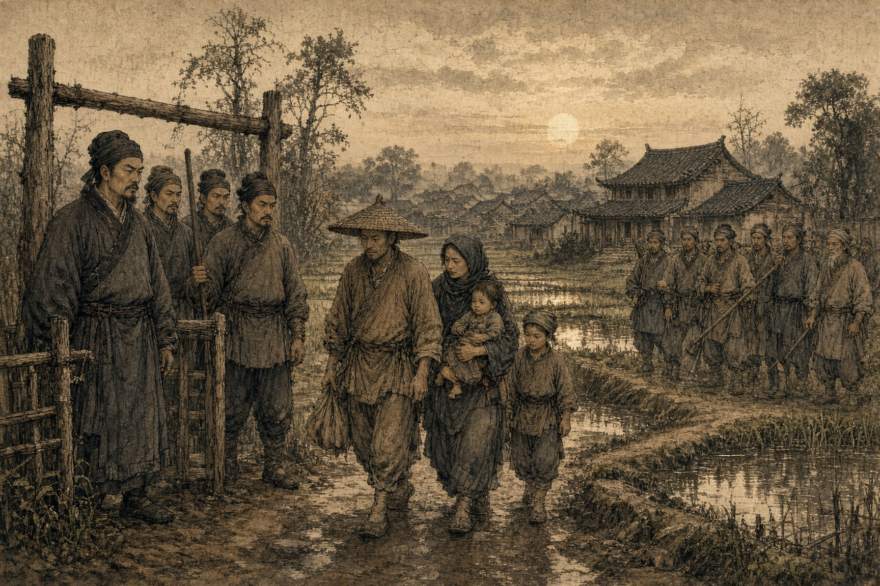
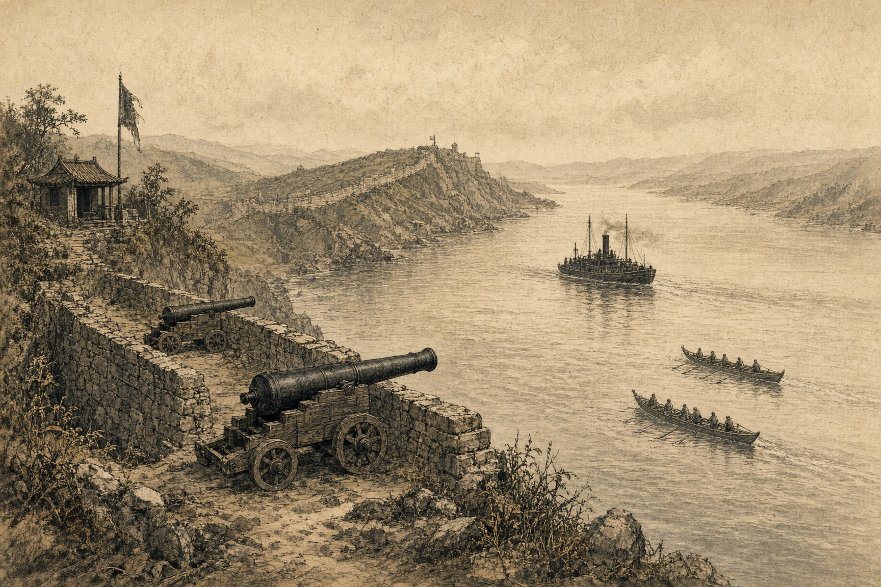
SMOKE ON THE MEDITERRANEAN · CHAPTER 2 · MJF
FAST CRABS
1839 · Lintin Island and the Pearl River Delta
In 1821 the yamen cleared 黄埔 Huángpǔ and 澳门 Àomén of the foreign opium ships. The trade did not stop. It moved to water the forts could not reach.
伶仃 Língdīng. A rock in the outer mouth of the Pearl. Winter on the island. Typhoon months in the lee at 急水门 Jíshuǐmén or Hong Kong. The agency houses stripped ocean rigging off large hulls and left them there. 趸船 dǔnchuán. Receiving ships. Cannon. Mercenary crews. Chests stacked in the dark. The drug sat in the grey water. The cash sat in Canton. Two books. Same firm.
What Calcutta had made legal on the Indian side had to become illegal again the moment it touched Chinese water. The whole inland economy grew in that seam.
Under the hulks, inland, the 窑口 yáokǒu. Wholesale dens in the river maze. 花地 Huādì, Flower Reach, just outside the city walls, was the one everyone named. 西关 Xīguān held the dens the city already knew how to find. Money shop in front. Ledger in the back. Orders in. Paper chits out. Bribes paid. Credit extended. The bosses were Chinese and they were not small men.
Between hulk and den ran the boats. 快蟹 kuàixiè — Fast Crabs. Also 扒龙 pālóng — scrambling dragons, in the mouths that watched them leave the reach. The larger ones were 蜈蚣船 wúgōngchuán, Centipede Boats. Eighty to a hundred feet. Fifty, sixty oars. A hundred men if the job was heavy. Long hull, shallow draft, speed no patrol junk could hold in the creeks. Iron wire or rattan along the gunwales so a musket ball died and a boarding party did not arrive. Swivel guns at the ends. 抬枪 táiqiāng. Firelocks.
The oars belonged to the 疍家 Dànjiā. Tanka. Boat people, and on the county rolls something worse than poor: 贱民 jiànmín — "mean people," a formal legal caste beneath the four recognized occupations, barred by statute from settling on land, from sitting the imperial examinations, from marrying into a shore family that had any standing left to protect. Known to every tide in the delta and welcome in none of the villages on the bank. One clean run paid more than months of nets. The syndicates paid them little against that math and put them where the shot was. They took it. There was not another wage that fit the skill, and no examination hall was ever going to open its rolls to a Tanka son no matter how the family prospered on smuggled silver.
The network did not hide from the state. It rented the state. 规银 guīyín. Protection silver. Village clerk to customs post to the navy. 韩肇庆 Hán Zhàoqìng, Guangdong Navy sub-commander, wrote the cleanest version of the contract. His junks did not chase the Crabs. They walked them upriver. Five to ten dollars a chest. For Beijing he staged the victories: empty boxes, rotten hulls, a report of seizure. The court made him general. The cut on every chest that entered the river stayed with him.
The capital that built the boats and bought the silence had already gone through the Calcutta hammer once. The risk that followed it inland — the gunfire, the rope when 林则徐 Lín Zéxú finally closed his hand — sat with the men swimming closest to where the blood was already in the water.
Silver left the country in chests of habit. The empire ran two metals. Copper cash in the market — grain, wages, a hoe. Silver taels on the tax roll. 纹银 wényín. Sycee. As the Lintin trade thickened, silver thinned. 银贵钱贱 yín guì qián jiàn. Silver dear. Copper cheap.
Early 1800s: a thousand 文 wén bought a tael. Late 1830s, 江苏 Jiāngsū, 浙江 Zhèjiāng, 广东 Guǎngdōng: sixteen hundred to two thousand. The land tax on the magistrate's paper did not move. The farmer sold rice for copper and bought silver to pay. The same field cost him twice. Default. Land to the moneylender. Collectors with force. Villages that answered with force. Tax risings. Societies that did not love the Qing.
The Fast Crabs were already through the estuary before a British gunboat found the forts at 虎门 Hǔmén.

