Slide 1


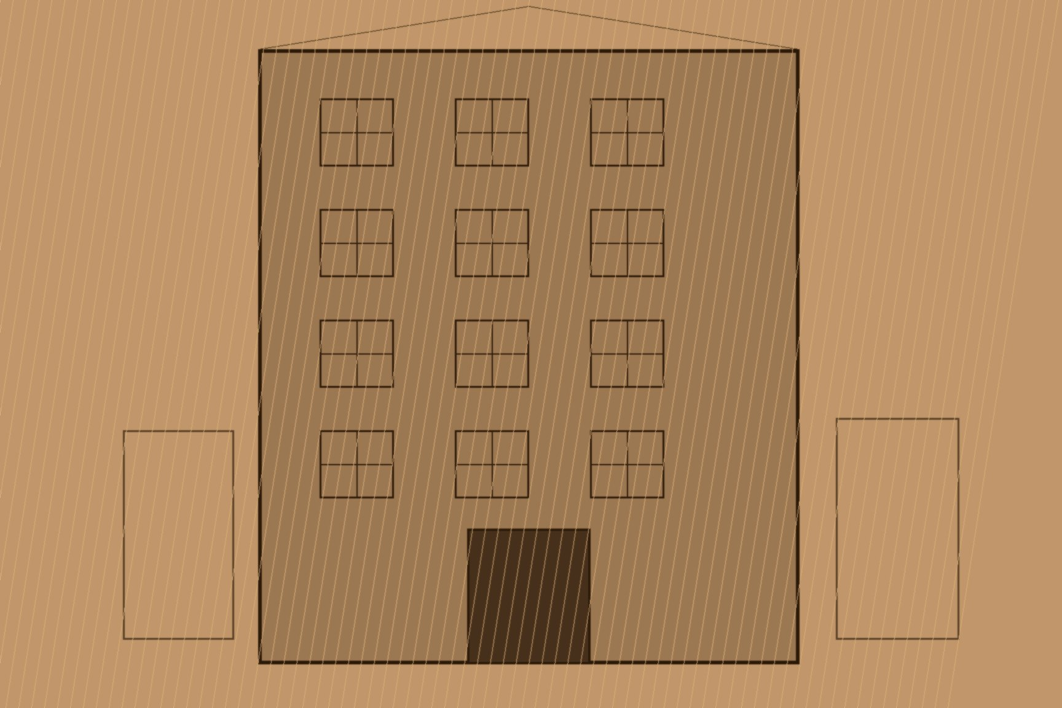


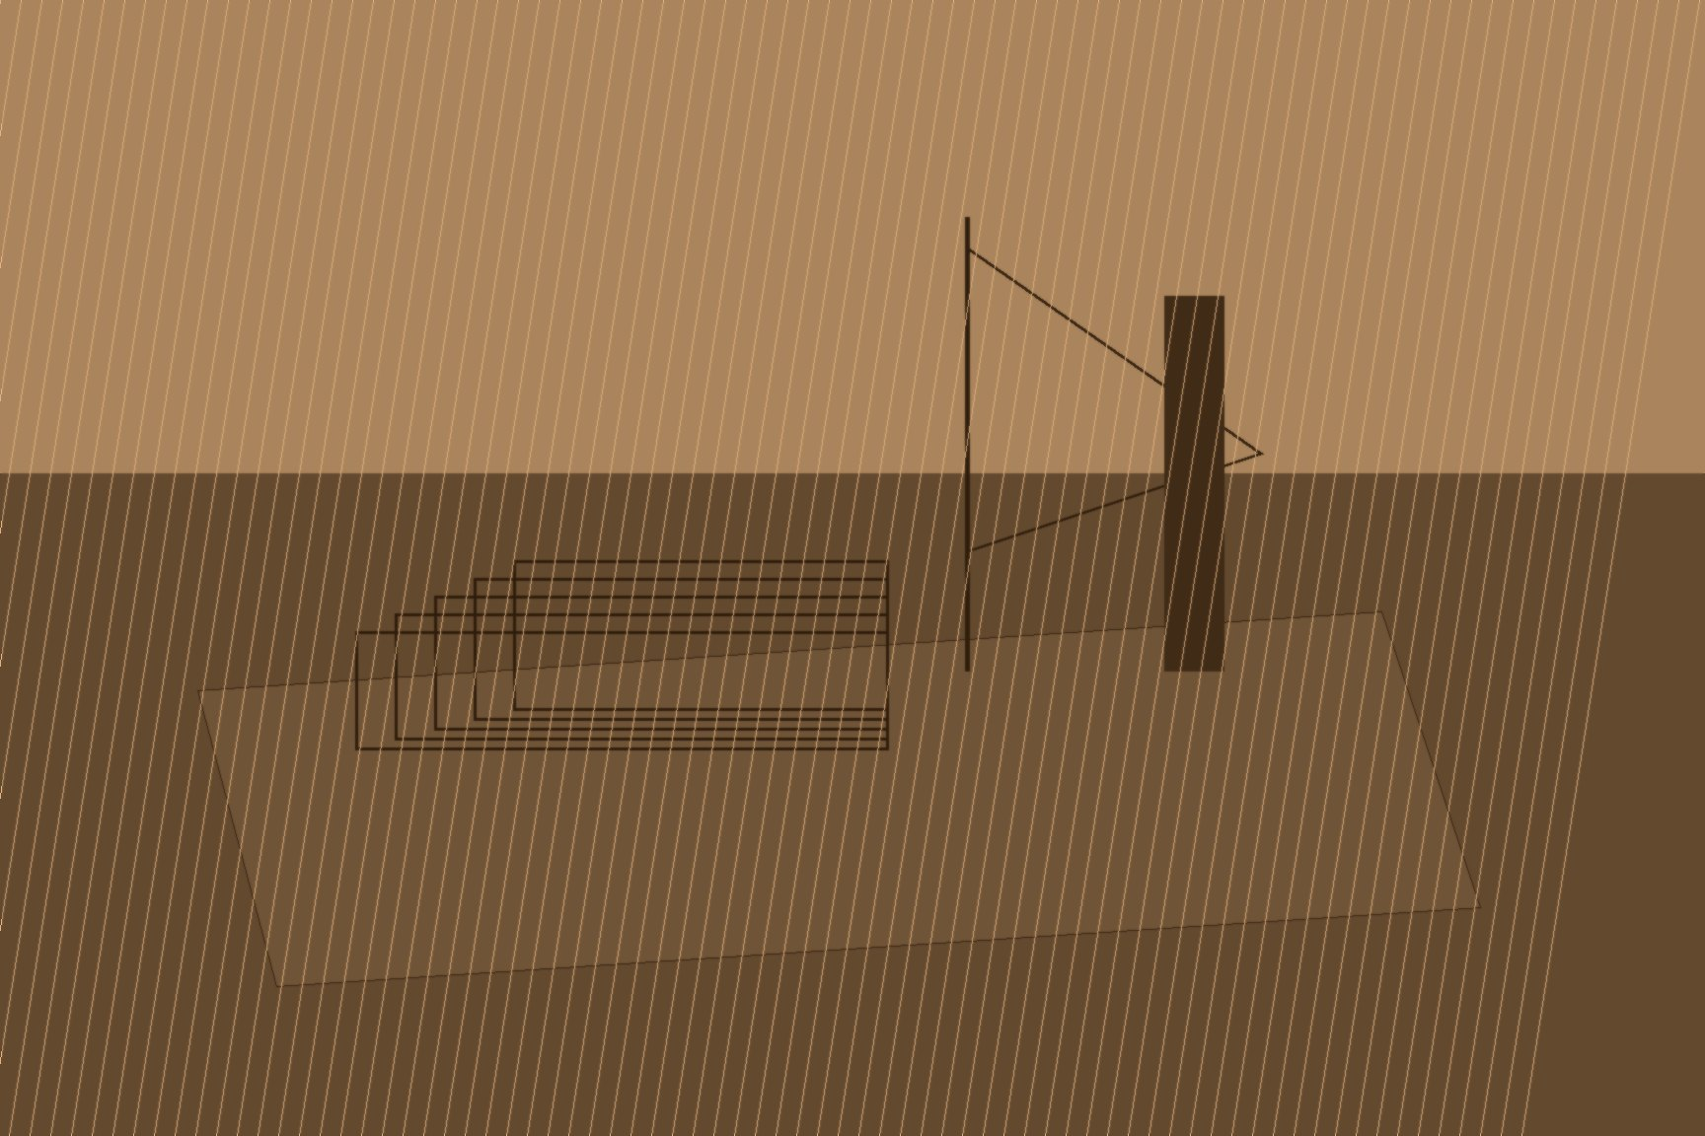

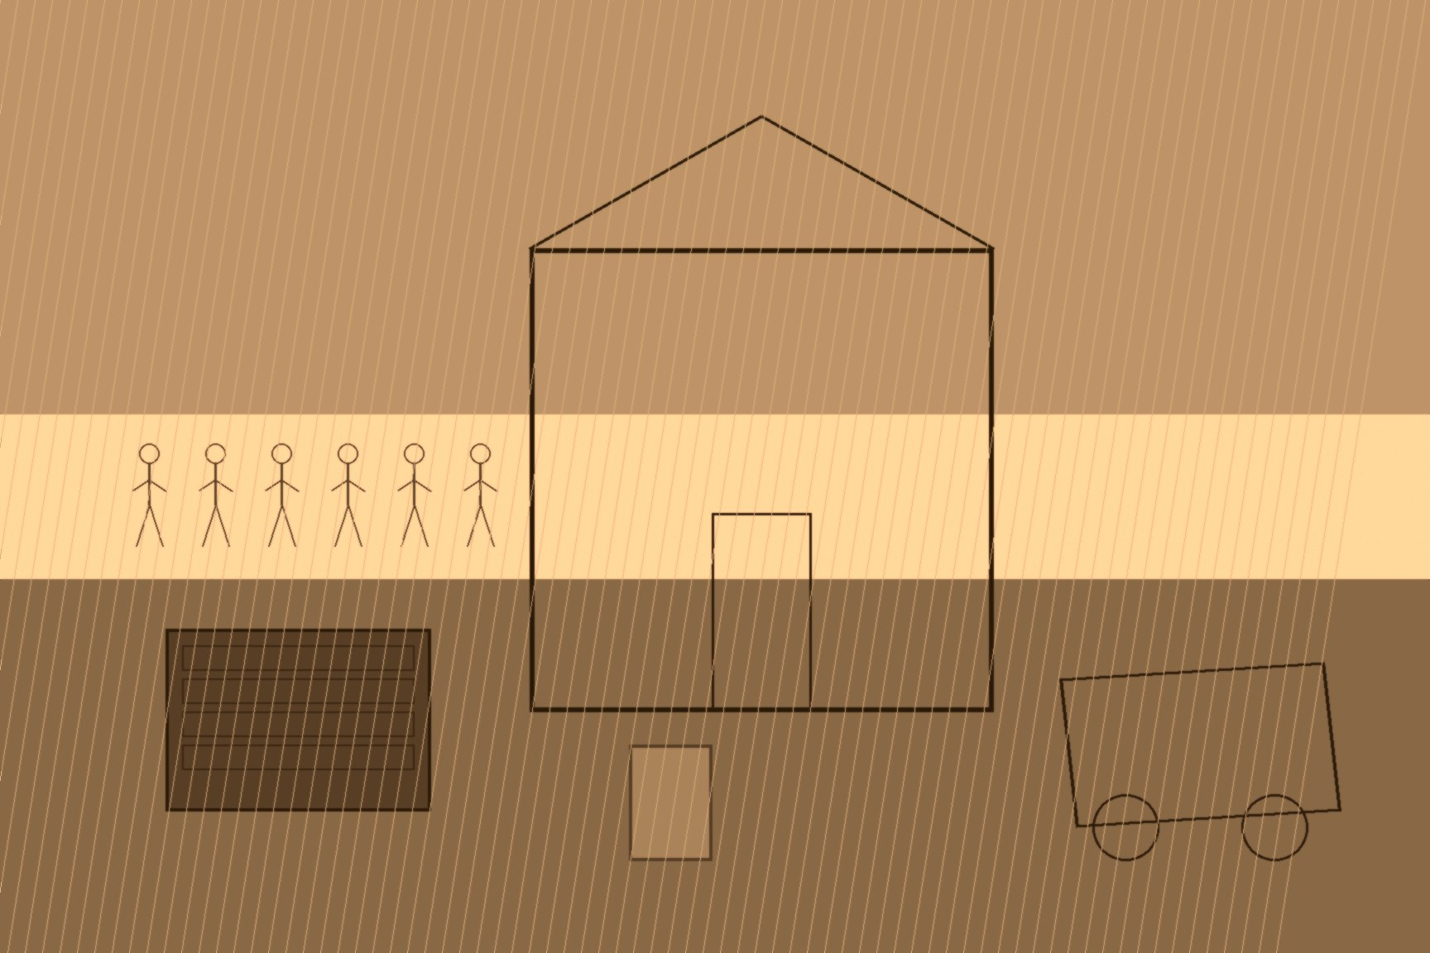
MJF
14 HENRIETTA STREET, 1849-1858
By the 1850s, the land itself in East Galway told two stories at once, and they belonged to two entirely different worlds. On one side stood what was left of the old gentry: the Eyre family of Eyrecourt, whose fortunes the Famine years had finished off, and Edmund Dowell, a Dublin wine merchant whose 4,401 acres at Skehaghard represented a family's stake in Ireland liquidating itself piece by piece. On the other side, arriving by ship rather than by inheritance, stood a Glasgow timber merchant named Allan Pollok, whose money had never touched Irish soil before and whose entire understanding of what land was for had been formed moving lumber across an ocean, not managing tenants across a generation. The instrument that let the second world absorb the first was the Incumbered Estates (Ireland) Act, which received royal assent on July 28, 1849. Its mechanism was simple and, for the men who designed it, genuinely necessary: before the Act, a mortgaged Irish estate could rarely be sold, no matter how deep in debt its owner was, because entails — trust arrangements meant to keep land inside a single family line — blocked creditors from forcing a sale through the slow-moving Court of Chancery. The new Act bypassed Chancery entirely. It created a fresh Encumbered Estates Court with the power to order a sale on the application of either owner or creditor, distribute the proceeds, and hand the buyer a clear title — wiped clean of every entail, every customary tenant arrangement, every prior claim that might otherwise have complicated the transaction. A government took a Dublin mansion at 14 Henrietta Street for the Commission's offices and converted the stable at the rear into a courtroom, where three commissioners sat two days a week and the public sales of estates were conducted in person. One barrister later recalled that the volume of business in 1851 to 1854 was "in excess of all anticipations," and that little account was taken of ordinary office hours in the effort to clear it.
Among the men who came to buy at that courtroom was Allan Pollok, a Scottish merchant based in Glasgow and a partner in the timber and shipping firm of Pollok, Gilmour & Co, which carried lumber across the Atlantic between Quebec, Liverpool, and Glasgow — the same ocean crossing, on the same kind of vessel, that had carried tens of thousands of Irish emigrants the other direction only a few years before. Between July 1853 and June 1858, Pollok paid £212,460 for 25,234 acres in East Galway and the Creggs district of County Roscommon, assembling the purchase in pieces from several distressed estates sold through the Court — among them land that had belonged to the Eyre family of Eyrecourt, whose gentry fortunes the Famine years had finished off, and a 4,401-acre parcel at Skehaghard sold in 1851 by Edmund Dowell, a Dublin wine merchant. Pollok had never set foot on any of it before he owned it.
His plan, once he arrived, was to run the land on the model of the Scottish Improvers — large consolidated farms, let to tenants with enough capital to work them properly, managed on scientific and commercial lines. It was the same argument County Clare landlord David J. Wilson had made to the Devon Commission a decade earlier: that a smallholding tenant, insecure and undercapitalized, was the obstacle to improvement, and that the fix was bigger units under stronger management. Putting the plan into practice meant clearing the tenants who were already living and working on the land Pollok had bought, in numbers large enough that the evictions required constabulary protection to carry out.
The scale of it reached Parliament directly. Debating a petition on the matter, both Benjamin Disraeli and Lord Palmerston suggested on the floor of the Commons that Pollok's evictions, and the police support they demanded, were themselves provoking exactly the rural disorder the Encumbered Estates Court had been built to prevent. When the debate resumed a month later, opinion split along familiar lines: George Henry Moore, a tenant-right advocate, offered qualified credit to Pollok for the employment his building projects were generating on the estate, and was immediately criticized for it by a parish priest, Father Colley of Lecarrow in County Roscommon, who saw nothing in an eviction-cleared farm worth crediting regardless of who it later put to work.
Pollok built anyway, and built at a scale that made the earlier controversy look almost incidental in hindsight. He commissioned new farmyards across the reorganized holdings, brought in an engineer and an architect to plan them, and had a vessel loaded with timber from his own firm's Canadian stock — the same Atlantic corridor his ships had always worked — dock at Limerick to supply "cottages of an improved style" for the laborers now working his consolidated farms. A foundation stone at Lismanny House, his new residence, was laid amid a public ceremony with a crowd in attendance and carriages arriving from the railway station. A local account written decades later would describe the finished result as an agricultural enterprise on a vast industrial scale — which, measured purely by output and organization, it was.

