Slide 1
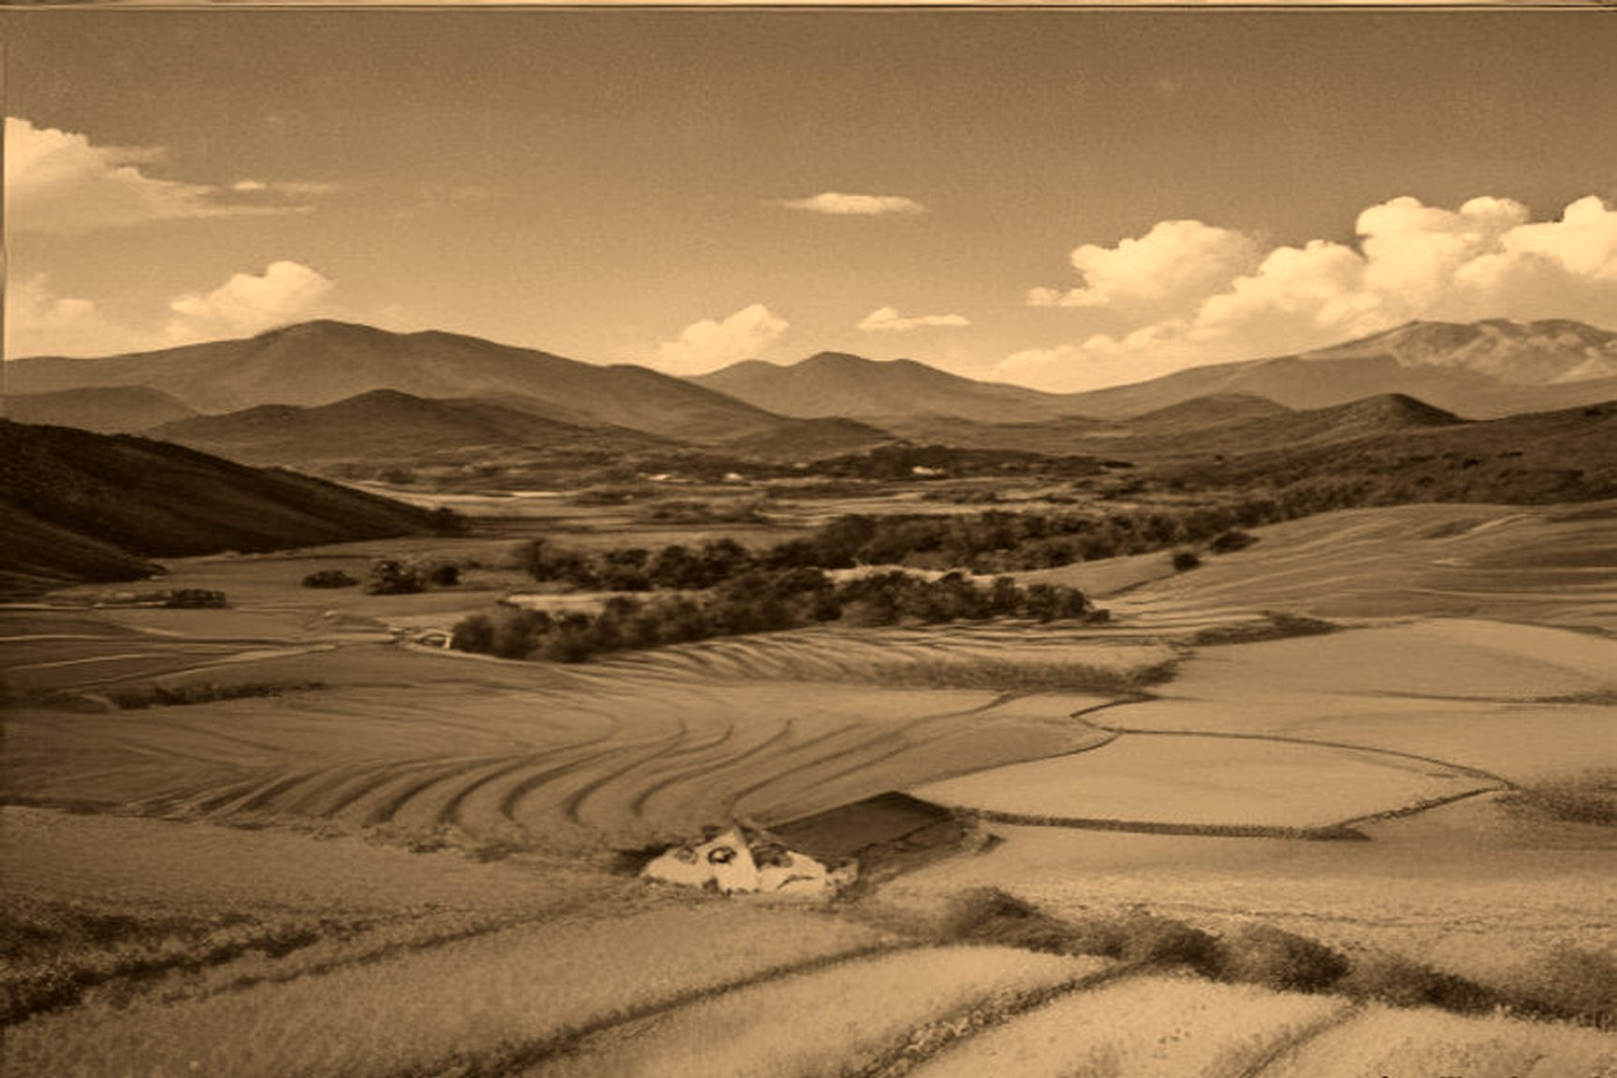
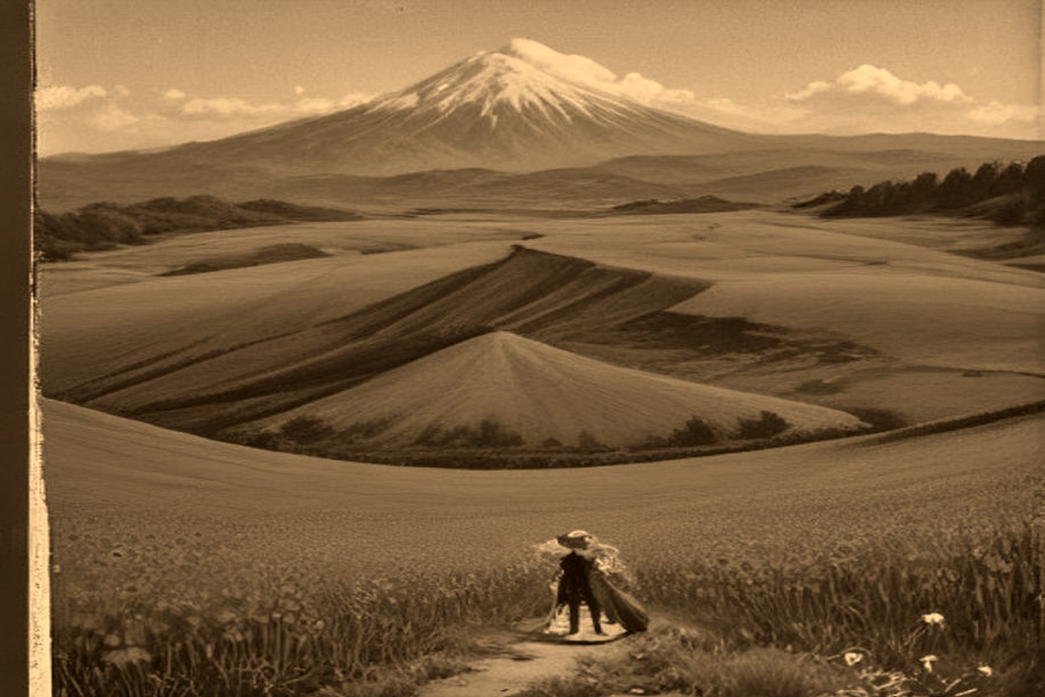
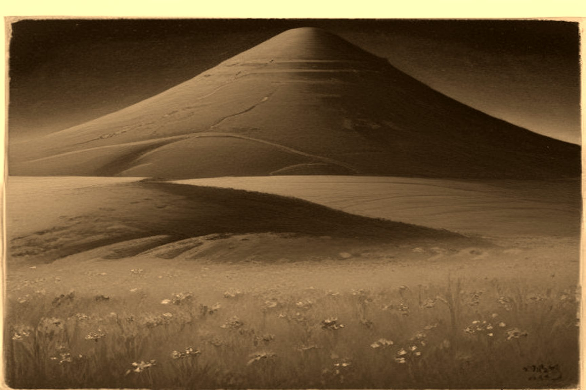
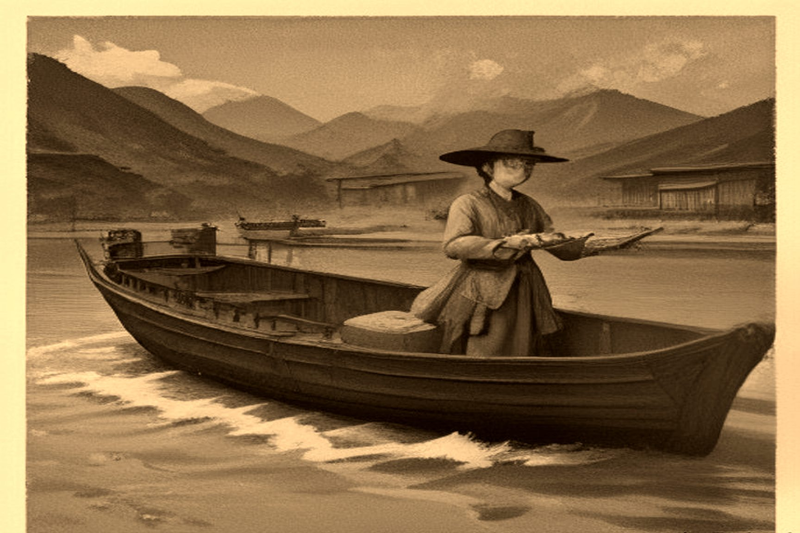
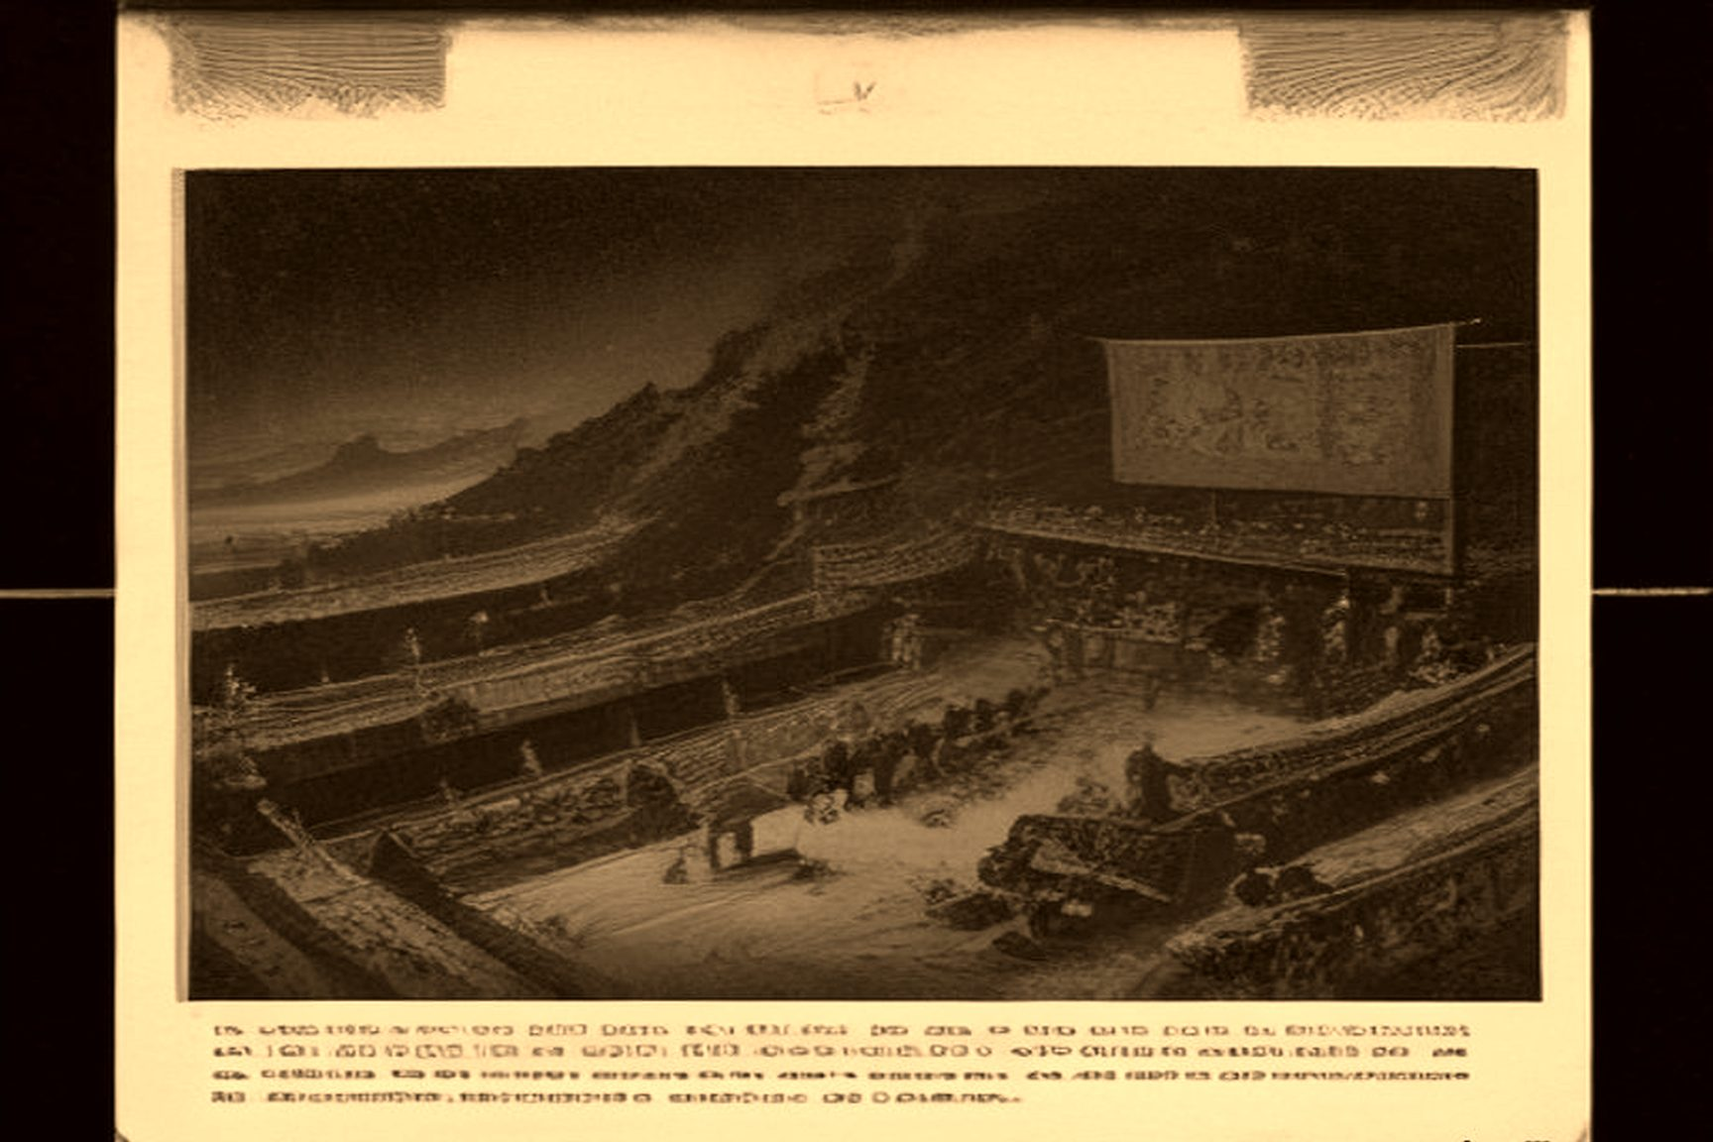
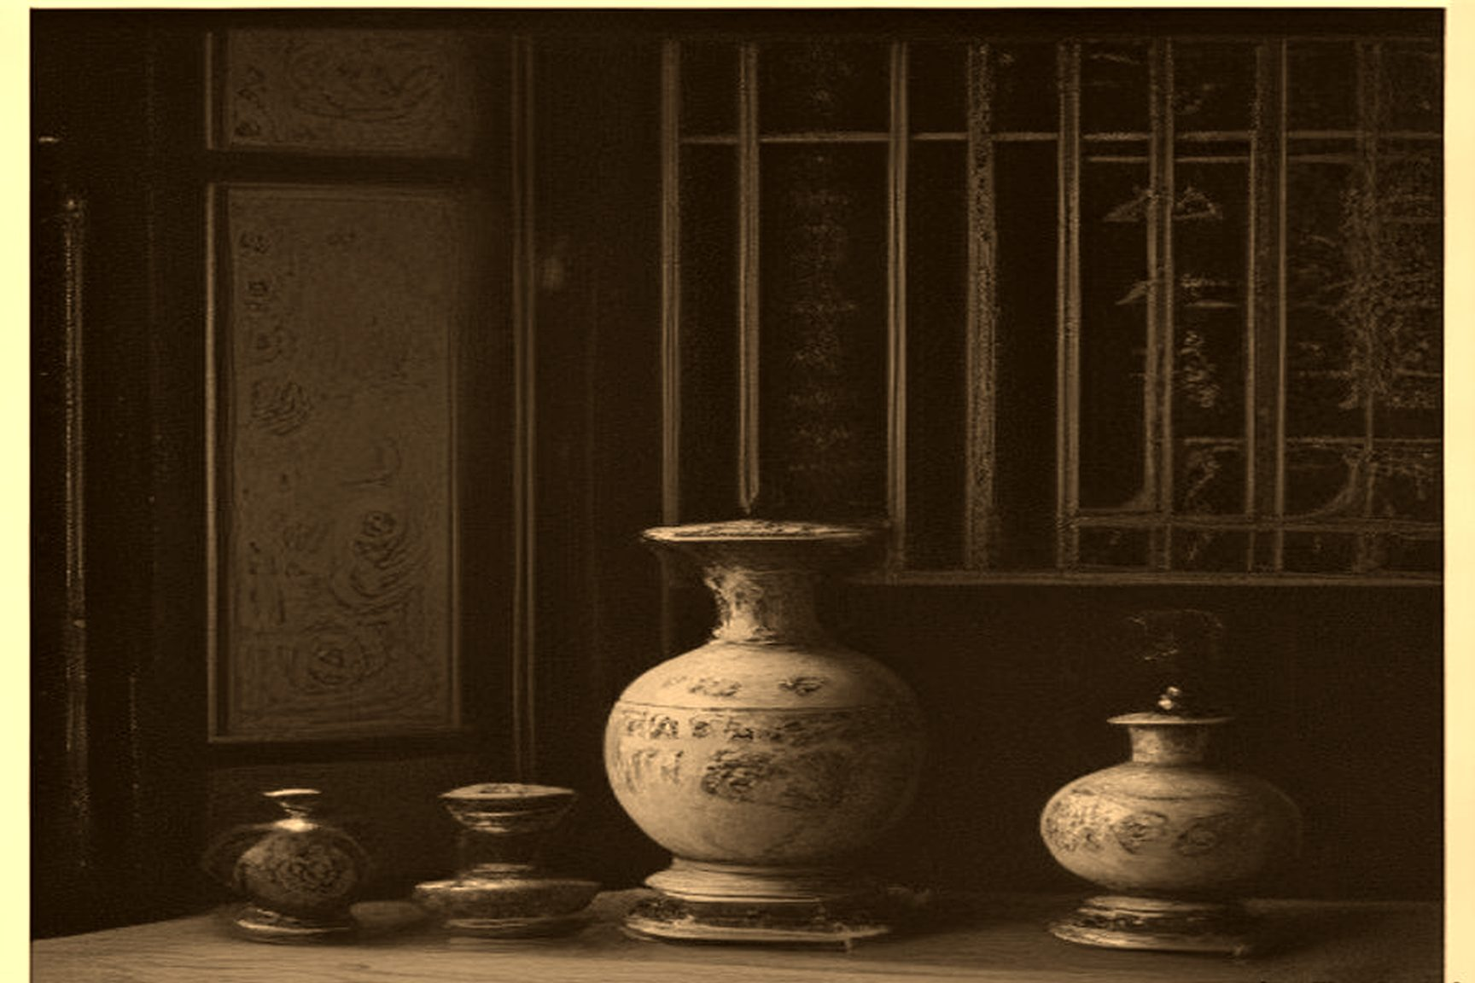
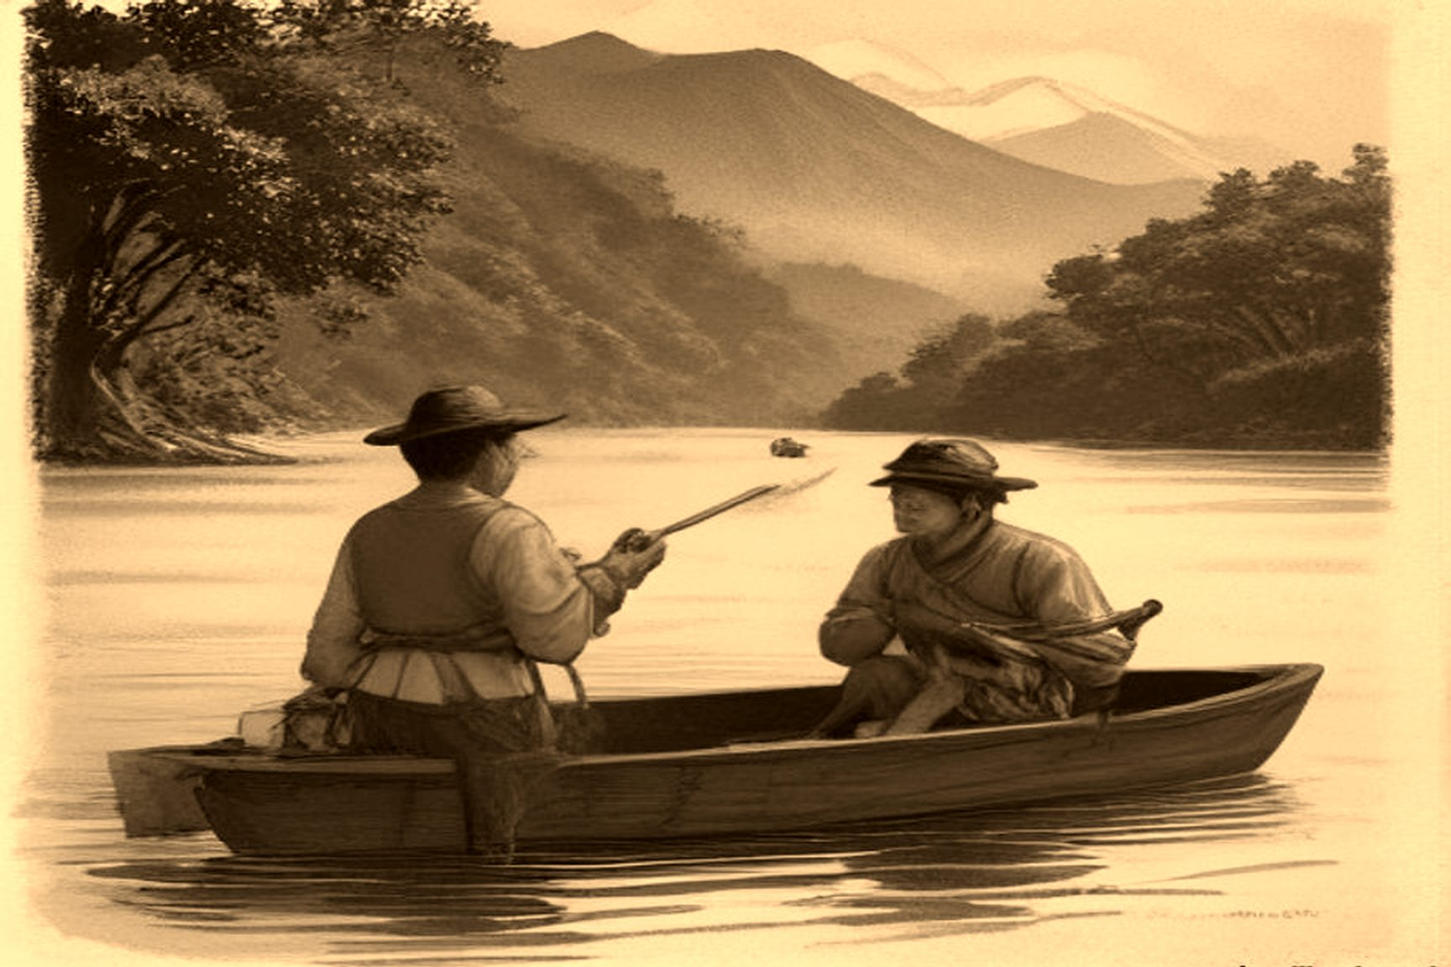
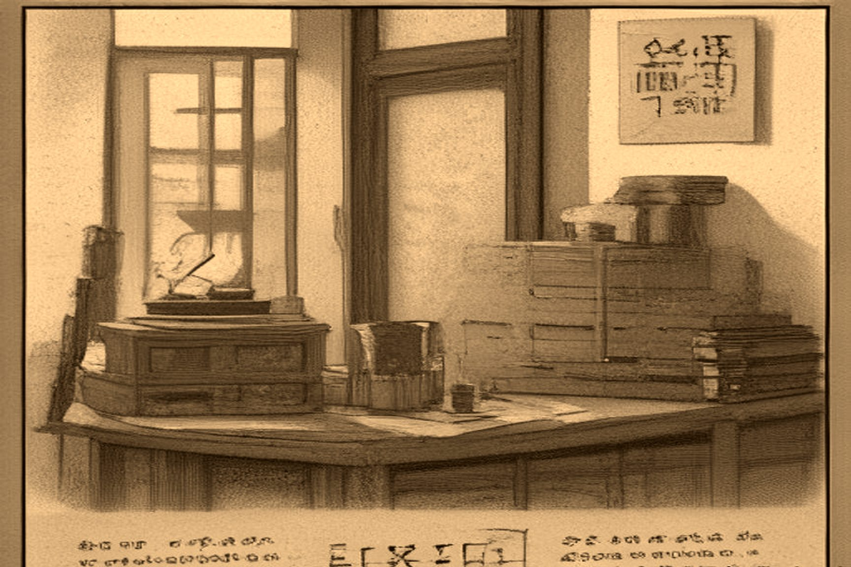
MJF
POPPIES INLAND
1839 · Yunnan and Sichuan
What landed at Lintin as a foreign cargo became, inside a generation, a crop. Yunnan's high valleys. Sichuan's river basins. The poppy stopped being an import and started being the thing that paid.
Two grades owned the inland trade. 云土 Yúntǔ — Yunnan earth. Altitude, rich soil, a smoothness that could stand next to Patna. 川土 Chuāntǔ — Sichuan earth. Dozens of counties in the Red Basin. Worse leaf, more of it, cheaper.
The gazetteers used the same four characters until the phrase itself became a kind of weather report. 废粮种烟 fèi liáng zhòng yān — abandon grain, plant smoke. The 坝子 bàzi, the irrigated valley floors that had fed the Southwest, went under white and purple blossom. A surplus region started buying rice. Bad weather on the leftover grain fields did the rest.
For generations the Southwest had run a grain surplus north along the Yangzi corridor — Sichuan rice feeding Hubei, Yunnan grain moving into Guizhou's mining camps. Once the bàzi went under poppy, that surplus reversed inside a few bad seasons. Counties that had shipped rice out now bought it in, at prices that moved against them twice over: less grain grown at home, and a market price set by neighboring provinces who could see a buyer with no alternative. Local gazetteers from the 1830s onward register a shift in vocabulary as much as in price — village elders petitioning the yamen not about opium at all, but about grain shortfall, framed as a weather problem in years when the harvest had done comparatively little wrong.
Confucian commerce had a rule for this and it was not subtle. 义利之辨 yì lì zhī biàn — the distinction between righteousness and profit. Wealth was supposed to come through 以义取利 yǐ yì qǔ lì: profit taken under right. Decades later Yan Fu, putting Adam Smith into Chinese, reached for 母财 mǔ cái for capital. Mother-wealth. A word that still sounded like something that fed a household.
The mountain trails did not use that word.
正月, Daoguang 21 — January 1841 — Qīng Shílù 清实录. An armed syndicate on the roads between 顺庆 Shùnqìng and 宁远 Níngyuǎn in Sichuan met imperial troops sent to break them. They did not bother with a cover name. The banner was eight characters:
将本求利，舍命取财 Jiāng běn qiú lì, shě mìng qǔ cái Use the stake to seek profit. Risk life to take wealth.
本 běn here is the outlay — cash turned into guns, hired men, cargo the statute forbade. 利 lì is stripped of the old obligation. 舍命 shě mìng is the cost line: their lives, the soldiers', whoever stood on the path. The Shílù recorded the slogan because it was already a public sentence. No one in those hills was translating Smith.
Consumption followed rank.
Gentry, officials, merchants sat in 花烟间 huāyān jiān — flower-smoke rooms — carved pipes, silver lamps, the habit dressed as leisure. Brothels ran the same furniture.
Porters, boatmen, chair-bearers, coolies drank 笼头水 lóngtóu shuǐ — cage-water: dregs and pipe scrapings boiled back into a dark cup. Not leisure. A few hours off the pain. Wages gone. Households after that.
The yamen in the interior had two failures and chose a third. Pull the plants and the villages whose year now lived in the poppy rose. Leave them and the district missed its grain quota and its silver quota both. So the clerks invented a fee schedule. Fines. Inspection money. 土药厘 tǔyào lí — native-drug likin — levied on the grower and the den. Pocketed, or poured into the hole in the local books. The prohibition office became the protection office.
Lin was still at the coast trying to stop the foreign chests. Behind him the interior was already in flower.

