Slide 1
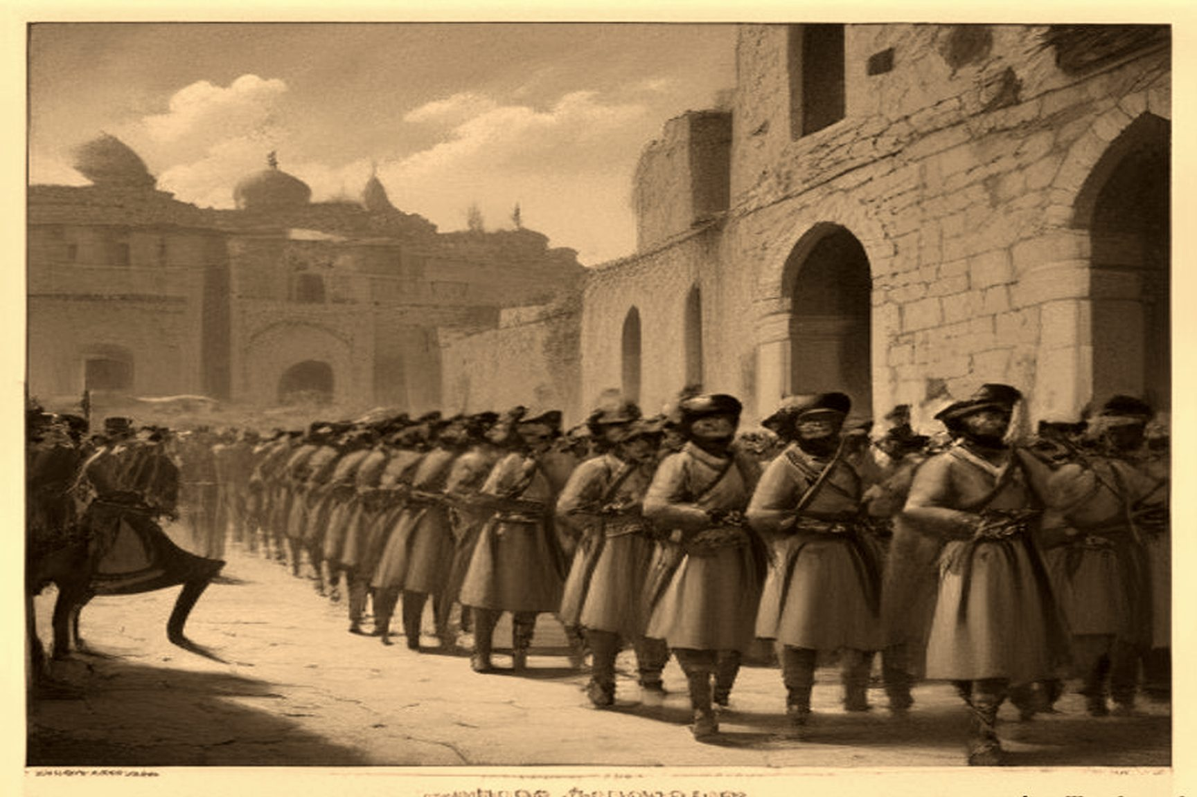

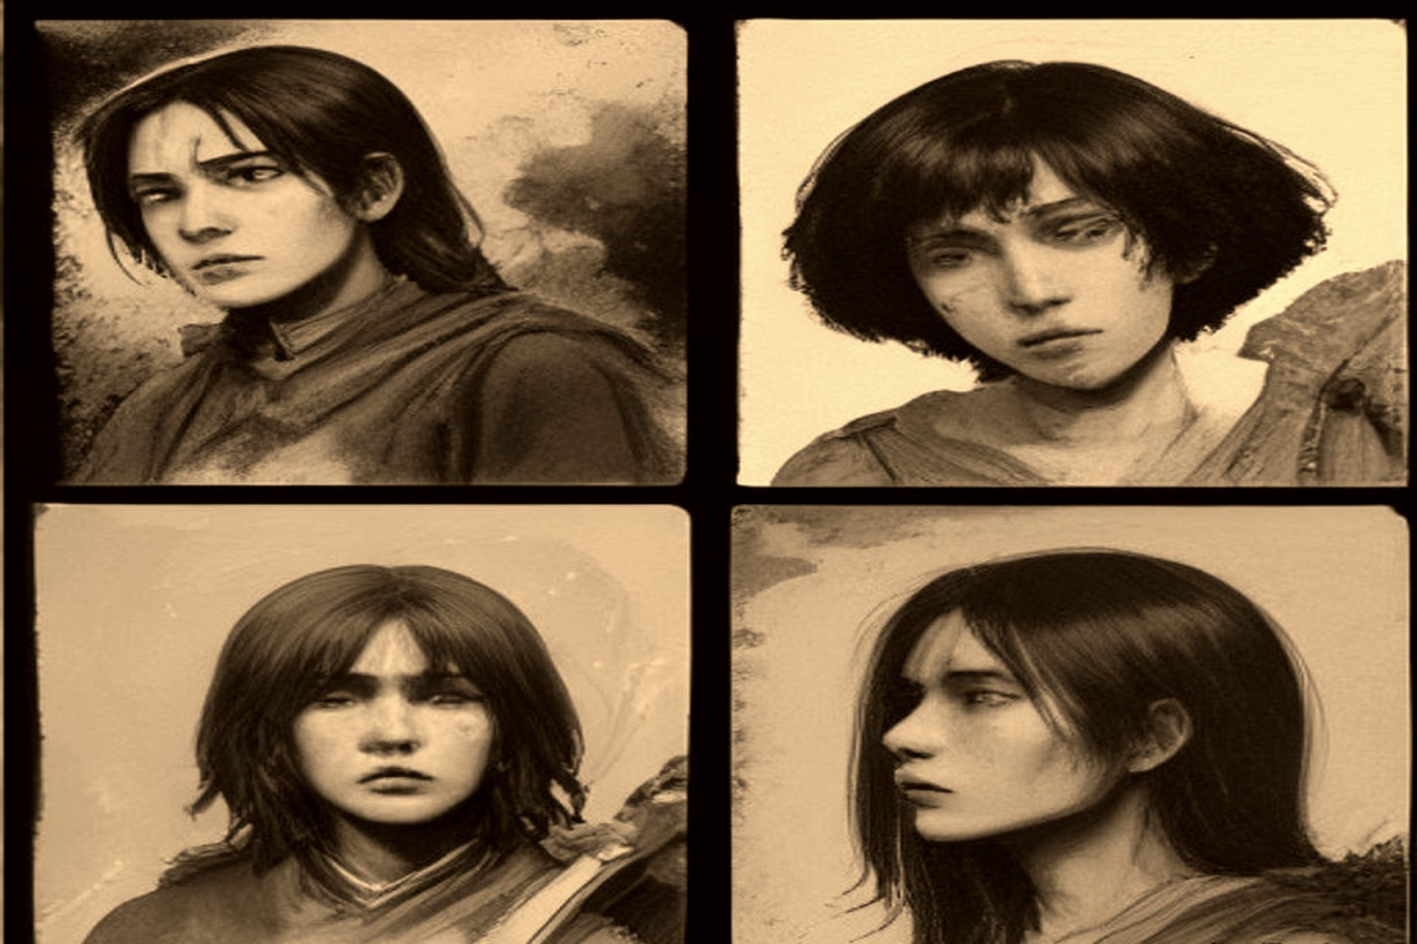

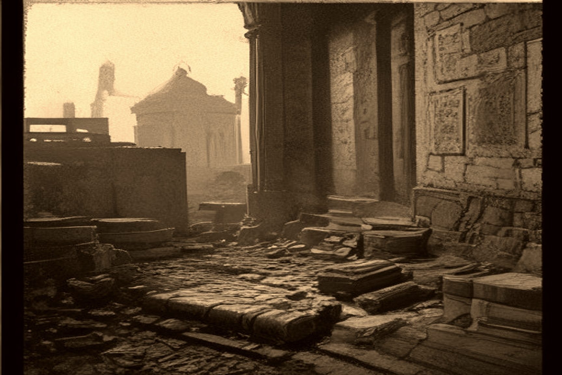

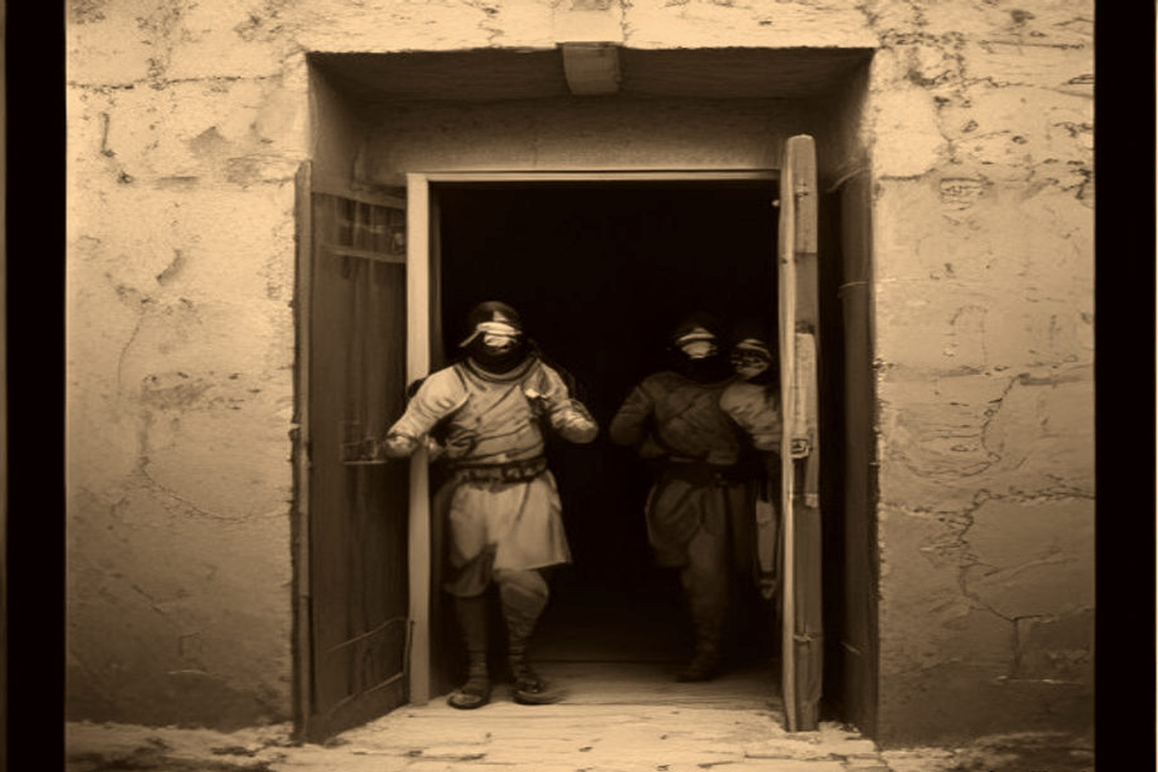

MJF
THE LEDGER AND THE MOB
1831–1840 · Galilee
In 1831 Ibrahim Pasha marched his army into Greater Syria in the name of his father, Muhammad ʿAli Pasha, and ended a century of Ottoman rule by proxy. Governance there had been outsourced for decades to local strongmen — Ahmad al-Jazzar Pasha in Acre, Muhammad Abu Nabbut in Jaffa — men who ran their own fiefdoms with their own muscle and their own tax arrangements, answering to Istanbul mostly in name. Ibrahim arrived with a modernizing army, the nizam, and a centralized bureaucracy built to replace that system with direct rule from Cairo.
Judith M. Rood, working from the Jerusalem Islamic court registers, the sijillat, treats the change as more than an administrative swap. For generations Ottoman subjects had lived under an understood contract of repose and tranquility: Muslim elites managed endowments, local sheikhs provided defensive levies, and the non-Muslim communities, the riʿaya, paid the jizya in exchange for physical protection and exemption from military service. Ibrahim dismantled the contract at both ends. His administration seized control of the Waqf al-Haramayn, the holy endowments of Mecca and Medina. It curbed the authority of the Sunni ulama. It imposed a universal head tax, the farda. It stripped the customary toll and portage fees that Bedouin tribes and the Abu Ghosh family had long collected along the pilgrimage roads near Jerusalem.
The sons still went to war. The offsetting half of the old bargain was redirected to a treasury in Cairo that none of those households would ever see a coin from. The jizya itself was not abolished. Jews and Christians went on paying it. Only one side of the arrangement was being touched.
On April 25, 1834, Ibrahim summoned the leading notables and scholars of Palestine to Jerusalem. Sitting across from him were the city's highest religious and administrative authorities: the Mufti Tahir Afandi al-Husayni, the Naqib al-Ashraf ʿUmar Afandi al-Husayni, and the chief court clerk, the Bashkatib Muhammad ʿAli al-Khalidi, alongside regional leaders — Qasim al-Ahmad, sheikh of Nablus, and ʿIsa al-Amr of Hebron. The demand: two hundred conscripts from Jerusalem to start, thirty-five hundred from the Jerusalem and Nablus districts combined, five hundred from Hebron.
The contemporary chronicler Spyridon recorded the exchange. Ibrahim pressed them directly: "As we, Muslims, have as perpetual enemies the Nazarene nations, is it or is it not necessary for us to have a big standing army?" The notables agreed with the principle and rejected the method. "There is no need for us to give up our boys and young men for war," they replied. "When the enemy of our religion enters our country, all of us, young and old, will go out and fight and willingly shed our blood…" Ibrahim dismissed the tradition out of hand. War was not for a herd of useless men called up only when trouble arrived at the door. He wanted professional conscripts forcibly inducted for life.
The two sides were describing the same word — service — and meaning two different social contracts by it. For a Muslim household, military service had been an episodic duty to defend one's home. Now Ibrahim was demanding their sons forever to fight Cairo's distant wars, disarming the peasantry, and leaving the Muslim population to carry the full blood debt of lifetime conscription while the neighbors paid redirected taxes to Cairo.
To render themselves medically unfit for modern musket warfare, young men across the villages began disabling their own bodies. They poured caustic lime into an eye, or used needles, so they could not aim a rifle. They chopped off the right index finger so they could not pull a trigger. They knocked out or extracted the front incisors so they could not bite open the paper gunpowder cartridges used to reload under fire.
By May the countryside detonated. On May 19 the notables of Jerusalem and Nablus told Egyptian officials they could no longer conscript anyone or collect the new taxes, because the men of the surrounding villages had taken up arms and fled into the mountains. Qasim al-Ahmad, recently removed from his post in the Jammaʿin subdistrict, organized the uprising from Beit Wazan, joined by ʿAbdullah al-Jarrar of Sanur and ʿIsa al-Barqawi of Shufa. In the Hebron hills ʿIsa al-Amr led the highland clans. In Bani Zeid, ʿAbd al-Jabir Barghouti called out the villages. Around Acre and Haifa, Masʿud al-Madi commanded the coastal rebels. In the Galilee, Aqil Agha — who had defected out of Ibrahim's own service — led Hawwara irregulars fighting alongside local sheikhs near Safed.
Ten thousand armed peasants from Nablus, Hebron, Jerusalem, and Gaza surrounded Jerusalem. Days later an earthquake shook the city. The rebels took it as divine judgment against the draft.
On May 19, locals from Silwan showed thirty-six rebels an abandoned sewer pipe running under the Dung Gate, Bab al-Maghariba. Crawling through the conduit on May 20, they threw open the gates and let thousands of armed peasants stream into the city. The Egyptian commander Rashid Bey withdrew his troops into the inner Citadel, the qalaʿa, and arrested Mufti Tahir Afandi al-Husayni, ʿUmar Afandi al-Husayni, and Bashkatib Muhammad ʿAli al-Khalidi as hostages. Two thousand Nablus fighters forced the Damascus Gate. Command dissolved.
The Greek Orthodox monk Neophytus recorded what followed. Peasant sheikhs explicitly ordered the crowd not to harm Christian and Jewish subjects, for fear of drawing European military intervention. Low-class bandits and enraged mobs overran the quarters regardless. Shops were smashed. Floors were dug up in search of hidden silver. Commercial quarters were looted.
In Safed, where local governance had already collapsed, the turmoil found a scapegoat. On Sunday, June 15, 1834 — the day after Shavuot — a local preacher named Muhammad Damoor, according to accounts later relayed to the British traveler Alexander Kinglake, told a crowd that true believers should rise up and take the gold and silver of the Jewish community. For thirty-three days, until July 17, the Jewish quarter was looted, burned, and desecrated. Later estimates cite around five hundred Torah scrolls and manuscripts destroyed. Israel Bak's printing press — at the time the only Hebrew press operating in the region — was wrecked. Fourteenth-century volumes belonging to Rabbi Isaac Aboab I were lost. A rabbi who hid in a cave was found and blinded in one eye.
Isaac Farhi, who survived the violence and died in 1853, left one of the clearest firsthand accounts. He recorded Rabbis Mendel of Kamenetz, Leib Cohen, and Shalom Hayyat walking through the wreckage to bury the dead and reunite separated children. Yisroel ben Shmuel of Shklov, who led what remained of the community, wrote to the foreign consuls in Beirut asking for intervention. Ibrahim eventually sent the Druze emir Bashir Shihab II with Egyptian and Druze troops to restore order. A researcher named Löwe later put the Jewish community's material losses at 135,250 piastres. Bak rebuilt the press in Jerusalem within a few years.
No letter survives from any man who took part in those thirty-three days explaining what he thought he was owed and from whom. What survives instead is the shape of what had happened to him in the months before it: sons conscripted or in hiding from conscription, weapons confiscated, the toll income a family might have lived on for generations redirected to Cairo, and then a man standing up in front of him with a date, a target, and the suggestion that none of it had been entirely fair to begin with. The grievance was real. The target was not the source of it.
What also survives, because he wrote it down himself, is what the thirty-three days felt like from the other direction. Jacob Saphir was twelve. He did not write about conscription decrees or toll income. He wrote about hunger — three days of it, before the village next door worked out how to hide and feed that many extra people without being caught — and about a sheikh he never learned the name of, who took that risk anyway. A number of Safed's Jewish families fled to Ein al-Zeitun, the Arab village beside the city, and were taken in. Saphir hid there for roughly forty days under the protection of the village's sheikh. No source names him. Mustafa Abbasi's research on Safed and the Galilee centers on the later Ottoman period and the Mandate. Mahmoud Yazbak's work on the sharia court registers covers Haifa, Jaffa, and Nazareth more than rural Safed in this exact decade. A name may exist in the Safed sijill for the Hijri years 1249 and 1250, in a kafalat al-wajh or a property settlement filed after the unrest. That is a real possibility, not a confirmed one. Some of the village's own young men joined the assault on Safed during the same unrest, which left Ein al-Zeitun's leadership exposed to Ibrahim's reprisals once the revolt was put down. Shelter and participation came out of the same village, in the same month.
On June 30, Muhammad ʿAli Pasha landed at Jaffa with fifteen thousand fresh troops. Ibrahim rejected all truce terms mediated by Mufti Tahir Afandi and ʿIsa al-Amr. Qasim al-Ahmad issued a final call to arms: "Fight bravely for your homes and your honour, for your rights and especially for your beloved children."
The Khedival army crushed the insurgency with total force. Jerusalem's top leadership — Mufti Tahir Afandi, ʿUmar Afandi, Bashkatib Muhammad ʿAli al-Khalidi, Shaykh ʿAbdullah Budayri, and Muhammad Abu Saud — were chained, exiled, and imprisoned in Egypt. Masʿud al-Madi and his son ʿIsa were beheaded at Acre.
In early August Ibrahim targeted Hebron, where Qasim al-Ahmad had made a final stand after reaching an agreement with the local sheikhs to keep fighting. Egyptian troops stormed the city and subjected it to a brutal sack. Roughly five hundred people were killed in heavy street fighting, the great majority of them Muslim rebels and residents, against Egyptian losses of around 260. Despite prior assurances that the Jewish quarter would be spared, twelve Jewish residents were killed. Hebron's Jewish community remembered it afterward as Yagma el Gabireh, the Great Destruction. This was a different mechanism than Safed: not a peasant mob targeting a specific community on a specific date, but a punitive army sacking a rebellious city and treating everyone inside it as the enemy.
Qasim fled across the Jordan to al-Karak. A Bedouin chief named Duwaikhi al-Samir sheltered him until Ibrahim besieged the town and destroyed its orchards, after which al-Samir handed him over. Qasim was executed in Damascus alongside Arsab al-Kahol and ʿIsa al-Barqawi. His sons Yusuf and Muhammad were beheaded at Acre.
When the blood cleared, the regional balance of power had been remade. Jabr Abu Ghosh, who had defected to the Egyptian side, was appointed mutasallim of Jerusalem. The allied Abd al-Hadi clan assumed control of Nablus. The same Abu Ghosh family whose toll income had been one of the things taken from them three years earlier now held the official post. Thousands of young local men who had not disabled themselves were dragged off in chains to serve in Egypt's distant wars.
History recorded the catastrophic failures of 1517, 1628, 1660, and 1834, preserving the paper trails of crisis while leaving unrecorded the quiet decades when the local security arrangement held.
On January 1, 1837, a massive earthquake leveled Safed almost completely, killing by some estimates more than half its population. Foreign travelers — William Thomson, the German prince Hermann von Pückler-Muskau — wrote accounts of the devastation. Edward Robinson, passing through the valley near Ein al-Zeitun not long after, described the town as rubble from a distance, and noted that the vineyards and olive groves around it were still being tended.

