Slide 1
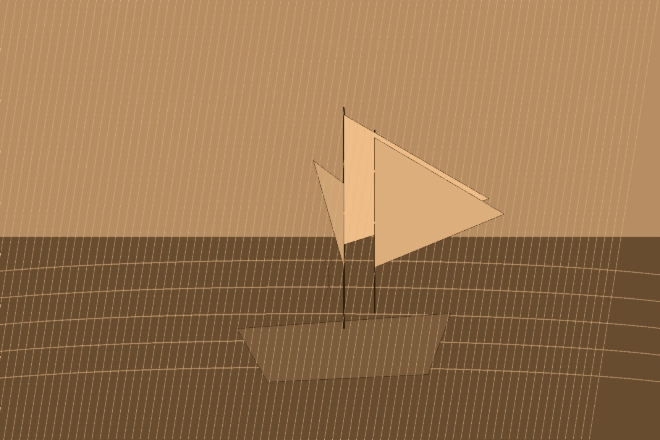
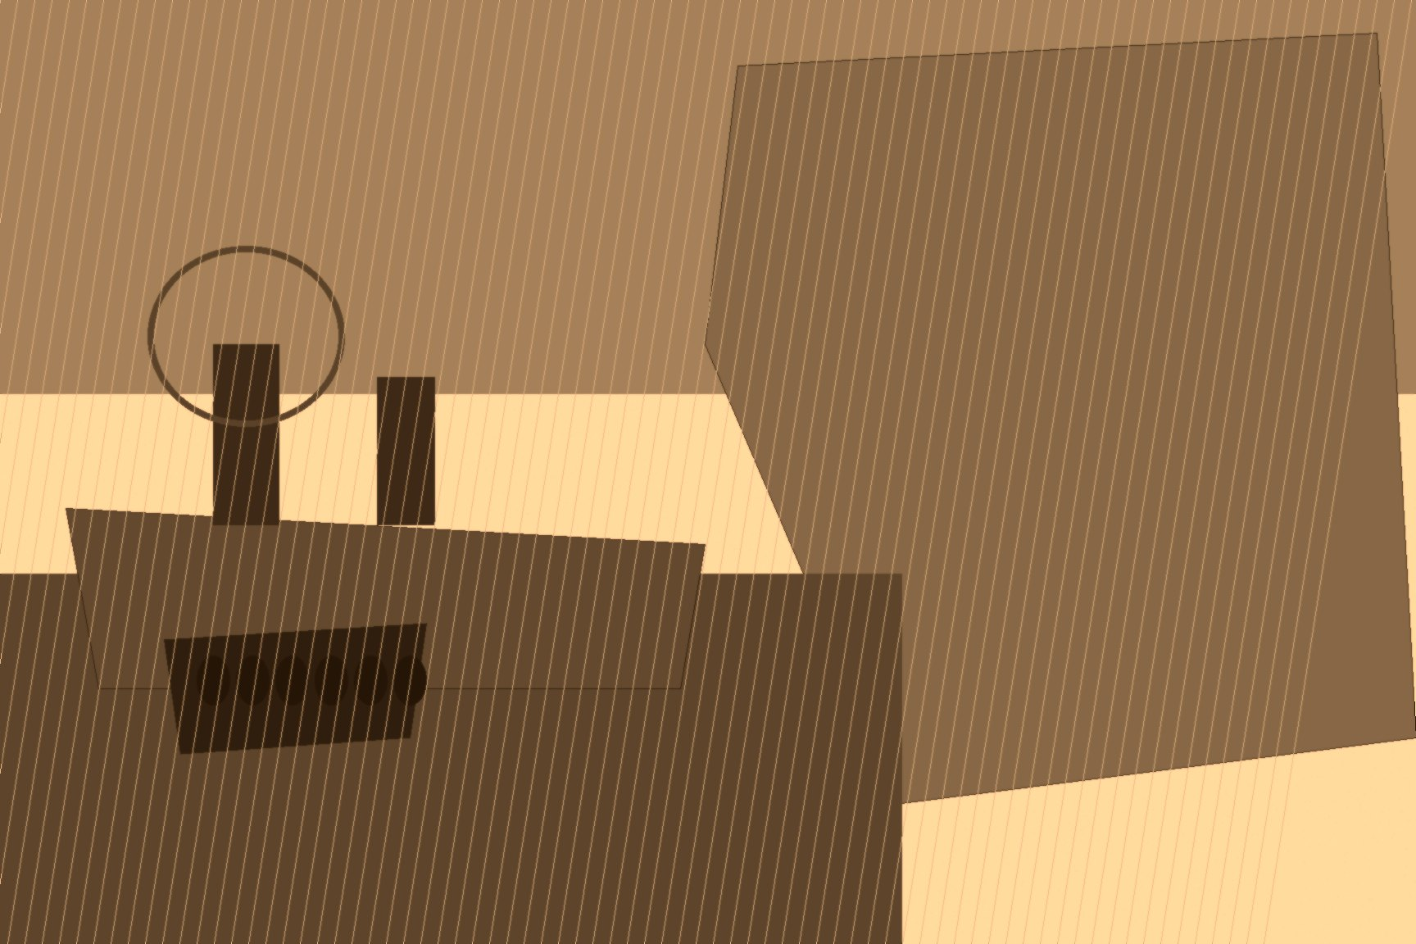
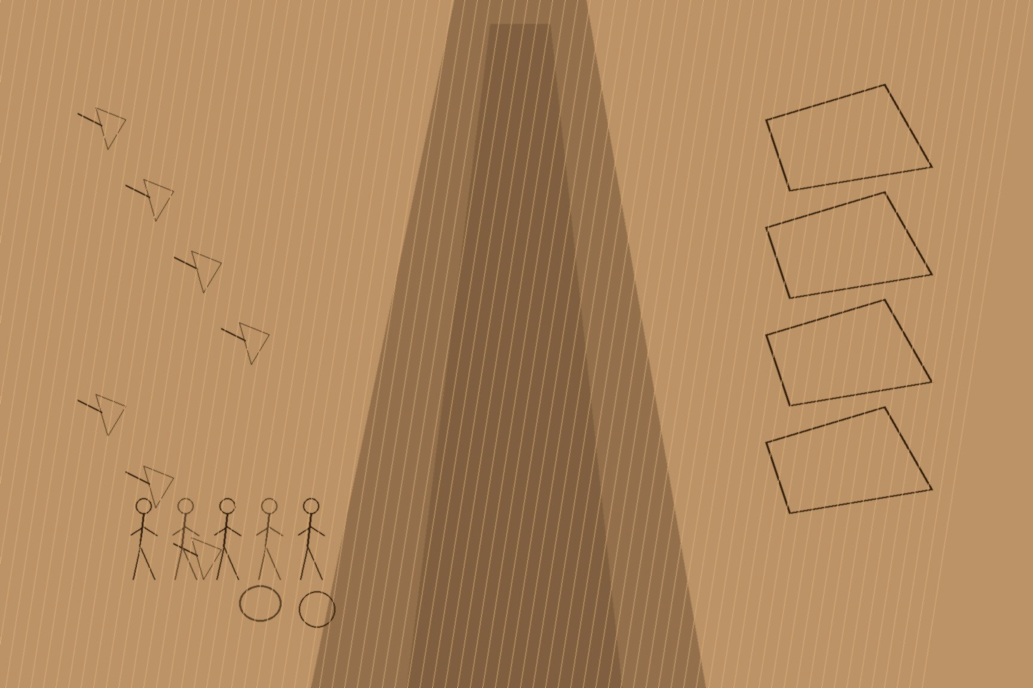
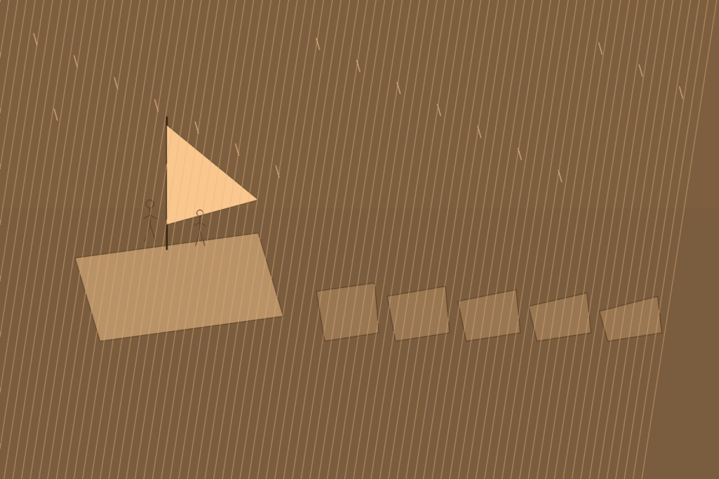
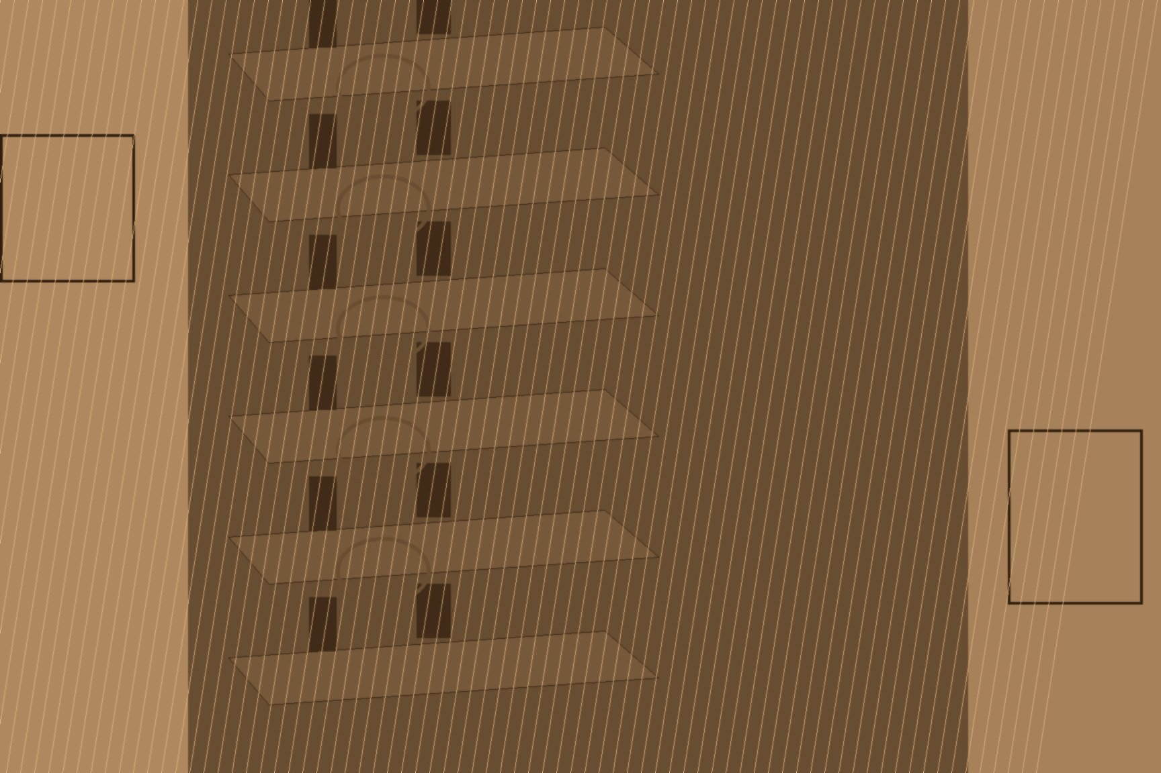
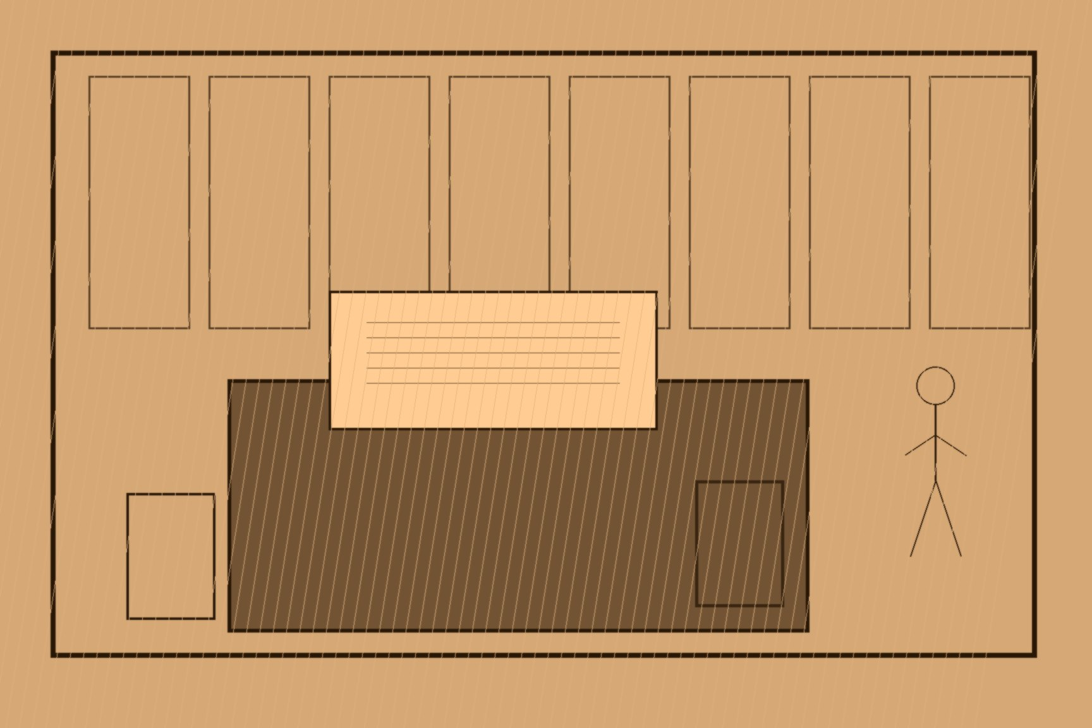
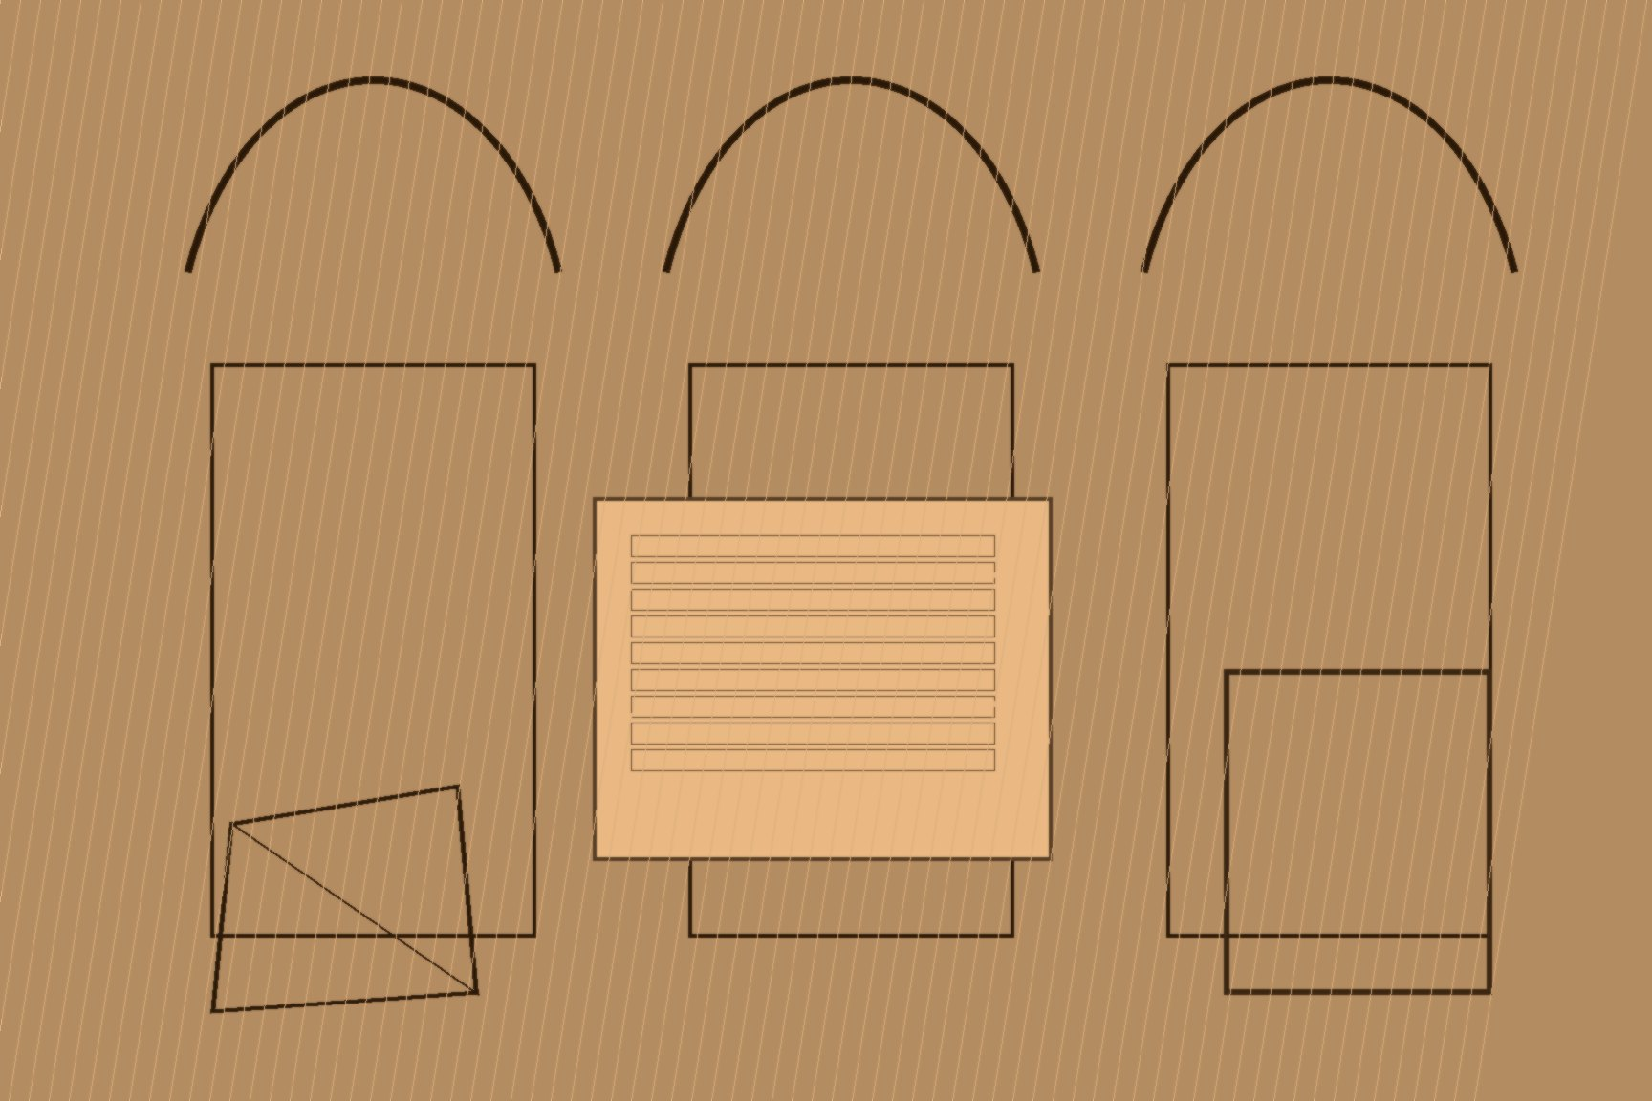
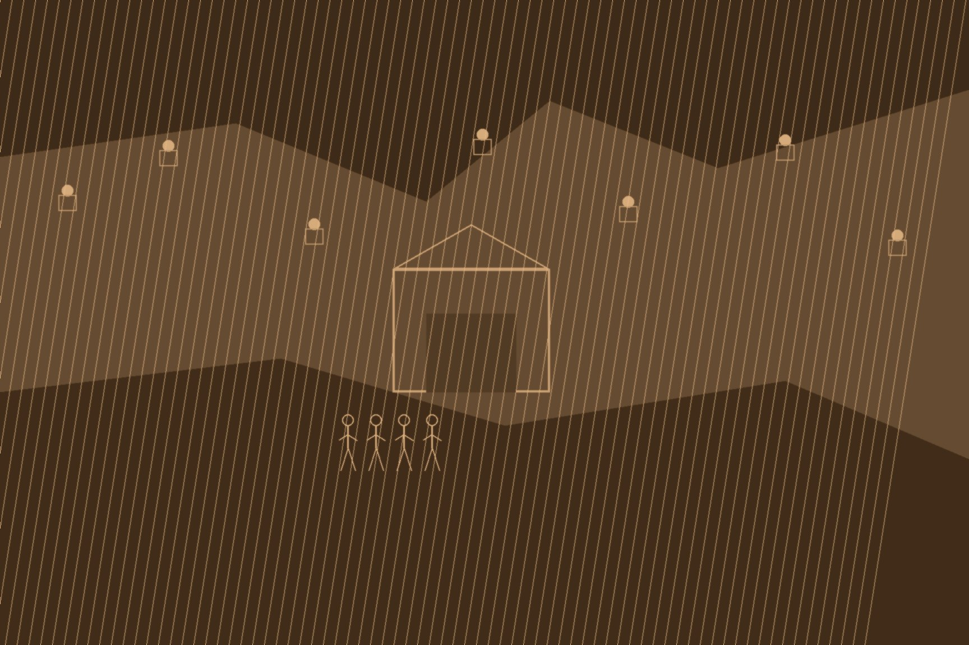
MJF
THE SUEZ CHOKEPOINT, 1875
Suez and London
For a century the books of the empire waited on a voyage around the bottom of the world. Tea out of Fuzhou and Shanghai. Opium out of Calcutta. Silk out of Canton. All of it around the Cape. Ninety days. A hundred and twenty if the wind was a thief. Credit, silver, the season's leaf — sitting in the hold for a third of a year. Not working.
Speed made the clippers. Cutty Sark. Thermopylae. Knife hulls, too much canvas, a premium for the first chest of new tea on the London quay, a bonus for the captain who did not lose the sticks. Wind still owned them. Early steam was punctual and fat: engine and coal where cargo wanted to be, and Africa still in the way. The circuit wanted a cut that did not move with the weather.
17 November 1869. The canal opened. Ferdinand de Lesseps. A hundred and sixty-four kilometres of Egyptian desert. Corvée by the hundred thousand. Before mechanized dredges took over the heavy work in 1864, tens of thousands of fellahin had been levied under Egyptian corvée law, pick and basket for weeks at a stretch, camped in the desert without clean water; cholera moved through the labor camps and killed by the thousand. Lesseps's company mechanized the later years partly to answer the international outcry the corvée had raised, not for speed alone. None of that traveled the guest list on opening day. The Empress Eugénie's yacht L'Aigle led the flotilla into the Bitter Lakes, khedival fireworks and champagne on deck, European royalty toasting a desert that had, within living memory of the men who dug it, buried its dead beside the cut. Mediterranean to Red Sea. Four thousand miles off the London–Bombay run, nearly a month. The inland sea stopped being a local water and became the road.
French money and Egyptian backs built it. British hulls filled it — more than four-fifths of the traffic almost at once. Britain owned no share. The artery to India and China sat with foreign stockholders and a khedive already drowning.
November 1875. Ismail Pasha put the government's forty-four percent on the block. Debt. Modernization loans. The French cabinet hesitated, mid-crisis at home, unable to commit treasury funds without a vote it had no time to hold. Disraeli did not wait for the House either — there was no House to wait for, Parliament not yet in session. He sent his private secretary, Montagu Corry, to New Court with one question for Lionel de Rothschild: could the house advance four million pounds against nothing but the government's word, on a Sunday afternoon, before a single MP had voted to authorize a shilling of it. Rothschild's one condition was his commission — two and a half percent, roughly one hundred thousand pounds — and the cash moved on that handshake. 25 November: 176,602 shares. Largest single holder. Disraeli to Victoria: "It is settled; you have it, Madam." Parliament, when it convened, ratified a purchase already completed rather than voted on one still pending.
The court in Beijing had already been told, if anyone there was reading the men who had gone to look.
魏源 Wèi Yuán, 海国图志 Hǎiguó Túzhì — Illustrated Gazetteer of the Maritime Kingdoms, 1842. He wrote 苏夷士 Sūyíshì for the isthmus and put it where the European seas meet the Indian Ocean. A lock. Not a curiosity.
斌椿 Bīn Chūn, 1866, first official Qing mission west, canal still a ditch. 乘槎笔记 Chéngchá Bǐjì — Notes from a Raft. He watched the cut and wrote that once the water joined, 欧亚两海瞬息可通 Ōu-Yà liǎng hǎi shùnxī kě tōng — the two seas of Europe and Asia could be crossed in a breath.
郭嵩焘 Guō Sōngtāo, first resident minister to Britain, went through the finished cut late in 1876 on the way to his post. 使西纪程 Shǐ Xī Jìchéng — Record of a Mission to the West. British warships and merchant steam in the slot. He did not treat Egypt as a separate European quarrel. He wrote that Britain was making the place an 东方驿站 dōngfāng yìzhàn — an eastern staging post — and that the grip on the canal was the grip on the pipe that carried Indian opium and Chinese tea. The diary cost him what a private log rarely costs a diplomat: conservative officials in Beijing read Shǐ Xī Jìchéng as praise of the barbarian and petitioned to have the printing blocks destroyed and Guo recalled in disgrace. The court obliged on the printing blocks, though it let him finish his posting. He remains, on the strength of that surviving fragment, one of the sharpest witnesses the Qing produced to the mechanics of the corridor he was sailing through.
Gibraltar. Malta. Suez. Aden. Ceylon. Singapore. Hong Kong. Guo put the beads on one string. The 1875 purchase was the paper. After the paper came the garrison, wherever a local population looked as if it might close the cut.

