Slide 1
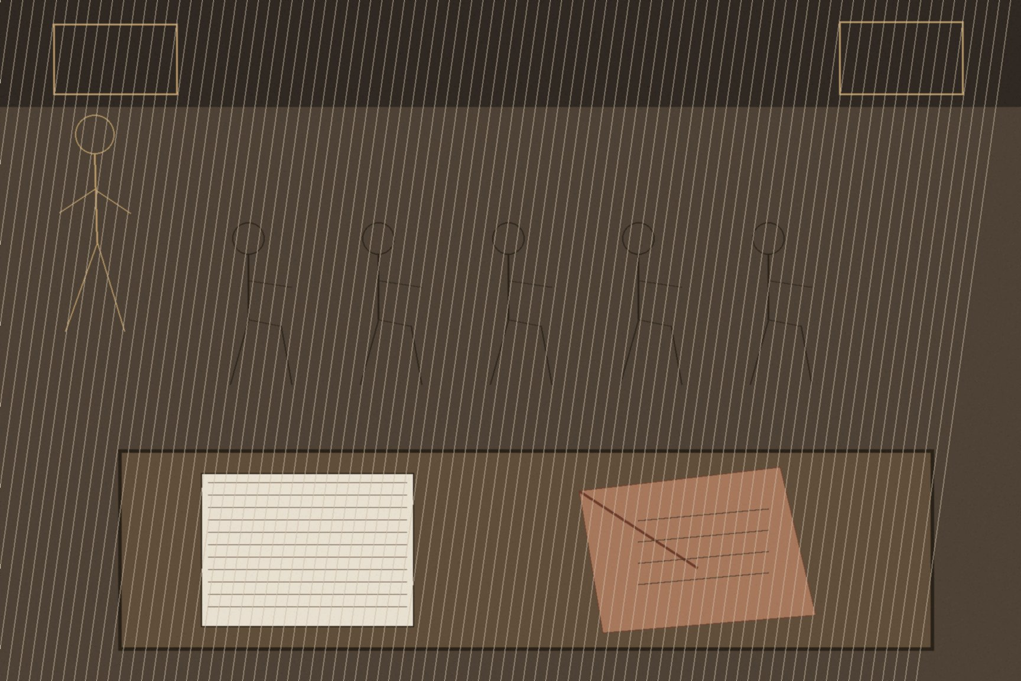
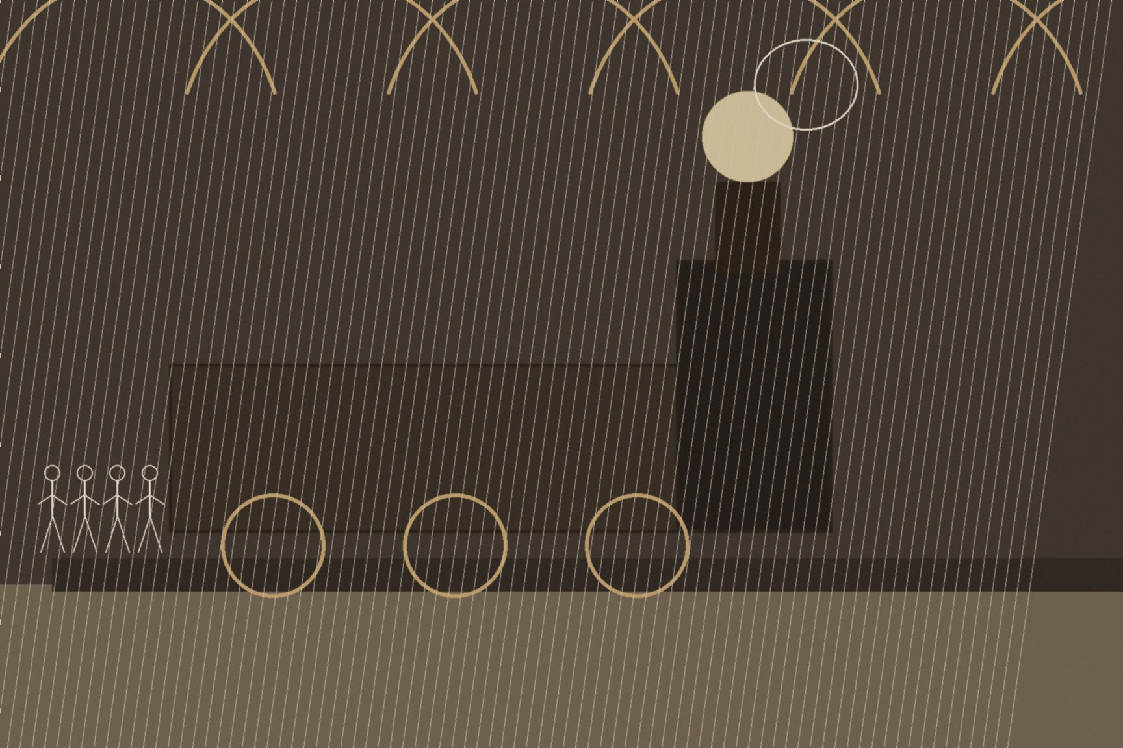
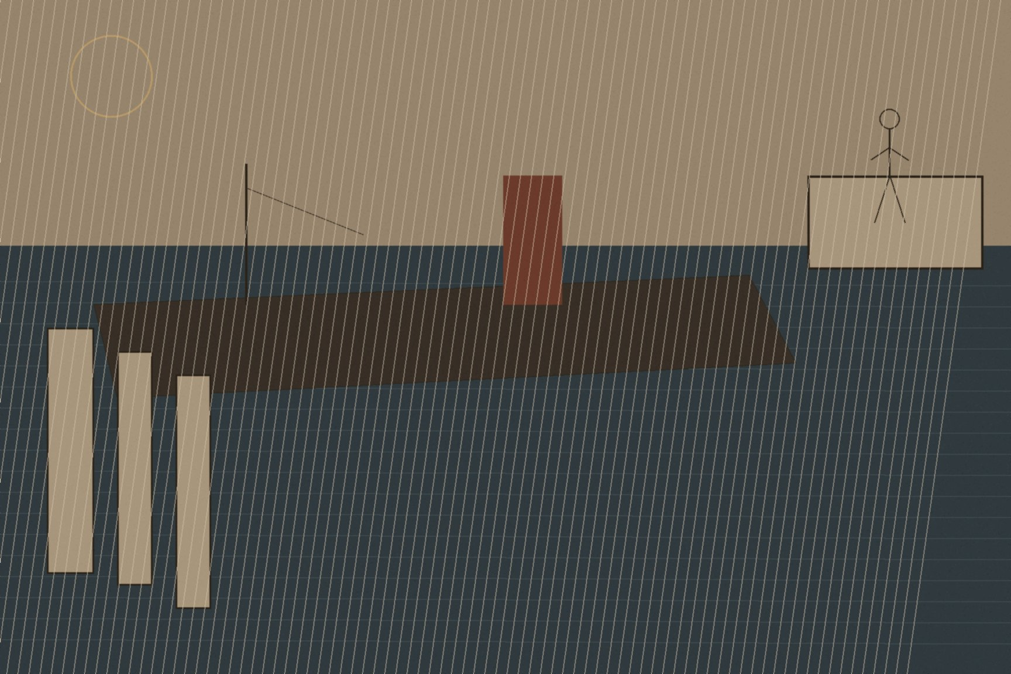
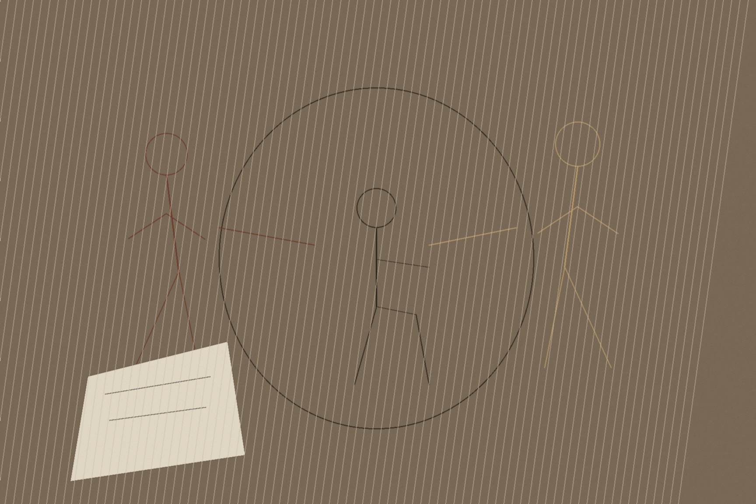
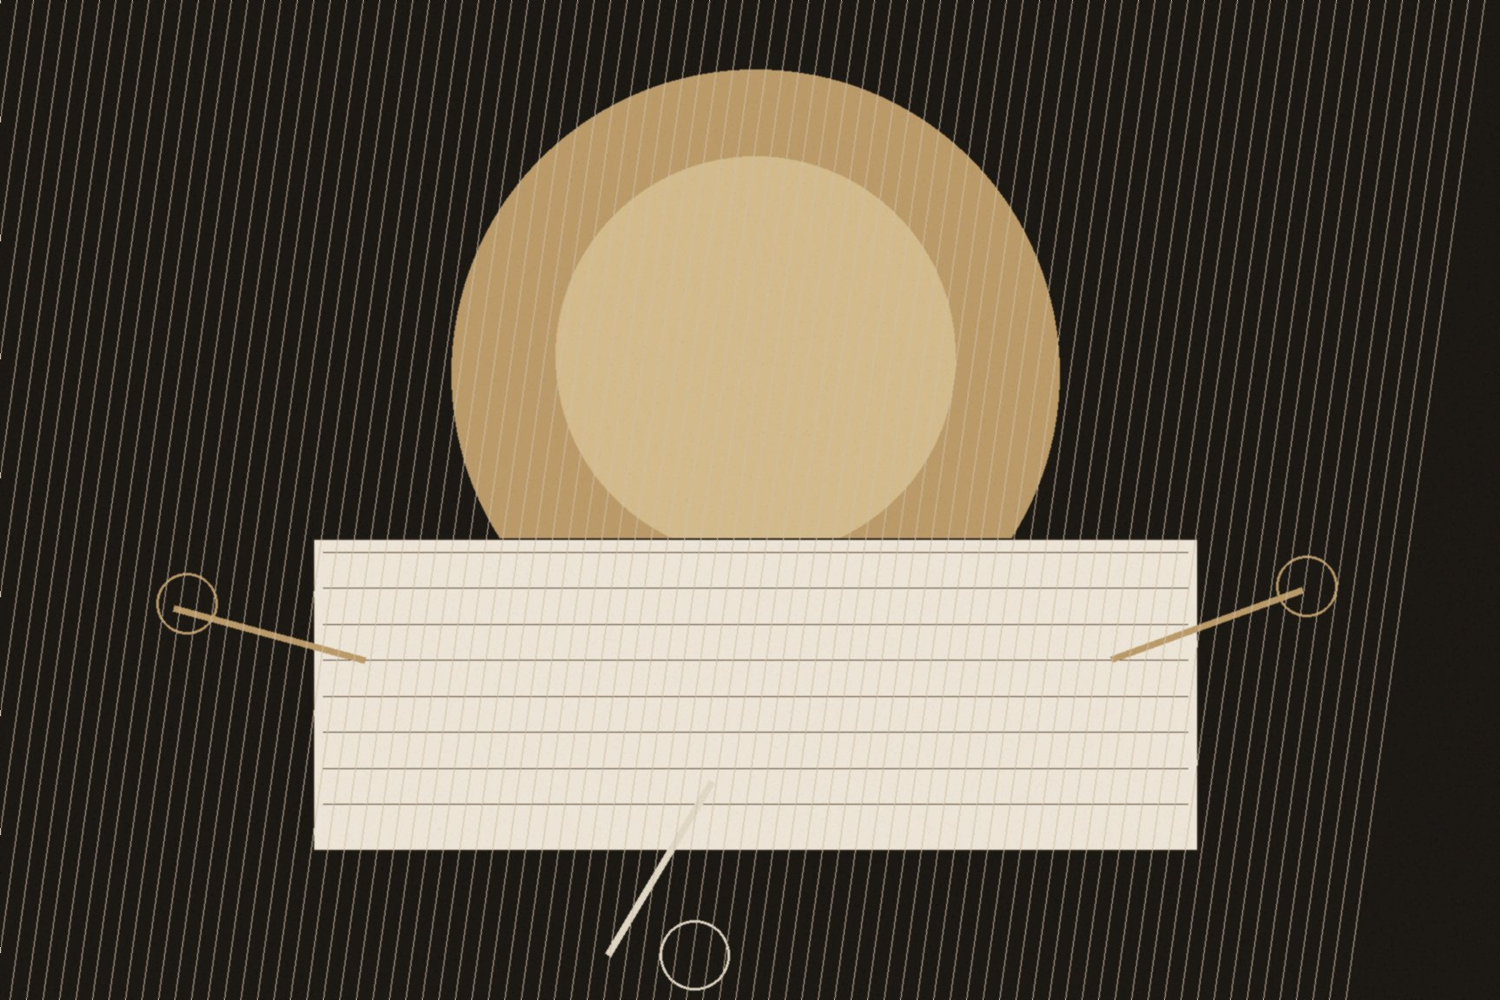
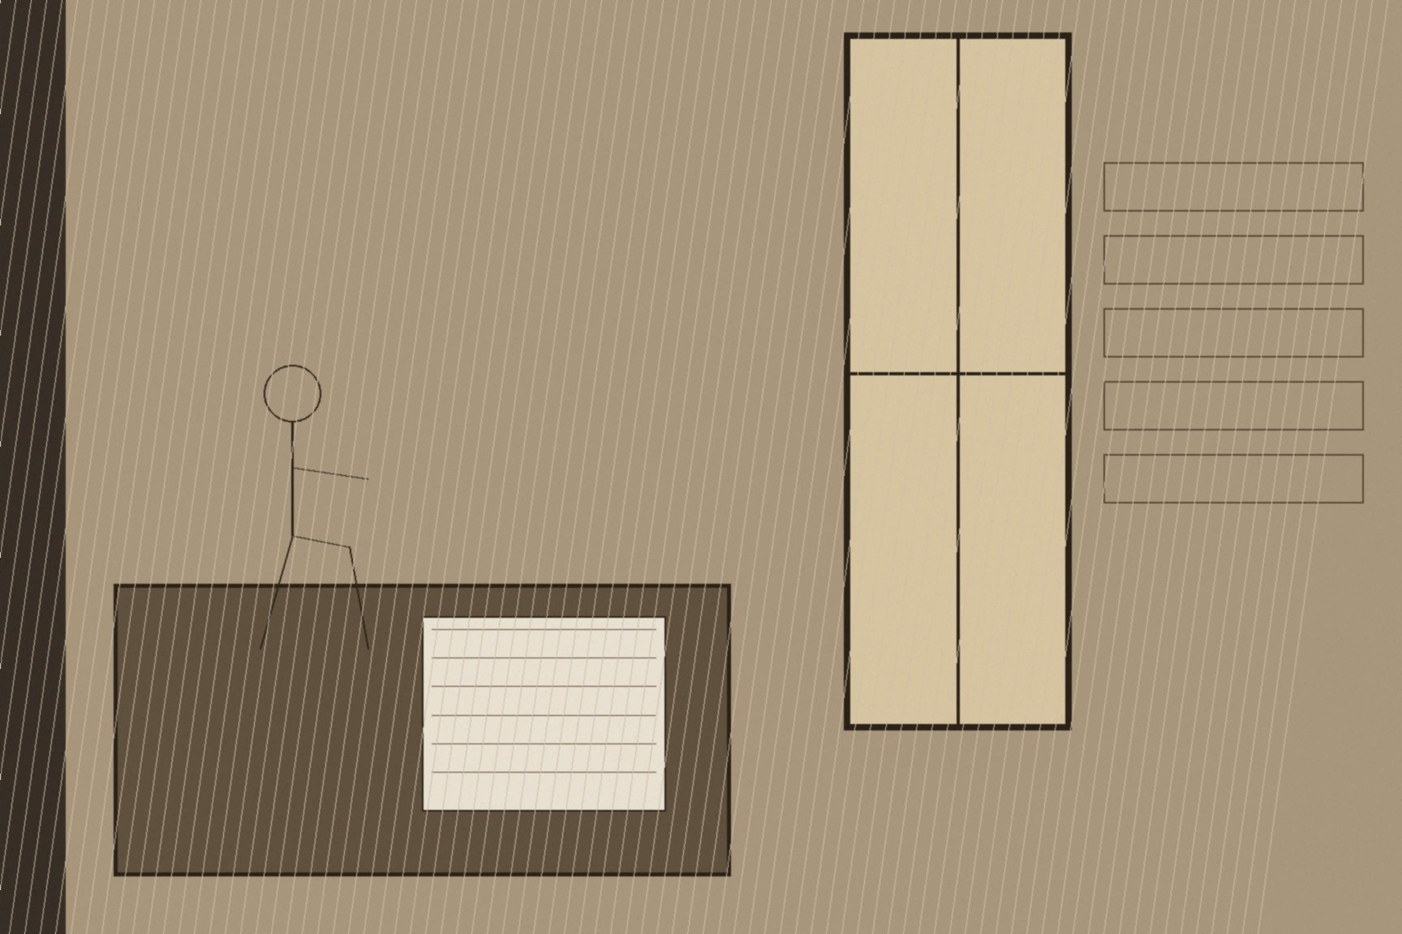
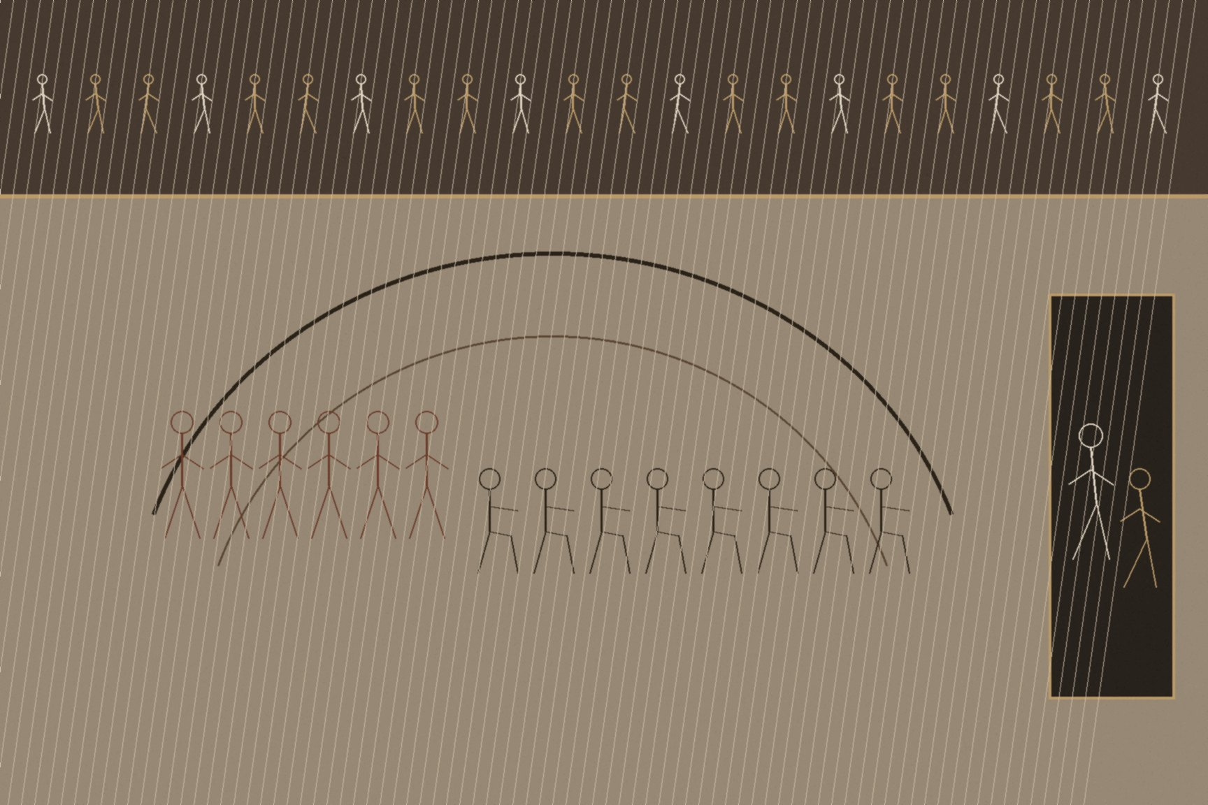
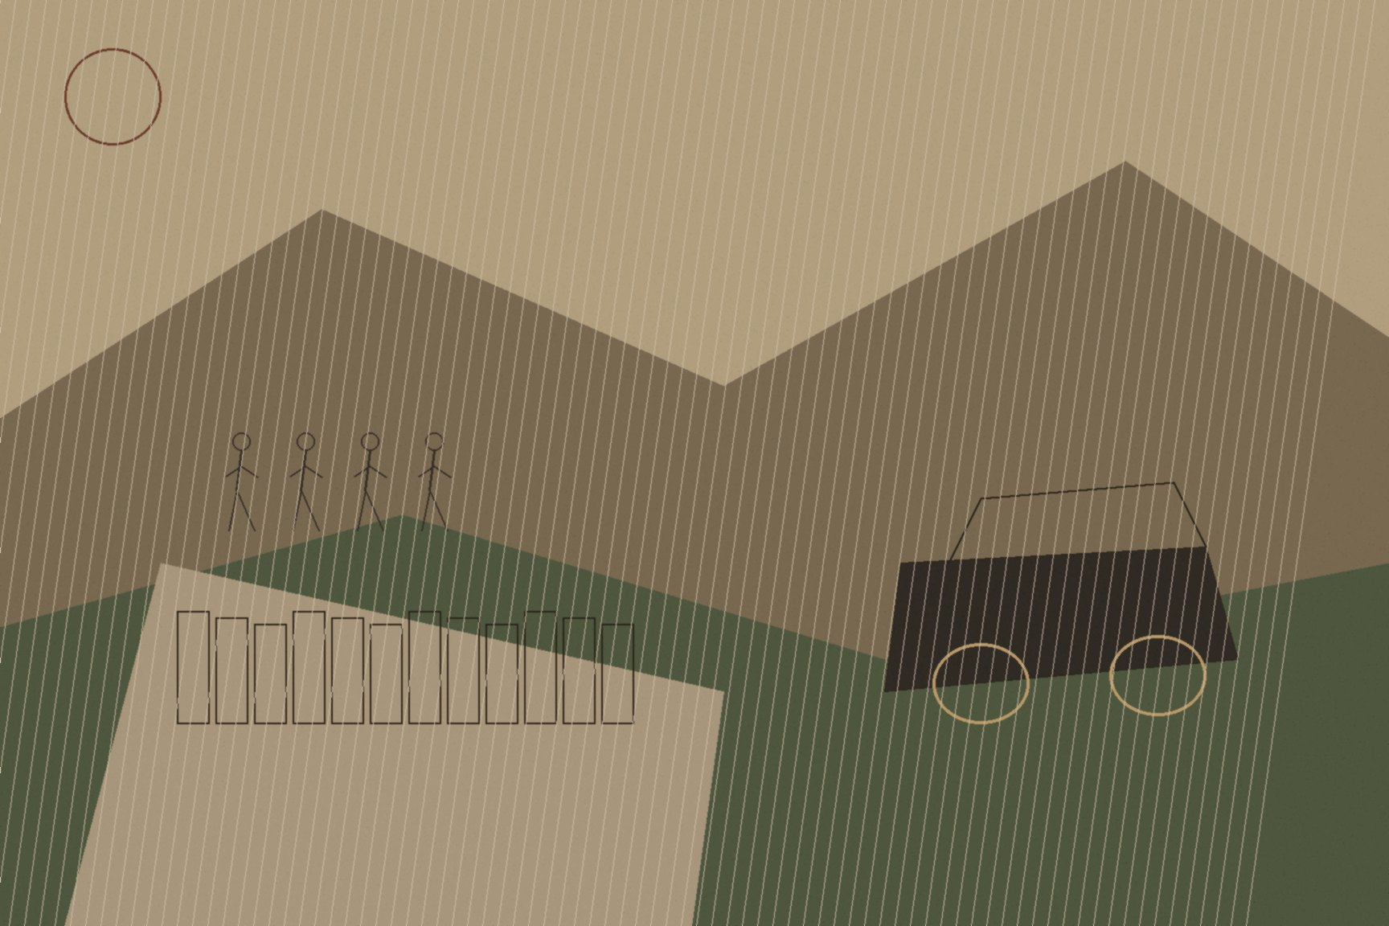
MJF
TWO LETTERS, DOWNING STREET, 1921
London
On the night of December 5, 1921, David Lloyd George laid two letters on the table in front of the five Irish plenipotentiaries — Arthur Griffith, Michael Collins, Robert Barton, Eamonn Duggan, and George Gavan Duffy — and told them a train stood ready at Euston Station and a Royal Navy destroyer waited at Holyhead to carry whichever one they chose north to Belfast, to Ulster's prime minister James Craig. One letter announced that Britain and Ireland had reached agreement. The other announced that talks had broken down, and Lloyd George told the delegation plainly what would follow: immediate and terrible war, within three days. Éamon de Valera, the President of the Irish Republic, had chosen not to lead the delegation himself and remained in Dublin; the men actually in the room that night had no President to defer the decision to.
Robert Barton held out longest. Collins and Griffith worked on him directly, telling him that if he alone refused to sign, he alone would carry responsibility for Irish homes laid waste and the youth of Ireland butchered. Barton gave way around eleven that night. It took hours more to reconcile both delegations' positions and get a final document printed, and the Articles of Agreement for a Treaty Between Great Britain and Ireland were signed at 2:20 in the morning on December 6, 1921 — a twenty-six-county Free State with dominion status inside the British Empire, an oath of fidelity to the Crown in place of the Republic that had been declared in the Mansion House three years earlier, partition made permanent pending a boundary commission nobody in the room fully believed would move the line.
Collins wrote to a friend, John O'Kane, that same morning, before the ink was properly dry on anything. Early this morning, he told him, he had signed his own death warrant — he thought at the time how odd, how ridiculous, since a bullet might just as well have done the job five years earlier. He did not treat the sentence as a figure of speech. He had spent three years running an intelligence war that had made him the single most wanted man in Ireland, and he understood exactly what walking back into Dublin with his name on that document was going to cost him among the men who had fought that war on the promise of something more than dominion status.
The Dáil debated the Treaty for three weeks starting that December, in public session at Earlsfort Terrace, arguing over dominion status, the oath, and partition in front of galleries packed with people who had buried sons and brothers for the Republic the document did not deliver. Collins made his case in the terms he actually believed: the Treaty gave Ireland not the ultimate freedom every nation wanted, but the freedom to achieve it. De Valera rejected that framing outright, treating any settlement short of the Republic as a betrayal of everyone who had died since 1916. On January 7, 1922, the Dáil voted to ratify the Treaty by 64 votes to 57 — a margin of seven. All six women deputies in the chamber voted against it without exception: Mary MacSwiney, Kathleen Clarke, Margaret Pearse, Countess Markievicz, Ada English, and Kate O'Callaghan. Margaret Pearse, whose sons Patrick and Willie had both been executed after the Rising, told the chamber she would be haunted by their ghosts if she voted otherwise. De Valera and the ministers who sided with him walked out when the result was announced.
Collins became chairman of the new Provisional Government within the week. He did not get eight more months. On August 22, 1922, on a tour through his home county of Cork during the civil war his own signature had helped set in motion, he was shot dead in an ambush at Béal na mBláth — the death warrant he had described writing for himself, at 2:20 in the morning eight months and sixteen days earlier, finally called in.

