Slide 1

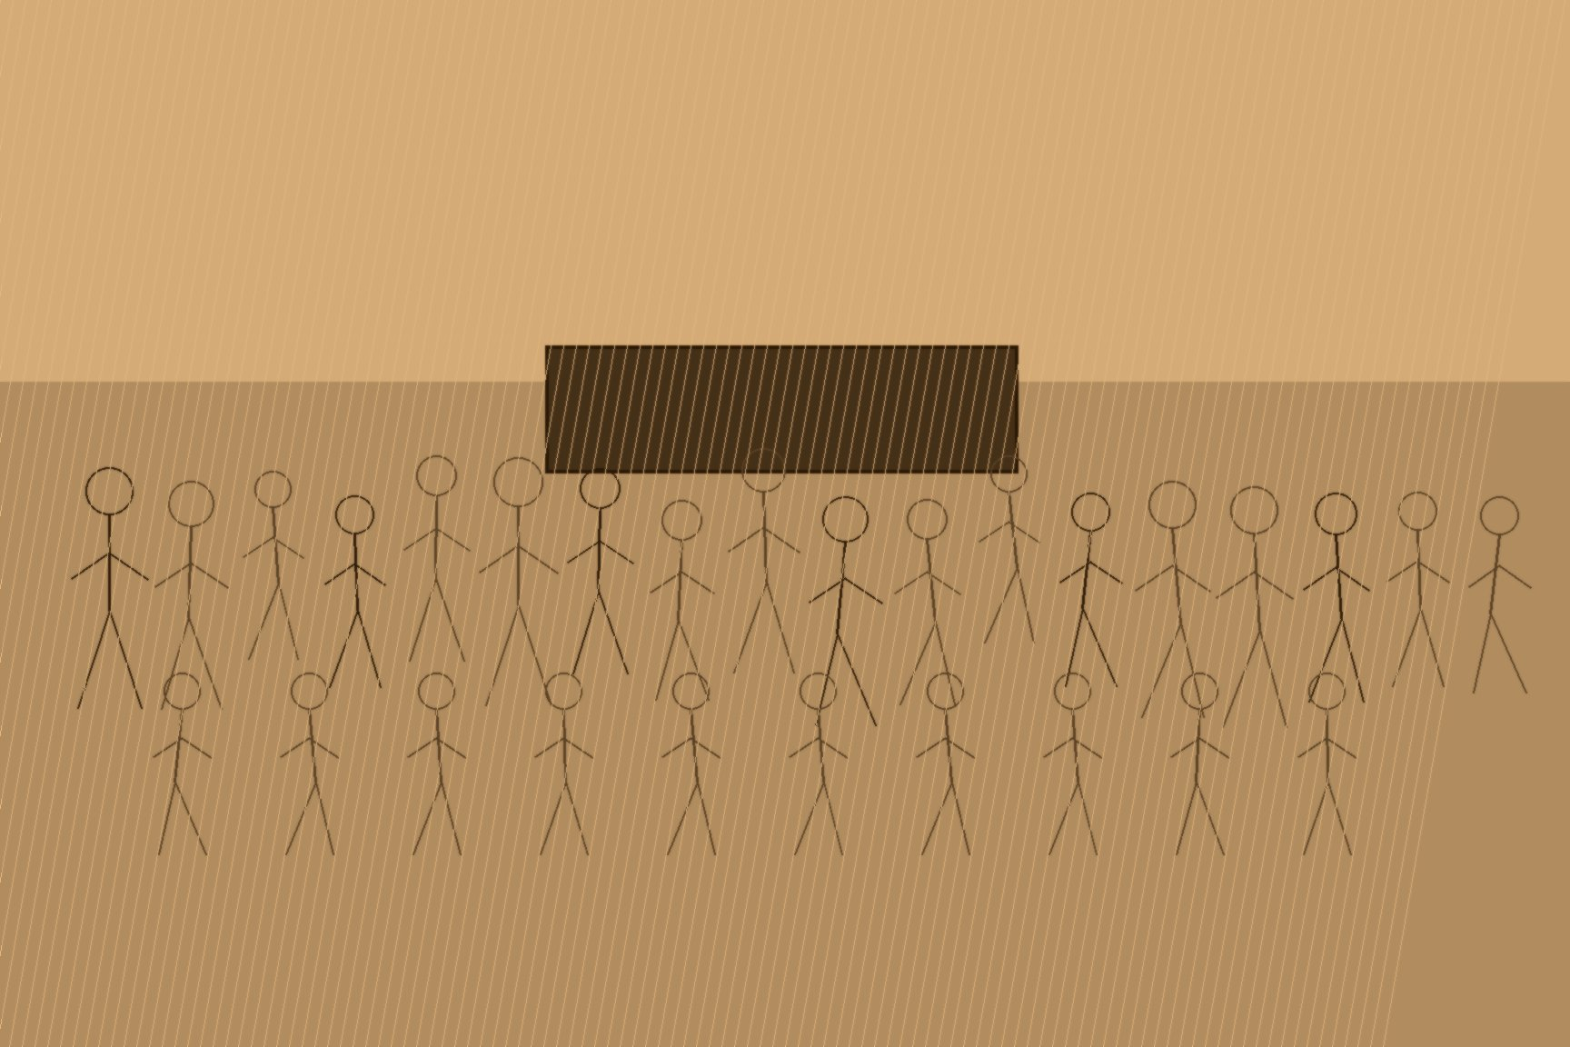




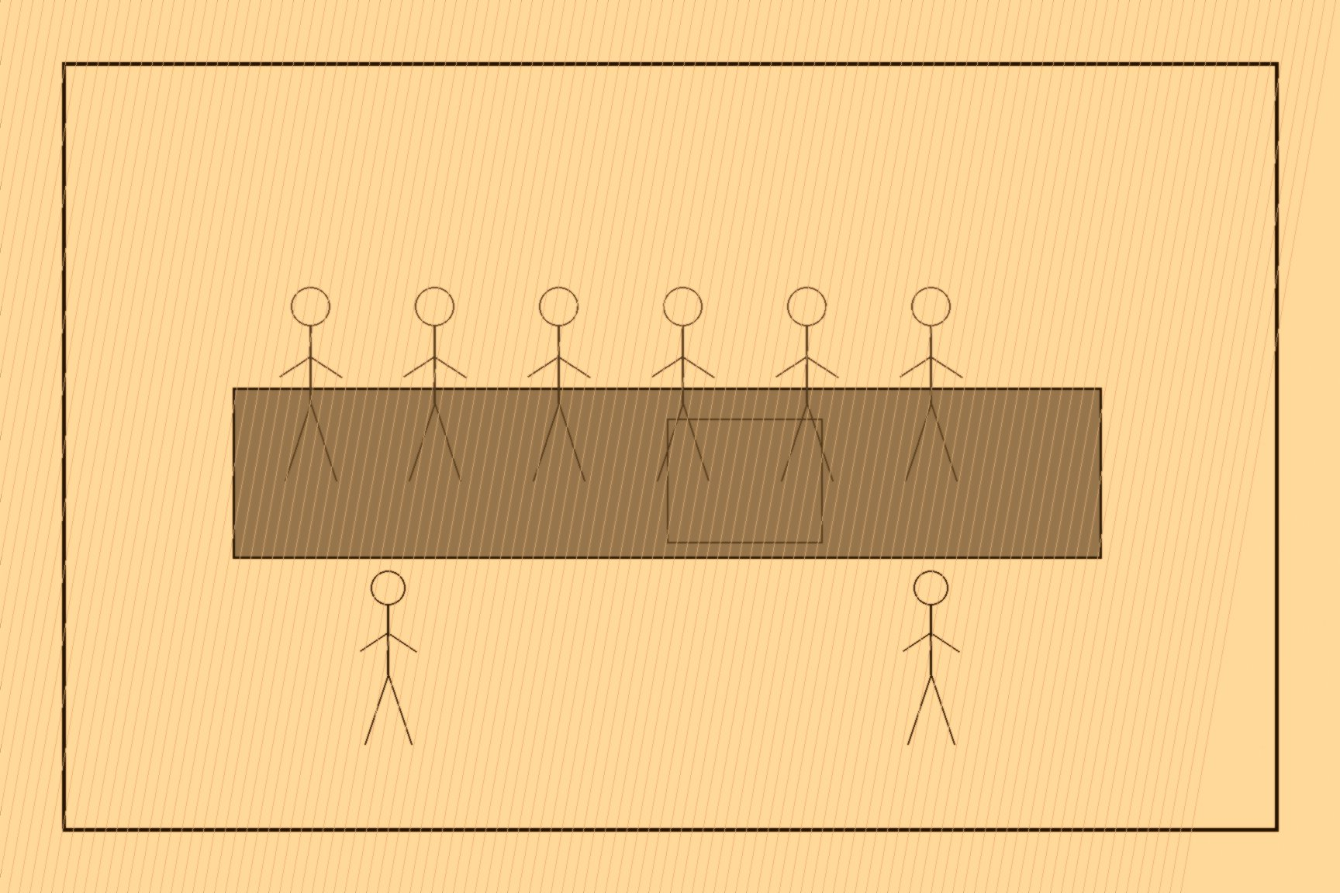
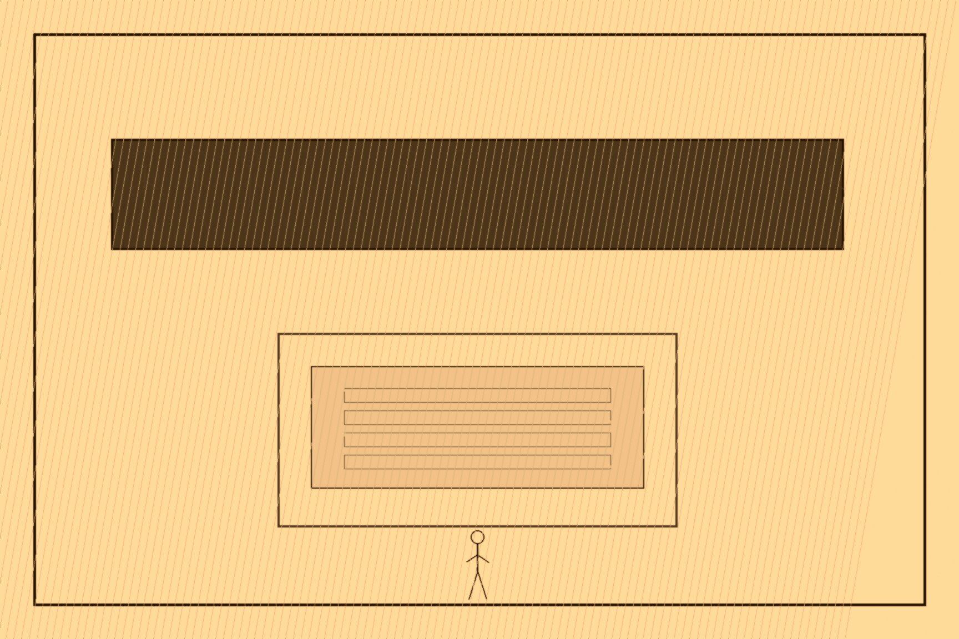
MJF
YA'BAD TO THE UN, 1935–1947
near Jenin, Mandatory Palestine
Izz ad-Din al-Qassam was fifty-two years old, a Syrian-born preacher at Haifa's Istiqlal Mosque, when two of the guerrillas he had spent five years training and arming through his Black Hand organization killed a Palestine Police constable hunting fruit thieves near Jenin in November 1935. British police tracked al-Qassam and his men to a cave near the village of Ya'bad and surrounded them. The battle lasted six hours. Al-Qassam was killed, along with two of his companions, and his funeral in Haifa drew thousands into what became a mass demonstration of Palestinian national unity. His followers began calling themselves Qassamiyun. The general strike did not wait until May. It started in Jaffa and Nablus on 19–20 April 1936 and was taken up by the new Arab Higher Committee on 25 April. 16 May was Palestine Day — solidarity strikes outside the country, and a harder turn inside it. Al-Qassam's death had already lit the fuse. The April strike was the fire.
The British met the revolt already primed for it, having spent the previous fourteen years staffing the Palestine Police with the same men and methods that had suppressed an insurgency in Ireland — a fact the revolt's British opponents did not need to know for it to shape how the response landed on Palestinian villages. By 1939 more than 20,000 British troops had been shipped into the territory, and the campaign killed thousands of Palestinian Arabs through collective punishment, home demolitions, and martial law before it burned itself out. Britain answered it with the 1939 White Paper, sharply capping Jewish immigration to Palestine for the following five years — a policy that took effect at the precise moment Europe's Jews had nowhere else on earth to go.
The White Paper did not solve the problem it was written to manage. It handed a second population a specific, documented grievance against the same government that had spent 1936 to 1939 fighting the first one. The Irgun, led by Menachem Begin, and the smaller, more radical Lehi launched a campaign explicitly built to drive Britain out of Palestine entirely — arms raids, assassinations of British officers, and eventually a direct strike at the Mandate's own seat of administration.
On July 22, 1946, Irgun operatives disguised as Arab kitchen staff carried roughly 350 kilograms of explosive, packed into milk churns, into the basement of the King David Hotel in Jerusalem, which housed the Mandate's military and civil headquarters. Three warning calls reportedly went out beforehand — to the hotel switchboard, the Palestine Post, and the French consulate — and the building was not evacuated. The blast brought down the southern wing and killed 91 people: 41 Arabs, 28 British, 17 Jews, and five others. The Haganah, the mainstream Jewish defense force, had approved the operation in coordination with the Irgun before withdrawing from it, and the Jewish National Council publicly denounced the bombing afterward even as the broader campaign against British rule continued regardless of the denunciation.
By February 1947, broke from a second world war and now facing organized armed resistance from both communities it had made contradictory promises to inside a twenty-five-month span three decades earlier, the British government stood up in the House of Commons and referred the entire Palestine question to the United Nations, announcing it would withdraw by May 15, 1948, regardless of what the UN decided to do about it. The department that made the announcement was the same Colonial Office that had drafted the White Paper, and its predecessor had signed both McMahon's letter and Balfour's. Britain had run out of ways to keep either promise, and had run out, finally, of any government left in the territory capable of pretending otherwise.

