Slide 1
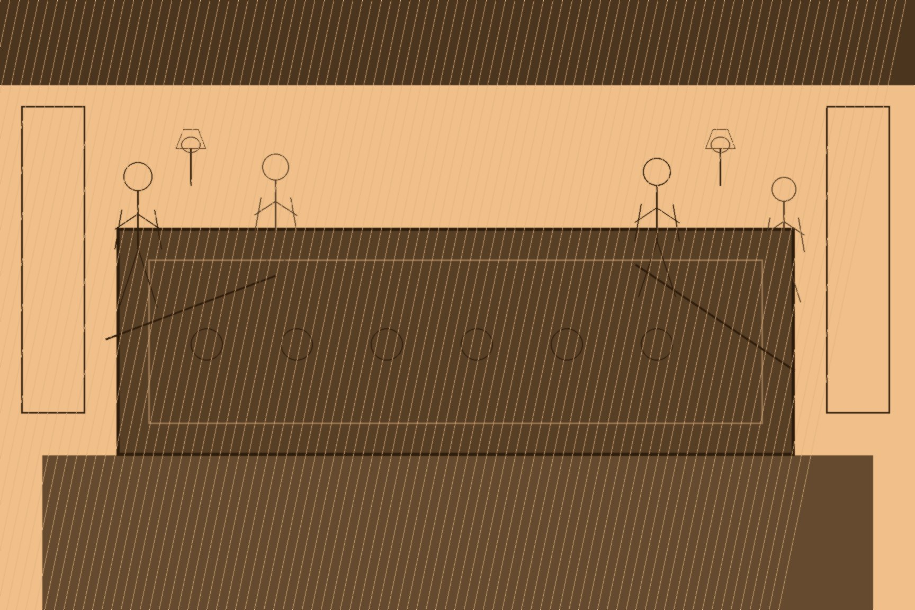
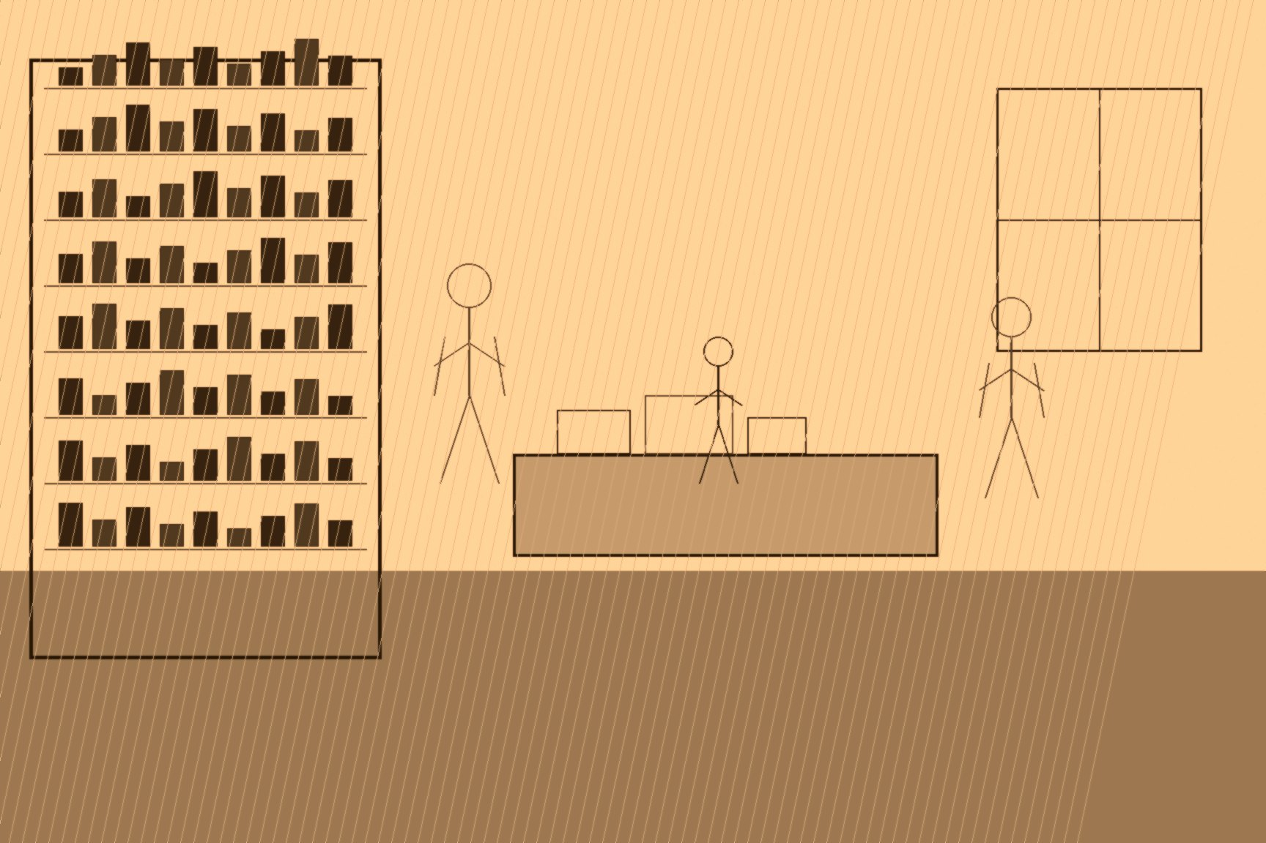
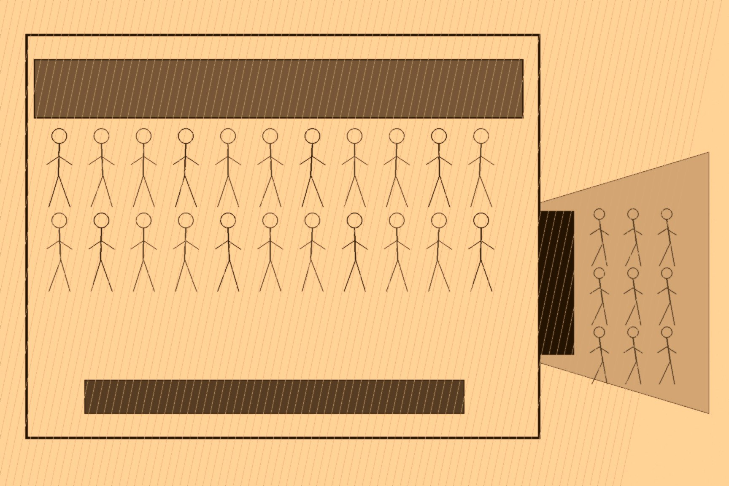
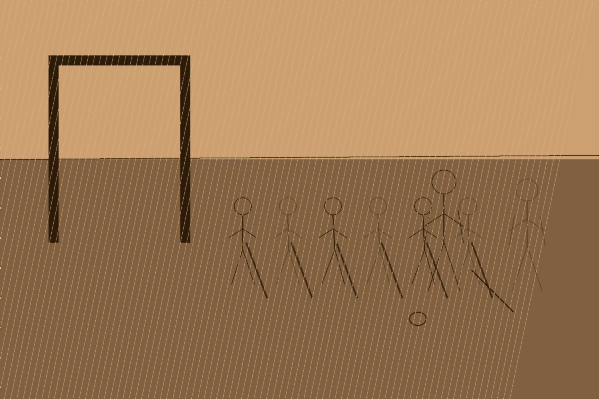
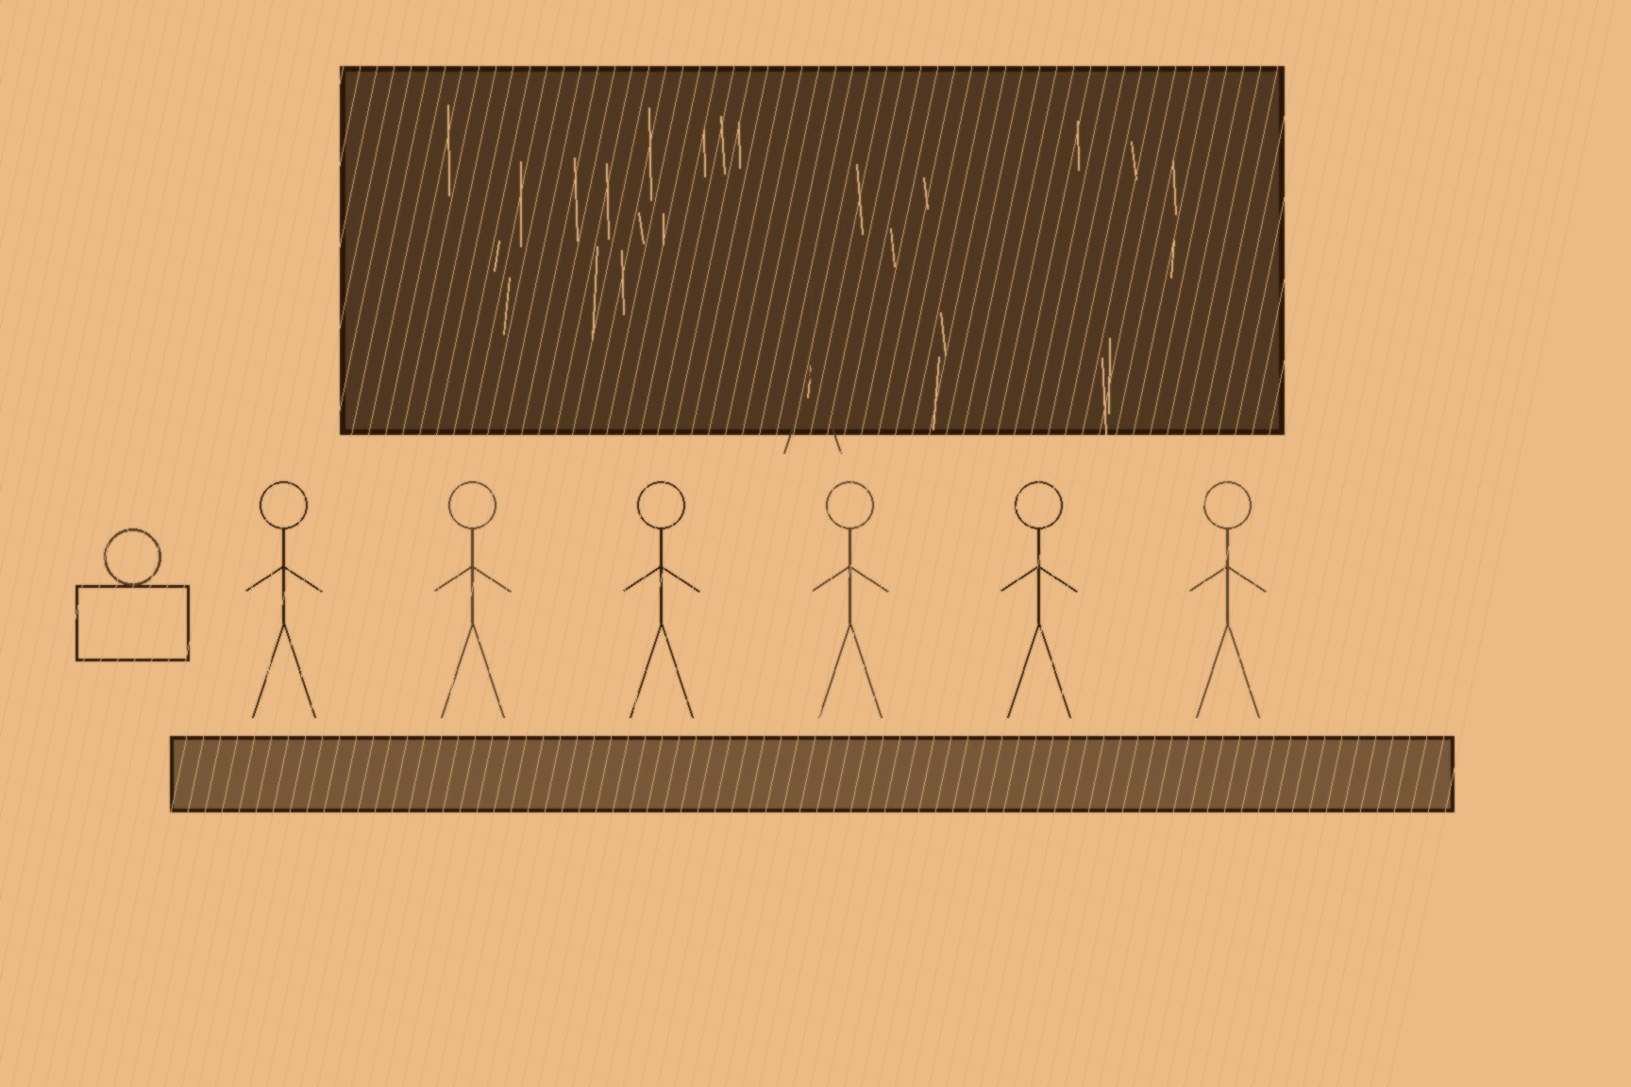
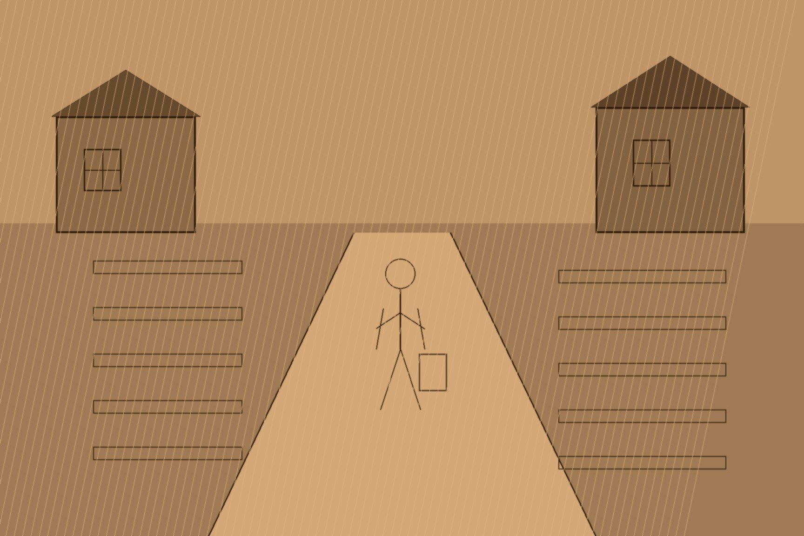
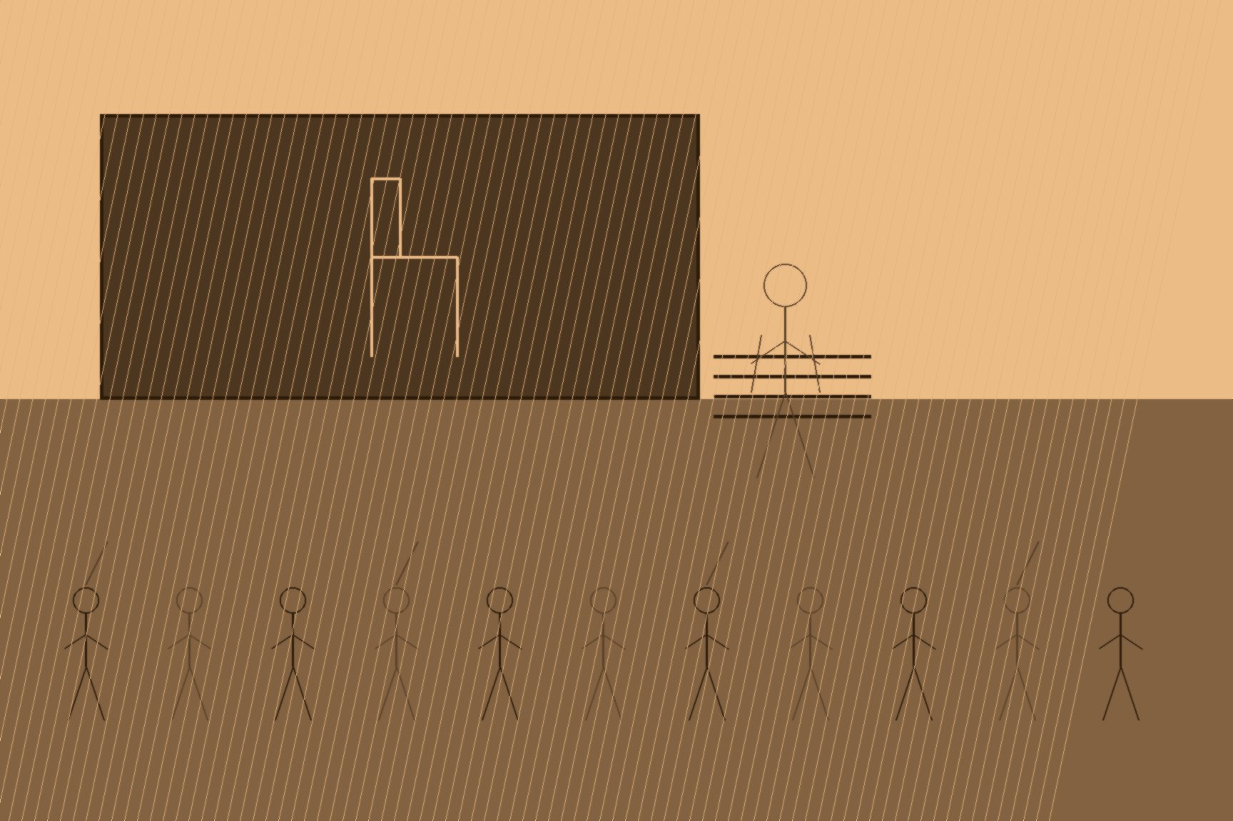
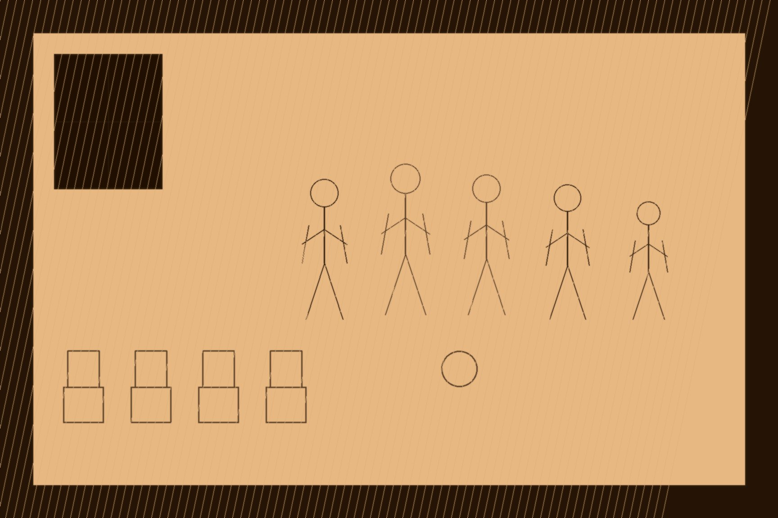
MJF
HYDE RESIGNS, DUNDALK, 1915
Dundalk, County Louth
Two organizations were founded, a decade apart, on charters that said the same thing in different words: we are not political. The Gaelic Athletic Association, called into being in the billiard room of Miss Hayes's Commercial Hotel in Thurles on November 1, 1884, existed by its own circular's stated purpose to preserve native pastimes and provide rational amusement in Irish people's leisure hours. The Gaelic League, founded in Dublin on July 31, 1893, existed by its founder Douglas Hyde's explicit design to revive the Irish language while staying strictly outside politics, open to unionist and nationalist alike. Both charters were sincere. Both organizations were, within a generation, run by a secret oath-bound society that had wanted exactly this kind of open, respectable, apparently harmless host body from the start. What follows is the mechanism, step by step, of how that happened to each of them.
The GAA's capture came first and came fast. At least two men in the room at Hayes's Hotel — J. K. Bracken and John Wyse Power — were already sworn members of the Irish Republican Brotherhood when the Association was founded. By the November 9, 1887 convention in Thurles, the IRB faction had a plan and executed it in public, in front of more than a thousand delegates with police lining the streets outside: arrive early, fill the hall, and make the case for control without euphemism — only men ready to die for their country belonged at the head of the GAA. When the chairmanship deadlocked, roughly two hundred moderate delegates walked out rather than sit through what followed, handing the IRB faction a working majority on the spot. Their candidate, Edward Bennett, a veteran of the 1867 Fenian rising, won the presidency 316 votes to 210. By 1890, of 810 affiliated GAA clubs nationwide, 497 were under direct IRB control.
What made the GAA useful for more than symbolism was what happened at the club level, away from any convention floor. Paddy O'Daly — who would go on to command Michael Collins's intelligence squad — was sworn into the IRB's Fintan Lalor Circle in 1907, at nineteen years old, through his own hurling club: a fellow club member who was already a circle organizer simply approached him, talked, and swore him in, no meeting hall required. The brothers Harry and Gerald Boland were recruited in 1904 the same way, approached directly after a hurling match by the man who had just refereed it. Neither case needed a coded signal or a secret rendezvous. It needed a match, a familiar face on the sideline, and a conversation that would look to anyone watching like nothing more than talk about the game just played — tradecraft built entirely out of material the GAA was already providing every weekend, for free, to any organizer patient enough to use it.
The Gaelic League took two decades longer to fall, and it fell by a slower version of the same method. Hyde's founding vision drew its intellectual force from his lecture "The Necessity for De-Anglicising Ireland," delivered the previous November, and the League grew fast enough to make his non-political ambition briefly plausible — over five hundred branches by 1903, more than six hundred at its peak a few years later, claiming some fifty thousand members at any given time. Tom Clarke, back from exile in the United States in 1907, rebuilt the IRB's structure alongside Seán Mac Diarmada and Bulmer Hobson. Mac Diarmada, appointed national organizer in 1908, toured the country under the open, legal cover of organizing Sinn Féin clubs while quietly identifying and recruiting likely men through the same League branches and classes Hyde had built to stay above politics entirely — an operative working two jobs at once, one of them visible and one of them not.
The mask came off on July 29, 1915, at the League's ard-fheis in Dundalk. Diarmuid Lynch, an IRB Supreme Council member who had spent years working the League from inside Dublin's Keating Branch — a branch that also counted Michael Collins, Cathal Brugha, and Thomas Ashe among its members — later gave his own account of what happened that day. With insurrection already being quietly prepared, IRB delegates carried a motion abolishing the League's founding non-political rule outright and inserting a free Ireland as a stated aim of the organization. Hyde, who had built the League from nothing and led it for twenty-two years on the promise that it would never do exactly this, resigned the presidency on the spot. Patrick Pearse, who had come up through the same League branches the IRB had just finished converting, had already said the quiet part aloud the year before: we went to school in the Gaelic League, he said. It was a good school. But we do not propose to remain schoolboys.

