Slide 1
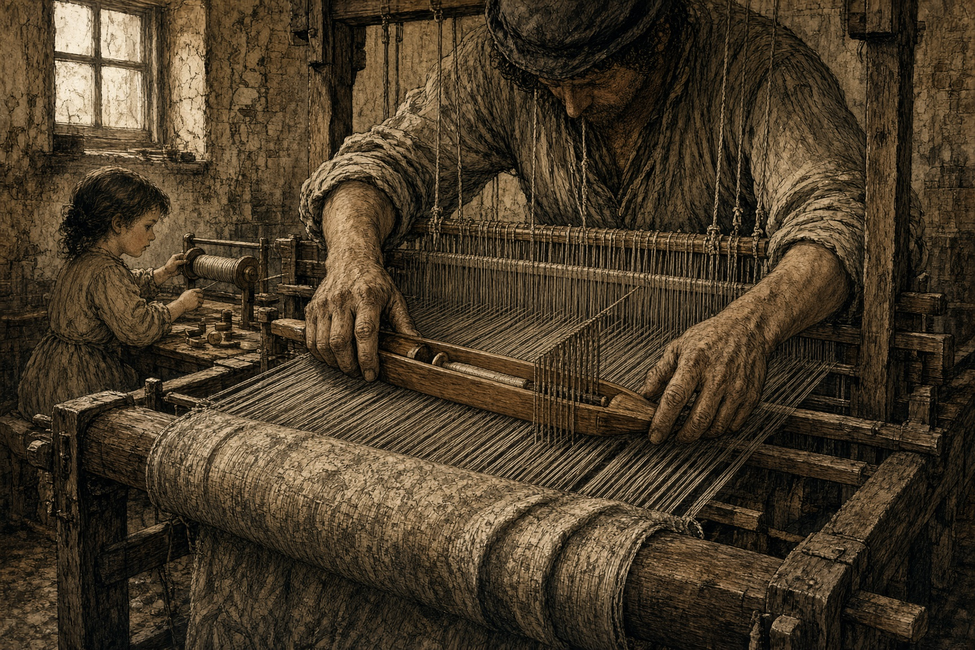
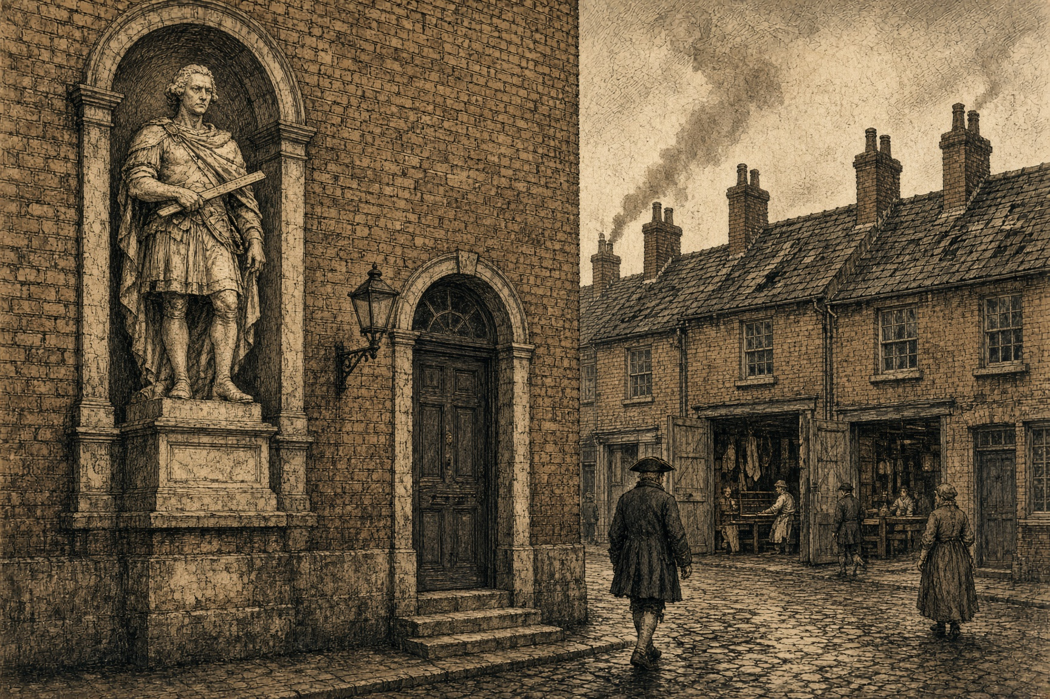
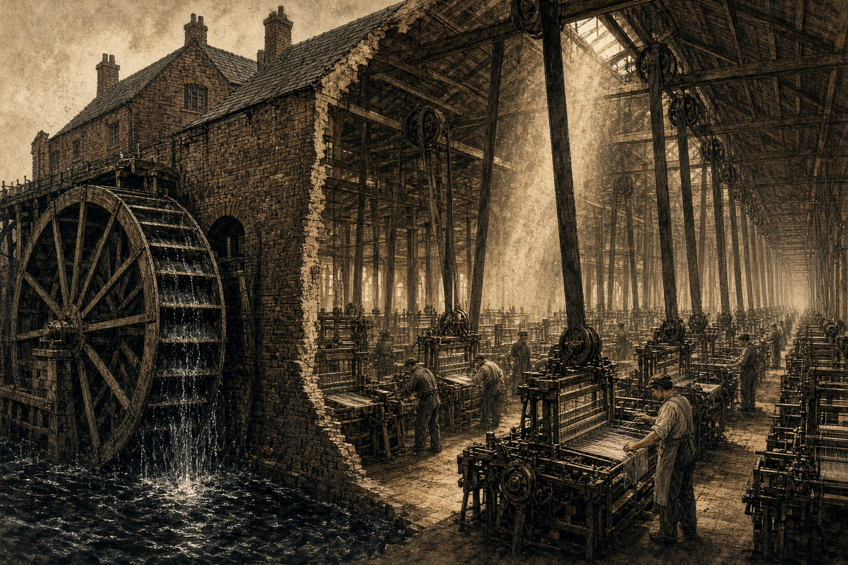
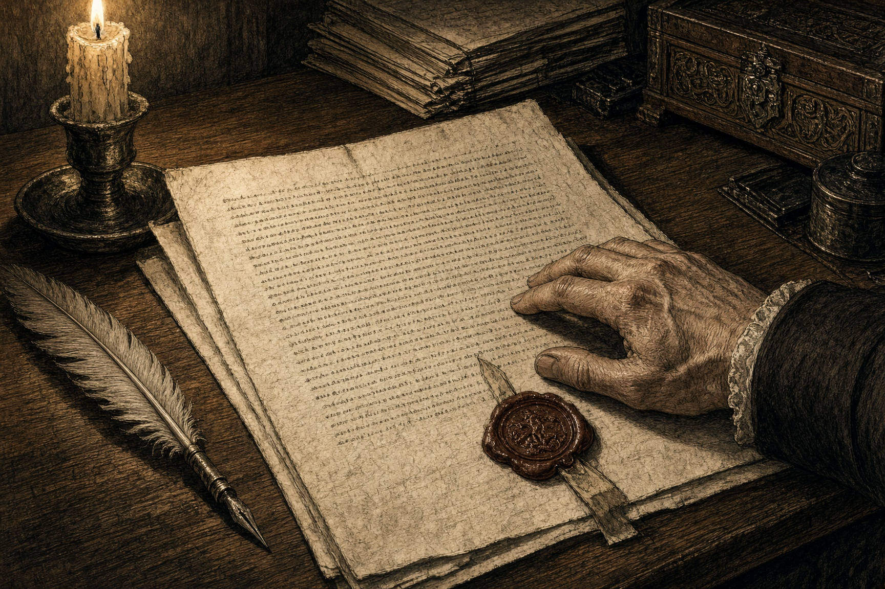
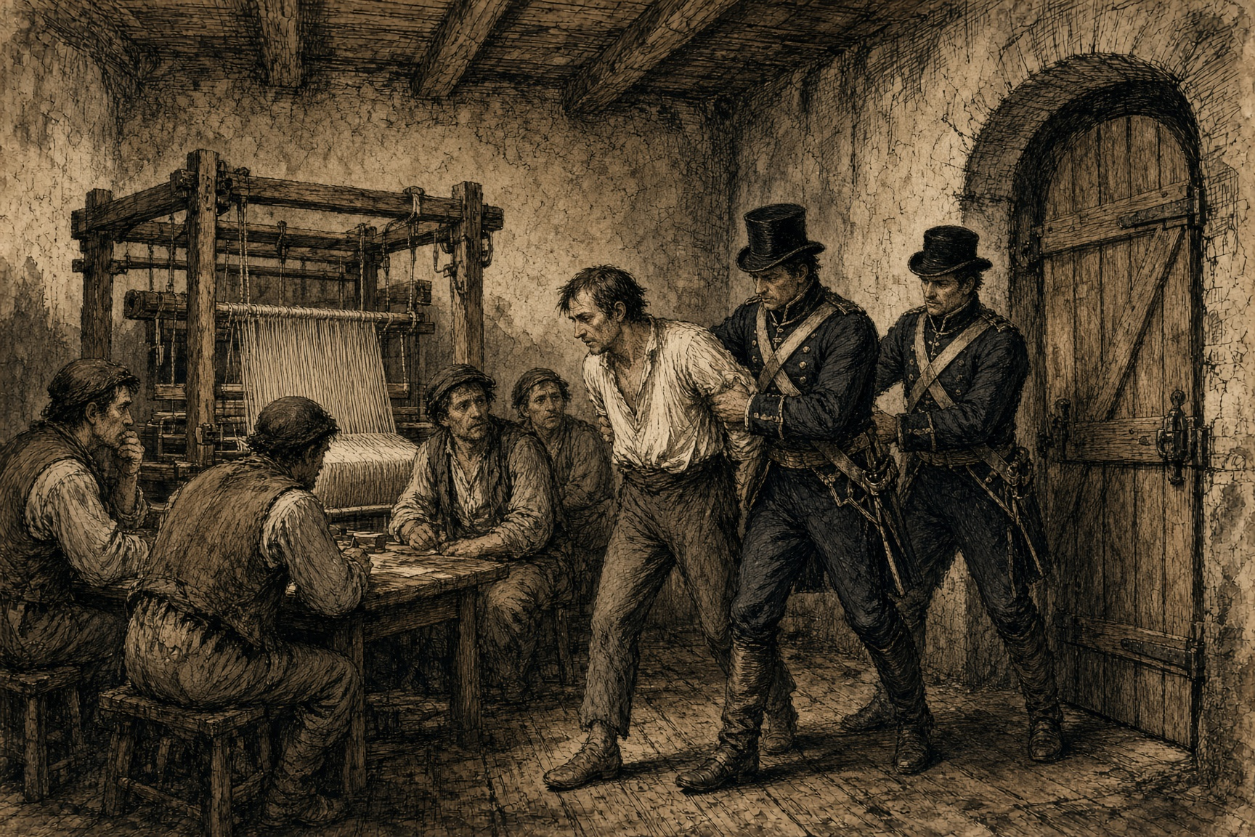
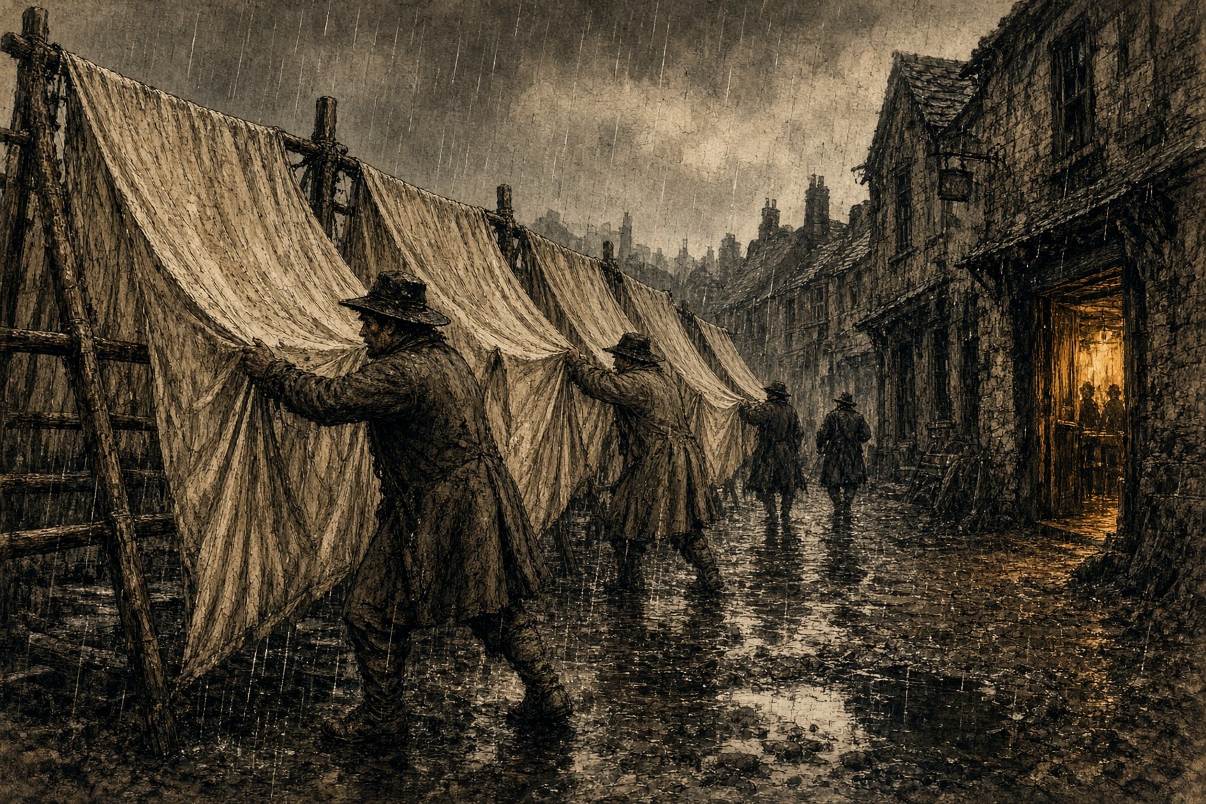
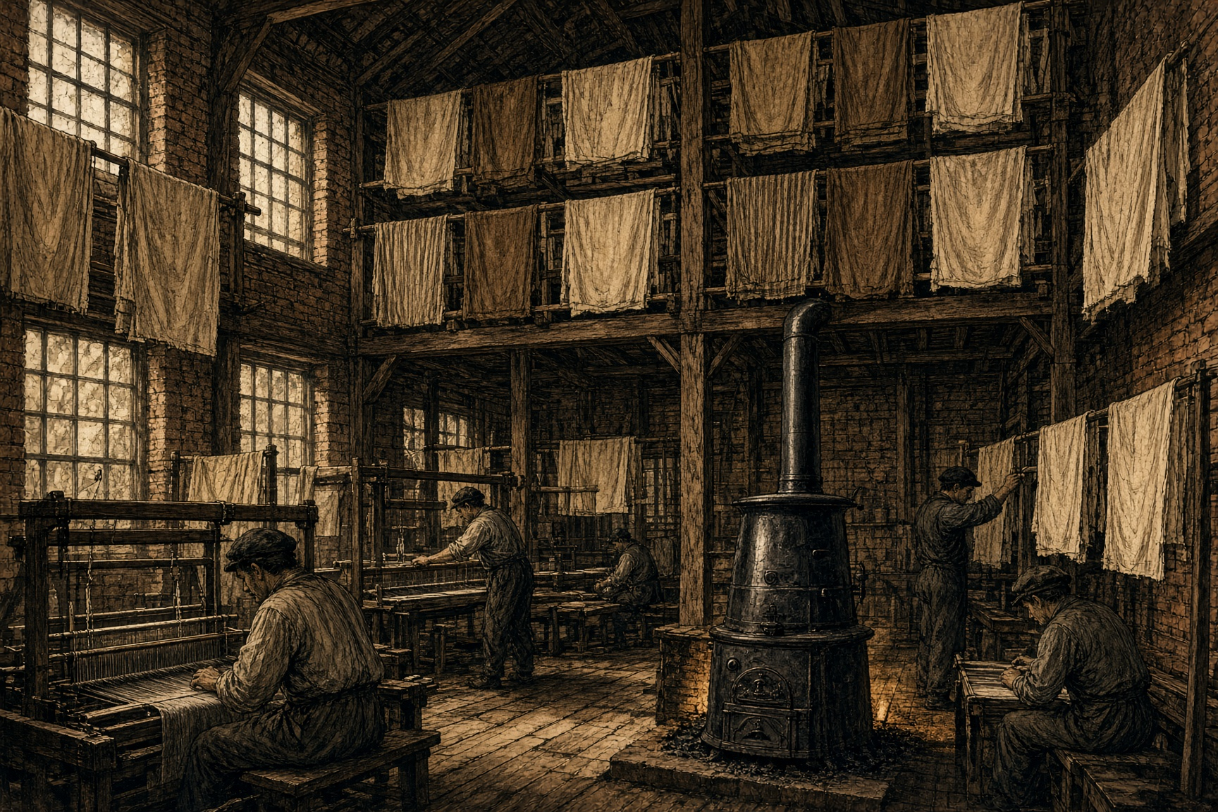
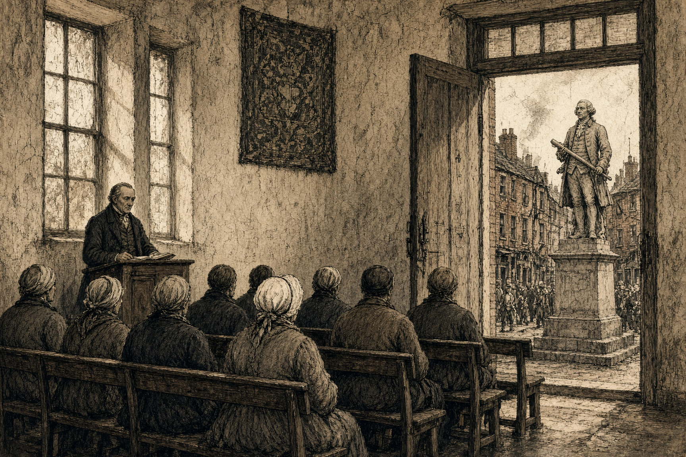
SMOKE ON THE MEDITERRANEAN · CHAPTER 1 · MJF
EQUALIZATION
1801–1824 · The Liberties, Dublin
Cloth is older than the states that later taxed it. Nobody’s name is on the first loom. Settled people were weaving by the time they were firing pottery: warp threads stretched tight, a weft thread passed across them, the row beaten in, the cloth growing an inch at a time. Linen from flax. Wool from a fleece. In China, silk from a worm. In Ireland, for centuries, wool and linen first; silk later, when the thread could be bought.
A hand loom is a wooden frame the size of a small room. The warp — the long threads that will be the length of the piece — is wound onto a beam at the back and run forward through heddles, which are eyes on cords that lift some warps and leave others down. The weaver’s feet work treadles. The feet open a shed, a gap in the warp. The right hand throws a shuttle, a hollow piece of wood carrying a bobbin of weft, across that gap. The left hand catches it. A beater swings forward and packs the new row tight against the last. Treadle. Throw. Catch. Beat. Yard by yard. A day’s work is measured in those yards, and in whether the light held.
That is what a hand weaver was. A person whose living was that sequence, usually in the same house the family slept in, often with children winding bobbins and a wife or a journeyman on a second beam. The cloth that left the house was clothing, furnishings, liveries, church stuffs, export pieces. The weaver did not own a factory. The weaver owned time, a frame, and a skill that took years to make even.
Dublin’s specialty by the eighteenth century was poplin: silk warp, wool weft. The silk gave the face a sheen. The wool gave the body weight. It took a dye and held a fold. Huguenot weavers, Protestants driven out of France after the 1680s, brought silk working into the Liberties, the streets west of Dublin Castle along the Coombe, Cork Street, Pimlico, Weaver’s Square. Houses there were workshops. The Weavers’ Guild of Dublin had been a legal corporation on those streets since 1446 — three and a half centuries of minutes, apprenticeships, and quality marks before the Union clock started. In 1745 the guild built a hall, fifty-six feet by twenty-one, wainscoted, portraits of kings, money from the Huguenot banker David Digges La Touche. In 1750 they set a statue of George II into the front with a weaver’s shuttle in his hand, and wrote the gesture into the minutes as sincere loyalty.
By then weaving as a human act was already thousands of years deep. What was new was a room in Lancashire that could throw more shuttles than a street of houses.
Edmund Cartwright patented a loom driven by power in 1785. Water turned a wheel; later steam turned a crank. A main shaft ran the length of a mill floor. Leather belts dropped from the shaft onto many looms at once. The mill did not invent cloth. It multiplied the number of rows a day one building could pack. Calico, fustian, plain cottons — goods that undercut a hand price once they could land without a duty. The river that turned many of those early wheels was the Irwell, through Manchester. The mill owner looking west needed the Irish duty off his bales. He did not need the name of the man on the Coombe.
Article VI of the Act of Union came into force on 1 January 1801. Ten-percent reciprocal duty on manufactured goods between Britain and Ireland, for twenty years. The expiry was in the clause: 1 January 1821. Dublin’s guilds later won 1 Geo. IV c. 45, in 1820, which tapered the protection toward 1825. Then 4 Geo. IV c. 26 and 5 Geo. IV c. 22 cut the silk duties early. What some later accounts call an 1806 announcement is Foster’s Corn Intercourse Act, 46 Geo. III c. 97. That statute is about grain. The manufacturing timetable is Article VI and the acts that chewed it from the edges.
War with France had already cut the raw silk the Liberties needed. In 1798 a significant number of the district’s weavers went out with the United Irishmen. By the Union negotiations of 1800 London kept the Coombe in view as a population as well as a trade. Emmet’s rising in 1803 put another mark on the same page.
The Act named no street. Article VI called the arrangement a customs union and free trade, and began to phase out the duties that had stood since Grattan’s Parliament won a measure of legislative independence two decades earlier. Article VII fixed Ireland’s share of imperial expenditure at two-seventeenths. When the Treasuries merged in 1817 and Irish taxation moved onto British rates, that fraction stayed on the paper.
1803. The Combination Laws already in force in Britain since 1800 — 39 & 40 Geo. III c. 106 — were extended to Ireland by 43 Geo. III c. 86. Irish penalties ran harder: six months in gaol or three months hard labour, against England’s three months or two months hard labour. From 1803 until 1824 a formal combination among the men standing on that tariff schedule was a crime. Pooling money toward a powered loom. Setting a common price. Meeting as a union. Francis Place and Joseph Hume drove the British repeal in 1824. The Irish ban lifted that year. The last duties fell that year.
Rain still ruined cloth on outdoor tenters. In 1815 Thomas Pleasants built the Tenter House on Cork Street, three stories of brick with a stove, so stretching and drying could go on in bad weather. Contemporary accounts of the years before that house say weavers caught by rain were “exposed to great distress, and not unfrequently reduced either to the hospital or the gaol.” The stove kept pieces coming off Dublin beams. It did not move a line in Article VI.
In 1820, with four years left on the tariff timetable, Dublin trade interests went to Westminster and asked for a delay. They got one. David Dickson’s work on the capital after Union puts that lobby on the record. Some Dublin merchants had already accepted the coming order and wanted no delay. A guild could still petition. A union could not.
A support-end date on a tool that still switches on is the later commercial form of the same paper. The object works. The manufacturer has printed the day after which it will not be helped. A shop line recut for a cheaper plant leaves the old ticket valid the week the line goes dark. The Coombe version was a duty with an expiry and a gaol term on the only legal way to buy the next engine together. The hand loom still packed a row. The shop downstairs had started selling the mill’s price.
1824 took the last protective duties, silk included. The Combination ban came off in the same twelvemonth. By 1825 the hall on the Coombe was recorded as little used. The main room was let to a Methodist congregation. George II remained on the brick. The guild, founded 1446, waited another fifteen years for a formal dissolution. Tenements stood where the weavers’ houses had stood a generation earlier.

