Slide 1


FACE RECOGNITION
with VGG-face net
Dang Quoc Vu

Slide 2
Overview
The face recognition task is divided into four steps:
Step 1: Data acquisition
Step 2: Face detection
Step 3: Face embedding
Step 4: Training
Dang Quoc Vu

Slide 3
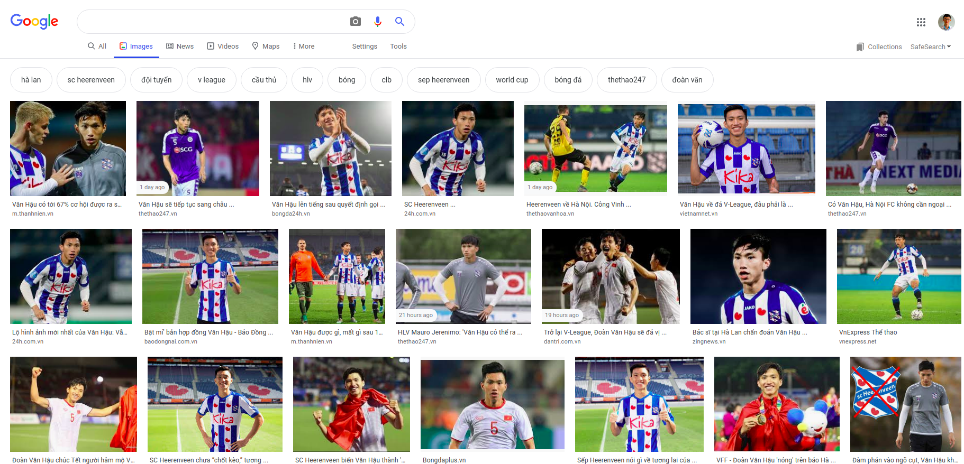
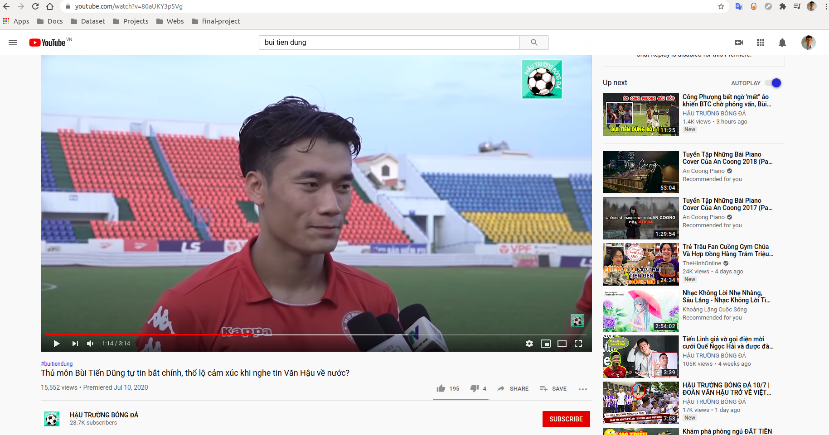
DATA ACQUISITION
Download images from google.com and capture frames from videos
Dang Quoc Vu
Dang Quoc Vu

Slide 4
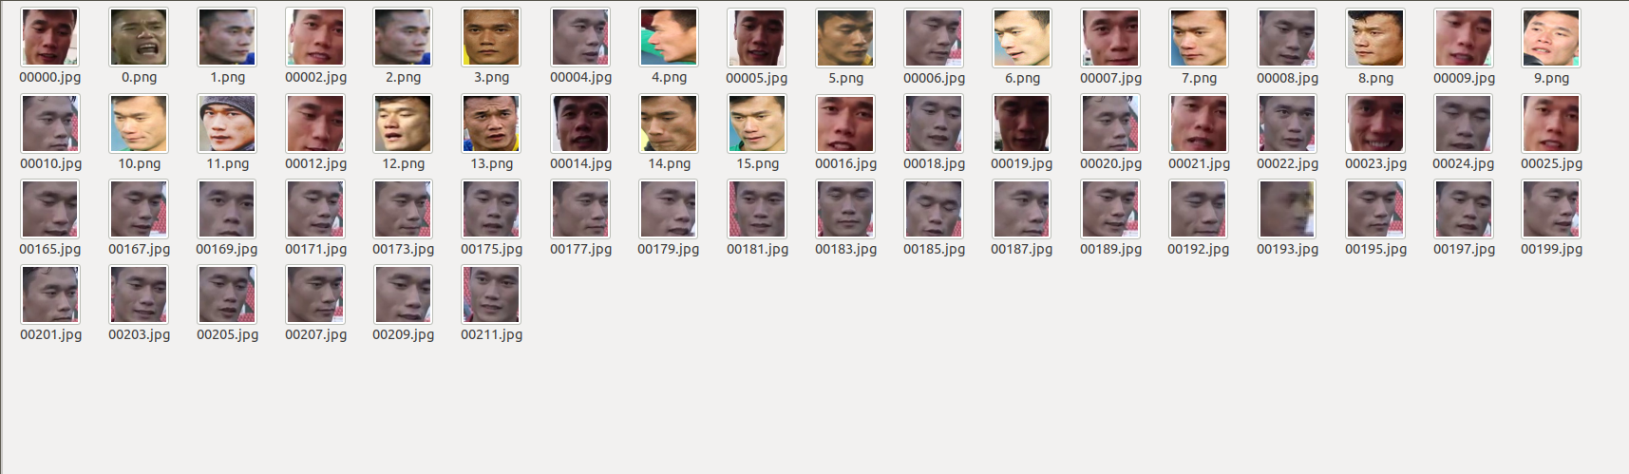
Face detection
Using dlib cnn face detector find faces in the large image and them into separate folder sorting by individual person.
Face-detector
Dang Quoc Vu
Dang Quoc Vu

Slide 5
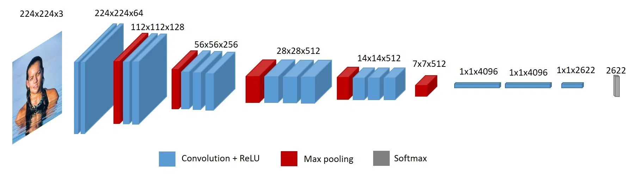
Face embedding
To get embeddings from Vgg-face net remove last softmax layer , it outputs 2622 units in last flatten layer which is the embeddings for each face.
Dang Quoc Vu
Dang Quoc Vu

Slide 6
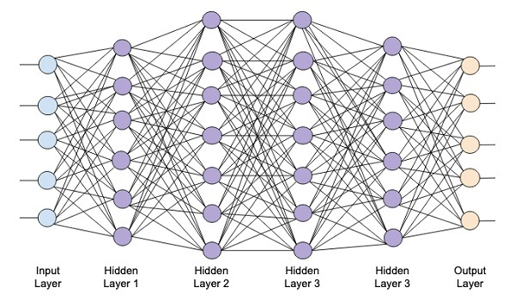
Training
Preprocess training data: Get embeddings for faces
Train these embeddings with softmax regressor to classify the person in image
Dang Quoc Vu
Dang Quoc Vu

Slide 7
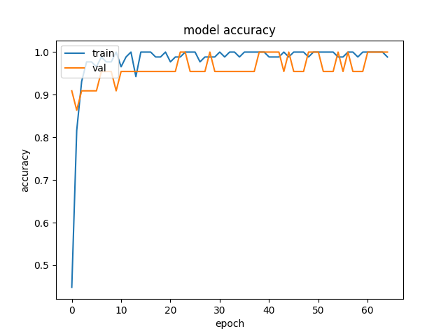
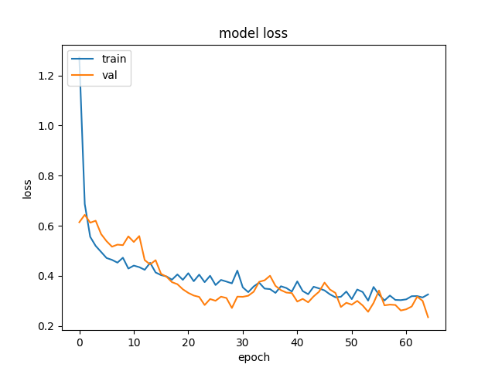
ReSULT
Dang Quoc Vu
Dang Quoc Vu

Slide 8
improvement
Develop the dataset for this topic
Impove the speed in detecting human face
Develop this project into a specific application
Dang Quoc Vu
Dang Quoc Vu

Slide 9
Thank for listening
Dang Quoc Vu
Dang Quoc Vu

