Slide 1
Federal Sector Hackfest
Behavioral Biometrics - Typing Pattern Authentication
Quinn Verbeke, Alex Leventhal, Tyler Montgomery, Arjun Pillai, Cody Fremont

Slide 2
The Idea
Behavioral Biometrics – multi-factor authentication
Active security, always checking for behavioral factors
Create a system that tracks typing behaviors that can validate the user as authentic
Words per Minute
Typing Accuracy
Preferred Capitalization Key
Store the data for cross comparison against other users
Does the typing style match the logged-in user?

Slide 3
The Method
A python script records metadata about keystrokes (such as WPM, key depress time, etc.)
A k-means machine learning model is trained on data points from each user
Incoming data is classified using the k-means model to determine if the active typist fits the active user’s statistics

Slide 4
Data Collection
Split the Keyboard into 5 sections
Recorded the time from keypress to key-release
Recorded the time from section pressed, released, then section to section
Records any other special keys such as ‘Space’, ‘Shift(s)’, ‘Backspace’, and ‘Deletes’
Formats data into a vector the machine learning algorithm can use
Ships data to the machine learning server after a specified time of inactivity

Slide 5
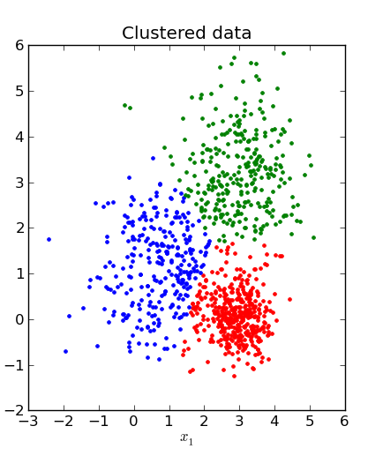
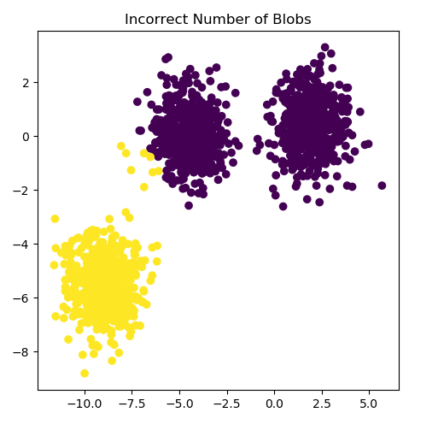
Machine Learning
K-Means – group data points into “clusters” based on distance from each other.
Unsupervised learning – unlabeled data
Multiple users may have similar style, one user may have multiple styles
“Elbow method” to find the optimal number of clusters.
When we get a new data point – classify it.
Call kmeans.predict() method on our model to predict the cluster that it will fall into
Compare against past classifications for that user – raise flags if unlikely classification.

Slide 6
Application
We have a system to classify typing as authentic or inauthentic
There needs to be a consequence to being labeled inauthentic
Computers which may be logged in for periods of time in high-risk environments
TSA, Border Security
An inauthentic classification could lead to lock-out
Email Signing
A user can type an email while our software is running
With an authentic classification, give the email an “authentic” signed certificate
Extensible – can be applied in many ways

Slide 7
Questions, Comments, Concerns?

