Slide 1
Droplets form the films

Slide 2
Importing Data
Parameters | values | Notes
Ndroplet | 1~8 | The number of Pt droplet.
L | 170 | The simulation box size.
c | 1 | The space grid size.
dt | 0.01c² | The time step.
N | L/c | The length of the data matrix.
thickness | 0.011 | The dimensionless thickness of a PtSe_{x} monolayer, which governs the consumption rate of Pt droplets during motion..
Rball | 15 | The initial radius of Pt droplets.
Rc | 35 | The critical radius above which Pt droplets solidify hence cease to move.
φ | -1, 1 | The order parameter, whereas -1 represents the bare MoS₂ substrate, and 1 represents the PtSe_{x} single layer.
λ | 10 | The dimensionless coupling constant
Step 1

Slide 3
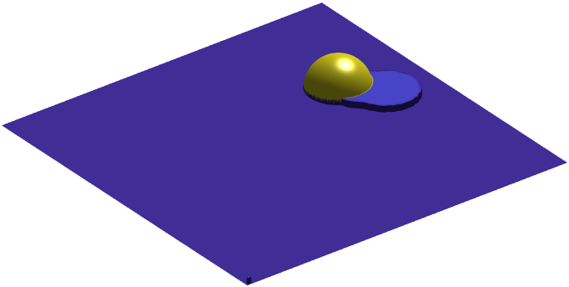
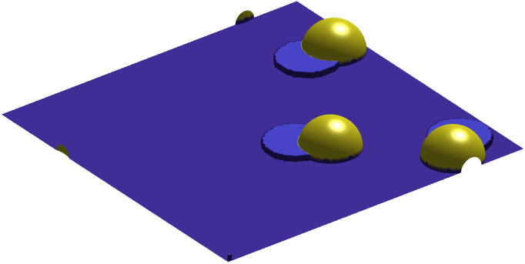
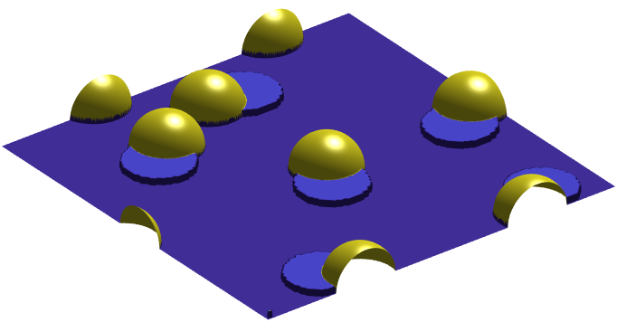
Running Code
Ndroplet=1
Ndroplet=3
Ndroplet=8
Step 2
Select the required Ndroplet to droplet numbers, click on the “Run” button in MATLAB or Octave. A new figure window will show up. Pt droplets selenized to form PtSe_{x} films drive the motion of the droplets, leaving a earthworm-like trail. Once the number of droplets reaches a certain threshold, a complete monolayer film of PtSe_{x} can be formed..

Slide 4
Droplet climbs the film

Slide 5

Importing Data
Parameters | values | Notes
L_{x}, L_{y}, L_{z} | 64 | The X, Y, and Z sizes of the simulation box.
R | 8~12 | The radius of the Pt droplet, while a smaller droplet will stay at step, and larger one will climb the step.
λ | 180 | The coupling constant.
c | 0.5 | The space step size along either X, Y, and Z.
dt | 0.01c² | The time step.
K | 1 | The droplet’s surface tension in simulation.
r | (x+5) ²+y²+(z-5)² | Setting droplet at film step initially.
ρ | Sign(R²-r²)/2+0.5 | The phase-field for the density of the liquid. ρ = 1 denotes liquid phase and ρ = 0 denotes the vapor phase.
Note: The introduction of the wetting angle θ is in lines 42 and 43 of the code. We set ρ_{s}=0.6323 such that the θ between Pt/PtSe_{x} is 67.2°, and ρ_{s}=0.5064 (0.6323-0.1259) such that the θ between Pt/MoS₂ is 88.9°.
Step 1

Slide 6
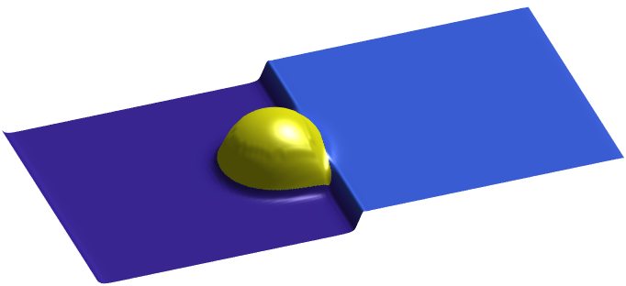
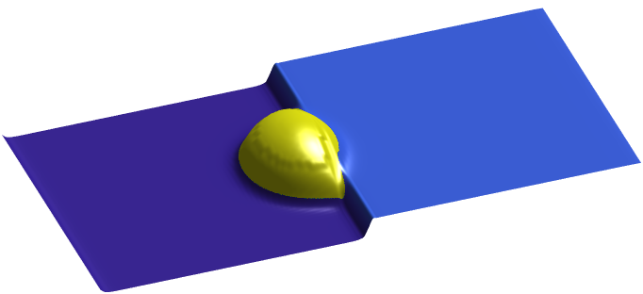
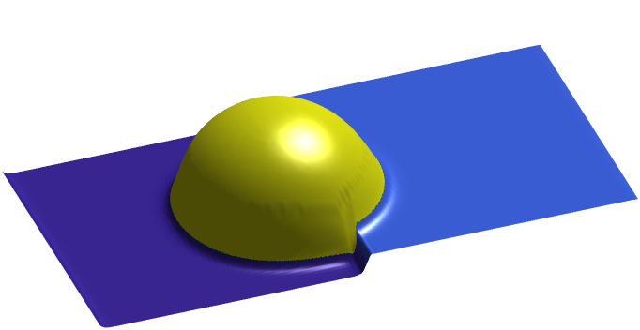
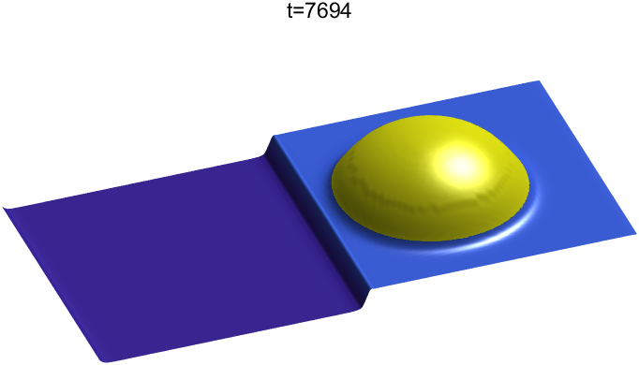
Running Code
R=8
R=10
Step 2
Select the required R to droplet sizes, click on the “Run” button in MATLAB or Octave. A new figure window will show up. The smaller droplet will stay at step, and larger one will climb the step.

