Slide 1
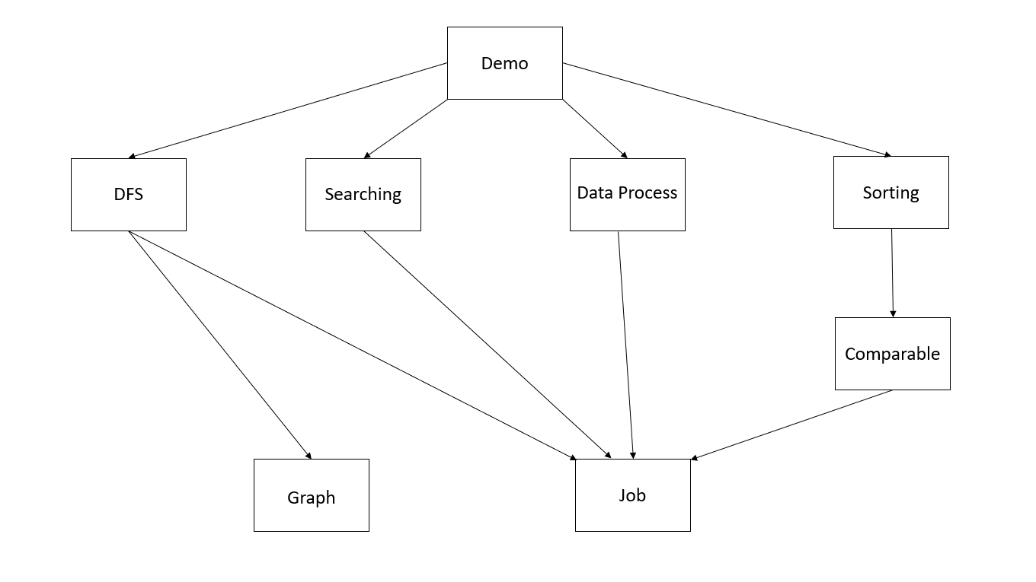
Demo
DFS
Searching
Data Process
Sorting
Comparable
Graph
Job

Slide 2
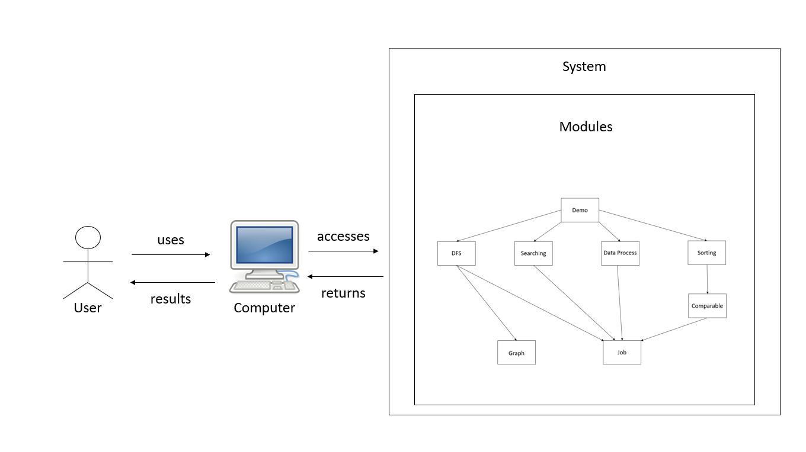

System
Modules
uses
accesses
results
returns
User
Computer

