Slide 1
Microwave intensity gradient

Slide 2


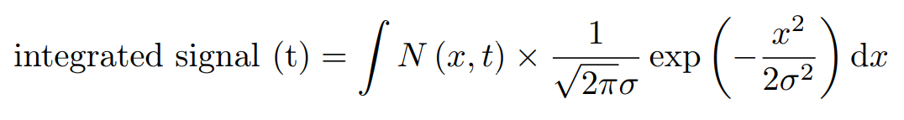
Assume microwave standing wave in MOT chamber (chamber is like a low-Q cavity..). Microwave gradient may cause “decoherence” in measured signal.
Consider the axial direction of ODT cloud, molecules at different position experience different Rabi frequency, which can show up as “decoherence” in the integrated signal. (Ignore the molecule motion along axial direction, since axial ODT trap frequency << Rabi frequency)
Peak Rabi frequency: 2pi*50 kHz
Wavevector: 2pi/2 cm
Distance between ODT cloud center and microwave standing wave origin
Rabi frequency:
N=1 state Population:
Integrated signal:
ODT cloud width: 0.5 mm

Slide 3
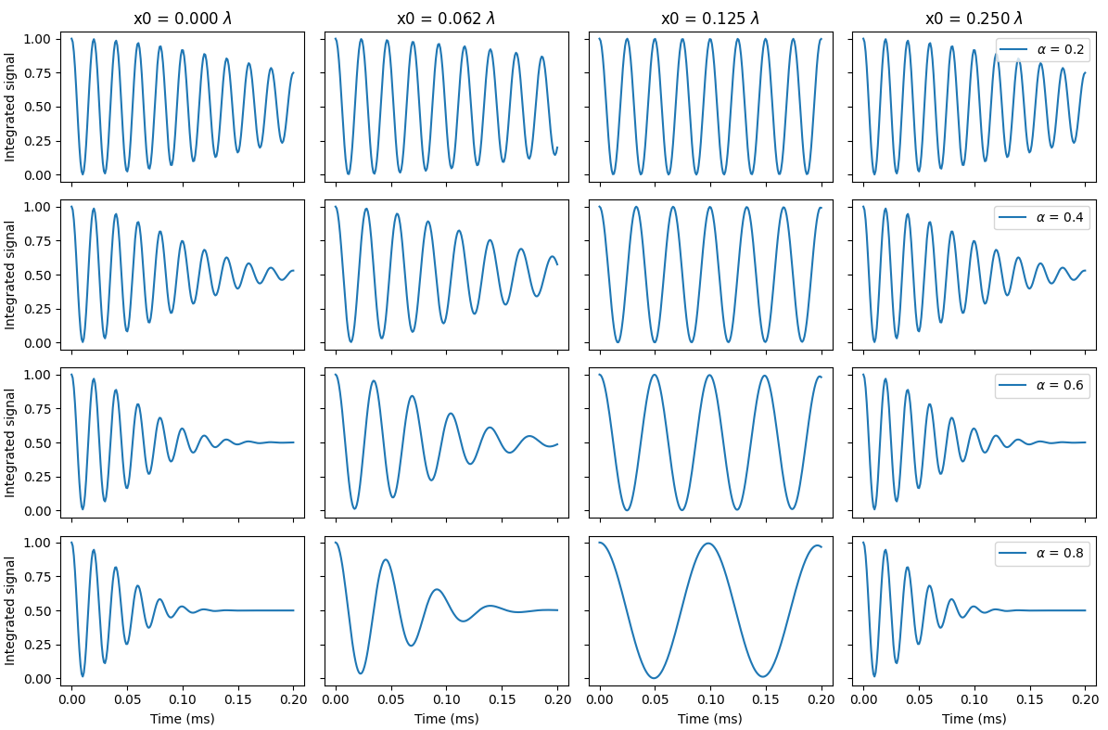

Slide 4
Higher Rabi frequency leads to shorter coherence time
But # of Rabi cycles remain the same within coherence time
Microwave standing wave:
horn orientation
chamber geometry
Try calculation again with microwave standing wave contrast < 1
Gaussian fit to ODT cloud instead of integrated signal:
Signal is also very noisy
Literature for bi-alkali and CaF cpherence:
Stainless chamber or glass cell
Similar short wavelength?
Near field
Crossed dipole trap, tweezer
Ramsey sequency help?
I don’t think so…?

