Slide 1
Extreme Learning Machine
Qi Wang

Slide 2
ELM
Application
Introduction to NN
ELM Theory
One Dimensional Case
Two Dimensional Case
Result

Slide 3
Introdunction to NN

Slide 4
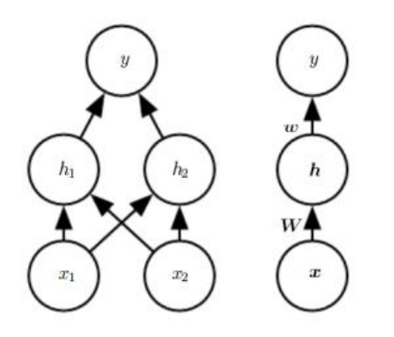

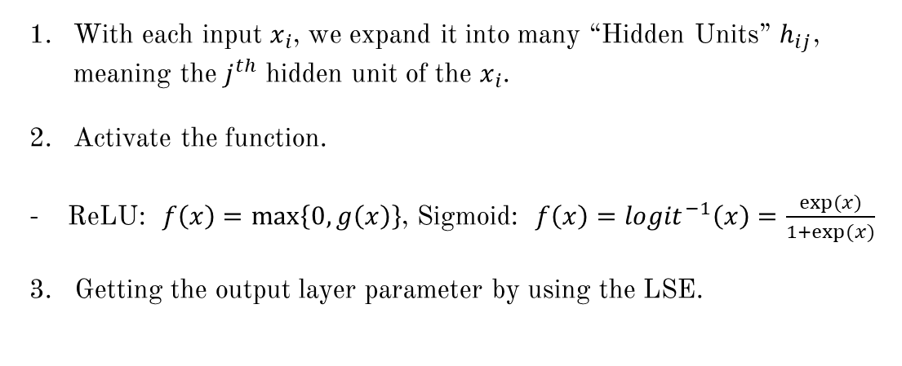

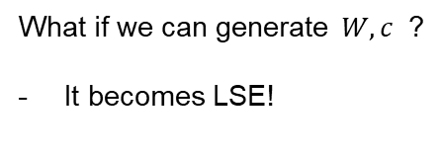
Neural Networking (Single Layer)
With each input $x_{i}$, we expand it into many “Hidden Units” $h_{ij}$, meaning the $j^{th}$ hidden unit of the $x_{i}$.
Activate the function.
ReLU: $f\left(x\right)=\max\left\{0,g\left(x\right)\right\}$, Sigmoid: $f\left(x\right)={logit}^{−1}\left(x\right)=\frac{exp⁡(x)}{1+exp⁡(x)}$
Getting the output layer parameter by using the LSE.
$$\text{l}\text{ =} \left(W^{T}x+c\right)$$
$$f^{\left(1\right)}\left(x;W,c\right)=g\left(W^{T}x+c\right)$$
$$f^{\left(2\right)}\left(h;ω,b\right)=ω^{T}h+b$$
Unknown Parameters: $W,c, ω,b$
So complicated!
What if we can generate $W,c$ ?
It becomes LSE!

Slide 5
ELM Theory

Slide 6
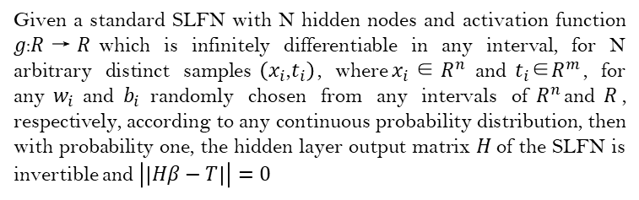
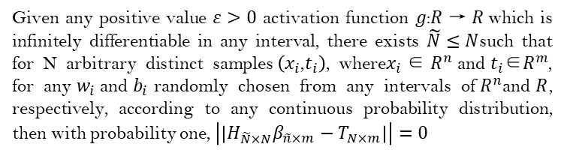
ELM Theory(Huang, G. B., Zhu, Q. Y., & Siew, C. K. (2006))
Theorem 1.2.1
Given a standard SLFN with N hidden nodes and activation function $\text{g}\text{:}\text{R} \text{→ }\text{R}$which is infinitely differentiable in any interval, for N arbitrary distinct samples$\left(x_{i}\text{,}t_{i}\right)$, where$x_{i} \text{∈ }R^{n}$and${ t}_{i}\text{∈}R^{m}$, for any${ w}_{i}$and${ b}_{i}$randomly chosen from any intervals of${ R}^{n}$and$\text{R}$, respectively, according to any continuous probability distribution, then with probability one, the hidden layer output matrix $\text{H}$of the SLFN is invertible and $\left|\left|Hβ−T\right|\right|=0$
Therefore, we can randomly generate the slope and intercept in the first step. But which distribution to choose?
Theorem 1.2.2
Main Purpose:
Centered around 0.
Easy to generate.
Given any positive value $ε>0$ activation function $\text{g}\text{:}\text{R} \text{→ }\text{R}$which is infinitely differentiable in any interval, there exists $\tilde{N}≤N$such that for N arbitrary distinct samples$\left(x_{i}\text{,}t_{i}\right)$, where$x_{i} \text{∈ }R^{n}$and${ t}_{i}\text{∈}R^{m}$, for any${ w}_{i}$and${ b}_{i}$randomly chosen from any intervals of${ R}^{n}$and$\text{R}$, respectively, according to any continuous probability distribution, then with probability one, $\left|\left|H_{\tilde{N}×N}β_{\tilde{n}×m}−T_{N×m}\right|\right|=0$
N(0,1) & Unif[-1, 1]

Slide 7
One Dimensional Case

Slide 8
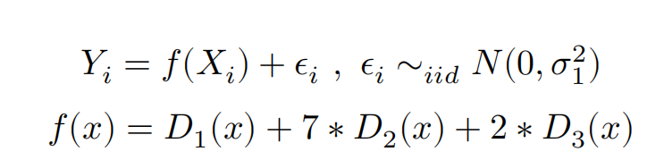
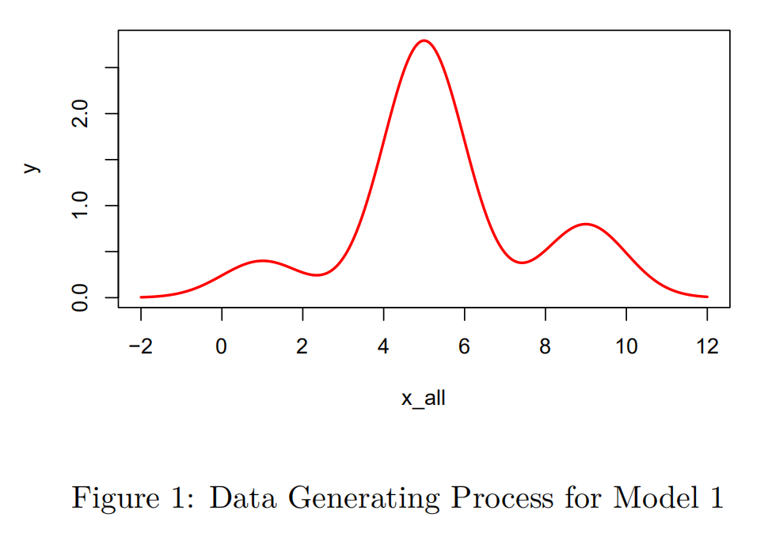

One Dimensional Case
Data Simulation
Factors affecting fitting result:
Distribution of Generating Parameters
Normal? Uniform?
Number of Hidden Nodes
10, 50, 100, 200, 500?
Activation Function
ReLU? Sigmoid?
$D_{i}$ is the PDF of $N(ν_{i},τ_{i}^{2})$, i = 1, 2, 3

Slide 9
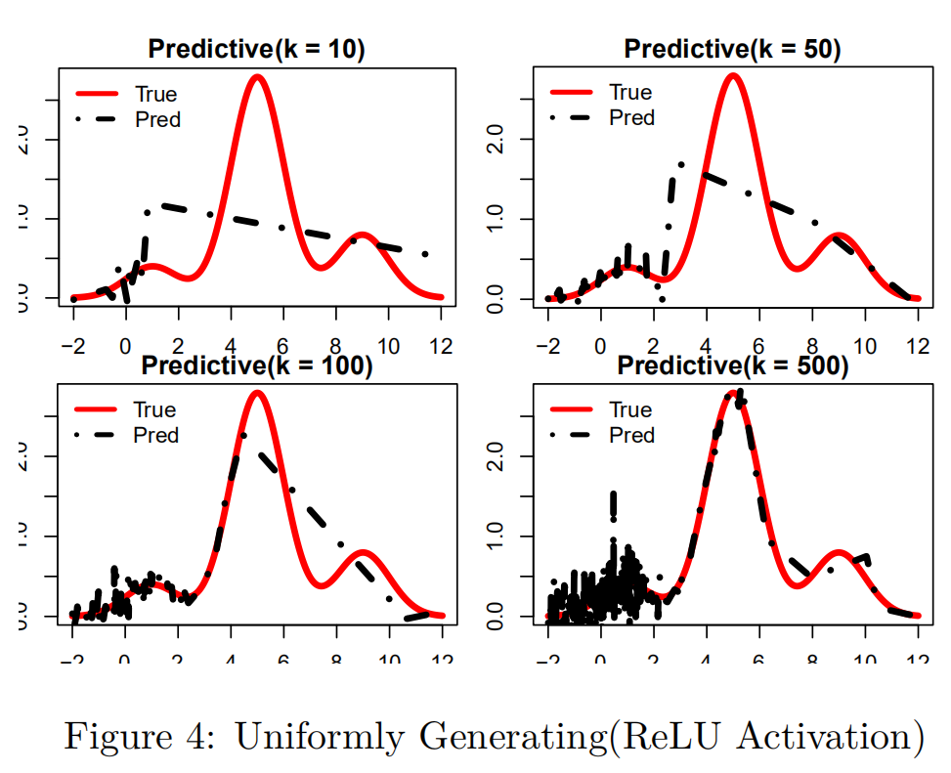
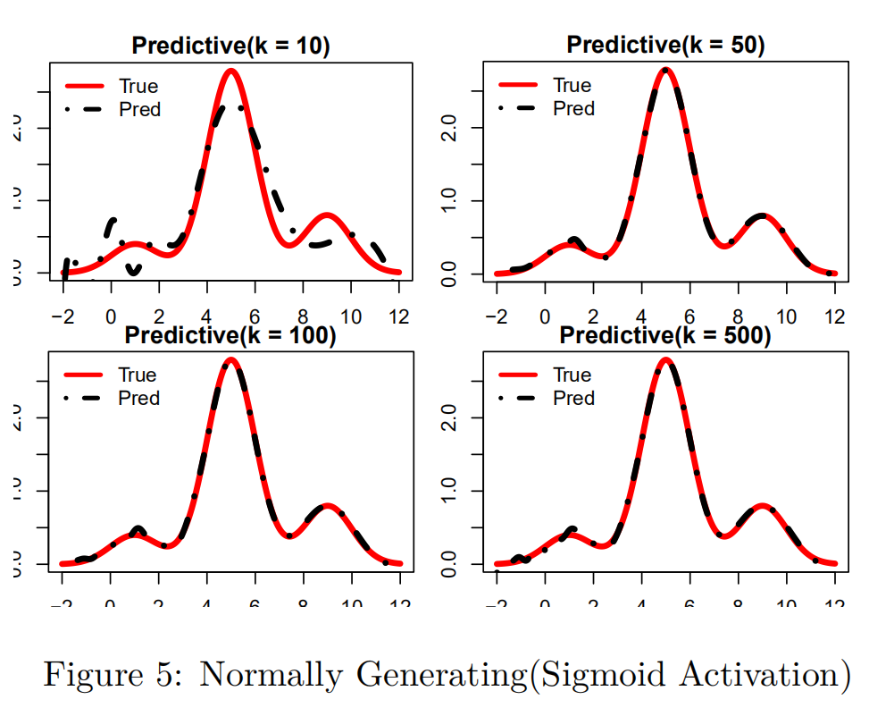
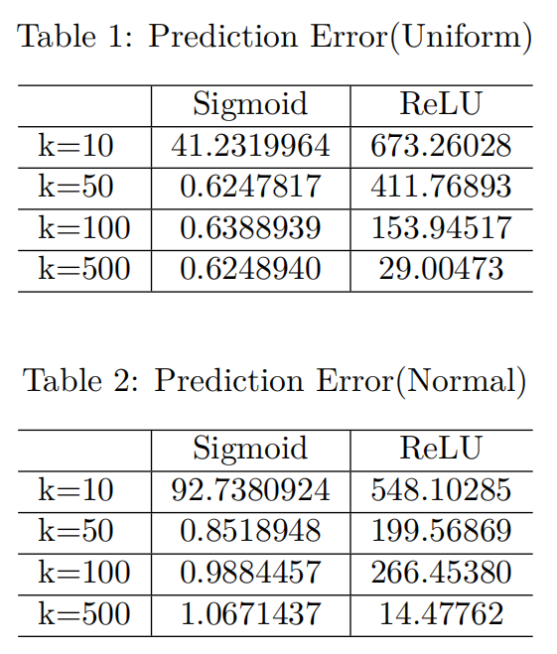
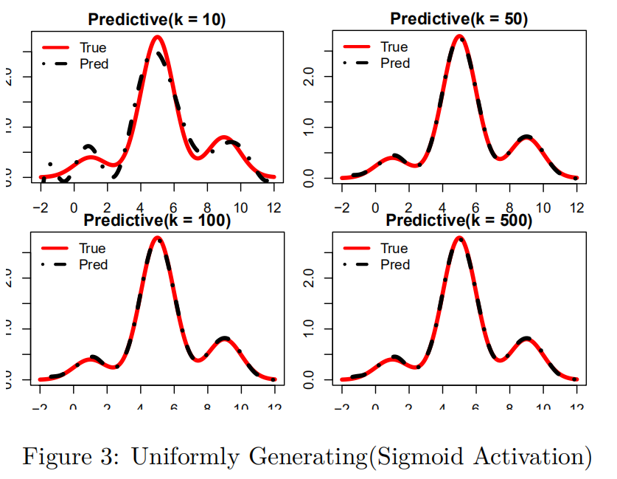
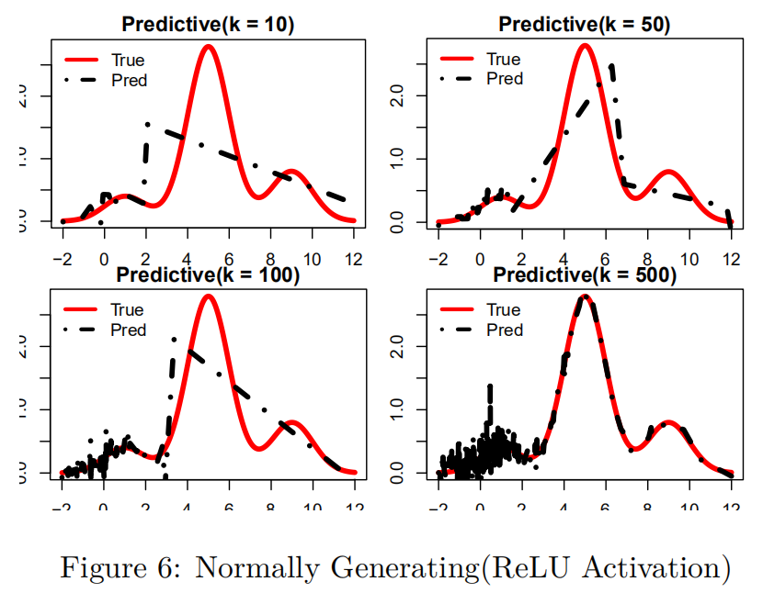
One Dimensional Case
Sum of Squared Error on each 0.01 step in [-2, 12]
Fitting Results

Slide 10
Two Dimensional Case

Slide 11
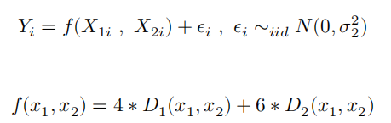
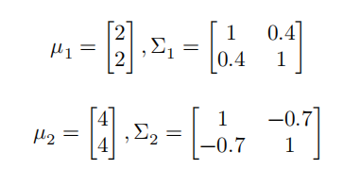
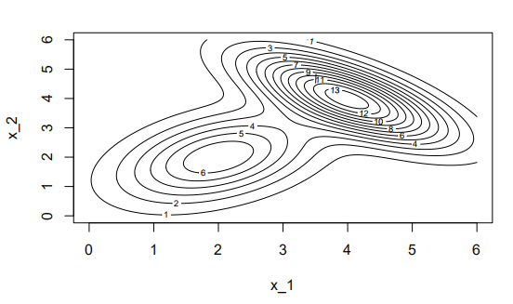

Two Dimensional Case
Data Simulation
Factors affecting fitting result:
Distribution of Generating Parameters
Normal? Uniform?
Number of Hidden Nodes
10, 50, 100, 200, 500?
Activation Function
ReLU? Sigmoid?
$D_{i}$ is the PDF of $MVN(μ_{i},Σ_{i})$, i = 1, 2

Slide 12
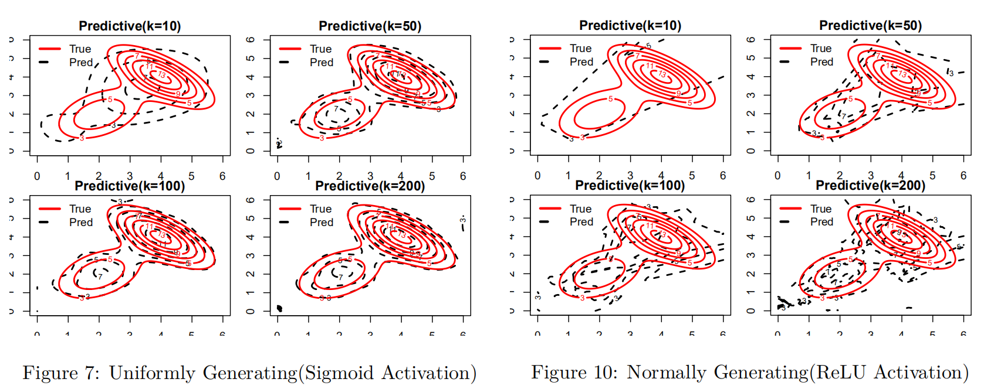
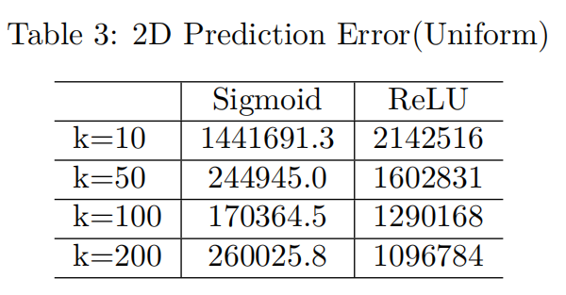
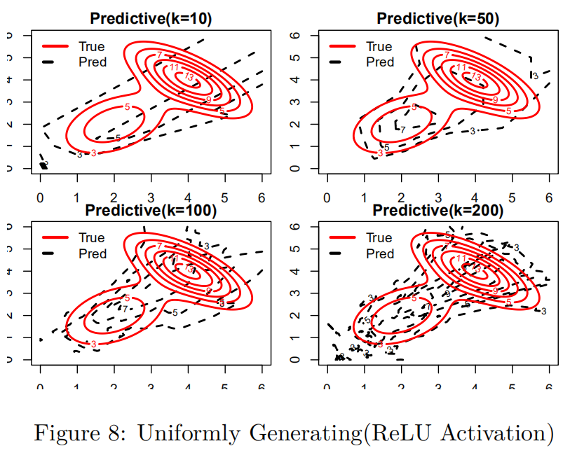
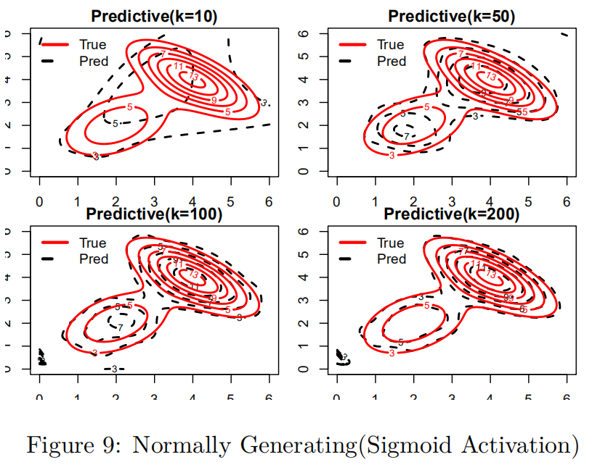
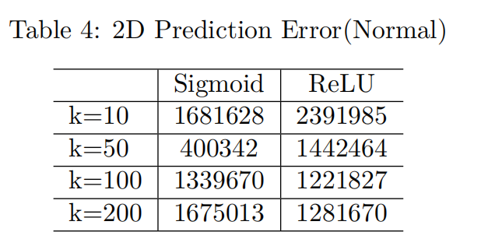
Two Dimensional Case
Sum of Squared Error on each 0.01 grid in [0,6]*[0.6]
Fitting Results

Slide 13
Result

Slide 14
Conclusion
For one-dimensional case, the sigmoid activation function performance better than ReLU function. And uniformly generating function performs better for sigmoid activation, but normal performs better in ReLU activation case. It could be explained by the extreme case generated by normal is rare, which leads more “useful” hidden units whose components are not all 0.

Slide 15
Conclusion
For two dimensional case, the results become more complicated. But sigmoid function still performs better than ReLU function when the parameters are uniformly generated. However, when the parameter is normally generated, and the number of hidden nodes is large, ReLU function case has a better prediction. That could be the case that the sigmoid function will be easier to overfit the model because when k=50, it approaches the smallest prediction error.

Slide 16
Conclusion
Overall, in this case, since the function are both smooth, sigmoid performs better than ReLU. Also, Uniformly generating the parameters will let the model explore the properties of the data better. Normally generating the parameters will have better performance in the case when overfitting exists.

