Slide 1
An ensemble quadratic echo state network for non-linear spatio-temporal forecasting
Patrick L. McDermott and Christopher K. Wikle

Slide 2
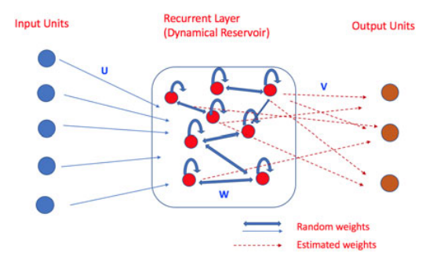
Spatio-temporal echo state network
Main point:
Recurrent Neuro Network Model
Notes:
Random weights from the ELM?
Units in the recurrent layer are affecting each other, not feedforward anymore, but feedback themselves and feedback to the parent of it.
So does it mean random weights are generated, only estimated consequences are evaluated by the ELM (A more manageable way like the LSE)

Slide 3
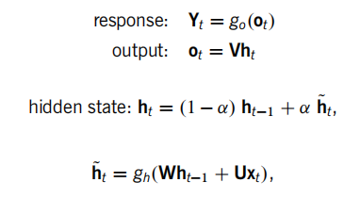
Spatio-temporal echo state network
Main point:
Recurrent Neuro Network Model
Notes:
Step 1: Generate ht~ by a linear combination of xt and ht-1, then activate the linear sum.
Step 2: Generate ht by a ht-1 and ht~ weighted sum.
Step 3: Generate the output unit by a linear operation of the ht.
Step 4: Activate the ot to get the response variable.

Slide 4
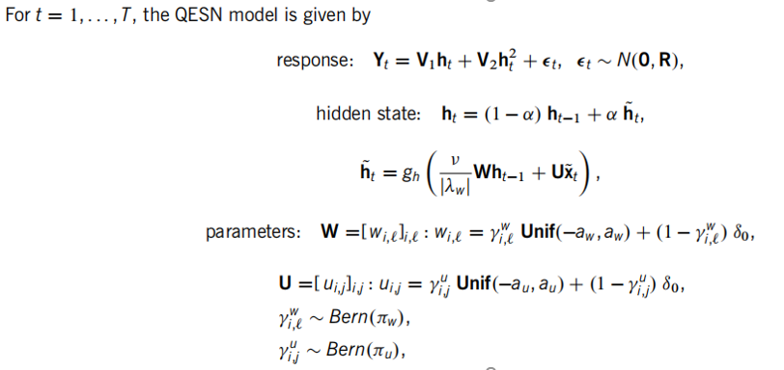
Quadratic echo state network
Main point:
Recurrent Neuro Network Model
Notes:
Step 1: Generate U and W by ELM method, U is a mixture model of a uniform distribution and delta_0 called Dirac function. What is Dirac?
Step 2: nu is the hyperparameter, lambda_w is the largest eigenvalue of matrix W, why choose lambda_w equal this, and how to select nu? Is that because of a ridge regressor?
Step 3:Generate the ht~ as the steps before
Step 4: Generate the ht.
Step 5: Estimate V1 and V2 by LSE like before.

