Slide 1
Deep echo state networks with uncertainty quantification for spatio-temporal forecasting
Patrick L. McDermott, Christopher K. Wikle

Slide 2
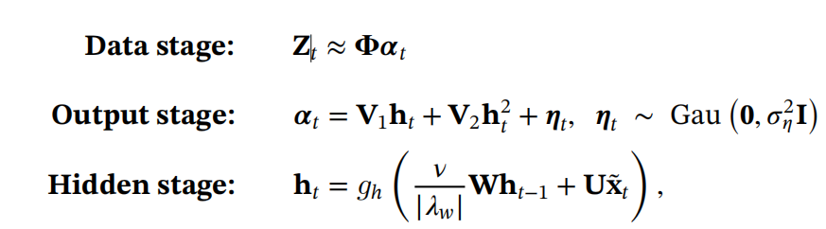

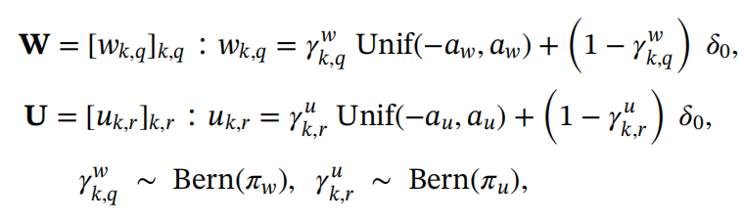
Basic ESN background (Long Term)
Main point:
Review of Basic ESN
Notes:
A review of basic ESN.
In data stage, we still don’t have the intercept.
X~t to some extent, it’s a tau period lagging with m as the total number of lagging.
Still a mixture of point mass at 0 and uniform around 0 to avoid overfitting.

Slide 3
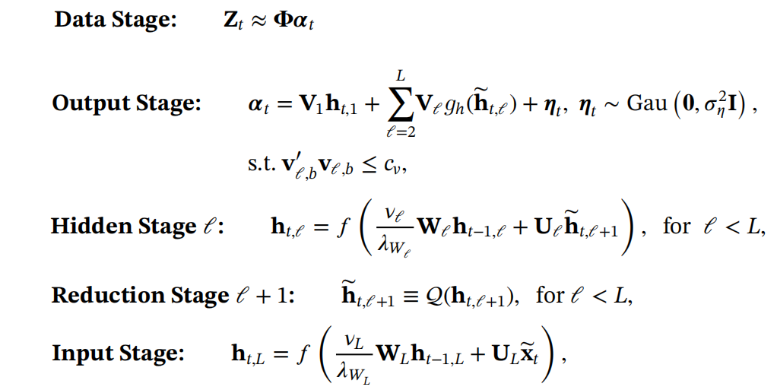
Deep ensemble ESN (D-EESN)
Main point:
Notes:
Step 1: Generate h_t,L using the last h_t-1,L and all the time lagging of data, x~t.
Step 2: Generate h~t,l+1 by applying a dimension reduction function Q. Why do we need dimension reduction?
Step 3: Generate h~t,l by ESN steps.
Step 4: Get alpha by a linear combination
Step 5: activate alpha t? Or forcast?
Question: Do we calculate from L to 1 or 1 to L?

Slide 4
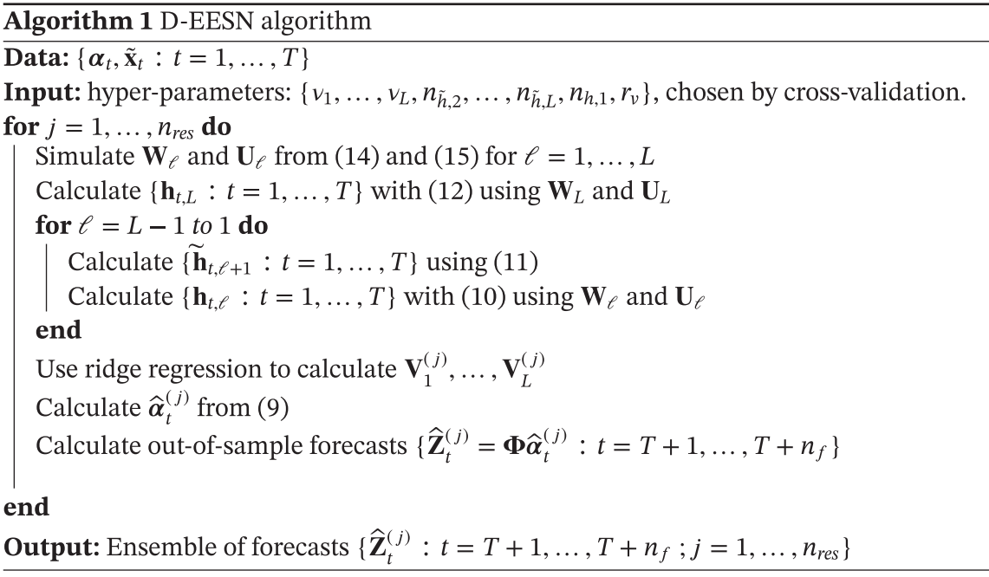
D-EESN Algorithm
Notes:
Calculate from L to 1 is confirmed.
Why do we use ridge regression here?

Slide 5
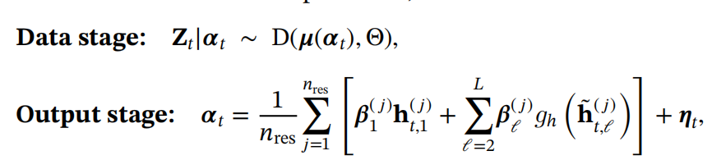
BD-EESN Algorithm, Bayesian D-EESN
Notes:
A Monte Carlo simulation? Because we have jth sample and calculated an overall average.
How to understand this?

