Slide 1
Sampling Methods, Monte Carlo Integration, Importance Sampling, Metropolis-Hasting Algorithm, 2-stage Gibbs Sampler

Slide 2

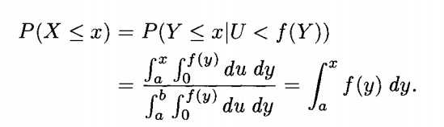
Accept-Reject Method (Ch2.3)
Main idea: Use a function covering the unknown function, sampling uniformly, only accept the ones that are under the unknown function.
Generalize: Choose m(x)=Mg(x) as close as possible to avoid wasting simulations, but m(x) should be greater than or equal to f all the time. M(x) is the envelope function, not needed to be a constant.

Slide 3
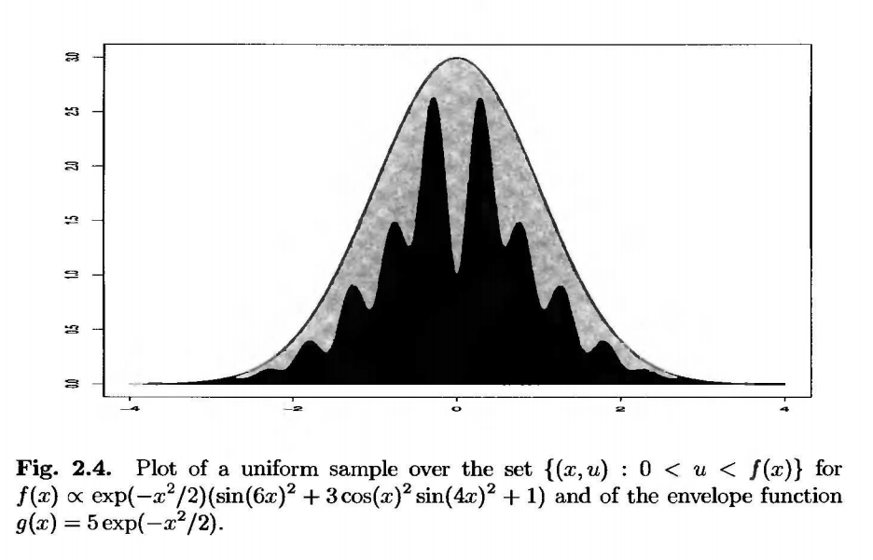
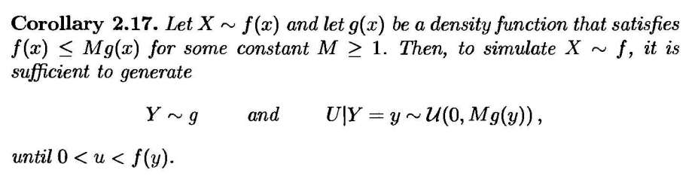
Accept-Reject Method (Ch2.3)
Step:
Generate x ~ g(x), U ~[0,1]
Accept y = x if U <= f(x)/Mg(x)
Repeat until we get the maximum iteration.

Slide 4
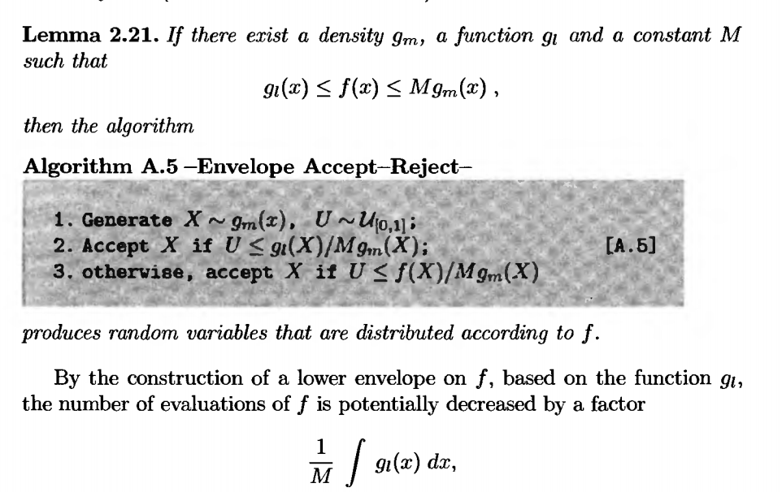
Envelope-Accept-Reject Method (Ch2.4)
Decrease the number of evaluations of f, maybe more convenient.
Why avoid evaluating values on f can reduce the calculation? What is the advantage?

Slide 5
Envelope-Accept-Reject Method (Ch2.4)
Decrease the number of evaluations of f, maybe more convenient.
Why avoid evaluating values on f can reduce the calculation? What is the advantage?

Slide 6


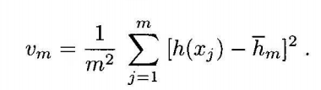

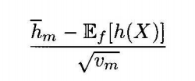
Monte Carlo Integration(Ch3.2)
- They converges in p or a.s. to the corresponding population moments by WLLN or SLLN.
- By CLT, this thing follows the standard normal distribution, easier to do the test

Slide 7
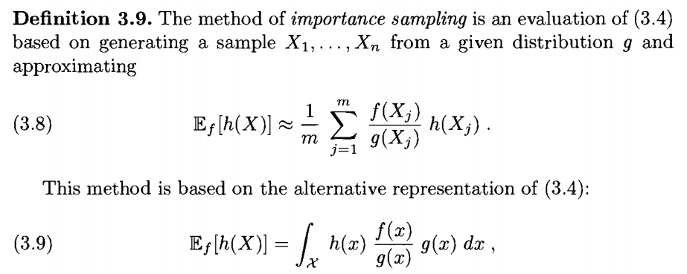
Importance Sampling(Ch3.3)
This method is used to calculate the expectation of a distribution when the distribution is not in closed form.
Also by LLN, it converges to the true value.
Any constraints on g()?Like the envelope?

Slide 8
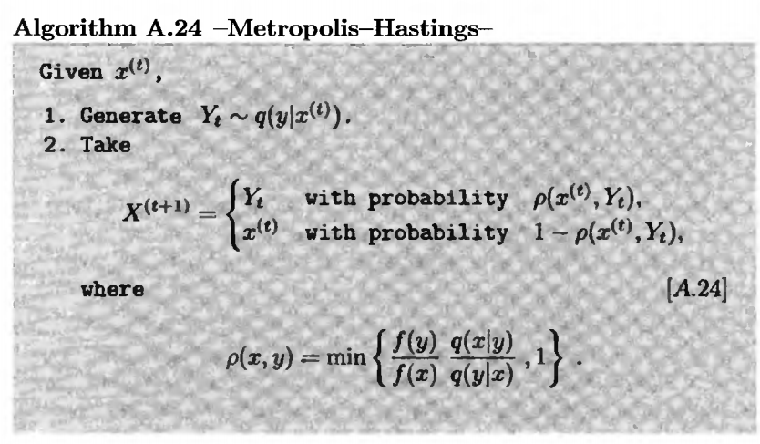
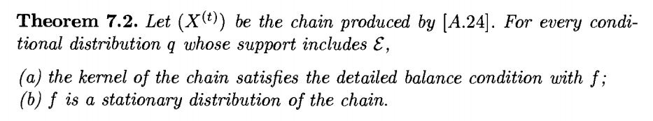
Metroplis-Hasting Algorithm(Ch7.3)
q(y|x) transition kernel (proposal), the probability of jump from x to y.
We are comparing the probability of the point stay at y and next step transit back with the probability of the point stay at x and transit to y, the transiting probability should between 0 and 1.

Slide 9
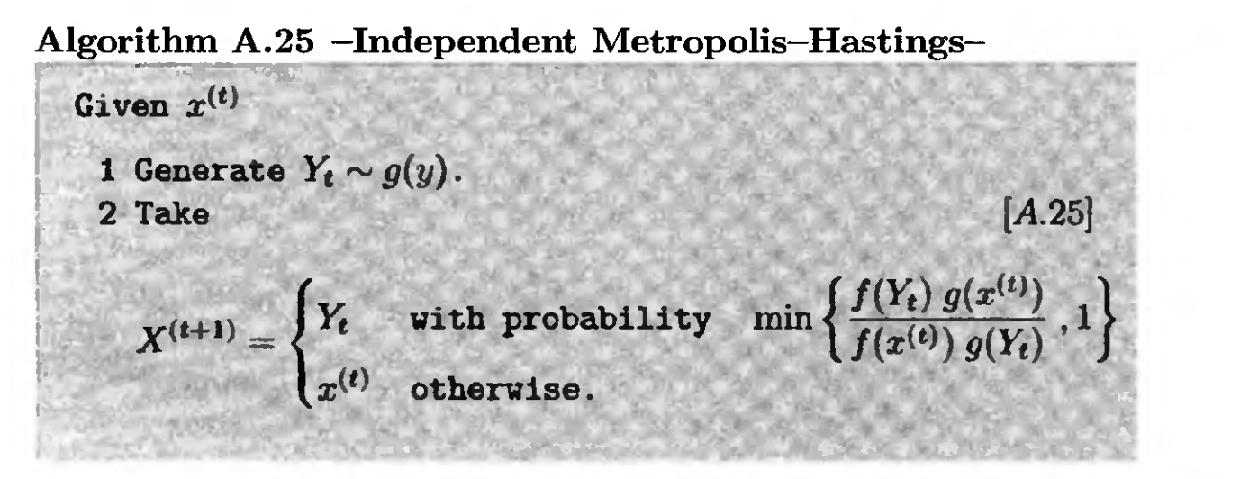
Independent Metroplis-Hasting Algorithm(Ch7.4)
q(y|x) does not depend on x. It is a function of y. I mean, no matter which x I jump from, the probability of jumping to the same y is the same, which is g(y).
But Yi’s generated by this algorithm are not independent, since the acceptance depends on each other.

Slide 10

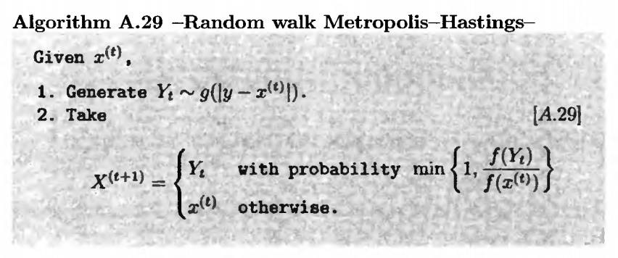
Random Walk Metroplis-Hasting Algorithm(Ch7.5)
q(y|x) = q(x|y) because the random walk is symmetric. So it could be eliminated from both the numerator and denominator.
It’s all about a function of epsilon t, because the distribution of epsilon t determines the g(epsilon_t).

Slide 11
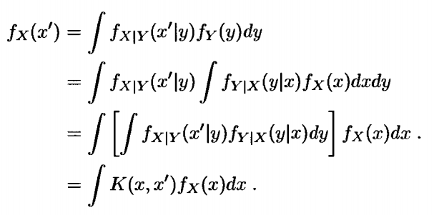
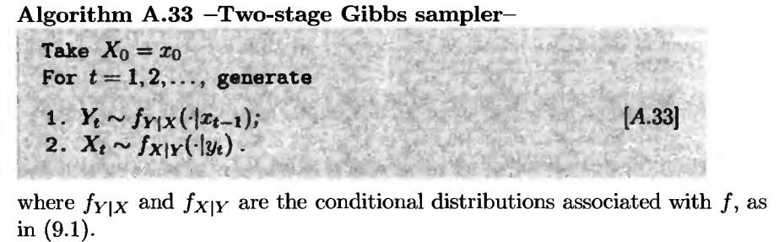

Two-stage Gibbs sampler(Ch9.1)
Based on the conditional distribution, sampling a vector.
Need the conditional distribution.
Not only the vector is a MC, the single dimension is also a MC. Because when selecting x again, we need to first select a y, and then select back, integrated by all possible y’s.
It has a stationary distribution in the end by the proof that the stationary distribution does not include the x or y, just the x’.

Slide 12
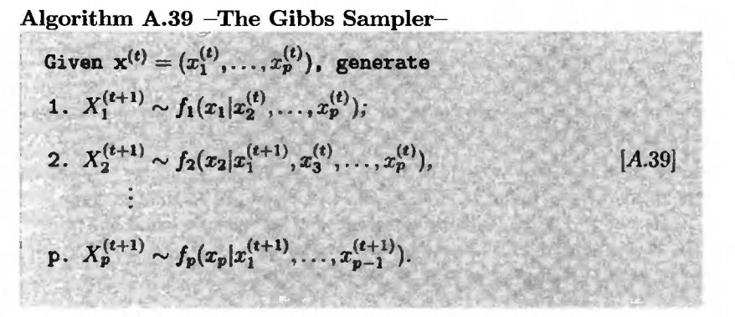
Multi-stage Gibbs sampler(Ch10.1)
Based on the conditional distribution, sampling a vector.
Need the conditional distribution.
Not only the vector is a MC, the single dimension is also a MC. Because when selecting x again, we need to first select a y, and then select back, integrated by all possible y’s.
It has a stationary distribution in the end by the proof that the stationary distribution does not include the x or y, just the x’.

