Slide 1
BAYESIAN ADDITIVE REGRESSION TREES
BY HUGH A. CHIPMAN, EDWARD I. GEORGE AND ROBERT E. MCCULLOCH

Slide 2


Extract Information from Posterior
Bayesian Backfitting MCMC:
At a general level, it is a Gibbs sampler.
Sigma is easy to get since it’s from IG and it’s conjugate.
But to generate T and M are a little difficult.

Slide 3


Extract Information from Posterior
Generate T and M:
The conditional distribution depends on others only through:
Rj is like a transformed dataset, so we are getting the posterior based on a “new dataset”.
This is how we calculate the posterior of Tj given Rj, since M is conjugate normal distribution, as long as we specify the kernel then the constant is easy to find.

Slide 4
Extract Information from Posterior
Generate T:
Metropolis-Hasting algorithm proposes a new tree based on one of four moves:
1. Growing a terminal node. (0.25)
2. Pruning a pair of terminal nodes. (0.25)
3. Changing a non-terminal rule. (0.4)
4.Swapping a rule between parent and child. (0.1)

Slide 5
Extract Information from Posterior
Generate M:
After giving the tree model, simply draw independently from each terminal node from a normal distribution.
Convergence Compared with CART:
CART tends to converge to a big tree and trapped in the local maximum.
BART mixes well and can explore the parameter space perfectly.
CART does not need to use multiple start points to check for convergence, since they always give similar results after enough long run. (Robustness?)

Slide 6
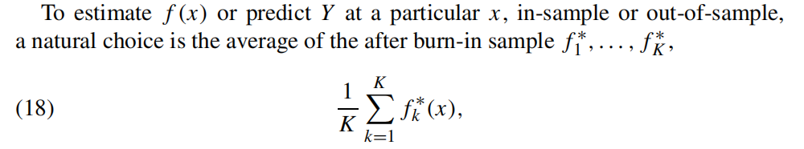

Posterior Inference
Inference on Variables of Our Interest:
Divide the variables into two sets, one of which we are interested in, the other includes others.
And now fx becomes
Just sum the items that have Xs?
And it could also be used to do the variable selection, the X that appears most frequent is the better variable, but when m (Total number of trees) is large, it performs not so well.

Slide 7
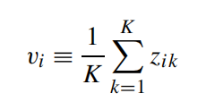
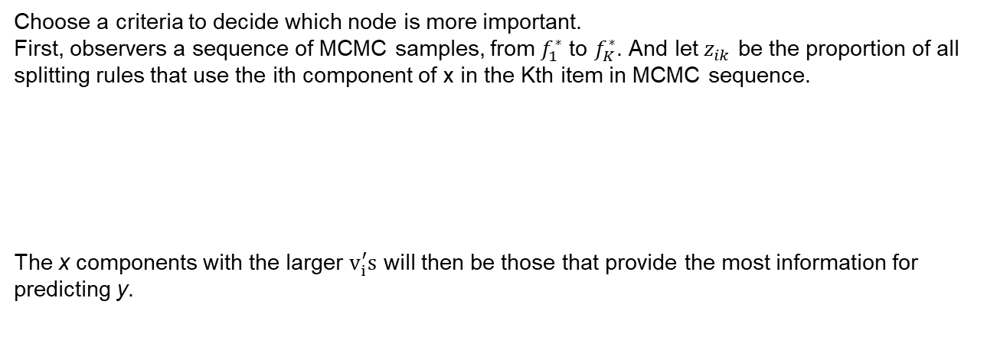
Variable Selection
Choose a criteria to decide which node is more important.
First, observers a sequence of MCMC samples, from $f_{1}^{∗}$ to $f_{K}^{∗}$. And let $z_{ik}$ be the proportion of all splitting rules that use the ith component of x in the Kth item in MCMC sequence.
The x components with the larger $v_{i}^{′}s$ will then be those that provide the most information for predicting y.

Slide 8
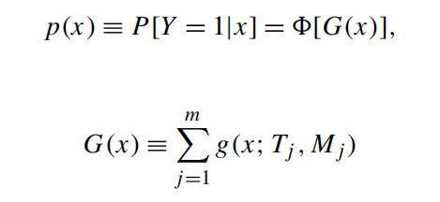
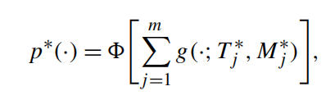
BART Probit Model

