Slide 1
BAYESIAN ADDITIVE REGRESSION TREES
BY HUGH A. CHIPMAN, EDWARD I. GEORGE AND ROBERT E. MCCULLOCH

Slide 2
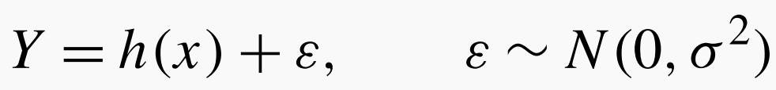

Introduction

Slide 3
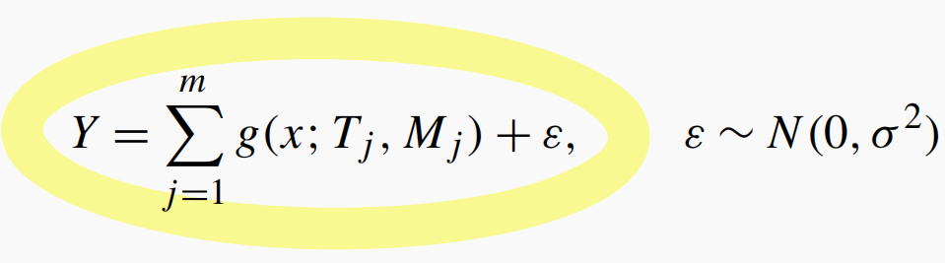
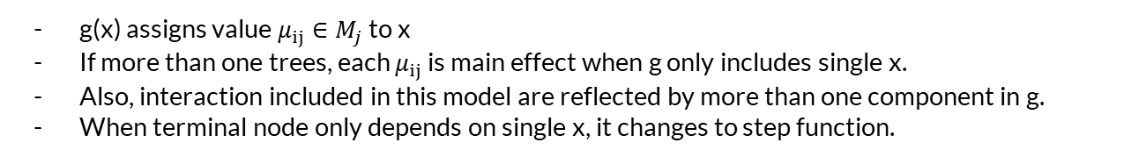
Model
g(x) assigns value $μ_{ij}∈M_{j}$ to x
If more than one trees, each $μ_{ij}$ is main effect when g only includes single x.
Also, interaction included in this model are reflected by more than one component in g.
When terminal node only depends on single x, it changes to step function.

Slide 4
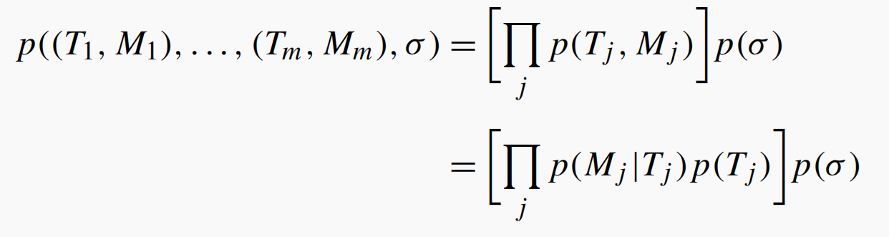
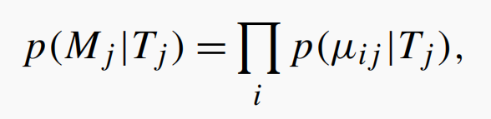
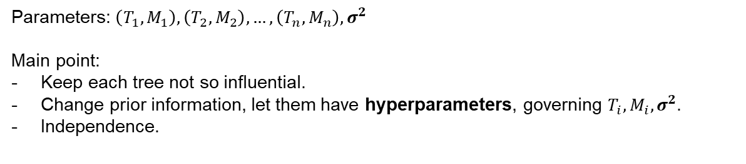
Regularization Prior
Parameters: $\left(T_{1}, M_{1}\right),\left(T_{2}, M_{2}\right), …, \left(T_{n}, M_{n}\right), σ^{2}$
Main point:
Keep each tree not so influential.
Change prior information, let them have hyperparameters, governing $T_{i}, M_{i},σ^{2}$.
Independence.

Slide 5
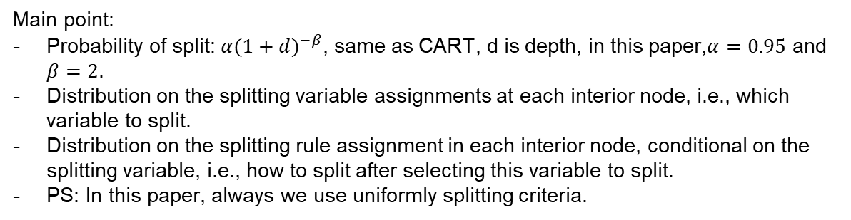
$T_{j}$ Prior
Main point:
Probability of split: $α{(1+d)}^{−β}$, same as CART, d is depth, in this paper,$α=0.95$ and $β=2$.
Distribution on the splitting variable assignments at each interior node, i.e., which variable to split.
Distribution on the splitting rule assignment in each interior node, conditional on the splitting variable, i.e., how to split after selecting this variable to split.
PS: In this paper, always we use uniformly splitting criteria.

Slide 6
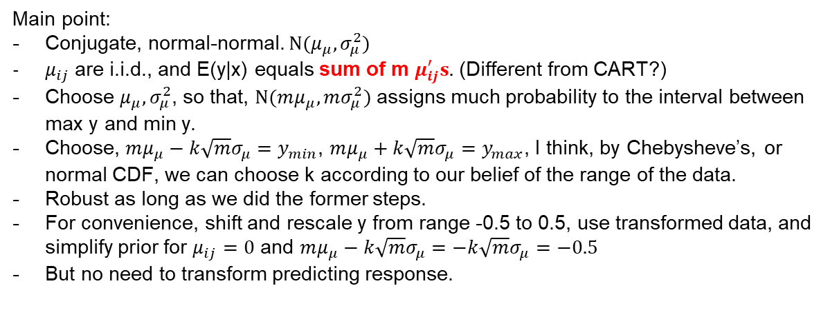
$μ_{ij}|T_{j}$ Prior
Main point:
Conjugate, normal-normal. $N(μ_{μ},σ_{μ}^{2})$
$μ_{ij}$ are i.i.d., and E(y|x) equals sum of m $μ_{ij}^{′}s.$ (Different from CART?)
Choose $μ_{μ},σ_{μ}^{2}$, so that, $N(mμ_{μ},mσ_{μ}^{2})$ assigns much probability to the interval between max y and min y.
Choose, $mμ_{μ}−k\sqrt{m}σ_{μ}=y_{min}$, $mμ_{μ}+k\sqrt{m}σ_{μ}=y_{max}$, I think, by Chebysheve’s, or normal CDF, we can choose k according to our belief of the range of the data.
Robust as long as we did the former steps.
For convenience, shift and rescale y from range -0.5 to 0.5, use transformed data, and simplify prior for $μ_{ij}=0$ and $mμ_{μ}−k\sqrt{m}σ_{μ}=−k\sqrt{m}σ_{μ}=−0.5$
But no need to transform predicting response.

Slide 7
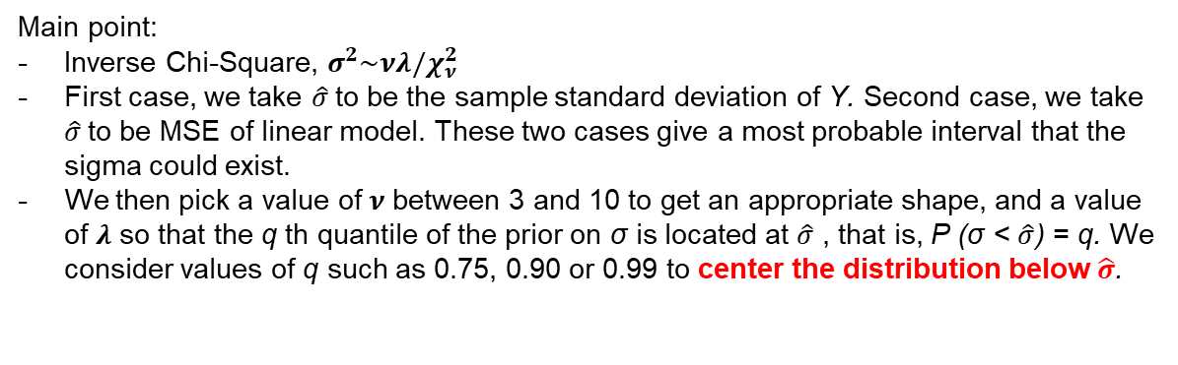
$σ^{2}$ Prior
Main point:
Inverse Chi-Square, $σ^{2}\sim νλ/χ_{ν}^{2}$
First case, we take $\hat{σ}$to be the sample standard deviation of Y. Second case, we take $\hat{σ}$to be MSE of linear model. These two cases give a most probable interval that the sigma could exist.
We then pick a value of$ν$ between 3 and 10 to get an appropriate shape, and a value of $λ$ so that the q th quantile of the prior on σ is located at $\hat{σ}$ , that is, P (σ < $\hat{σ}$) = q. We consider values of q such as 0.75, 0.90 or 0.99 to center the distribution below $\hat{σ}$.

