Slide 1
Computationally Efficient Bayesian Unit-Level Random Neural Network Modeling of Survey Data under Informative Sampling for Small Area Estimation
Paul A. Parker, Scott H. Holan

Slide 2

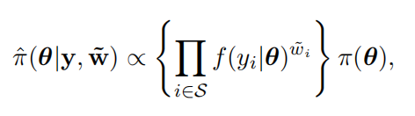
Pseudo-likelihood based SAE
Main point:
The general idea is to use the reported survey weights to exponentially re-weight the likelihood contribution of each survey unit.
- PS: y_i is the response value and w_i is the survey weight for unit i in the sample S.
Bayesian setting pseudo posterior:
This distribution converges into the true population generating distribution
Notes:
- w_i is the survey weight, so for discrete case, w_i is meaningful, what about continuous case? Divide them into small intervals? Like [x-a, x+a] for a barplot?

Slide 3
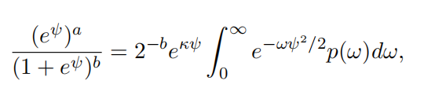
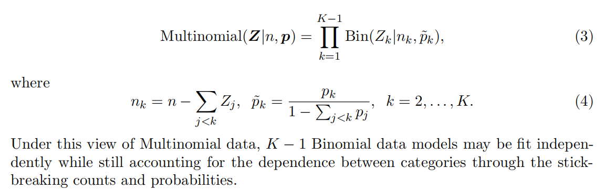
Logistic Models
Main point:
According to a data augmentation approach:
- Put a Gaussian prior on beta, the full conditional distribution is also Gaussian, and it is conjugate under the pseudo likelihood.
Notes:
w_i is the survey weight, so for discrete case, w_i is meaningful, what about continuous case? Divide them into small intervals? Like [x-a, x+a] for a barplot?
How to transfer the multinomial into a binomial like the augmentation?

Slide 4
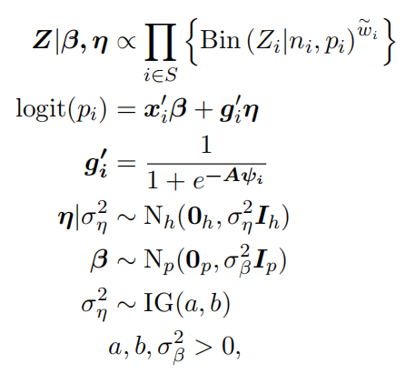
Proposed Model
Main point:
Notes:
What is phi_i here?
After sampling, use the Monte Carlo method to estimate the parameters of the true data generating distribution, what is the difference between data generating function and the distribution of data.

