Slide 1
Deep Learning Concepts
https://www.deeplearningbook.org/contents/mlp.html

Slide 2
$$Feedback and Feedforward$$
Main point:
Feedforward model don’t give feedback, that means, information flow from layer to layer only in one direction until the output layer.
Feedback model has two-direction information flow, the information from the next layer also gives feedback for the former layer. It’s called “recurrent neural networks”
Layer:
Hidden layer?
Units in the layer?

Slide 3
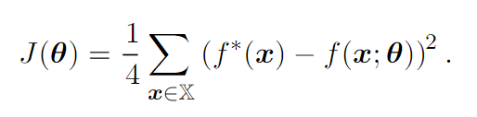

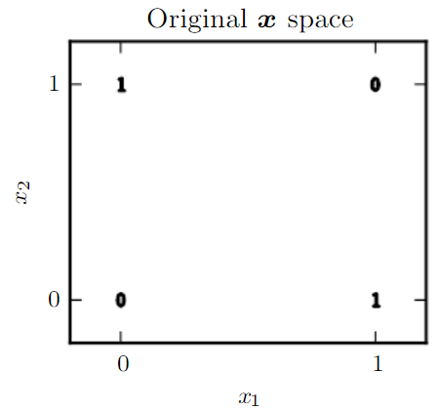
$$Example:Learning XOR$$
Main point:
XOR: f(x1, x2), when exactly one of x1 and x2 is 1, then it returns 1, or it returns 0.
If we use the mean square error loss function and linear model:
Minimize J, we have, w = 0 (vector), b = 0.5.

Slide 4
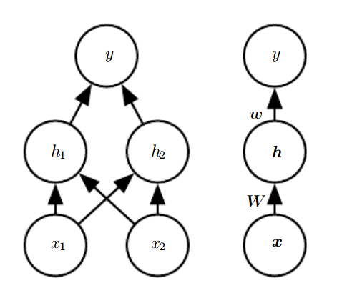





$$Example:Learning XOR −Continued$$
Main point:
If we introduce a simple feedforward network with one hidden layer containing two hidden units:
PS: We cannot set f1 and f2 to be both linear, because the result will still be linear, we should avoid being the same as the former case.
Instead, we use:
So:
Activation function?
At last, with certain value of W, w, c, b to map from (x1, x2) to y correctly

Slide 5

$$Gradient−Based Learning$$
Main point:
For neural network models, the non-linearity sometimes causes the function not to have a convexity properties as linear functions. So we use iterative gradient methods to drive the cost function to a small value.
Cost function can be negative likelihood for those model with a distribution given the parameters.

Slide 6




$$Output Units$$
Main point:
Linear Units:
PS: Linear units are always used for producing a mean of conditional Gaussian Distribution, i.e., like linear regression.
Sigmoid Units:
PS: This unit is used for Bernoulli outputs.
Softmax Units:
PS: What is the loss function in this case? How to maximize the LLH?

