Slide 1
Extreme Learning Machine
Guang-Bin Huang, Qin-Yu Zhu, Chee-Kheong Siew

Slide 2
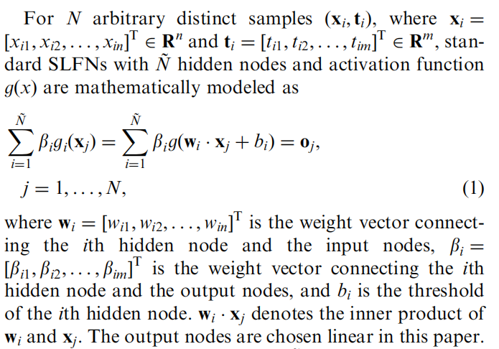
$$\text{Single} \text{hidden} \text{layer} \text{feedforward} \text{networks}\text{ (}\text{SLFNs}\text{)} \text{with} \text{random} \text{hidden} \text{nodes}$$
Main point:
Notes:
Does it mean n inputs and m outputs?
Why doesn’t this model have intercept term outside of activation function?
Dimension of g (activation function) should be from n to m?
What does threshold mean? For b_i.

Slide 3
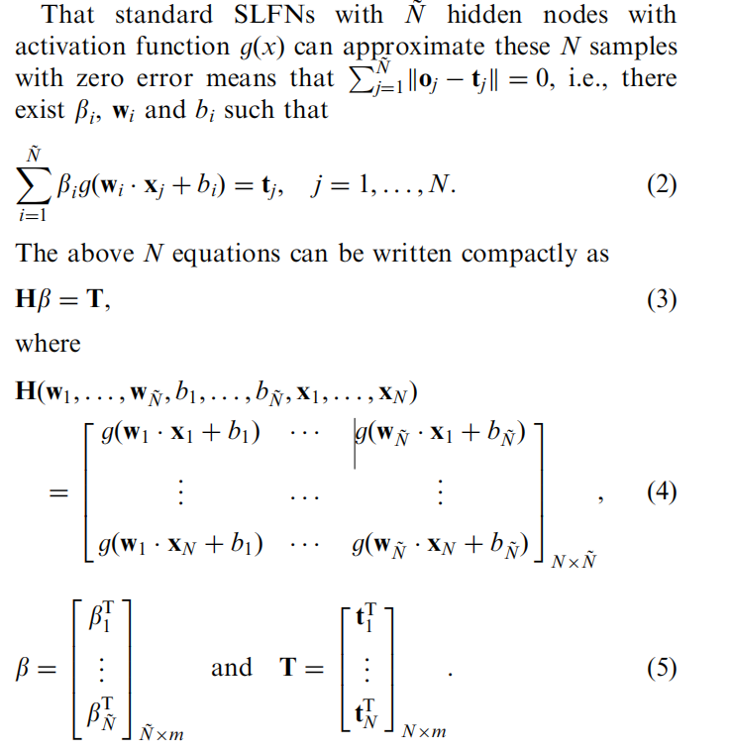
$$\text{Single} \text{hidden} \text{layer} \text{feedforward} \text{networks}\text{ (}\text{SLFNs}\text{)} \text{with} \text{random} \text{hidden} \text{nodes}$$
Main point:
Notes:
Why it can approximate each one with zero error?
If there is zero error, should we use different g or the same g for them?

Slide 4
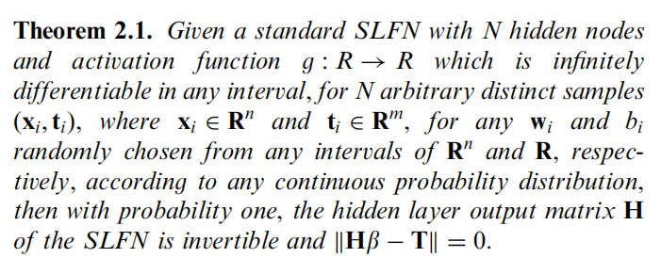
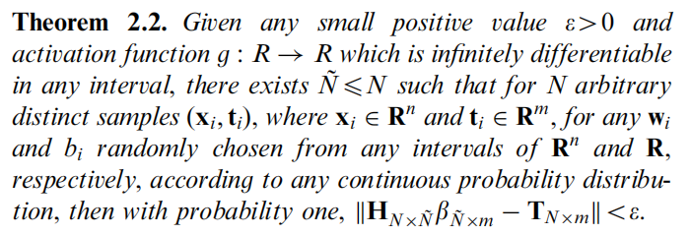
$$Two Theorems$$
Main point:
Notes:
For non-linear functions, some of it can’t satisfy this condition since it cannot be differentiable. For example, truncated linear. Does it mean it cannot be used here?
What is the second theorem talking about? If we have the first one, why do we need the second one.

Slide 5
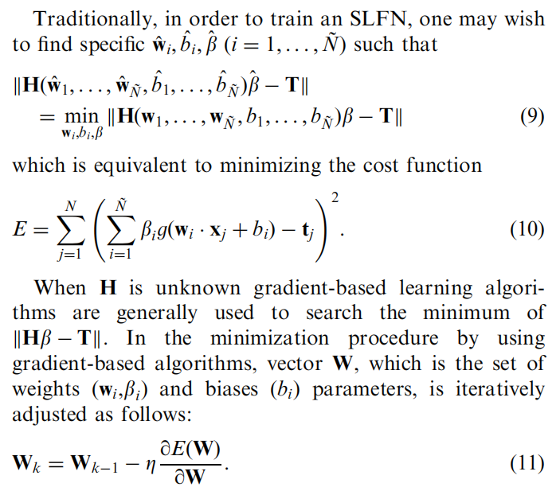
$$\text{Conventional} \text{gradient}\text{-}\text{based} \text{solution} \text{of} \text{SLFNs}$$
Main point:
Notes:
Gradient based, stochastic gradient method, Newton’s method.
Eta is the learning rate, like length of the steps. When it’s small, it converges in a low speed, when it is too big, it moves everywhere and does not converge.
What is “BP”?

Slide 6
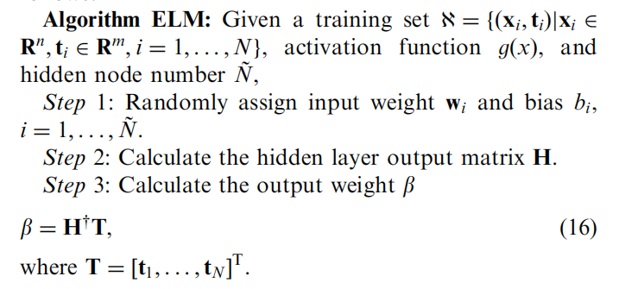
$$\text{Algorithm} \text{ELM}$$
Main point:
Notes:
Randomly select input weight w and bias b. How is random? Uniform? Normal? Is it like a prior?
Last step seems like a LSE of a linear model, again, do we have intercept?

