Slide 1
STATS 07 Discussion 2
TA: Qi Wang
Email: qwang113@ucsc.edu

Slide 2
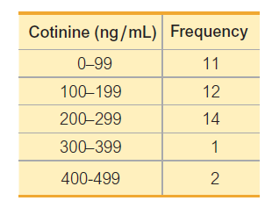
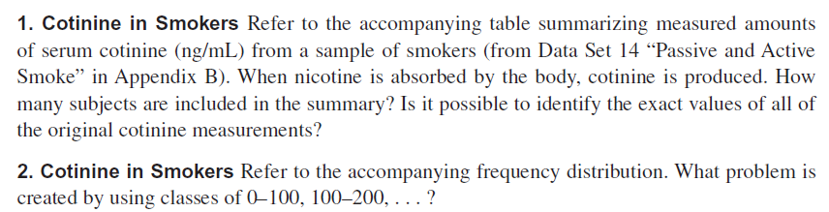
Section 2-1:

Slide 3

Section 2-2:

Slide 4
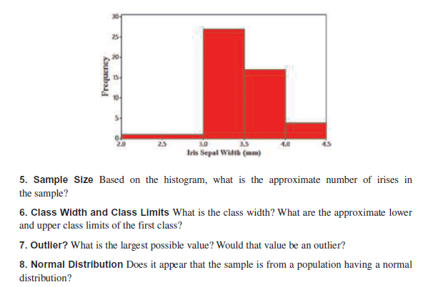
Section 2-2:

Slide 5

Section 2-3:

Slide 6

Section 3-1:

Slide 7
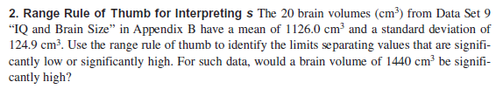

Section 3-2:

Slide 8

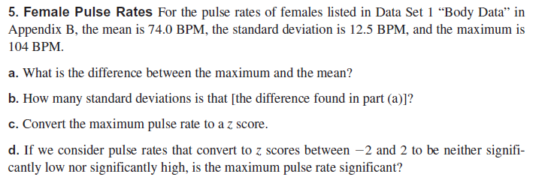
Section 3-3:

