Slide 1
STATS 07 Discussion 3
TA: Qi Wang
Email: qwang113@ucsc.edu

Slide 2
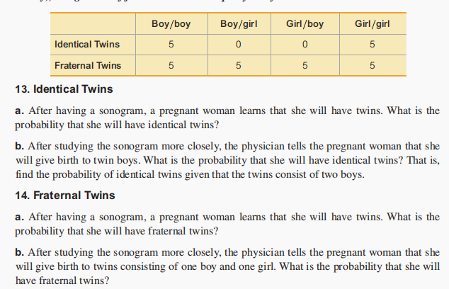
Section 4-3:

