Slide 1
STATS 07 Discussion 4
TA: Qi Wang
Email: qwang113@ucsc.edu

Slide 2
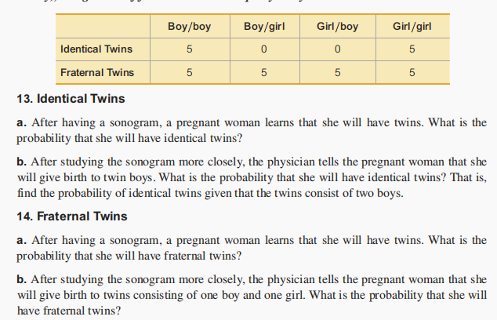
Section 4-3:

Slide 3
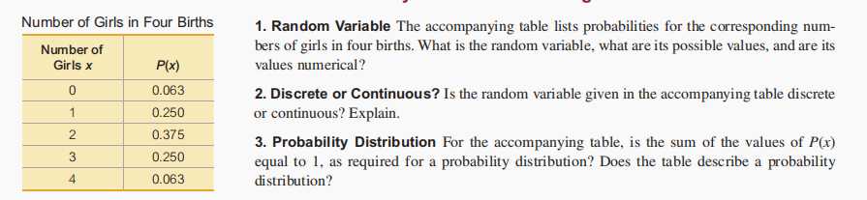
Section 5-1:

Slide 4
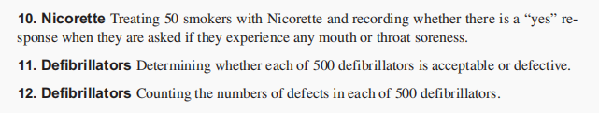
Section 5-2: Whether it’s Binomial

Slide 5
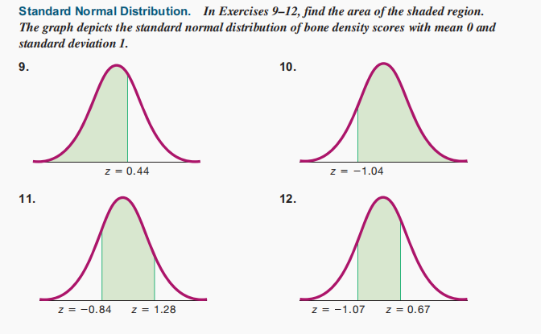
Section 6-1:

Slide 6
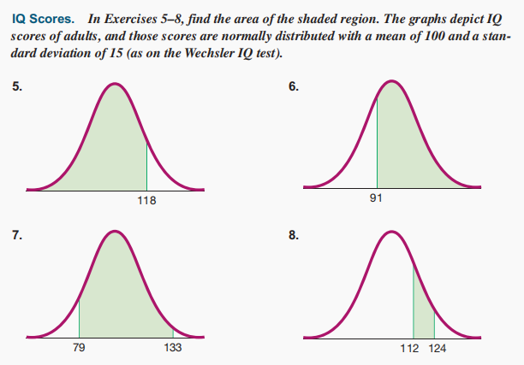
Section 6-2:

