Slide 1
STATS 07 Discussion 6
TA: Qi Wang
Email: qwang113@ucsc.edu

Slide 2

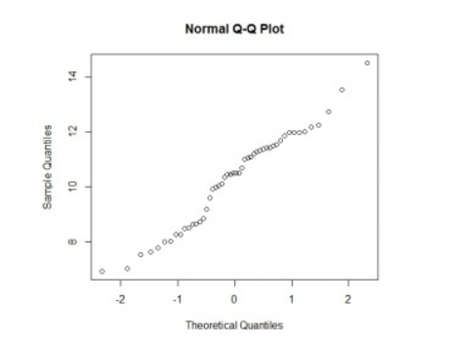
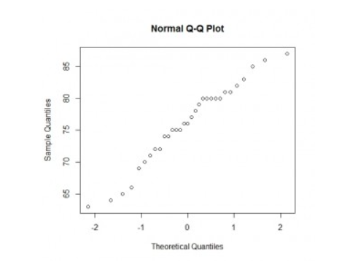
Section 6-5:

Slide 3

Section 6-5:
Histogram, Outliers, QQplot

Slide 4
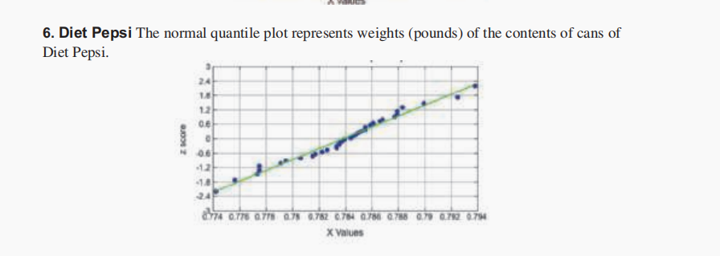
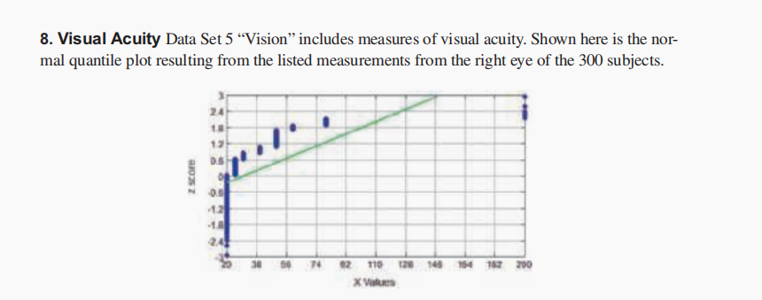
Section 6-5:

Slide 5

Section 6-6:

Slide 6
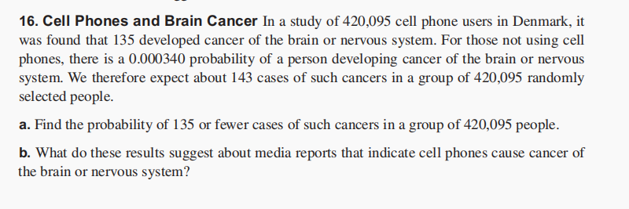
Section 6-6:

Slide 7


Section 7-1:

Slide 8

Section 7-1:

Slide 9
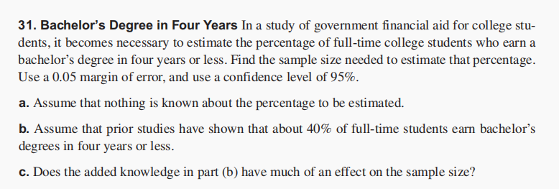
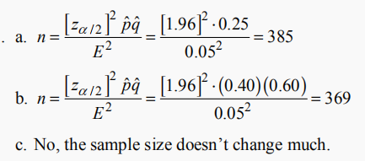
Section 7-1:

