Slide 1
STATS 07 Discussion 7
TA: Qi Wang
Email: qwang113@ucsc.edu

Slide 2


Section 7-1:

Slide 3
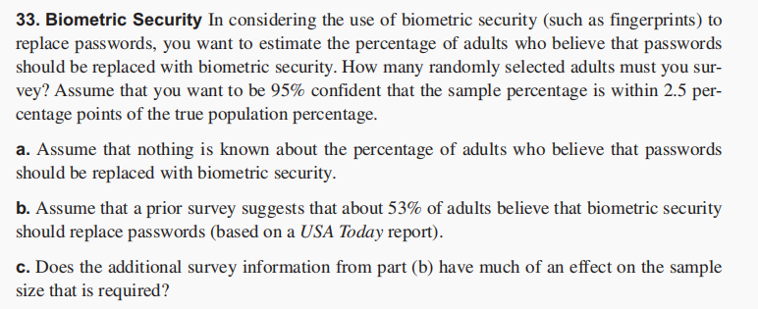

Section 7-1:

Slide 4
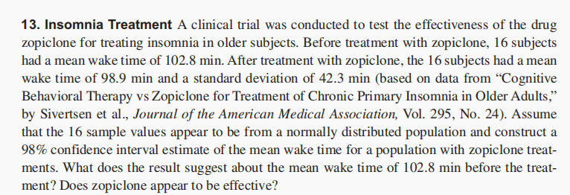

Section 7-2:

Slide 5
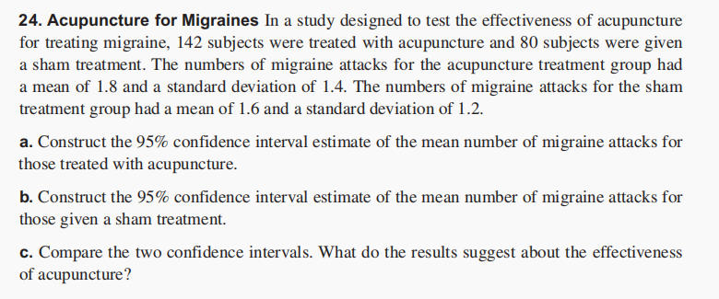

Section 7-2:

Slide 6

Section 7-2:

Slide 7
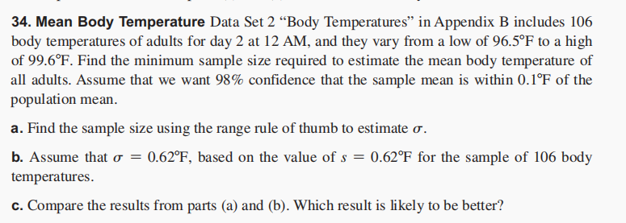

Section 7-2:

