Slide 1
STATS 07 Discussion 8
TA: Qi Wang
Email: qwang113@ucsc.edu

Slide 2
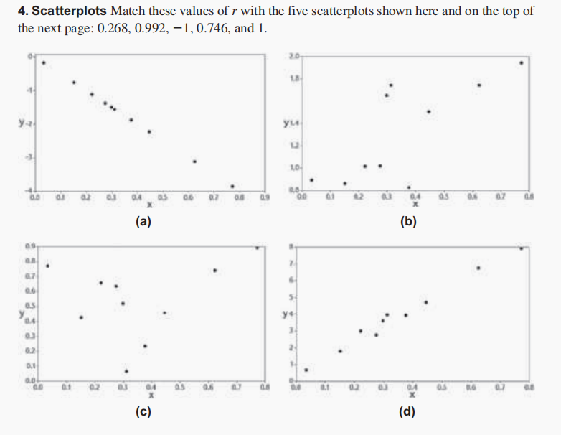
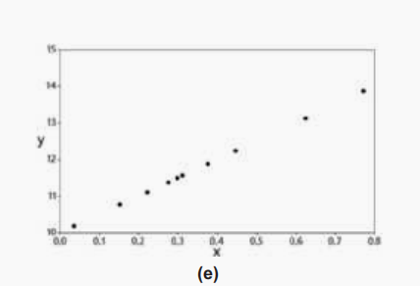
Section 10-1:

Slide 3
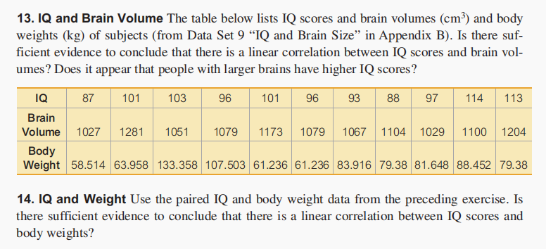
Section 10-1:

Slide 4

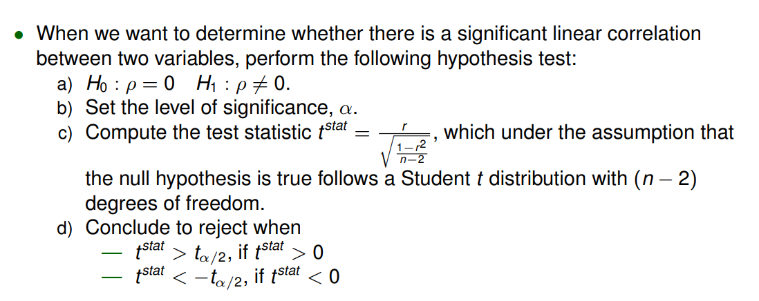

Slide 5
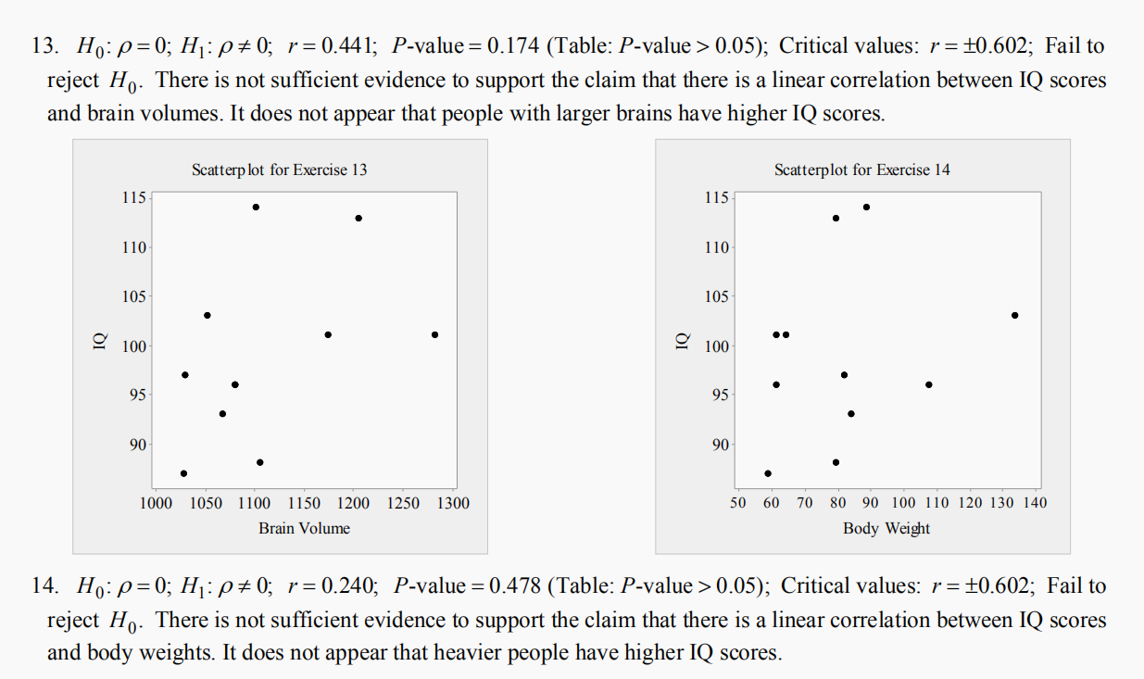

Slide 6

Section 10-2:

Slide 7

Section 10-2:

Slide 8
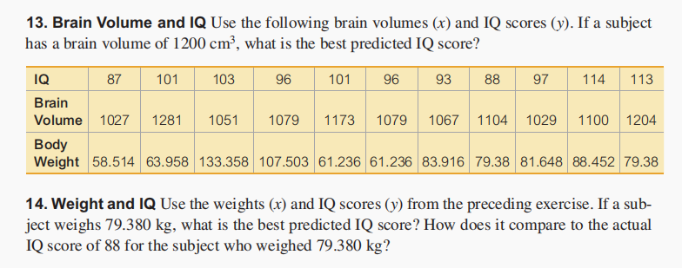
Section 10-2:

Slide 9

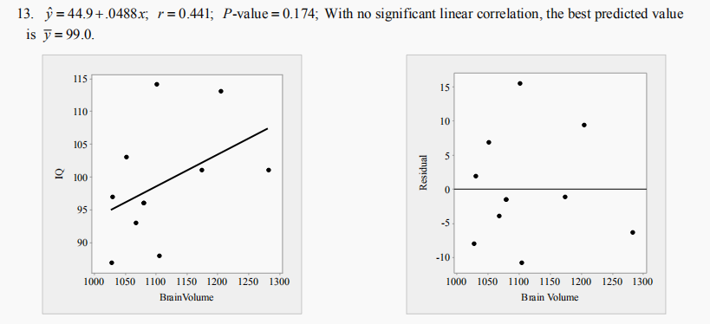
Section 10-2:

Slide 10
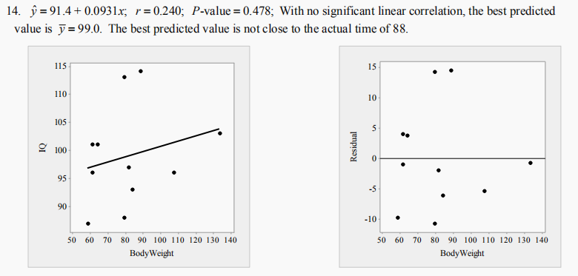
Section 10-2:

