Slide 1

STAT7: Discussion Section #2

Slide 2
Problem 8: Resistance of Statistic
The arithmetic mean of a variable is computed by adding all the values of the variable in the data set and dividing by the number of observations.
The median of a variable is the value that lies in the middle of the data when arranged in ascending order. We use M to represent the median.
The mode of a variable is the most frequent observation of the variable that occurs in the data set.

Slide 3
Problem 8: Resistance of Statistic
[3.1.1] (Page 119)
What does it mean if a statistic is resistant?
Ans:
A numerical summary of data is said to be resistant if extreme values (very large or small) relative to the data do not affect its value substantially.
PS: Mean is NOT resistant, median and mode are resistant.
(For you: Go back to the definition to check it.)

Slide 4
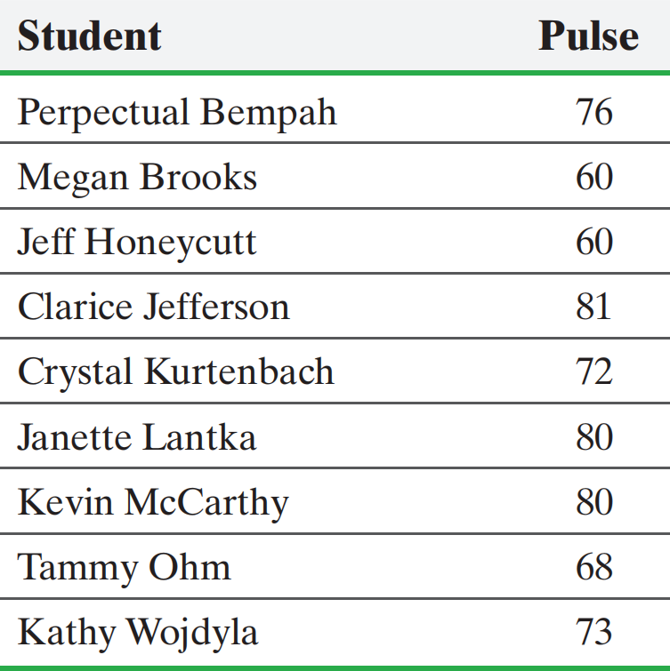
Problem 9: Measures of Central Tendency
[3.1.21] (Page 120) Pulse Rates
The following data represent the pulse rates (beats per minute) of nine students enrolled in a section of Sullivan’s Introductory Statistics course. Treat the nine students as a population.

Slide 5
Problem 9: Measures of Central Tendency
Determine the population mean pulse.
Ans: 72.2, sum and divided by number of students.
(b) Determine the median pulse.
Ans: 60, 60, 68, 72, 73, 76, 80, 80, 81
(c) Determine the population mode pulse.
Ans: 60, 60, 68, 72, 73, 76, 80, 80, 81
PS: No mode or more than one mode are possible.
(For you: Select 3 of them and repeat the steps.)

Slide 6
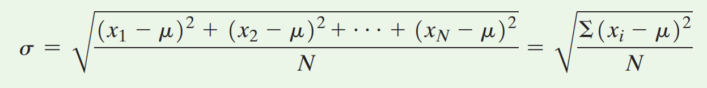
Problem 10: Measures of Dispersion
The range, R, of a variable is the difference between the largest and the smallest data value.
Range = R = largest data value - smallest data value
The population standard deviation of a variable is the square root of the sum of squared deviations about the population mean divided by the number of observations in the population, N. That is, it is the square root of the mean of the squared deviations about the population mean.

Slide 7
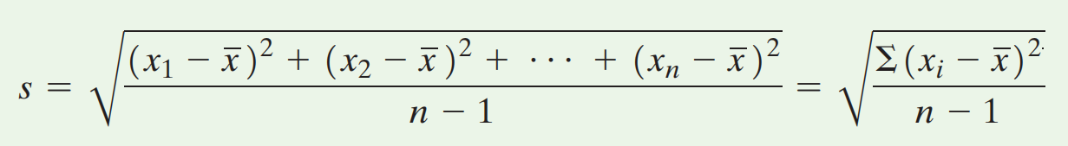

Problem 10: Measures of Dispersion
The sample standard deviation, s, of a variable is the square root of the sum of squared deviations about the sample mean divided by n-1, where n is the sample size.
PS:
No $μ$ anymore!
Divided by n-1 instead of n!
The variance of a variable is the square of the standard deviation. The population variance is $σ^{2}$and the sample variance is${ s}^{2}$.

Slide 8
Problem 10: Measures of Dispersion
[3.2.3](Page 134) True or False
When comparing two populations, the larger the standard deviation, the more dispersion the distribution has, provided that the variable of interest from the two populations has the same unit of measure.
Ans:
It is correct if the unit is the same.

Slide 9
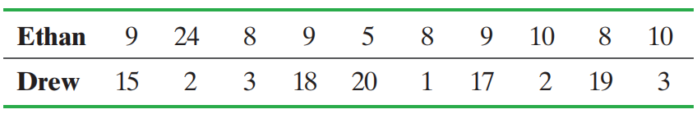
Problem 10: Measures of Dispersion
[3.2.21](Page 136) A Fish Story
Ethan and Drew went on a 10-day fishing trip. The number of smallmouth bass caught and released by the two boys each day was as follows:

Slide 10
Problem 10: Measures of Dispersion
[3.2.21](Page 136) A Fish Story
Find the population mean and the range for the number of smallmouth bass caught per day by each fisherman. Do these values indicate any differences between the two fishermen’s catches per day? Explain.
Ans:
Ethan: m = 10 fish, R = 19 fish; Drew: m = 10 fish, R = 19 fish.
There is no difference between Ethan and Drew based on these measures

Slide 11
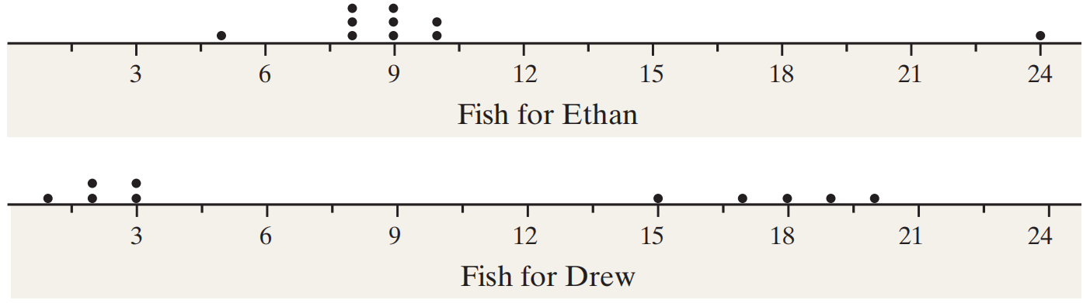
Problem 10: Measures of Dispersion
[3.2.21](Page 136) A Fish Story
(b) Draw a dot plot for Ethan. Draw a dot plot for Drew.
Which fisherman seems more consistent?
Ans:
Ethan appears to be more consistent.

Slide 12

Problem 10: Measures of Dispersion
[3.2.21](Page 136) A Fish Story
(c) Find the population standard deviation for the number of smallmouth bass caught per day by each fisherman. Do these values present a different story about the two fishermen’s catches per day? Which fisherman has the more consistent record? Explain.
Ans:
Ethan: $σ$ = 4.9 fish, Drew:$σ$= 7.9 fish;
Ethan has the more consistent record.

Slide 13
Problem 10: Measures of Dispersion
[3.2.21](Page 136) A Fish Story
(d) Discuss limitations of the range as a measure of dispersion.
Ans:
Range is not resistant.
It loses too much information compared with the standard deviation, it only uses two numbers in the data, so it only indicates the information about the difference between the min and max point in the data. No more other information.

Slide 14
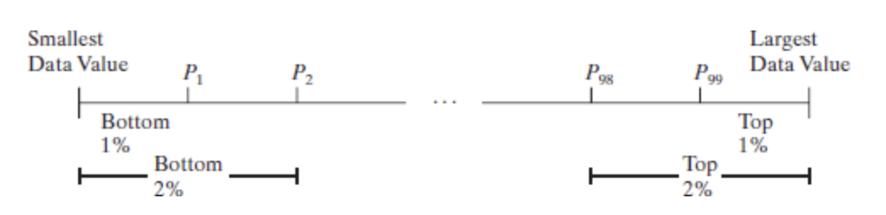

3.4: Percentiles
The kth percentile, denoted $P_{k}$, of a set of data is a value such that k percent of the observations are less than or equal to that value.
Percentiles divide a set of data that is written in ascending order into 100 parts. For example $P_{1}$ divides the bottom 1% of the observations from the top 99%. $P_{2}$ divides the bottom 2% of the observations from the top 98% and so on.

Slide 15
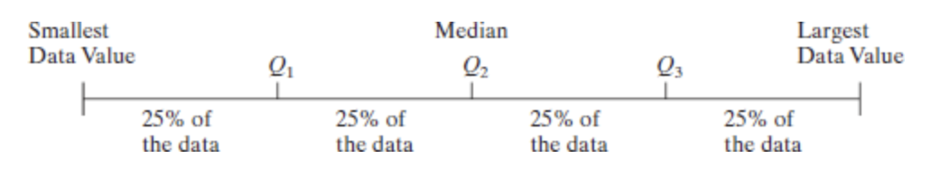
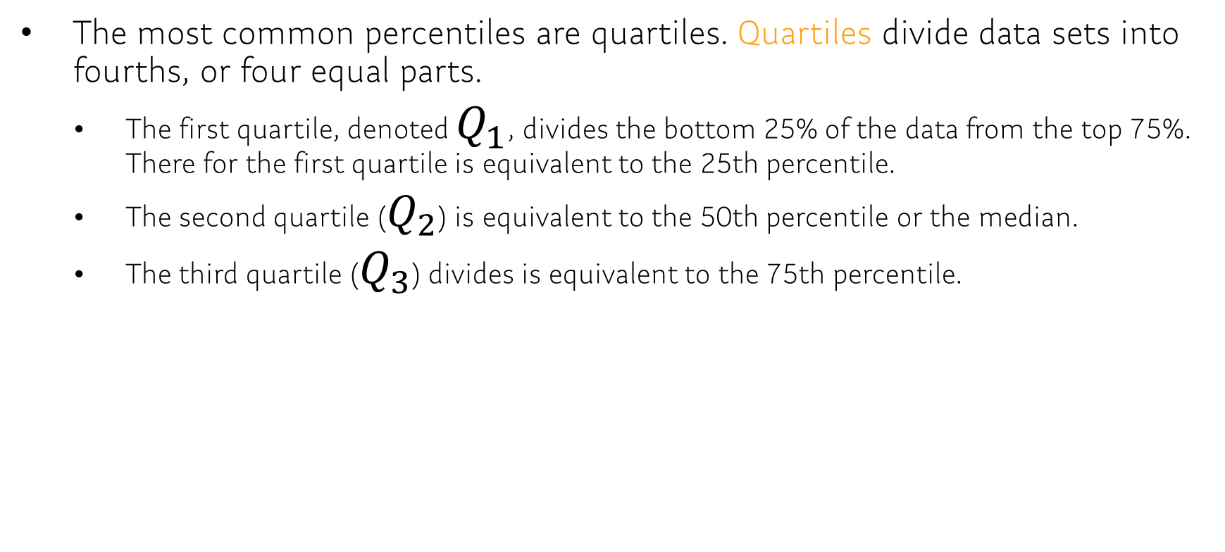
3.4 Quartiles
The most common percentiles are quartiles. Quartiles divide data sets into fourths, or four equal parts.
The first quartile, denoted $Q_{1}$, divides the bottom 25% of the data from the top 75%. There for the first quartile is equivalent to the 25th percentile.
The second quartile ($Q_{2}$) is equivalent to the 50th percentile or the median.
The third quartile ($Q_{3}$) divides is equivalent to the 75th percentile.

Slide 16
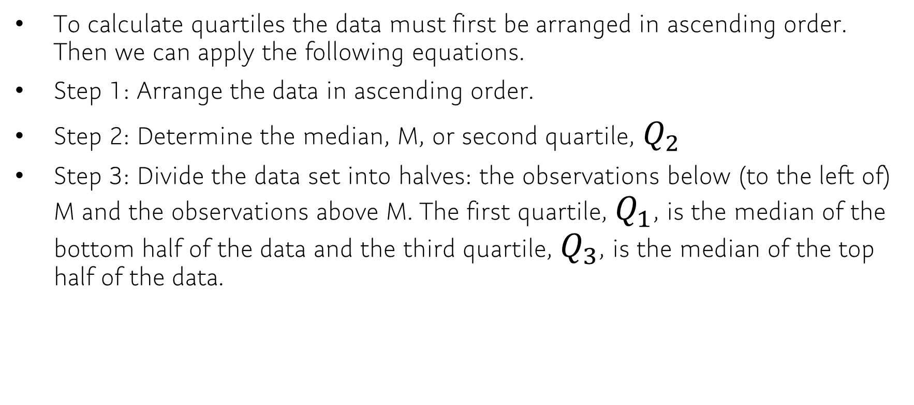
3.4: Calculating Quartiles
To calculate quartiles the data must first be arranged in ascending order. Then we can apply the following equations.
Step 1: Arrange the data in ascending order.
Step 2: Determine the median, M, or second quartile, $Q_{2}$
Step 3: Divide the data set into halves: the observations below (to the left of) M and the observations above M. The first quartile, $Q_{1}$, is the median of the bottom half of the data and the third quartile, $Q_{3}$, is the median of the top half of the data.

Slide 17
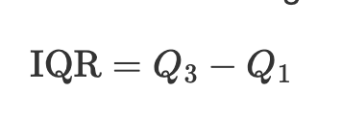
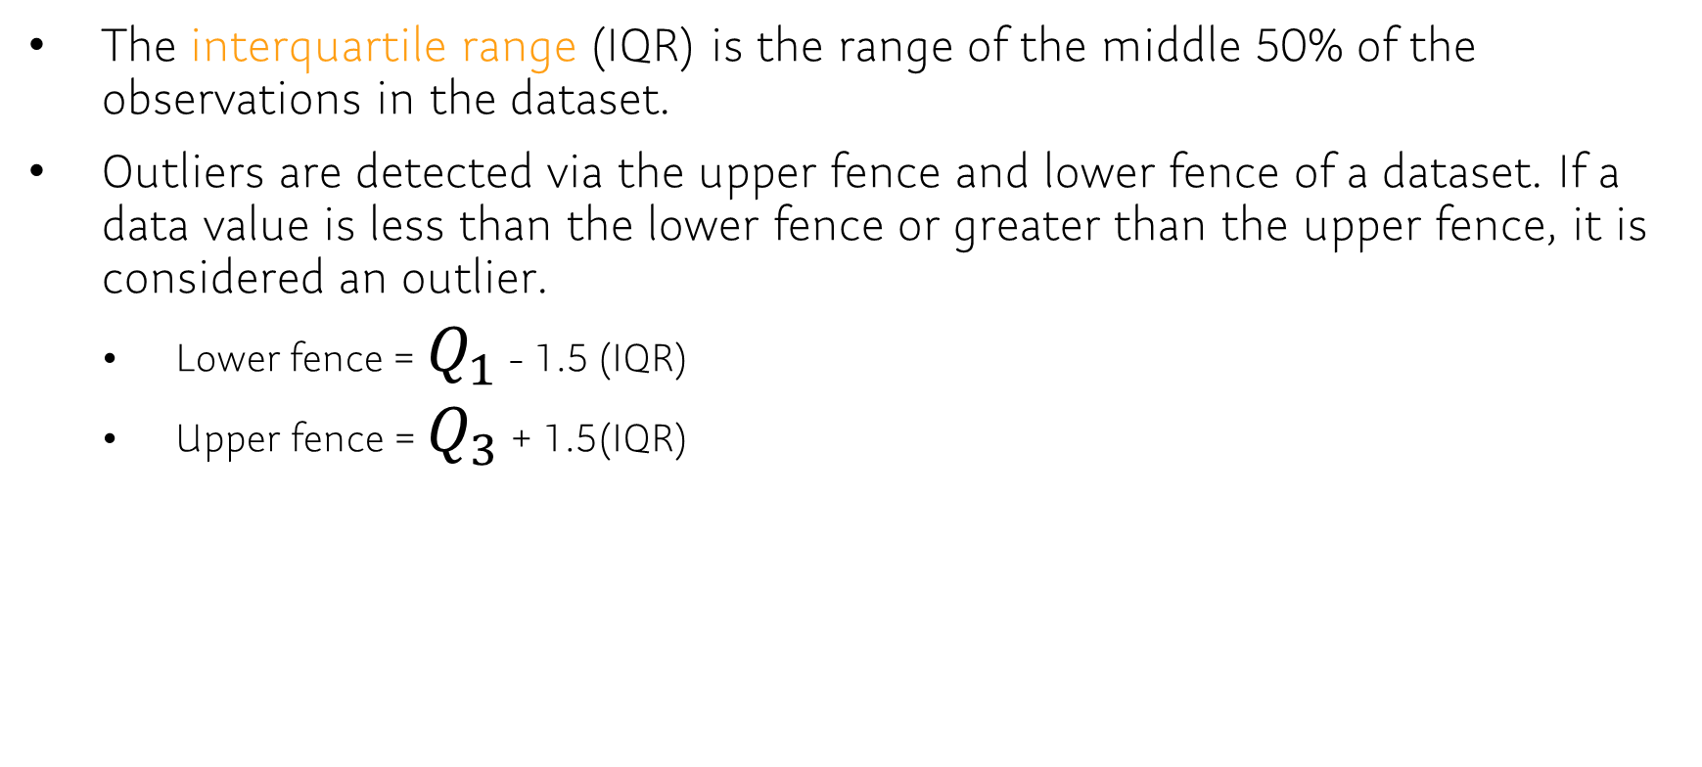
3.4: Interquartile and Outliers
The interquartile range (IQR) is the range of the middle 50% of the observations in the dataset.
Outliers are detected via the upper fence and lower fence of a dataset. If a data value is less than the lower fence or greater than the upper fence, it is considered an outlier.
Lower fence = $Q_{1}$ - 1.5 (IQR)
Upper fence = $Q_{3}$ + 1.5(IQR)

Slide 18
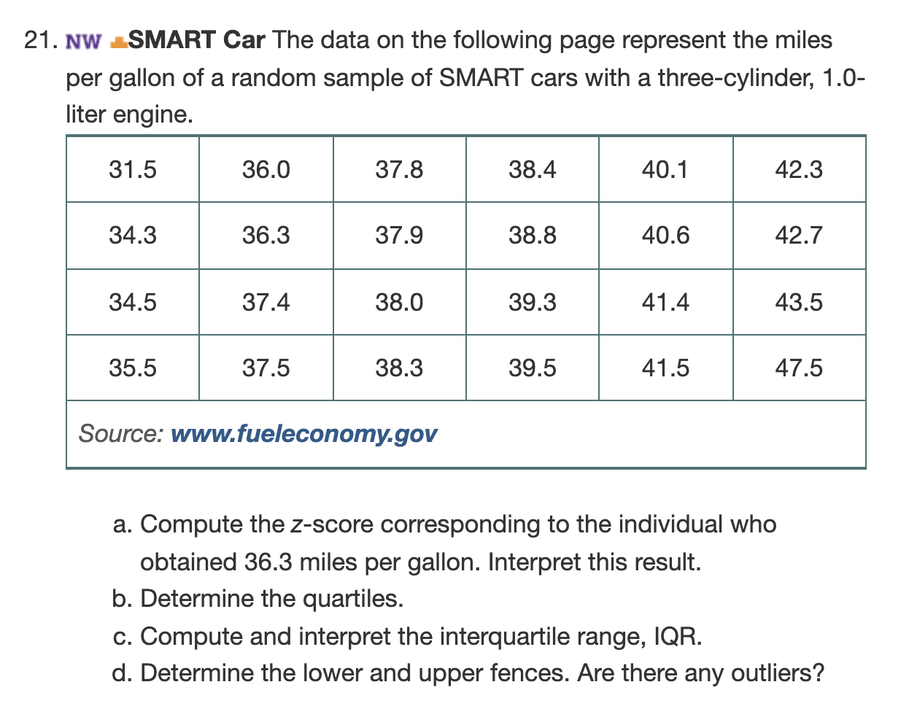
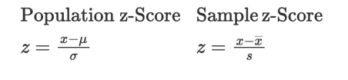
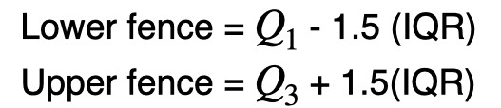

3.4: Example
Calculate z-score for an individual who obtained 36.3 mpg.
Hint: You need the sample mean and sample standard deviation
Need to calculate $Q_{1}$, $Q_{2}$, and $Q_{3}$.
Recall:

Slide 19
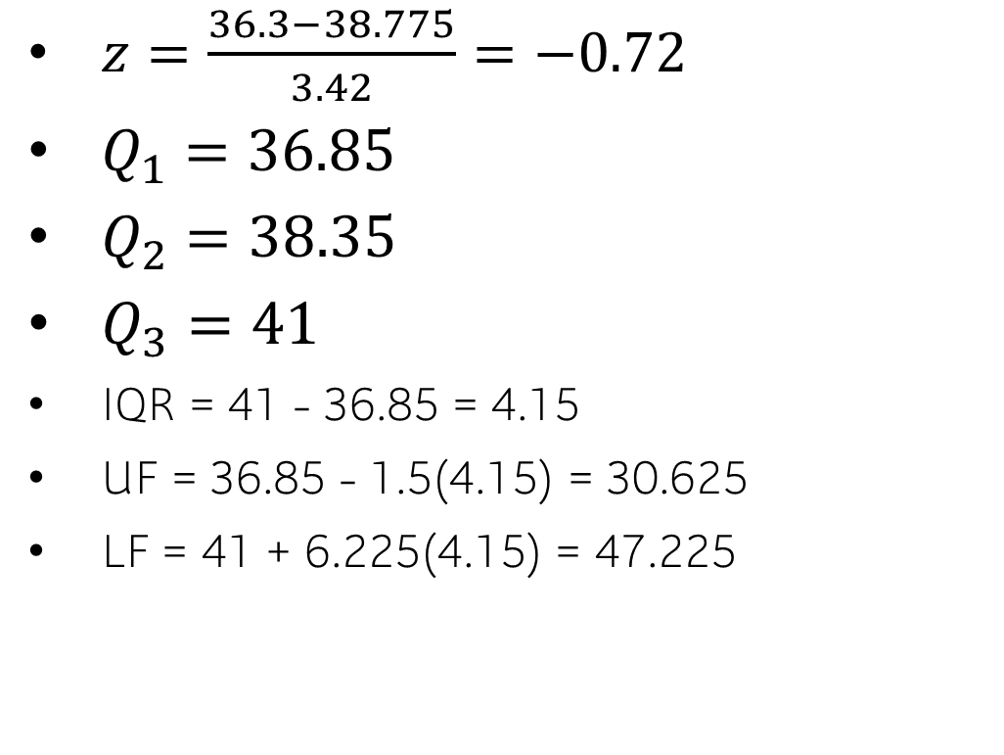
$z=\frac{36.3−38.775}{3.42}=−0.72$
$Q_{1}=36.85$
$Q_{2}=38.35$
$Q_{3}=41$
IQR = 41 - 36.85 = 4.15
UF = 36.85 - 1.5(4.15) = 30.625
LF = 41 + 6.225(4.15) = 47.225

Slide 20
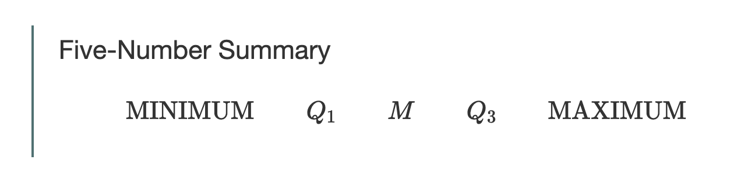
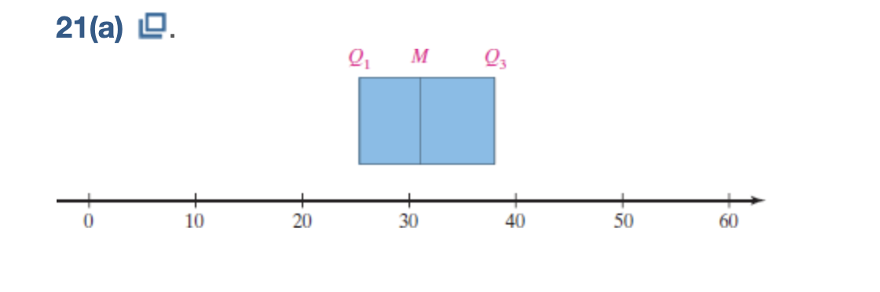
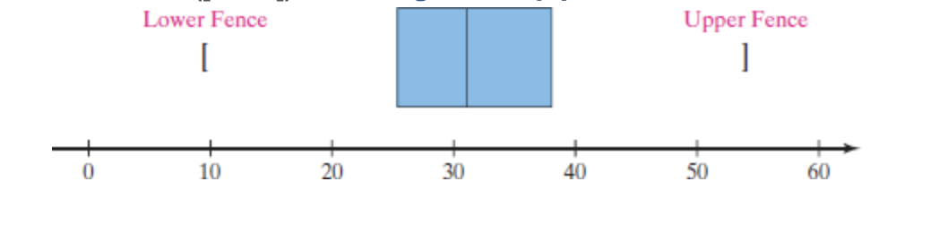
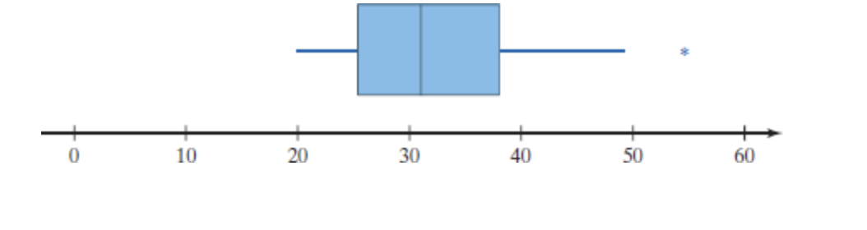

3.5 The Five-Number Summary and Box Plots
The five-number summary of a set of data consists of the smallest data value, $Q_{1}$, the median, $Q_{3}$, and the largest data value. We organize the five-number summary as follows:

