Slide 1

STAT7: Discussion Section #2

Slide 2
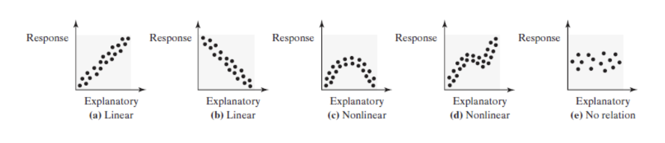
4.1: Scatter Diagrams and Correlative
A scatter diagram is a graph that shows the relationship between two qualitative variables measured on the same individual.

Slide 3
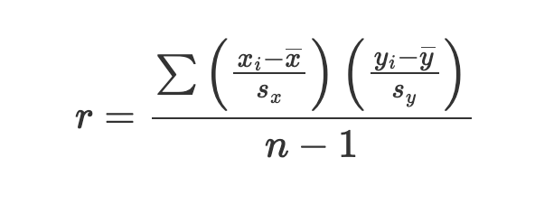
4.1: Sample Linear Correlation Coefficient
The linear correlation coefficient is a measure of the strength and direction of the linear relation between two quantitative variables.
The linear correlation coefficient is always between -1 and 1inclusive.
The closer r is to +1, the stronger the evidence of positive association between the two variables.
The closer r is to -1, the stronger the evidence of negative association between the two variables.
If r is close to 0, then little or not evidence exists of a linear relation between the two variables.

Slide 4
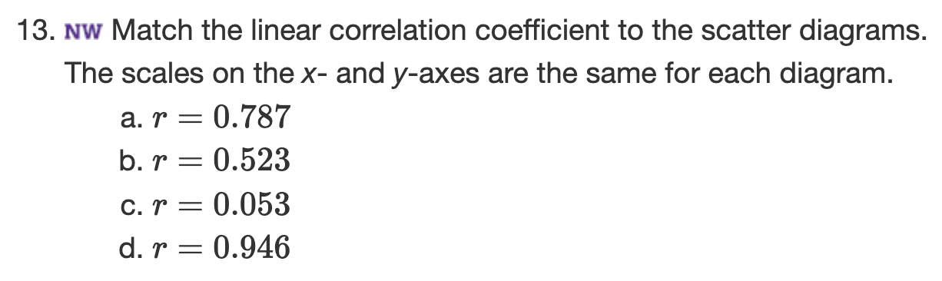
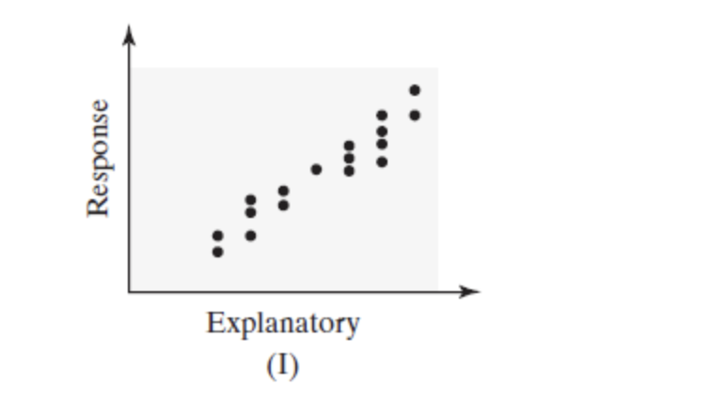
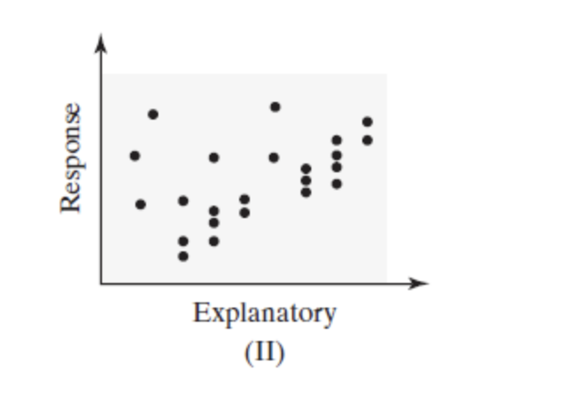
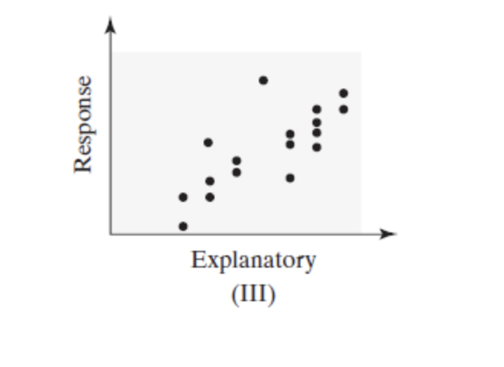
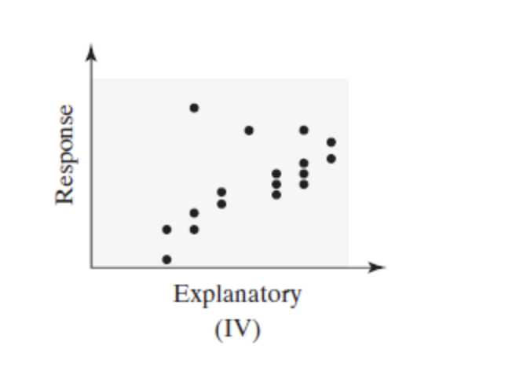
4.1: Example-Linear Correlation Coefficient

Slide 5
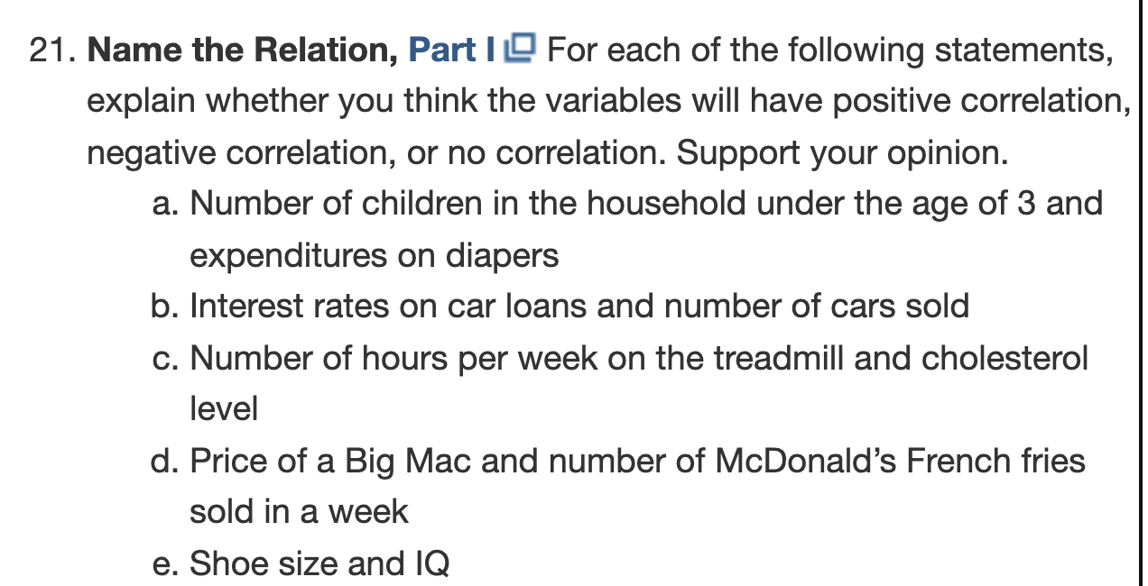
4.1: Example: Conceptualizing Correlation

Slide 6
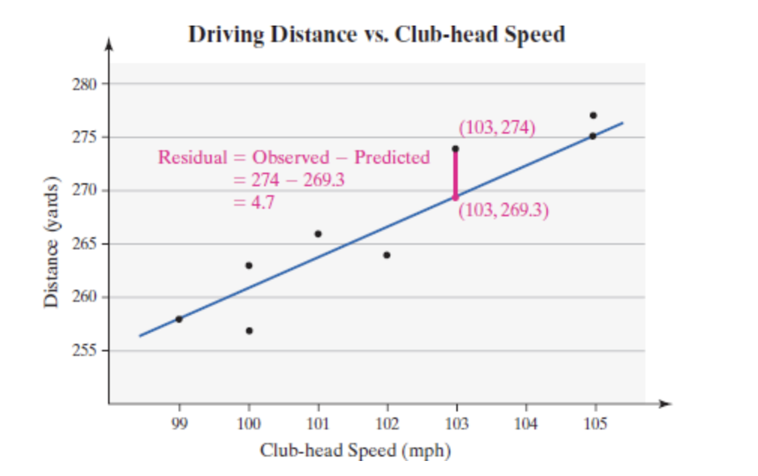
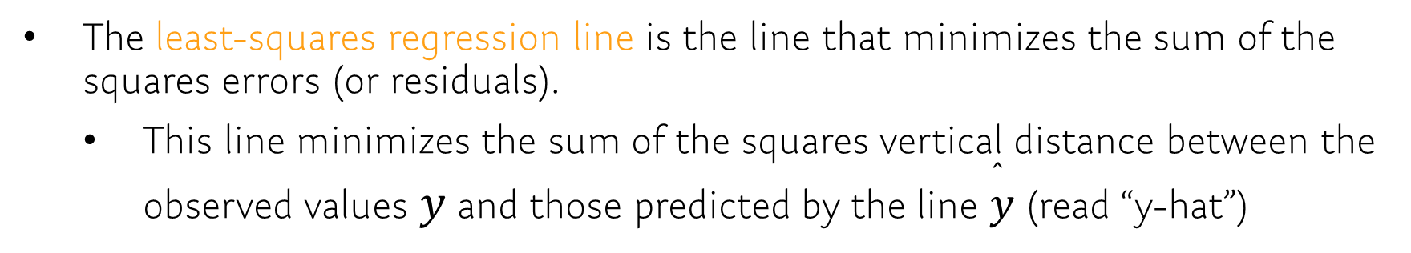
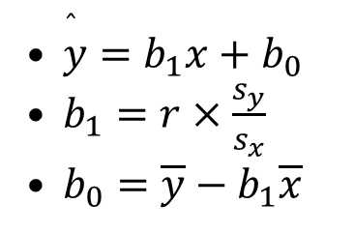
4.2: Least Squares Regression
The least-squares regression line is the line that minimizes the sum of the squares errors (or residuals).
This line minimizes the sum of the squares vertical distance between the observed values $y$ and those predicted by the line $\overset{̂}{y}$ (read “y-hat”)
$\overset{̂}{y}=b_{1}x+b_{0}$
$b_{1}=r×\frac{s_{y}}{s_{x}}$
$b_{0}=\overline{y}−b_{1}\overline{x}$

Slide 7
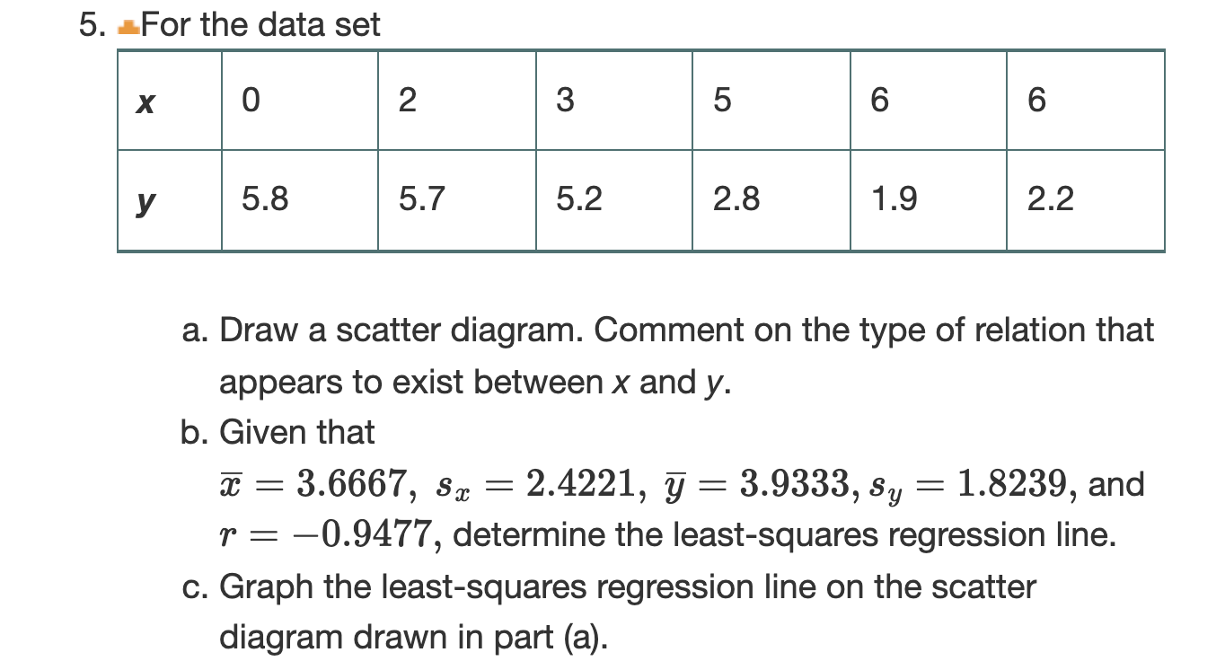
4.2: Linear Regression Example

Slide 8
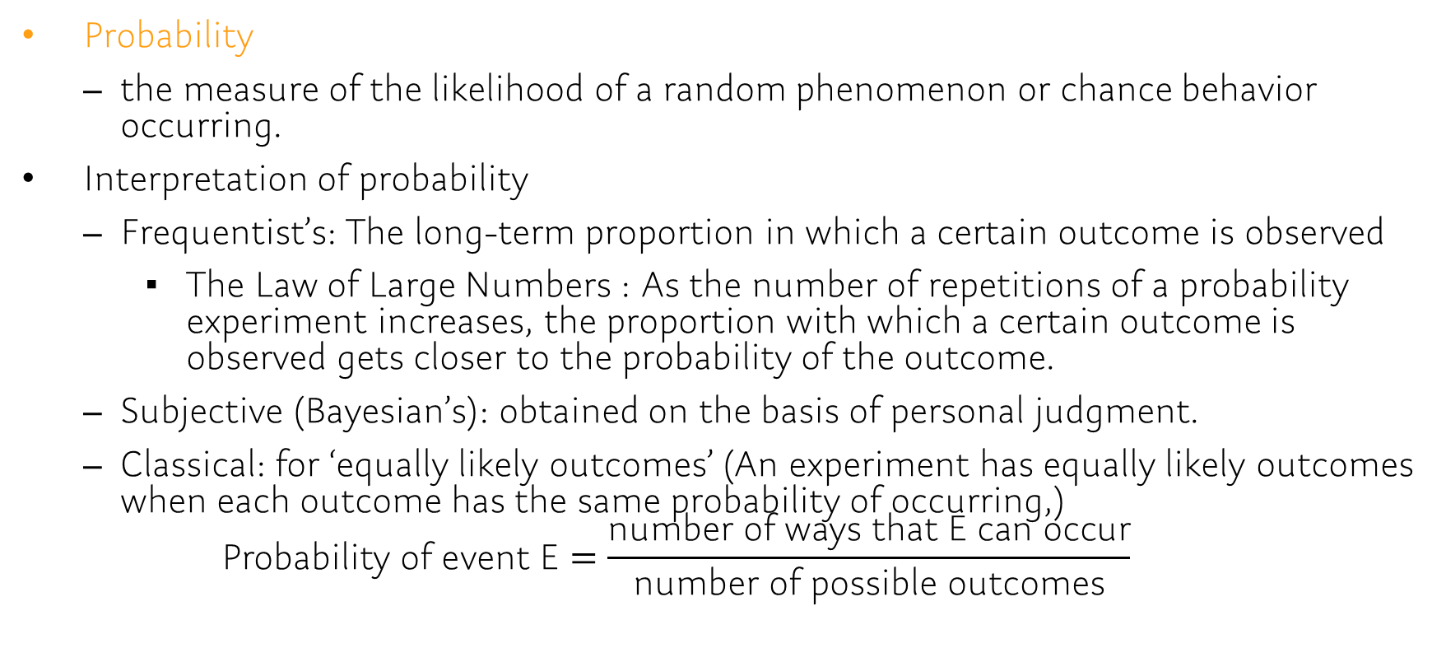
Chap5.1
Probability
the measure of the likelihood of a random phenomenon or chance behavior occurring.
Interpretation of probability
Frequentist’s: The long-term proportion in which a certain outcome is observed
The Law of Large Numbers : As the number of repetitions of a probability experiment increases, the proportion with which a certain outcome is observed gets closer to the probability of the outcome.
Subjective (Bayesian’s): obtained on the basis of personal judgment.
Classical: for ‘equally likely outcomes’ (An experiment has equally likely outcomes when each outcome has the same probability of occurring,) $\text{Probability} \text{of} \text{event} \text{E}=\frac{\text{number} \text{of} \text{ways} \text{that} \text{E} \text{can} \text{occur}}{\text{number} \text{of} \text{possible} \text{outcomes}}$
Notes:
random short-term results = outcomes

Slide 9
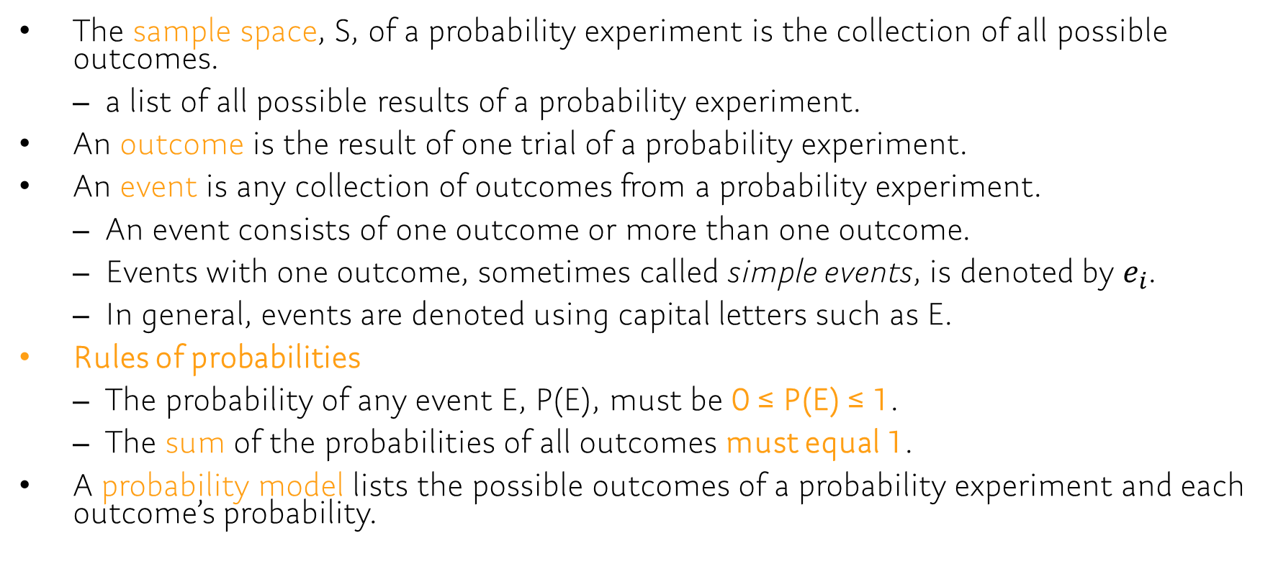
Chap5.1
The sample space, S, of a probability experiment is the collection of all possible outcomes.
a list of all possible results of a probability experiment.
An outcome is the result of one trial of a probability experiment.
An event is any collection of outcomes from a probability experiment.
An event consists of one outcome or more than one outcome.
Events with one outcome, sometimes called simple events, is denoted by $e_{i}$.
In general, events are denoted using capital letters such as E.
Rules of probabilities
The probability of any event E, P(E), must be 0 ≤ P(E) ≤ 1.
The sum of the probabilities of all outcomes must equal 1.
A probability model lists the possible outcomes of a probability experiment and each outcome’s probability.

Slide 10
Problem: Example
Let the sample space be S = {1,2,3,4,5,6,7,8,9,10}. Suppose the outcomes are equally likely.
[5.1.23] Compute the probability of the event E={1,2,3}
[5.1.25] Compute the probability of the event E = "an even number less than 9.”
With the table, which of the assignments of probabilities-
[5.1.39] are consistent
with the definition of a probability model?
[5.1.40] should be used if the coin is known to be fair?
[5.1.41] should be used if the coin is known to always come up tails?
[5.1.42] should be used if tails is twice as likely to occur as heads?
Assignments | HH | HY | TH | TT
A | 1/4 | 1/4 | 1/4 | 1/4
B | 0 | 0 | 0 | 1
C | 3/16 | 5/16 | 5/16 | 3/16
D | 1/2 | 1/2 | -1/2 | 1/2
E | 1/4 | 1/4 | 1/4 | 1/8
F | 1/9 | 2/9 | 2/9 | 4/9
Notes:
[5.1.23] 3/10 = 0.3
[5.1.25] 4/10 = 0.4
[5.1.39] A, B, C, and F are consistent with the definition of a probability model.
[5.1.40] A
[5.1.41] B
[5.1.42] F

Slide 11
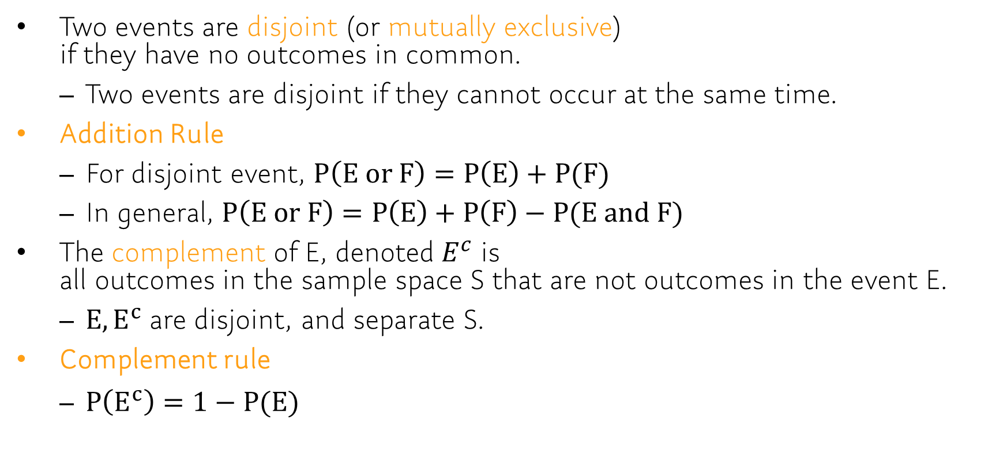
Chap5.2
Two events are disjoint (or mutually exclusive) if they have no outcomes in common.
Two events are disjoint if they cannot occur at the same time.
Addition Rule
For disjoint event, $P\left(E or F\right)=P\left(E\right)+P(F)$
In general, $P\left(E or F\right)=P\left(E\right)+P\left(F\right)−P(E and F)$
The complement of E, denoted $E^{c}$ is all outcomes in the sample space S that are not outcomes in the event E.
$E,E^{c}$ are disjoint, and separate S.
Complement rule
$P\left(E^{c}\right)=1−P(E)$
Notes:
Setting: Let S denote the sample space of a probability experiment and let E and F denote events.

Slide 12

Problem: Example
Let E, F be events with P(E)=0.25, P(F)=0.45
[5.2.13] P(E or F) if P(E and F) = 0.25
[5.2.14] P(E and F) if P(E or F) = 0.6
[5.2.15] P(E or F) if E and F are mutually exclusive
[5.2.16] P(E and F) if E and F are mutually exclusive
[5.2.17] $P(E^{c})$
[5.2.18] $P(F^{c})$
Notes:
[5.2.13] 0.55
[5.2.14] 0.1
[5.2.15] 0.7
[5.2.16] 0
[5.2.17] 0.75
[5.2.18] 0.55

Slide 13
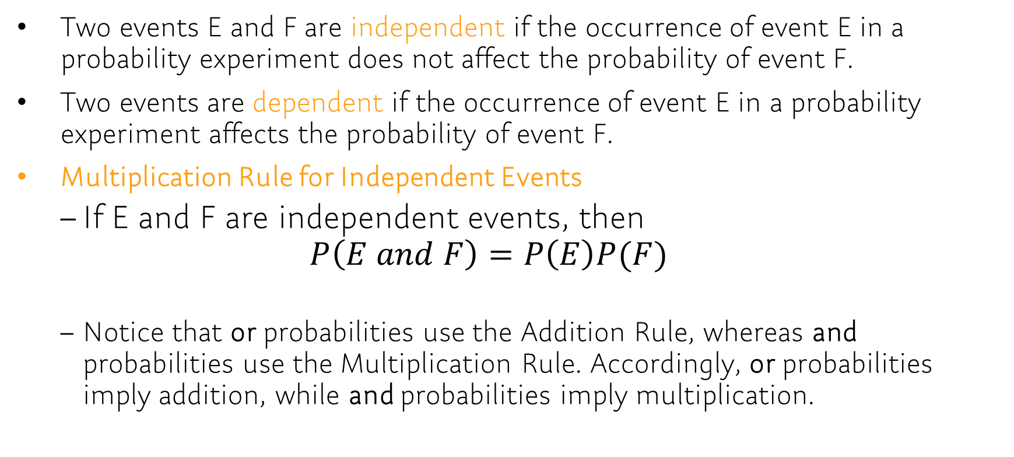
Chap 5.3
Two events E and F are independent if the occurrence of event E in a probability experiment does not affect the probability of event F.
Two events are dependent if the occurrence of event E in a probability experiment affects the probability of event F.
Multiplication Rule for Independent Events
If E and F are independent events, then $P\left(E and F\right)=P\left(E\right)P(F)$
Notice that or probabilities use the Addition Rule, whereas and probabilities use the Multiplication Rule. Accordingly, or probabilities imply addition, while and probabilities imply multiplication.

Slide 14
Problem: Example
[5.3.7] Determine whether the events E and F are independent or dependent.
E: Speeding on the interstate. VS F: Being pulled over by a police officer.
E: You gain weight. VS F: You eat fast food for dinner every night.
E: You get a high score on a stat7 exam. VS F: The Boston Red Sox win a baseball game.
[5.3.15] The ELISA is a test to determine whether the HIV antibody is present. The test is 99.5% effective, which means that the test will come back negative if the HIV antibody is not present 99.5% of the time. The probability of a test coming back positive when the antibody is not present (a false positive) is 0.005. Suppose that the ELISA is given to five randomly selected people who do not have the HIV antibody.
What is the probability that the ELISA comes back negative for all five people?
What is the probability that the ELISA comes back positive for at least one of the five people?
Notes:
[5.3.7] Dependent, Dependent, Independent
[5.3.15] P(all five are negative) = 0.995^5 = 0.9752, P(at least one is positive) = 1-0.9752 = 0.0248

Slide 15
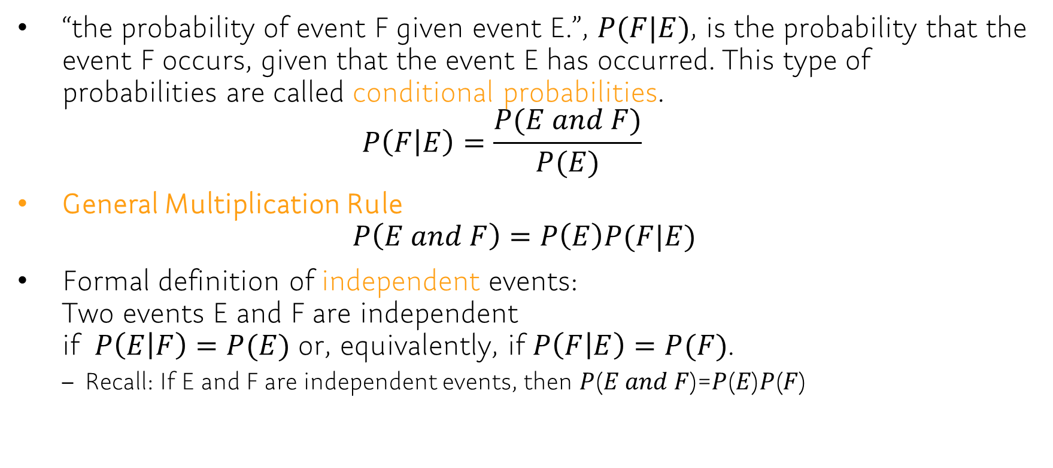
Chap 5.4
“the probability of event F given event E.”, $P(F|E)$, is the probability that the event F occurs, given that the event E has occurred. This type of probabilities are called conditional probabilities. $P\left(F | E\right)=\frac{P(E and F)}{P(E)}$
General Multiplication Rule $P\left(E and F\right)=P\left(E\right)P(F|E)$
Formal definition of independent events: Two events E and F are independent if $P\left(E | F\right)=P(E)$ or, equivalently, if $P\left(F | E\right)=P(F)$.
Recall: If E and F are independent events, then 𝑃(𝐸 𝑎𝑛𝑑 𝐹)=𝑃(𝐸)𝑃(𝐹)

