Slide 1

STAT7: Discussion Section #4
Jan 31, 2022

Slide 2
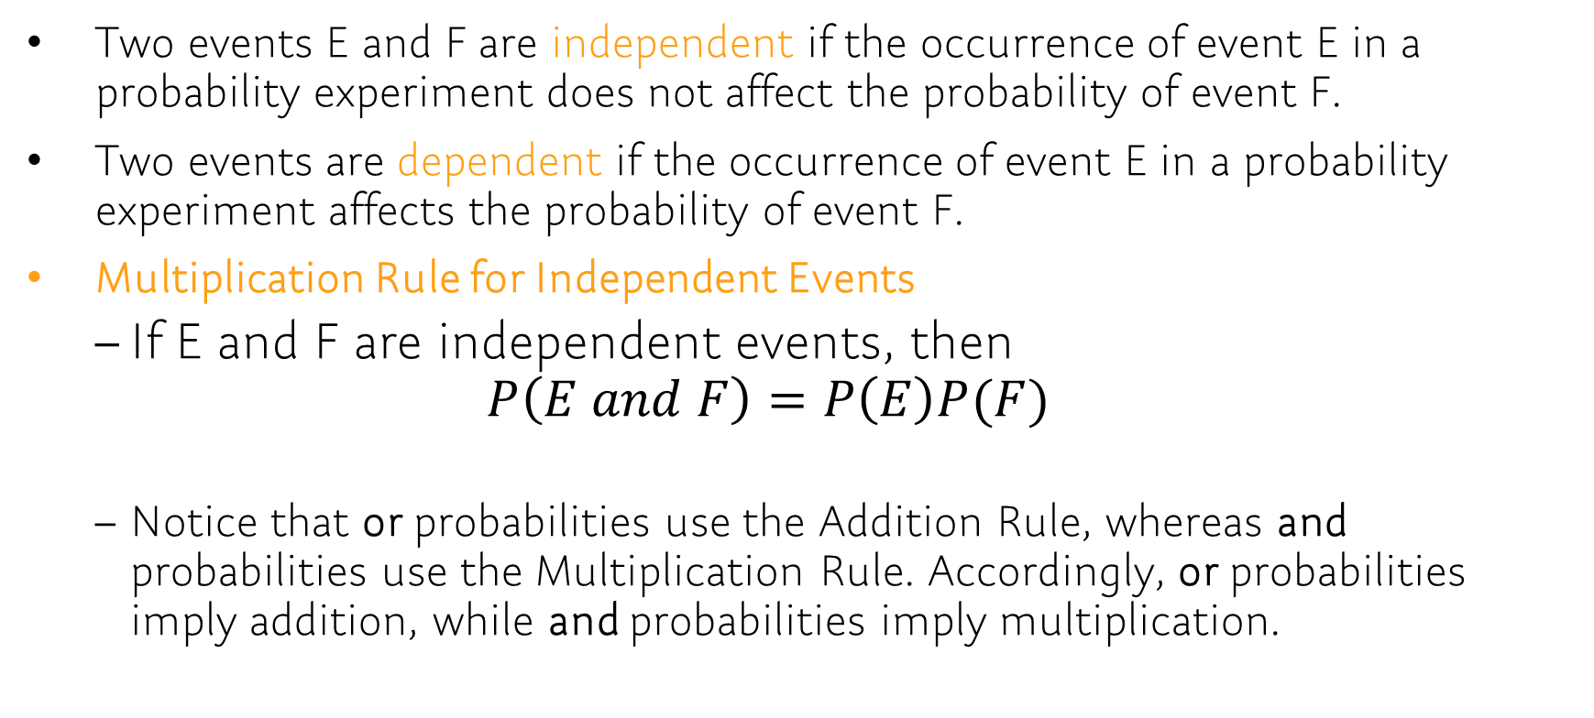
Chap 5.3
Two events E and F are independent if the occurrence of event E in a probability experiment does not affect the probability of event F.
Two events are dependent if the occurrence of event E in a probability experiment affects the probability of event F.
Multiplication Rule for Independent Events
If E and F are independent events, then $P\left(E and F\right)=P\left(E\right)P(F)$
Notice that or probabilities use the Addition Rule, whereas and probabilities use the Multiplication Rule. Accordingly, or probabilities imply addition, while and probabilities imply multiplication.

Slide 3
Problem: Example
[5.3.7] Determine whether the events E and F are independent or dependent.
E: Speeding on the interstate. VS F: Being pulled over by a police officer.
E: You gain weight. VS F: You eat fast food for dinner every night.
E: You get a high score on a stat7 exam. VS F: The Boston Red Sox win a baseball game.
[5.3.15] The ELISA is a test to determine whether the HIV antibody is present. The test is 99.5% effective, which means that the test will come back negative if the HIV antibody is not present 99.5% of the time. The probability of a test coming back positive when the antibody is not present (a false positive) is 0.005. Suppose that the ELISA is given to five randomly selected people who do not have the HIV antibody.
What is the probability that the ELISA comes back negative for all five people?
What is the probability that the ELISA comes back positive for at least one of the five people?
Notes:
[5.3.7] Dependent, Dependent, Independent
[5.3.15] P(all five are negative) = 0.995^5 = 0.9752, P(at least one is positive) = 1-0.9752 = 0.0248

Slide 4
Problem
[5.3.8] Determine whether the events E and F are independent or dependent.
E: The battery in your cell phone is dead. VS F: The batteries in your calculator are dead.
E: Your favorite color is blue. VS F: Your friend’s favorite hobby is fishing.
E: You are late for school. VS F: Your car runs out of gas.
[5.3.18] The probability that a randomly selected 40-year-old female will live to be 41 years old is 0.99855 according to the National Vital Statistics Report, Vol. 56, No. 9.
What is the probability that five randomly selected 40-year-old females will live to be 41 years old?
What is the probability that at least one of five randomly selected 40-year-old females will not live to be 41 years old?
Would it be unusual if at least one of five randomly selected 40-year-old females did not live to be 41 years old?

Slide 5
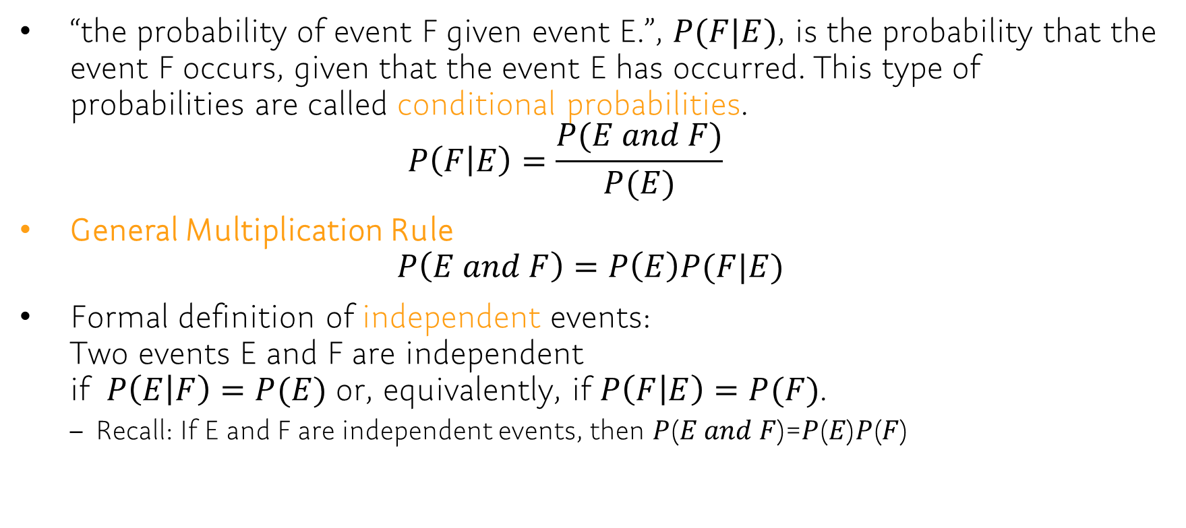
Chap 5.4
“the probability of event F given event E.”, $P(F|E)$, is the probability that the event F occurs, given that the event E has occurred. This type of probabilities are called conditional probabilities. $P\left(F | E\right)=\frac{P(E and F)}{P(E)}$
General Multiplication Rule $P\left(E and F\right)=P\left(E\right)P(F|E)$
Formal definition of independent events: Two events E and F are independent if $P\left(E | F\right)=P(E)$ or, equivalently, if $P\left(F | E\right)=P(F)$.
Recall: If E and F are independent events, then 𝑃(𝐸 𝑎𝑛𝑑 𝐹)=𝑃(𝐸)𝑃(𝐹)

Slide 6
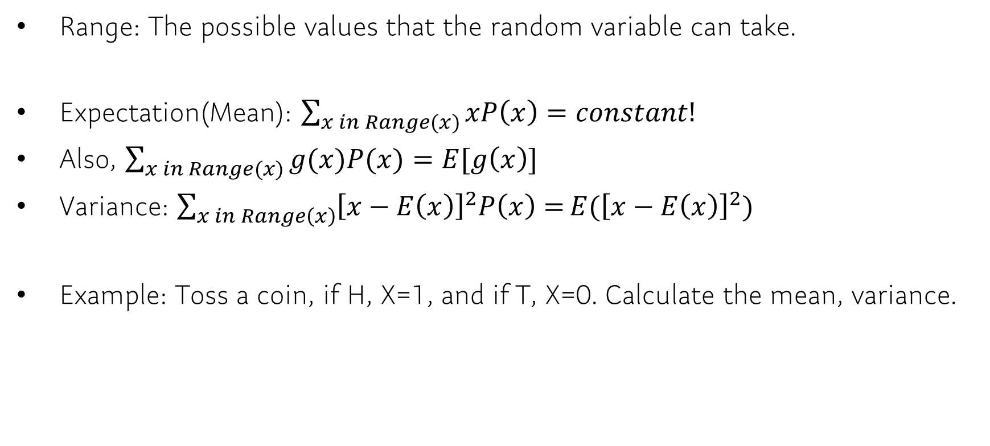
Discrete Random Variables
Range: The possible values that the random variable can take.
Expectation(Mean): $\sum_{x in Range(x)}{xP\left(x\right)=constant!}$
Also, $\sum_{x in Range(x)}{g(x)P(x)}=E[g\left(x\right)]$
Variance: $\sum_{x in Range\left(x\right)}{{\left[x−E\left(x\right)\right]}^{2}P\left(x\right)=}E({\left[x−E\left(x\right)\right]}^{2})$
Example: Toss a coin, if H, X=1, and if T, X=0. Calculate the mean, variance.

Slide 7
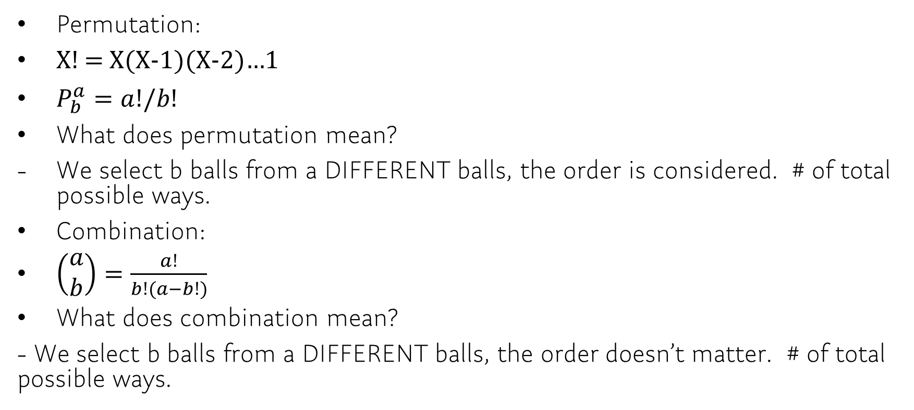
Binomial Distribution
Permutation:
X! = X(X-1)(X-2)…1
$P_{b}^{a}=a!/b!$
What does permutation mean?
We select b balls from a DIFFERENT balls, the order is considered. # of total possible ways.
Combination:
$\left(\begin{matrix}a \\ b\end{matrix}\right)=\frac{a!}{b!(a−b!)}$
What does combination mean?
- We select b balls from a DIFFERENT balls, the order doesn’t matter. # of total possible ways.

Slide 8


Properties
PMF:
Interpret: The probability of getting exactly k successes in n independent Bernoulli trials
Example:
Suppose a biased coin comes up heads with probability 0.3 when tossed. The probability of seeing exactly 4 heads in 6 tosses is

