Slide 1

STAT7: Discussion Section #9
Mar 6, 2022

Slide 2
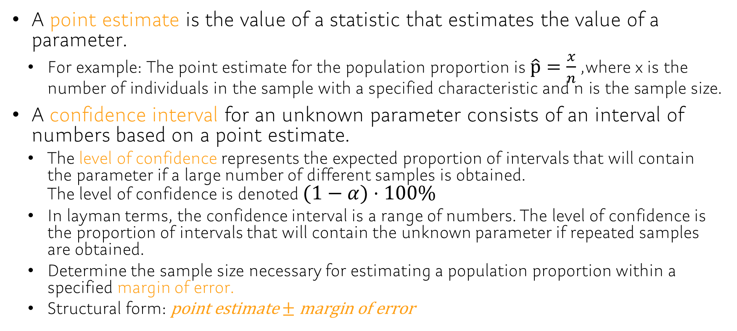
Chap9
A point estimate is the value of a statistic that estimates the value of a parameter.
For example: The point estimate for the population proportion is $\hat{p}=\frac{x}{n}$, where x is the number of individuals in the sample with a specified characteristic and n is the sample size.
A confidence interval for an unknown parameter consists of an interval of numbers based on a point estimate.
The level of confidence represents the expected proportion of intervals that will contain the parameter if a large number of different samples is obtained. The level of confidence is denoted $(1−α)⋅100\%$
In layman terms, the confidence interval is a range of numbers. The level of confidence is the proportion of intervals that will contain the unknown parameter if repeated samples are obtained.
Determine the sample size necessary for estimating a population proportion within a specified margin of error.
Structural form: $\text{point} \text{estimate}±\text{margin} \text{of} \text{error}$

Slide 3

CLT and Sample Statistic
Sample statistic: Properties of samples, a function of sample.
Distribution of Sample mean: Calculated the mean repeatedly for different samples and then calculate the estimated distribution
What about distribution of sample proportion?
CLT:
What’s the relationship between sample mean and proportion?
If we set a indicator function…

Slide 4
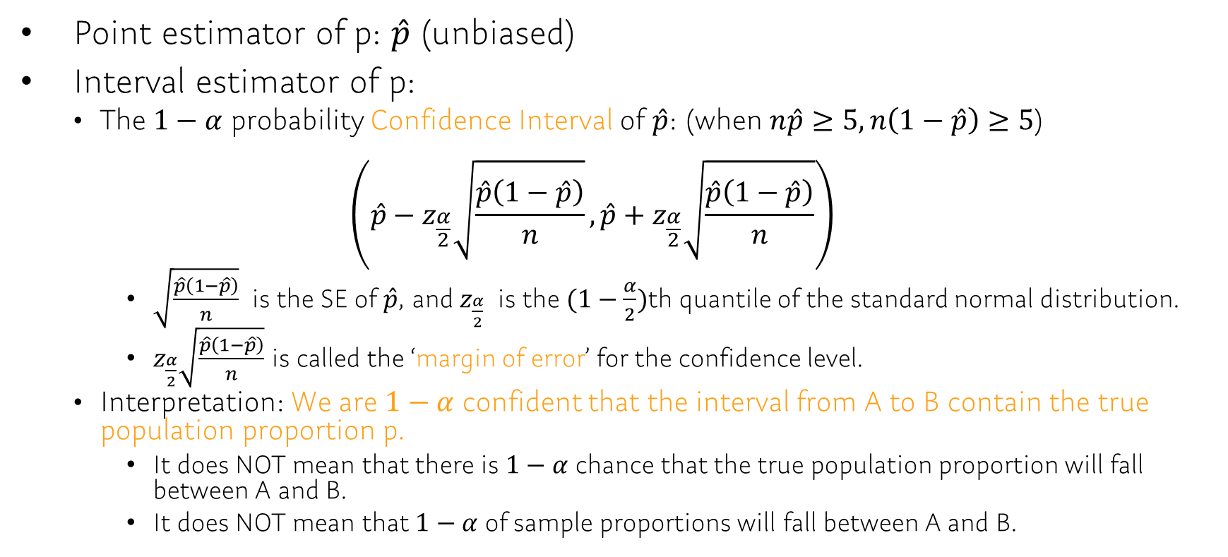
Ch9.1 Estimating a Population Proportion
Point estimator of p: $\hat{p}$ (unbiased)
Interval estimator of p:
The $1−α$ probability Confidence Interval of $\hat{p}$: (when $n\hat{p}≥5, n\left(1−\hat{p}\right)≥5$)
$$\left(\hat{p}−z_{\frac{α}{2}}\sqrt{\frac{\hat{p}\left(1−\hat{p}\right)}{n}},\hat{p}+z_{\frac{α}{2}}\sqrt{\frac{\hat{p}\left(1−\hat{p}\right)}{n}}\right)$$
$\sqrt{\frac{\hat{p}\left(1−\hat{p}\right)}{n}}$ is the SE of $\hat{p}$, and $z_{\frac{α}{2}}$ is the $(1−\frac{α}{2})$th quantile of the standard normal distribution.
$z_{\frac{α}{2}}\sqrt{\frac{\hat{p}\left(1−\hat{p}\right)}{n}}$ is called the ‘margin of error’ for the confidence level.
Interpretation: We are $1−α$ confident that the interval from A to B contain the true population proportion p.
It does NOT mean that there is $1−α$ chance that the true population proportion will fall between A and B.
It does NOT mean that $1−α$ of sample proportions will fall between A and B.

Slide 5
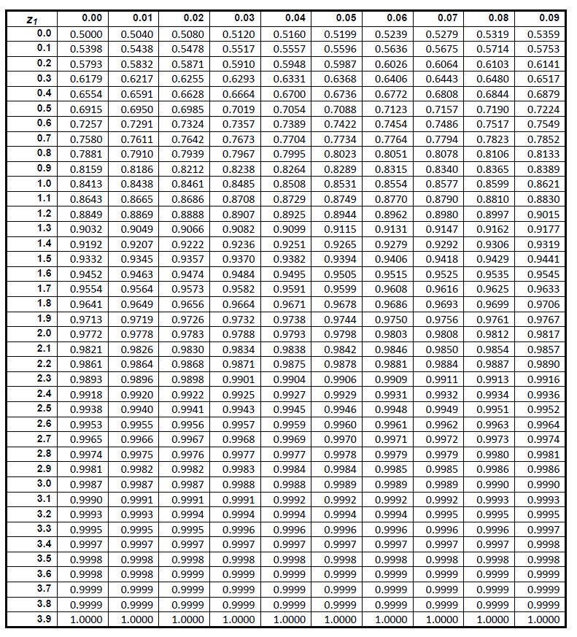
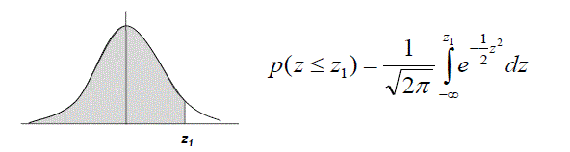
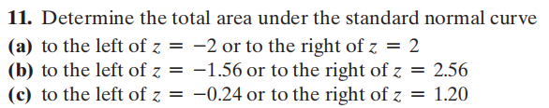
Ch7.2 Application of Normal Distribution
Remember:
All the area under the curve sums to 1.
The distribution is symmetric about the mean.

Slide 6
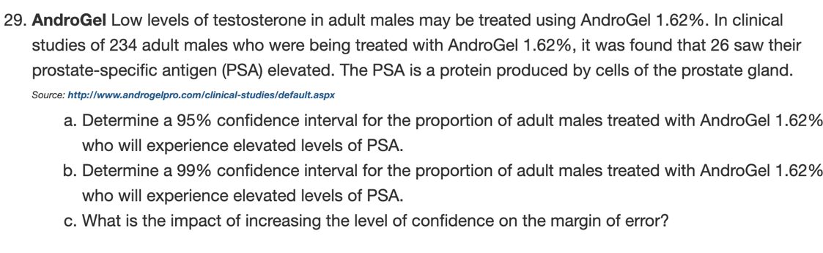
Ch9.1: Example
STAT7 Discussion Section
Notes:
p_hat=26/234 = 0.111
-> p_hat +- z*sqrt(p_hat(1-p_hat)/n) = 0.111 +- z*0.02053546
For 95% conf.interval, z=qnorm(0.975)=1.96 => interval: 0.111 +- 0.0402495
For 99% conf.interval, z=qnorm(0.995)=2.58 => interval: 0.111 +- 0.05298149

Slide 7
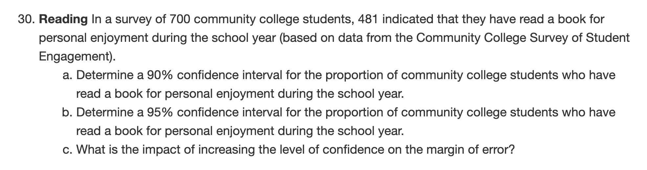
Ch9.1
STAT7 Discussion Section

