Slide 1
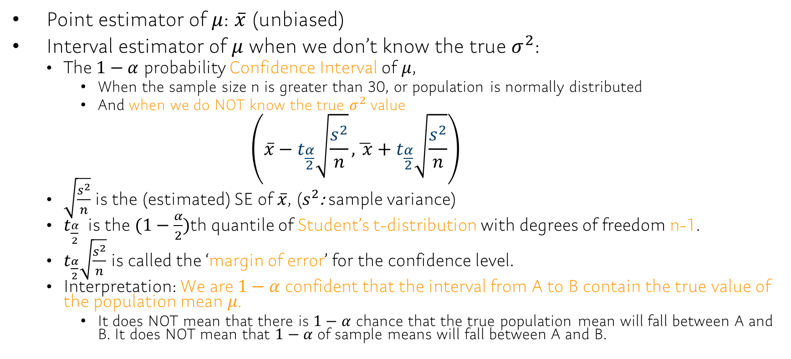
Ch9.2 Estimating a Population Mean
Point estimator of $μ$: $\overline{x}$ (unbiased)
Interval estimator of $μ$ when we don’t know the true $σ^{2}$:
The $1−α$ probability Confidence Interval of $μ$,
When the sample size n is greater than 30, or population is normally distributed
And when we do NOT know the true $σ^{2}$value $\left(\overline{x}−t_{\frac{α}{2}}\sqrt{\frac{s^{2}}{n}},\overline{ x}+t_{\frac{α}{2}}\sqrt{\frac{s^{2}}{n}}\right)$
$\sqrt{\frac{s^{2}}{n}}$is the (estimated) SE of $\overline{x}$, ($s^{2}$: sample variance)
$t_{\frac{α}{2}}$ is the $(1−\frac{α}{2})$th quantile of Student’s t-distribution with degrees of freedom n-1.
$t_{\frac{α}{2}}\sqrt{\frac{s^{2}}{n}}$ is called the ‘margin of error’ for the confidence level.
Interpretation: We are $1−α$ confident that the interval from A to B contain the true value of the population mean 𝜇.
It does NOT mean that there is $1−α$ chance that the true population mean will fall between A and B. It does NOT mean that $1−α$ of sample means will fall between A and B.

Slide 2
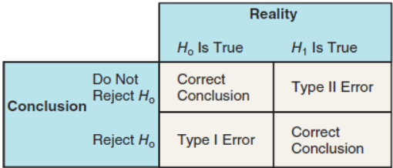
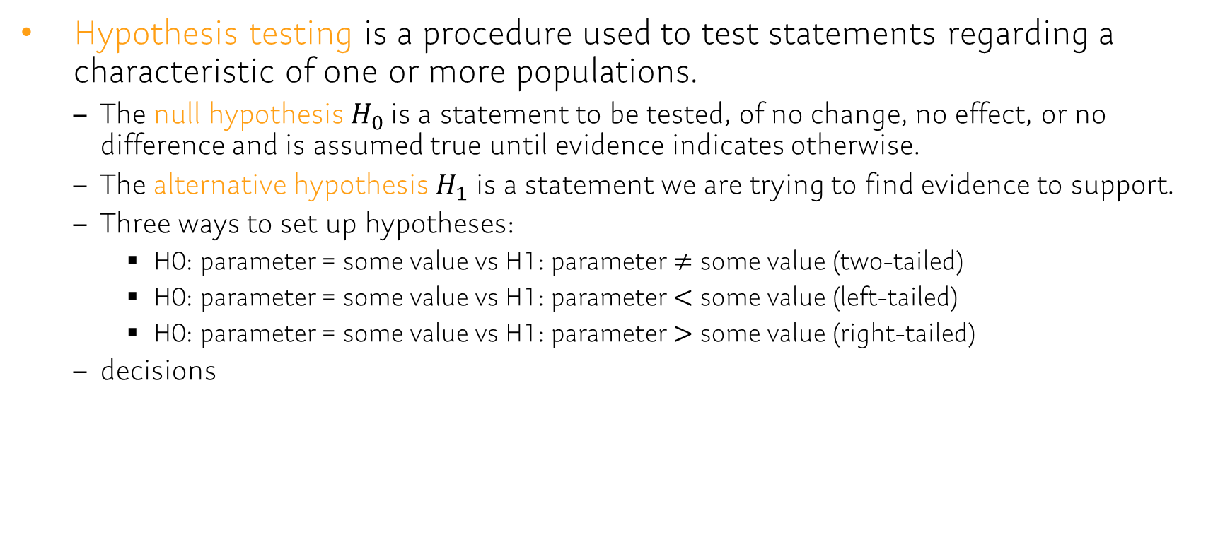
Ch 10.1 The Language of Hypothesis Testing
Hypothesis testing is a procedure used to test statements regarding a characteristic of one or more populations.
The null hypothesis$H_{0}$ is a statement to be tested, of no change, no effect, or no difference and is assumed true until evidence indicates otherwise.
The alternative hypothesis $H_{1}$ is a statement we are trying to find evidence to support.
Three ways to set up hypotheses:
H0: parameter = some value vs H1: parameter $≠$ some value (two-tailed)
H0: parameter = some value vs H1: parameter $<$ some value (left-tailed)
H0: parameter = some value vs H1: parameter $>$ some value (right-tailed)
decisions

Slide 3
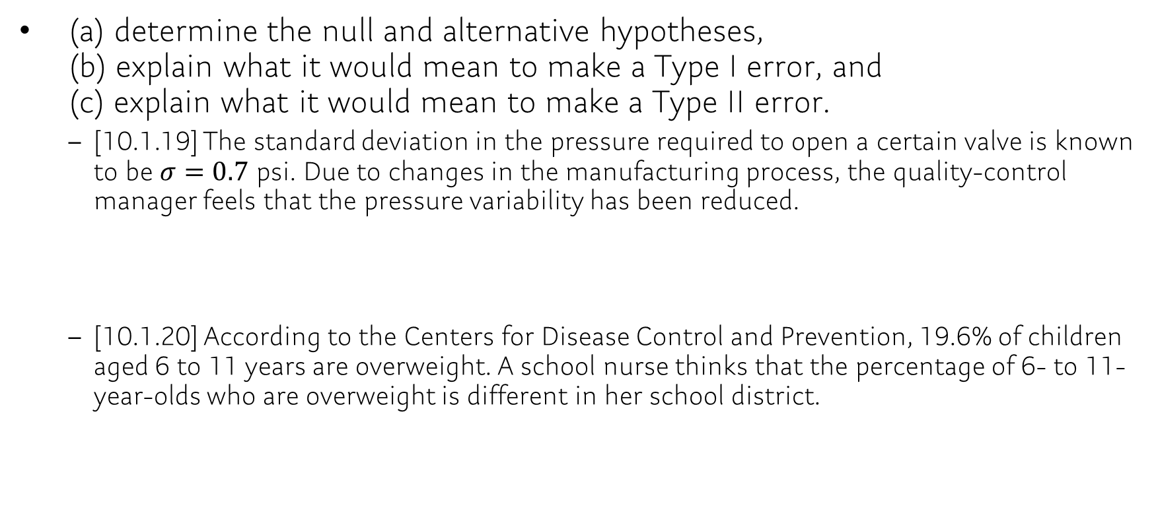
Ch 10.1
(a) determine the null and alternative hypotheses, (b) explain what it would mean to make a Type I error, and (c) explain what it would mean to make a Type II error.
[10.1.19] The standard deviation in the pressure required to open a certain valve is known to be $σ=0.7$ psi. Due to changes in the manufacturing process, the quality-control manager feels that the pressure variability has been reduced.
[10.1.20] According to the Centers for Disease Control and Prevention, 19.6% of children aged 6 to 11 years are overweight. A school nurse thinks that the percentage of 6- to 11-year-olds who are overweight is different in her school district.
Notes:
H0: σ = 0.7 psi, H1: σ < 0.7 psi
The quality-control manager rejects the hypothesis that the variability in the pressure required is 0.7 psi, when the true variability is 0.7 psi.
The quality-control manager fails to reject that the variability in the pressure required is 0.7 psi, when the variability is less than 0.7 psi.

Slide 4
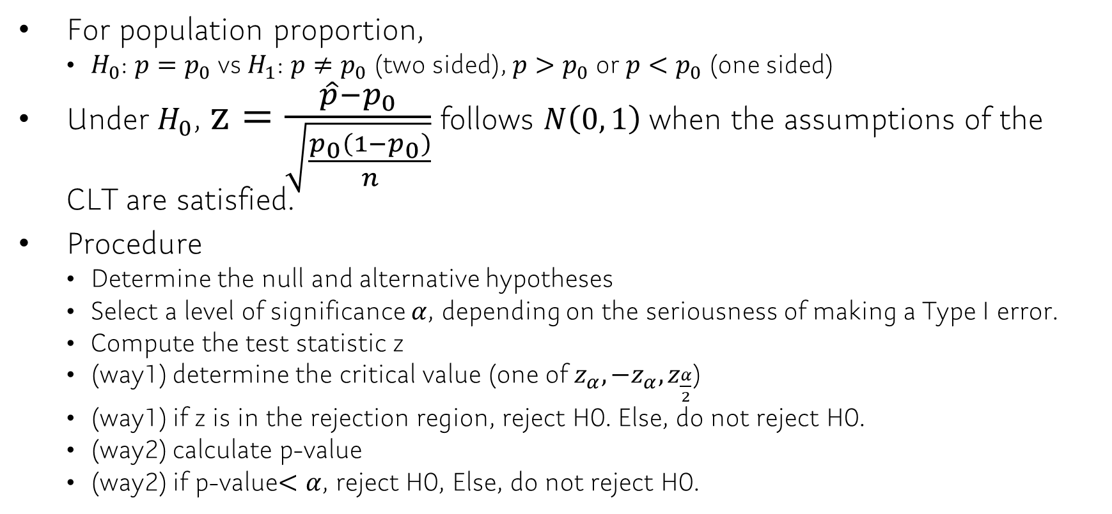
Ch 10.2 Hypothesis Tests for a Population Proportion
For population proportion,
$H_{0}$: $p=p_{0}$ vs $H_{1}$: $p≠p_{0}$ (two sided), $p>p_{0}$ or $p<p_{0}$ (one sided)
Under $H_{0}$, $z=\frac{\hat{p}−p_{0}}{\sqrt{\frac{p_{0}\left(1−p_{0}\right)}{n}}}$ follows $N\left(0, 1\right)$ when the assumptions of the CLT are satisfied.
Procedure
Determine the null and alternative hypotheses
Select a level of significance $α$, depending on the seriousness of making a Type I error.
Compute the test statistic z
(way1) determine the critical value (one of $z_{α},{−z}_{α}, z_{\frac{α}{2}}$)
(way1) if z is in the rejection region, reject H0. Else, do not reject H0.
(way2) calculate p-value
(way2) if p-value$<α$, reject H0, Else, do not reject H0.

