Slide 1
Ch 10.3 Hypothesis Test for a Population Mean
For population mean
$H_{0}$: $μ=μ_{0}$ vs $H_{1}$: $μ≠μ_{0}$ (two sided), $μ>μ_{0}$ or $μ<μ_{0}$ (one sided)
Under $H_{0}$, $t=\frac{\overline{x}−μ_{0}}{s/\sqrt{n}}$ follows $t(n−1)$ when the assumptions of the CLT are satisfied.
Procedure
Determine the null and alternative hypotheses
Select a level of significance $α$, depending on the seriousness of making a Type I error.
Compute the test statistic t
(way1) determine the critical value (one of $t_{α},{−t}_{α}, t_{\frac{α}{2}}$)
(way1) if t is in the rejection region, reject H0. Else, do not reject H0.
(way2) calculate p-value
(way2) if p-value$<α$, reject H0, Else, do not reject H0.

Slide 2
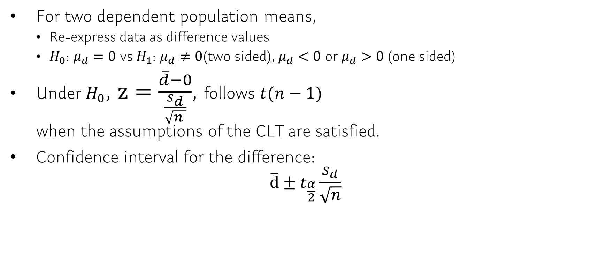
Ch 11.1 Inference about Two Means: Dependent Samples
For two dependent population means,
Re-express data as difference values
$H_{0}$: $μ_{d}=0$ vs $H_{1}$: $μ_{d}≠0$(two sided), $μ_{d}<0$ or$μ_{d}>0$ (one sided)
Under $H_{0}$, $z=\frac{\overline{d}−0}{\frac{s_{d}}{\sqrt{n }}}$, follows $t(n−1)$ when the assumptions of the CLT are satisfied.
Confidence interval for the difference: $\overline{d}±t_{\frac{α}{2}}\frac{s_{d}}{\sqrt{n}}$

Slide 3
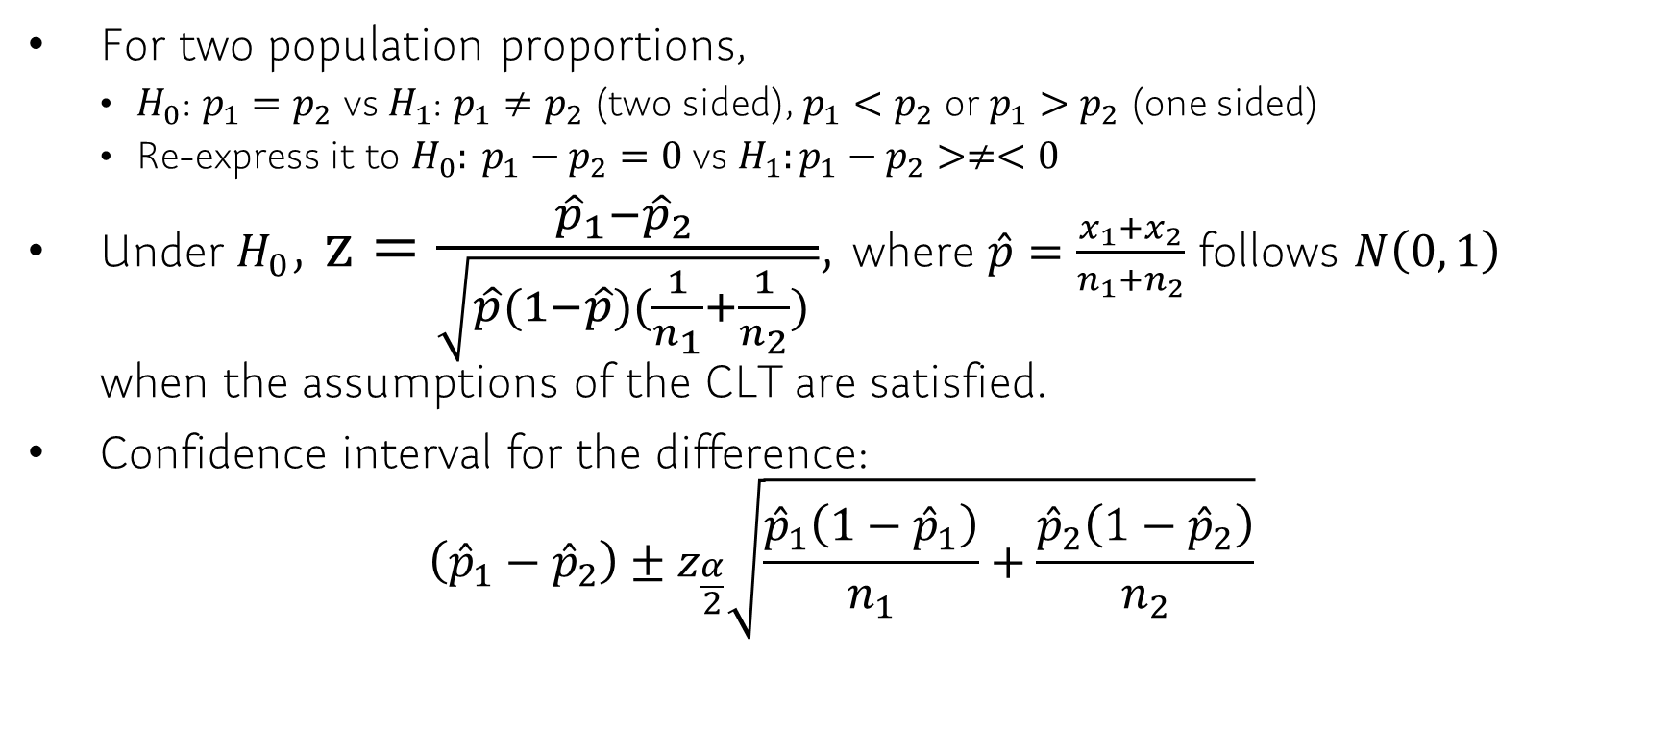
Ch 11.2 Inference about Two Population Proportions
For two population proportions,
$H_{0}$: $p_{1}=p_{2}$ vs $H_{1}$: $p_{1}≠p_{2}$ (two sided), $p_{1}<p_{2}$ or $p_{1}>p_{2}$ (one sided)
Re-express it to $H_{0}: p_{1}−p_{2}=0$ vs $H_{1}:p_{1}−p_{2}>≠<0$
Under $H_{0}$, $z=\frac{{\hat{p}}_{1}−{\hat{p}}_{2 }}{\sqrt{\hat{p}(1−\hat{p})(\frac{1}{n_{1}}+\frac{1}{n_{2}}) }}$, where $\hat{p}=\frac{x_{1}+x_{2}}{n_{1}+n_{2}}$ follows $N\left(0, 1\right)$ when the assumptions of the CLT are satisfied.
Confidence interval for the difference: $\left({\hat{p}}_{1}−{\hat{p}}_{2}\right)±z_{\frac{α}{2}}\sqrt{\frac{{\hat{p}}_{1}\left(1−{\hat{p}}_{1}\right)}{n_{1}}+\frac{{\hat{p}}_{2}\left(1−{\hat{p}}_{2}\right)}{n_{2}}}$

Slide 4
Ch 11.2 Inference about Two Means: Dependent Samples
For two dependent population means,
Re-express data as difference values
$H_{0}$: $μ_{d}=0$ vs $H_{1}$: $μ_{d}≠0$(two sided), $μ_{d}<0$ or$μ_{d}>0$ (one sided)
Under $H_{0}$, $z=\frac{\overline{d}−0}{\frac{s_{d}}{\sqrt{n }}}$, follows $t(n−1)$ when the assumptions of the CLT are satisfied.
Confidence interval for the difference: $\overline{d}±t_{\frac{α}{2}}\frac{s_{d}}{\sqrt{n}}$

Slide 5
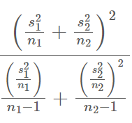
Ch 11.3 Inference about Two Means: Independent Samples
For two population proportions,
$H_{0}$: $μ_{1}=μ_{2}$ vs $H_{1}$: $μ_{1}≠μ_{2}$ (two sided), $μ_{1}<μ_{2}$ or $μ_{1}>μ_{2}$ (one sided)
Re-express it to $H_{0}: μ_{1}−μ_{2}=0$ vs $H_{1}:μ_{1}−μ_{2}>≠<0$
Under $H_{0}$, $z=\frac{\left({\overline{x}}_{1}−{\overline{x}}_{2}\right)−(μ_{1}−μ_{2})}{\sqrt{\frac{s_{1}^{2}}{n_{1}}+\frac{s_{2}^{2}}{n_{2}} }}$ follows $t(min⁡(n_{1}−1, n_{2}−1))$ when the assumptions of the CLT are satisfied.
Confidence interval for the difference: $\left({\overline{x}}_{1}−{\overline{x}}_{2}\right)±t_{\frac{α}{2}}\sqrt{\frac{s_{1}^{2}}{n_{1}}+\frac{s_{2}^{2}}{n_{2}} }$

