Slide 1

STAT7: Discussion Section #2

Slide 2
Problem 4
A census is a list of all individuals in a population along with certain characteristics of each individual.
Random sampling is the process of using chance to select individuals from a population to be included in the sample.
A sample of size n from a population of size N is obtained through simple random sampling if every possible sample of size n has an equally likely chance of occurring. The sample is then called a simple random sample.

Slide 3
Problem 4: example
1. Alabama | 19. Maine | 35. Ohio
2. Alaska | 20. Maryland | 36. Oklahoma
3. Arizona | 21. Massachusetts | 37. Oregon
4. Arkansas | 22. Michigan | 38. Pennsylvania
5. California | 23. Minnesota | 39. Rhode Island
6. Colorado | 24. Mississippi | 40. South Carolina
7. Connecticut | 25. Missouri | 41. South Dakota
8. Delaware | 26. Montana | 42. Tennessee
9. Florida | 27. Nebraska | 43. Texas
10. Georgia | 28. Nevada | 44. Utah
11. Hawaii | 29. New Hampshire | 45. Vermont
12. Idaho | 30. New Jersey | 46. Virginia
13. Illinois | 31. New Mexico | 47. Washington
14. Indiana | 32. New York | 48. West Virginia
15. Iowa | 33. North Carolina | 49. Wisconsin
16. Kansas | 34. North Dakota | 50. Wyoming
17. Kentucky | 33. North Carolina
18. Louisiana | 34. North Dakota
[1.3.11] Obtain a simple random sample of size 10 from lists the 50 states.
Random Numbers Column Number
Row Number | 01-05 | 06-10 | 11-15 | 16-20 | 21-25 | 26-30 | 31-35 | 36-40 | 41-45 | 46-50
01 | 89392 | 23212 | 74483 | 36590 | 25956 | 36544 | 68518 | 40805 | 09980 | 00467
02 | 61458 | 17639 | 96252 | 95649 | 73727 | 33912 | 72896 | 66218 | 52341 | 97141
03 | 11452 | 74197 | 81962 | 48443 | 90360 | 26480 | 73231 | 37740 | 26628 | 44690
04 | 27575 | 04429 | 31308 | 02241 | 01698 | 19191 | 18948 | 78871 | 36030 | 23980
05 | 36829 | 59109 | 88976 | 46845 | 28329 | 47460 | 88944 | 08264 | 00843 | 84592
06 | 81902 | 93458 | 42161 | 26099 | 09419 | 89073 | 82849 | 09160 | 61845 | 40906
07 | 59761 | 55212 | 33360 | 68751 | 86737 | 79743 | 85262 | 31887 | 37879 | 17525
08 | 46827 | 25906 | 64708 | 20307 | 78423 | 15910 | 86548 | 08763 | 47050 | 18513
09 | 24040 | 66449 | 32353 | 83668 | 13874 | 86741 | 81312 | 54185 | 78824 | 00718
10 | 98144 | 96372 | 50277 | 15571 | 82261 | 66628 | 31457 | 00377 | 63423 | 55141
11 | 14228 | 17930 | 30118 | 00438 | 49666 | 65189 | 62869 | 31304 | 17117 | 71489
12 | 55366 | 51057 | 90065 | 14791 | 62426 | 02957 | 85518 | 28822 | 30588 | 32798
13 | 96101 | 30646 | 35526 | 90389 | 73634 | 79304 | 96635 | 06626 | 94683 | 16696
14 | 38152 | 55474 | 30153 | 26525 | 83647 | 31988 | 82182 | 98377 | 33802 | 80471
15 | 85007 | 18416 | 24661 | 95581 | 45868 | 15662 | 28906 | 36392 | 07617 | 50248
16 | 85544 | 15890 | 80011 | 18160 | 33468 | 84106 | 40603 | 01315 | 74664 | 20553
17 | 10446 | 20699 | 98370 | 17684 | 16932 | 80449 | 92654 | 02084 | 19985 | 59321
18 | 67237 | 45509 | 17638 | 65115 | 29757 | 80705 | 82686 | 48565 | 72612 | 61760
19 | 23026 | 89817 | 05403 | 82209 | 30573 | 47501 | 00135 | 33955 | 50250 | 72592
20 | 67411 | 58542 | 18678 | 46491 | 13219 | 84084 | 27783 | 34508 | 55158 | 78742
Notes:
[1.3.11] Choose 10 samples randomly with the same probability!

Slide 4
Problem 4
[1.3.12] Obtain a simple random sample of size 8 from lists the 44 presidents of the United States (as of June, 2016).
1. Washington | 16. Lincoln | 31. Hoover
2. J. Adams | 17. A. Johnson | 32. F. D. Roosevelt
3. Jefferson | 18. Grant | 33. Truman
4. Madison | 19. Hayes | 34. Eisenhower
5. Monroe | 20. Garfield | 35. Kennedy
6. J. Q. Adams | 21. Arthur | 36. L. B. Johnson
7. Jackson | 22. Cleveland | 37. Nixon
8. Van Buren | 23. B. Harrison | 38. Ford
9. W. H. Harrison | 24. Cleveland | 39. Carter
10. Tyler | 25. McKinley | 40. Reagan
11. Polk | 26. T. Roosevelt | 41. G. H. Bush
12. Taylor | 27. Taft | 42. Clinton
13. Fillmore | 28. Wilson | 43. G. W. Bush
14. Pierce | 29. Harding | 44. Obama
15. Buchanan | 30. Coolidge
Random Numbers Column Number
Row Number | 01-05 | 06-10 | 11-15 | 16-20 | 21-25 | 26-30 | 31-35 | 36-40 | 41-45 | 46-50
01 | 89392 | 23212 | 74483 | 36590 | 25956 | 36544 | 68518 | 40805 | 09980 | 00467
02 | 61458 | 17639 | 96252 | 95649 | 73727 | 33912 | 72896 | 66218 | 52341 | 97141
03 | 11452 | 74197 | 81962 | 48443 | 90360 | 26480 | 73231 | 37740 | 26628 | 44690
04 | 27575 | 04429 | 31308 | 02241 | 01698 | 19191 | 18948 | 78871 | 36030 | 23980
05 | 36829 | 59109 | 88976 | 46845 | 28329 | 47460 | 88944 | 08264 | 00843 | 84592
06 | 81902 | 93458 | 42161 | 26099 | 09419 | 89073 | 82849 | 09160 | 61845 | 40906
07 | 59761 | 55212 | 33360 | 68751 | 86737 | 79743 | 85262 | 31887 | 37879 | 17525
08 | 46827 | 25906 | 64708 | 20307 | 78423 | 15910 | 86548 | 08763 | 47050 | 18513
09 | 24040 | 66449 | 32353 | 83668 | 13874 | 86741 | 81312 | 54185 | 78824 | 00718
10 | 98144 | 96372 | 50277 | 15571 | 82261 | 66628 | 31457 | 00377 | 63423 | 55141
11 | 14228 | 17930 | 30118 | 00438 | 49666 | 65189 | 62869 | 31304 | 17117 | 71489
12 | 55366 | 51057 | 90065 | 14791 | 62426 | 02957 | 85518 | 28822 | 30588 | 32798
13 | 96101 | 30646 | 35526 | 90389 | 73634 | 79304 | 96635 | 06626 | 94683 | 16696
14 | 38152 | 55474 | 30153 | 26525 | 83647 | 31988 | 82182 | 98377 | 33802 | 80471
15 | 85007 | 18416 | 24661 | 95581 | 45868 | 15662 | 28906 | 36392 | 07617 | 50248
16 | 85544 | 15890 | 80011 | 18160 | 33468 | 84106 | 40603 | 01315 | 74664 | 20553
17 | 10446 | 20699 | 98370 | 17684 | 16932 | 80449 | 92654 | 02084 | 19985 | 59321
18 | 67237 | 45509 | 17638 | 65115 | 29757 | 80705 | 82686 | 48565 | 72612 | 61760
19 | 23026 | 89817 | 05403 | 82209 | 30573 | 47501 | 00135 | 33955 | 50250 | 72592
20 | 67411 | 58542 | 18678 | 46491 | 13219 | 84084 | 27783 | 34508 | 55158 | 78742

Slide 5
Problem 5
If the results of the sample are not representative of the population, then the sample has bias.
Sampling bias means that the technique used to obtain the sample’s individuals tends to favor one part of the population over another. Any convenience sample has sampling bias because the individuals are not chosen through a random sample.
Nonresponse bias exists when individuals selected to be in the sample who do not respond to the survey have different opinions from those who do. Nonresponse can occur because individuals selected for the sample do not wish to respond or the interviewer was unable to contact them.
Response bias exists when the answers on a survey do not reflect the true feelings of the respondent. Response bias can occur in a number of ways.

Slide 6
Problem 5: example
the survey has bias. (a) Determine the type of bias. (b) Suggest a remedy.
[1.5.5] A retail store manager wants to conduct a study regarding the shopping habits of his customers. He selects the first 60 customers who enter his store on a Saturday morning.
[1.5.9] A polling organization conducts a study to estimate the percentage of households that speaks a foreign language as the primary language. It mails a questionnaire to 1023 randomly selected households throughout the United States and asks the head of household if a foreign language is the primary language spoken in the home. Of the 1023 households selected, 12 responded.
[1.5.15] Suppose you are conducting a survey regarding illicit drug use among teenagers in the Baltimore school district. You obtain a cluster sample of 12 schools within the district and sample all sophomore students in the randomly selected schools. The survey is administered by the teachers.
Notes:
[1.5.5] a. Sampling bias due to under coverage since the first 60 customers may not be representative of the customer population.
b. Since a complete frame is not possible, systematic random sampling could be used to make the sample more representative of the customer population.
[1.5.9] a. Nonresponse bias; if the survey is only written in English, non-English speaking homes will not complete the survey, resulting in undercoverage
b. The survey can be improved through face-to-face or telephone interviews.
[1.5.15] a. Response bias because the students are not likely to be truthful when the teacher is administering the survey
b. The survey should be administered by an impartial party so that the students will be more likely to respond truthfully.

Slide 7
Problem 6: Basic Statistical Figures and Tables
- [2.1.29](Page 73 in Textbook)
Keeping students engaged in the learning process greatly increases their chance of success in a course. Traditional lecture-based math instruction has given way to a more student-engaged approach where students interact with the teacher in class and receive immediate feedback to their responses. The teacher presence allows students, when incorrect in a response, to be guided through a solution and then immediately be given a similar problem to attempt.
A researcher conducted a study to investigate whether an online homework system using an attempt–feedback– reattempt approach improved student learning over traditional pencil-and-paper homework. The online homework system was designed to increase student engagement outside class, something commonly missing in traditional pencil-and-paper assignments, ultimately leading to increased learning.
The study was conducted using two first-semester calculus classes taught by the researcher in a single semester. One class was assigned traditional homework and the other was assigned online homework that used the attempt–feedback–reattempt approach. The summaries are based on data from the study.

Slide 8
Problem 6: Basic Statistical Figures and Tables
(a) What is the research objective?
Ans: Which way is better for students to learn.
(b) Is this study an observational study or experiment?
Ans: Experiment. We assigned them, not just observed them.
(c) Give an example of how the researchers control variables in the study?
Ans: Control the same instructor, same course, same semester …
(d) Explain why assigning homework type to entirely separate classes can confound the conclusions of the study.
- Ans: Different instructors/courses have different GPA distributions …

Slide 9
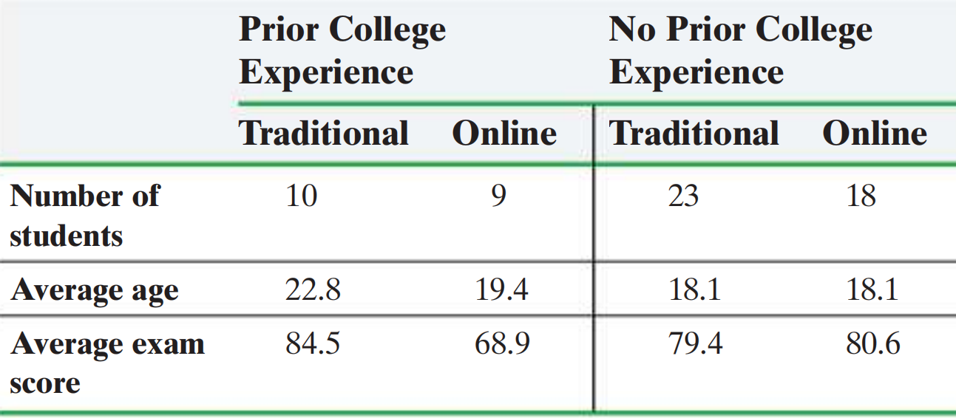
Problem 6: Basic Statistical Figures and Tables
(e) Answer the following questions:
(i) Identify the variables
(ii) Indicate whether the variables are qualitative or quantitative
(iii) For quantitative variable, the variable is discrete or continuous.
Ans:
Number of students, Age, Score, Type of Class, Prior College Experience.
Quantitative, Quantitative, Quantitative, Qualitative, Qualitative.
Number of students, age: Discrete.
Score: Continuous. (Or: Discrete because the minimum unit is 0.1)

Slide 10
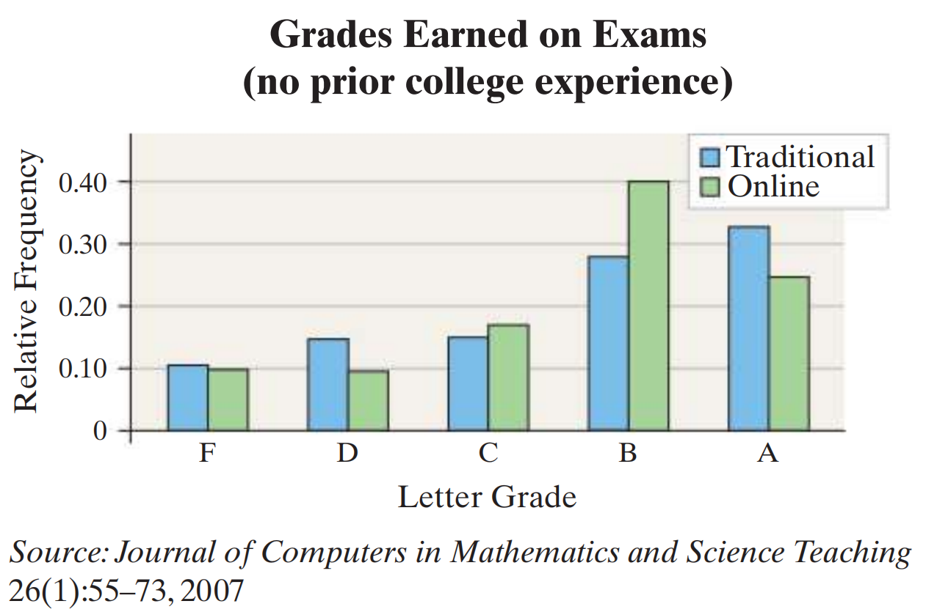
Problem 6: Basic Statistical Figures and Tables
(f) Answer the following questions:
(i) What type of variable is letter grade?
(ii) What level of measurement is letter grade?
(iii) Presenting the data in a table from A to F would be better?
Ans:
Qualitative variable.
Ordinal variables.
Yes, for ordinal variables, order matters.
Level of Measurement:
• The nominal level of measurement data type is not possible to arrange in
some order.
• The ordinal level of measurement data type can be arranged in some order, but differences (obtained by subtraction) between data values either cannot be determined or are meaningless.

Slide 11
Problem 6: Basic Statistical Figures and Tables
(g) What type of graph is displayed?
- Ans: Relative Frequency Bar Graph.
(h) Could the data in the graph be presented in a pie chart? If so, what is the “whole”? If not, why not?
- Ans: Yes, since pie chart carry out the percentage or proportion of the learners. The “whole” is all the learners involved in the research.
Definition:
A bar graph is constructed by labeling each category of data on either the horizontal or vertical axis and the frequency or relative frequency of the category on the other axis. Rectangles of equal width are drawn for each category. The height of each rectangle represents the category’s frequency or relative frequency.
A Pareto chart is a bar graph whose bars are drawn in decreasing order of frequency or relative frequency.
A pie chart is a circle divided into sectors. Each sector represents a category of data. The area of each sector is proportional to the frequency of the category.

Slide 12
Problem 6: Basic Statistical Figures and Tables
(i) Considering the students with no prior college experience, how might the table and the graph generate conflicting conclusions?
-Ans: (Not Unique)
From the table, the average scores are almost the same. But more students get A and B for online courses. Although A proportion is smaller, but the overall distribution seems better (probably, idk).

Slide 13
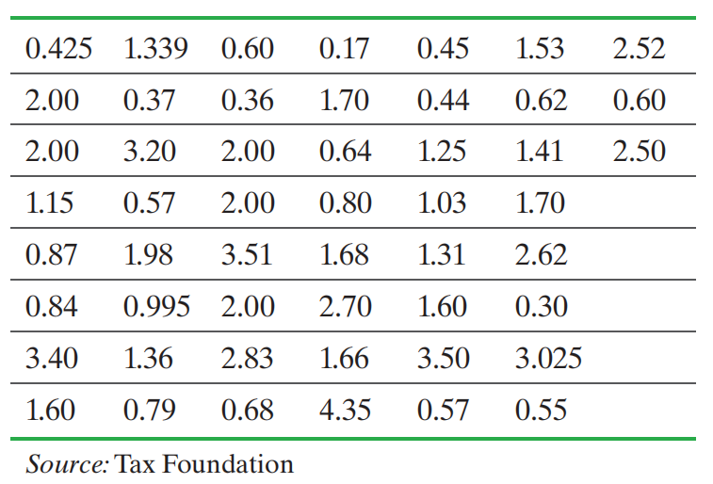
Problem 7: Quantitative Variables Statistical Analysis
- [2.2.31](Page 90 in Textbook) Cigarette Tax Rates
The table shows the tax, in dollars, on a pack of cigarettes in each of the 50 states and Washington, DC, as of January 2014.
Note: The state with the lowest tax is Missouri and the state with the highest tax is New York.

Slide 14
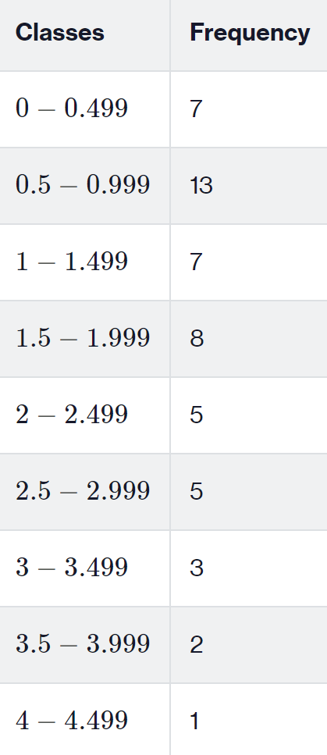
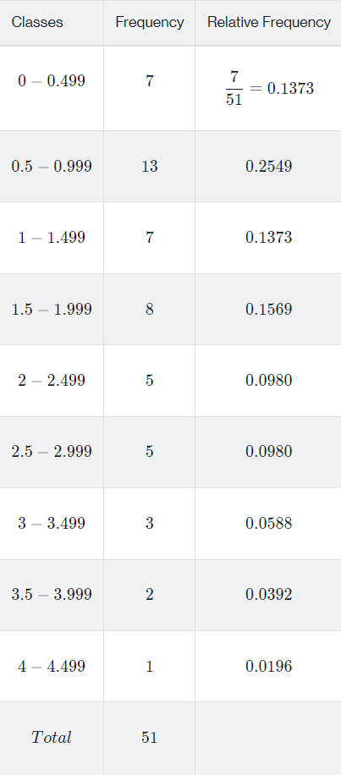
Problem 7: Quantitative Variables Statistical Analysis
With a first class having a lower class limit of 0 and a class width of 0.50:
(a) Construct a frequency distribution.
(b) Construct a relative frequency distribution.
Ans:

Slide 15
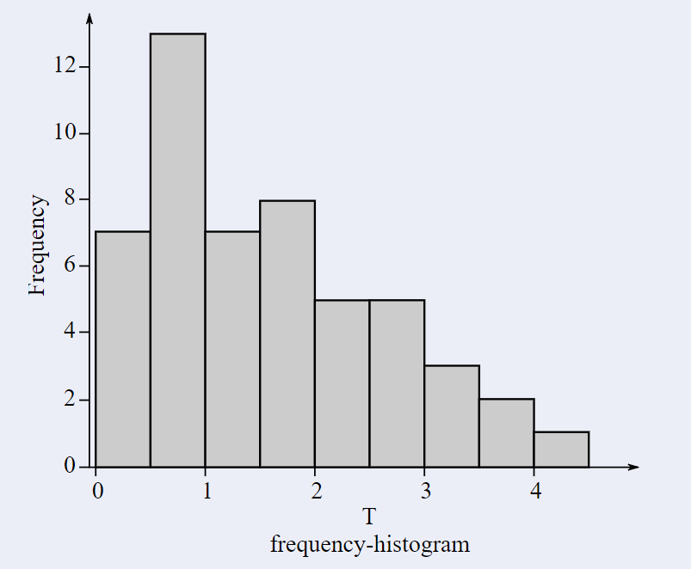
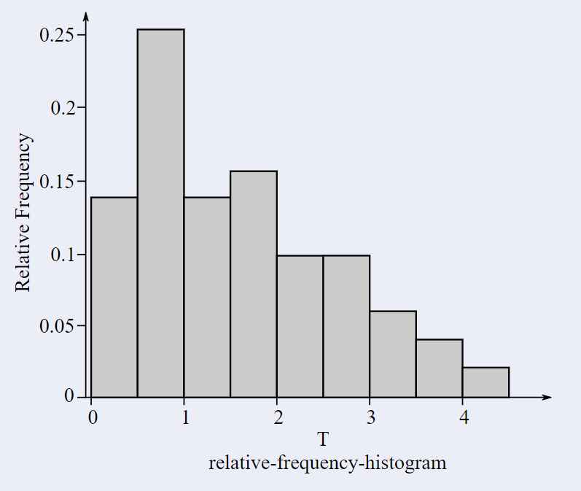
Problem 7: Quantitative Variables Statistical Analysis
With a first class having a lower class limit of 0 and a class width of 0.50:
(c) Construct a frequency histogram of the data.
(d) Construct a relative frequency histogram of the data.
Ans:

Slide 16
Problem 7: Quantitative Variables Statistical Analysis
With a first class having a lower class limit of 0 and a class width of 1:
(e) Describe the shape of the distribution.
Ans:
More samples are between zero and 1. As the tax increases,
the frequency decreases. And it is “right skewed”.
PS: Compare the length of the tail, the tail on the right is longer.

Slide 17
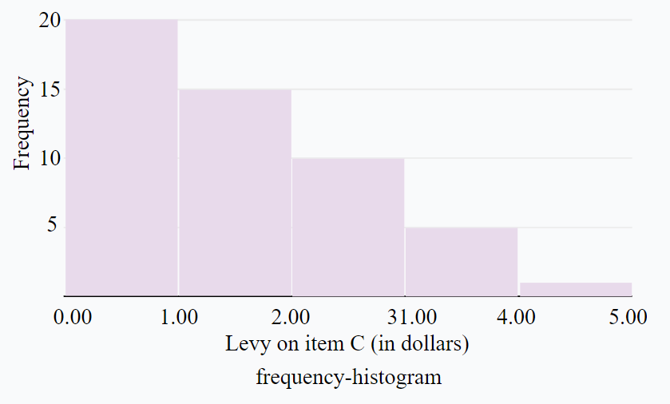
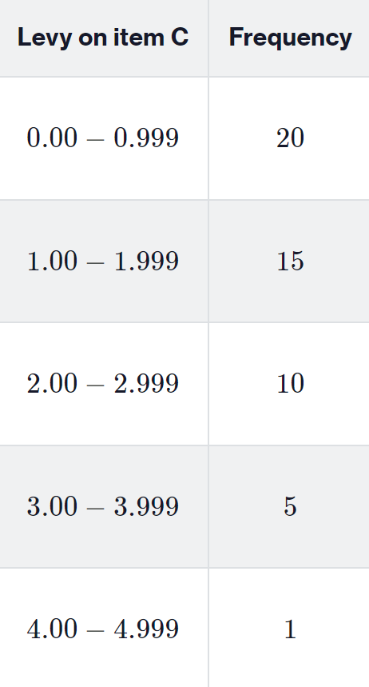
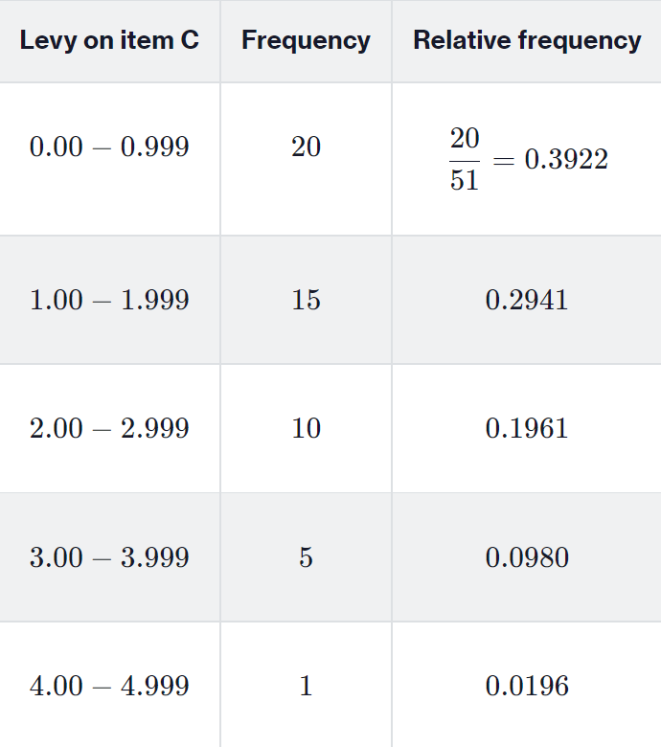
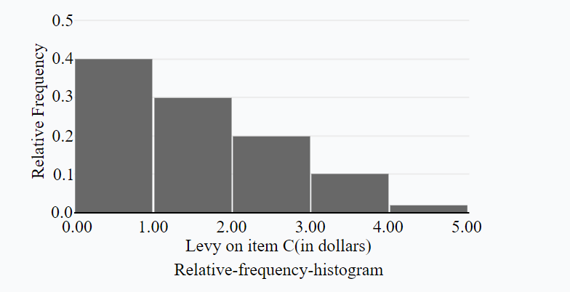
Problem 7: Quantitative Variables Statistical Analysis
With a first class having a lower class limit of 0 and a class width of 0.50:
(f) Repeat parts (a)–(e) using a class width of 1.
Ans:

Slide 18
Problem 7: Quantitative Variables Statistical Analysis
With a first class having a lower class limit of 0 and a class width of 0.50:
(g) Does one frequency distribution provide a better summary of the data than the other? Explain.
Ans:
The first two histograms include more information.
PS: The smaller the bandwidth, the more information included.

Slide 19
Problem 8: Resistance of Statistic
The arithmetic mean of a variable is computed by adding all the values of the variable in the data set and dividing by the number of observations.
The median of a variable is the value that lies in the middle of the data when arranged in ascending order. We use M to represent the median.
The mode of a variable is the most frequent observation of the variable that occurs in the data set.

Slide 20
Problem 8: Resistance of Statistic
[3.1.1] (Page 119)
What does it mean if a statistic is resistant?
Ans:
A numerical summary of data is said to be resistant if extreme values (very large or small) relative to the data do not affect its value substantially.
PS: Mean is NOT resistant, median and mode are resistant.
(For you: Go back to the definition to check it.)

Slide 21
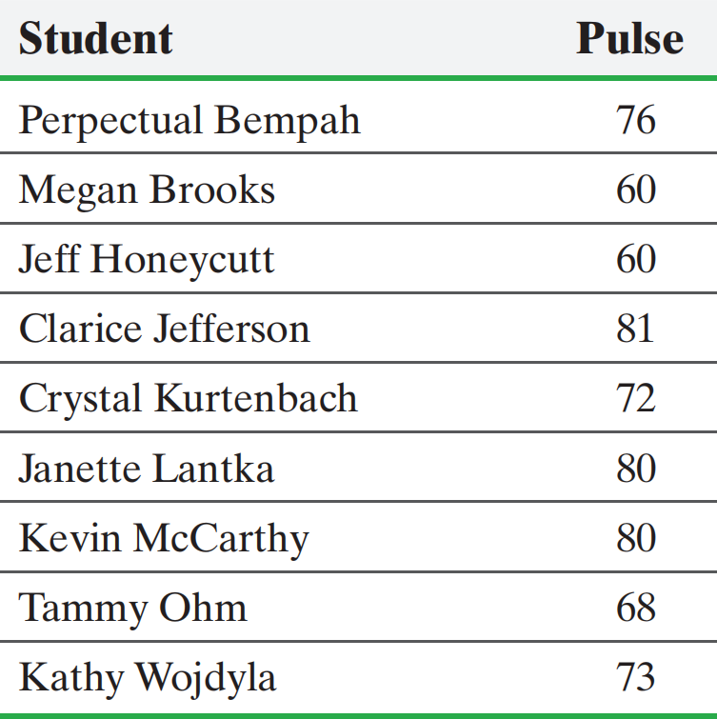
Problem 9: Measures of Central Tendency
[3.1.21] (Page 120) Pulse Rates
The following data represent the pulse rates (beats per minute) of nine students enrolled in a section of Sullivan’s Introductory Statistics course. Treat the nine students as a population.

Slide 22
Problem 9: Measures of Central Tendency
Determine the population mean pulse.
Ans: 72.2, sum and divided by number of students.
(b) Determine the median pulse.
Ans: 60, 60, 68, 72, 73, 76, 80, 80, 81
(c) Determine the population mode pulse.
Ans: 60, 60, 68, 72, 73, 76, 80, 80, 81
PS: No mode or more than one mode are possible.
(For you: Select 3 of them and repeat the steps.)

Slide 23
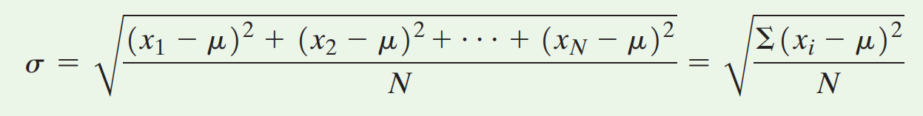
Problem 10: Measures of Dispersion
The range, R, of a variable is the difference between the largest and the smallest data value.
Range = R = largest data value - smallest data value
The population standard deviation of a variable is the square root of the sum of squared deviations about the population mean divided by the number of observations in the population, N. That is, it is the square root of the mean of the squared deviations about the population mean.

Slide 24
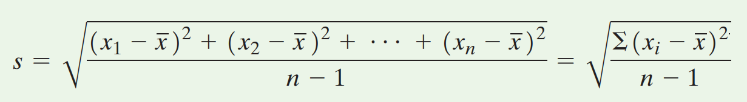

Problem 10: Measures of Dispersion
The sample standard deviation, s, of a variable is the square root of the sum of squared deviations about the sample mean divided by n-1, where n is the sample size.
PS:
No $μ$ anymore!
Divided by n-1 instead of n!
The variance of a variable is the square of the standard deviation. The population variance is $σ^{2}$and the sample variance is${ s}^{2}$.

Slide 25
Problem 10: Measures of Dispersion
[3.2.3](Page 134) True or False
When comparing two populations, the larger the standard deviation, the more dispersion the distribution has, provided that the variable of interest from the two populations has the same unit of measure.
Ans:
It is correct if the unit is the same.

Slide 26
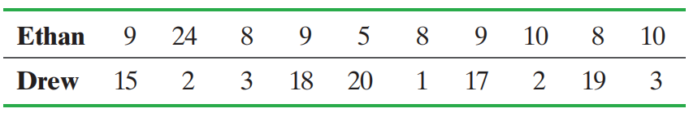
Problem 10: Measures of Dispersion
[3.2.21](Page 136) A Fish Story
Ethan and Drew went on a 10-day fishing trip. The number of smallmouth bass caught and released by the two boys each day was as follows:

Slide 27
Problem 10: Measures of Dispersion
[3.2.21](Page 136) A Fish Story
Find the population mean and the range for the number of smallmouth bass caught per day by each fisherman. Do these values indicate any differences between the two fishermen’s catches per day? Explain.
Ans:
Ethan: m = 10 fish, R = 19 fish; Drew: m = 10 fish, R = 19 fish.
There is no difference between Ethan and Drew based on these measures

Slide 28
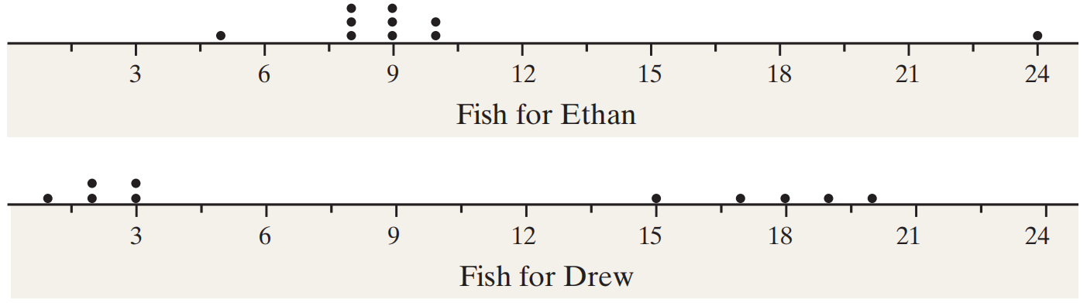
Problem 10: Measures of Dispersion
[3.2.21](Page 136) A Fish Story
(b) Draw a dot plot for Ethan. Draw a dot plot for Drew.
Which fisherman seems more consistent?
Ans:
Ethan appears to be more consistent.

Slide 29

Problem 10: Measures of Dispersion
[3.2.21](Page 136) A Fish Story
(c) Find the population standard deviation for the number of smallmouth bass caught per day by each fisherman. Do these values present a different story about the two fishermen’s catches per day? Which fisherman has the more consistent record? Explain.
Ans:
Ethan: $σ$ = 4.9 fish, Drew:$σ$= 7.9 fish;
Ethan has the more consistent record.

Slide 30
Problem 10: Measures of Dispersion
[3.2.21](Page 136) A Fish Story
(d) Discuss limitations of the range as a measure of dispersion.
Ans:
Range is not resistant.
It loses too much information compared with the standard deviation, it only uses two numbers in the data, so it only indicates the information about the difference between the min and max point in the data. No more other information.

